Slide 1


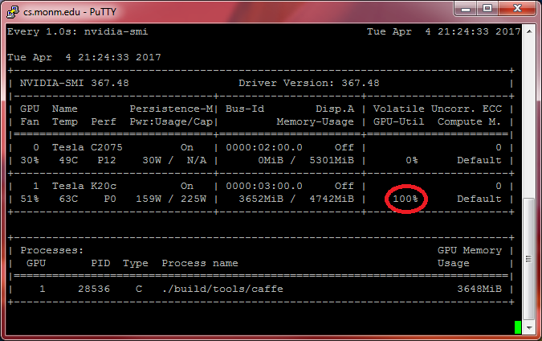
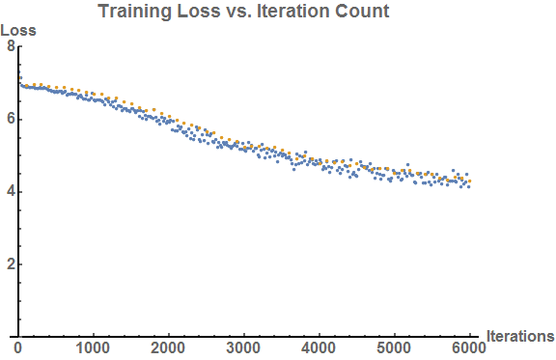
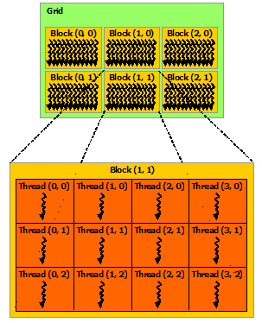
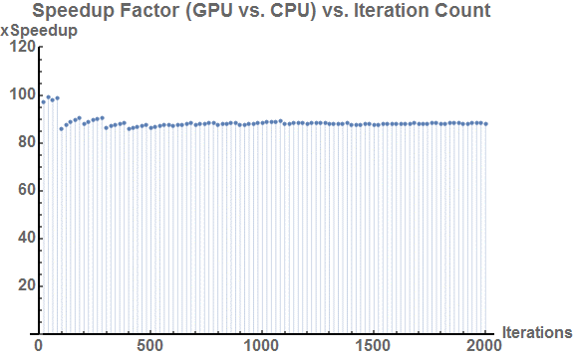


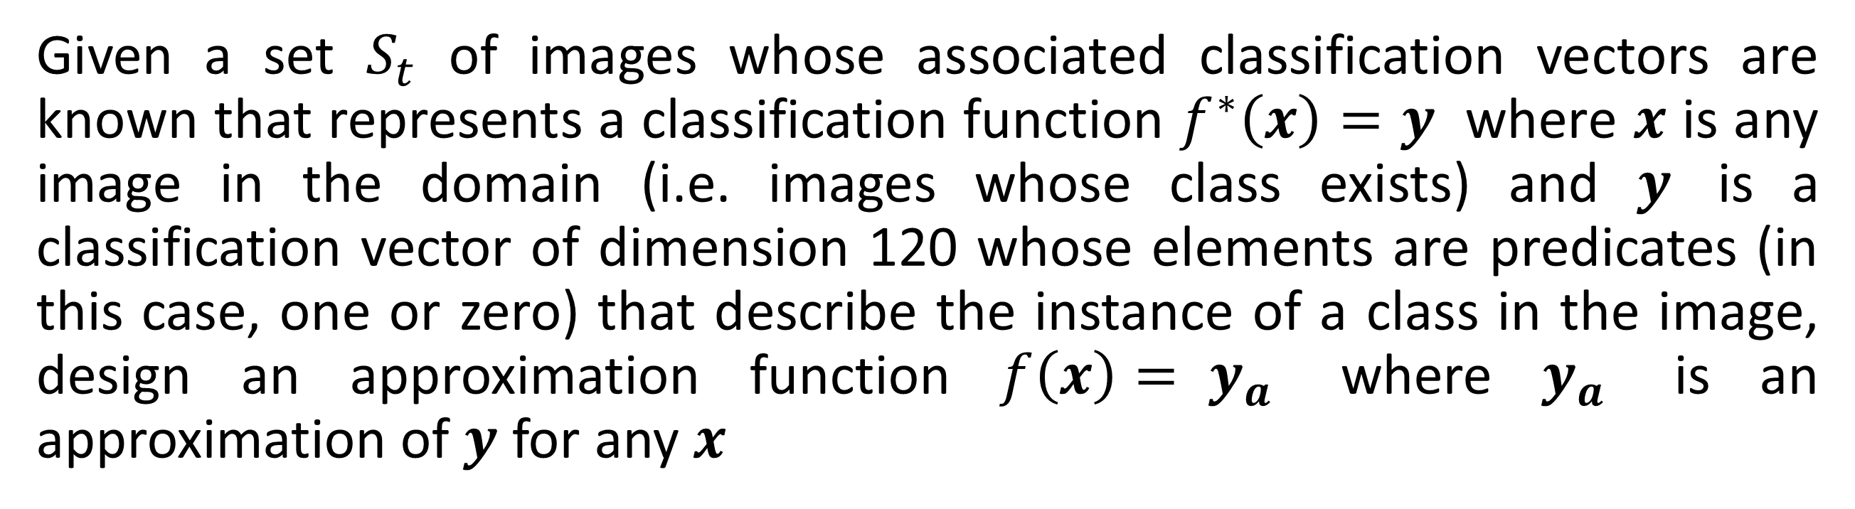

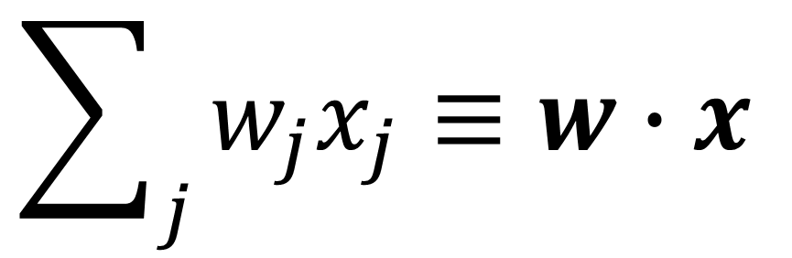

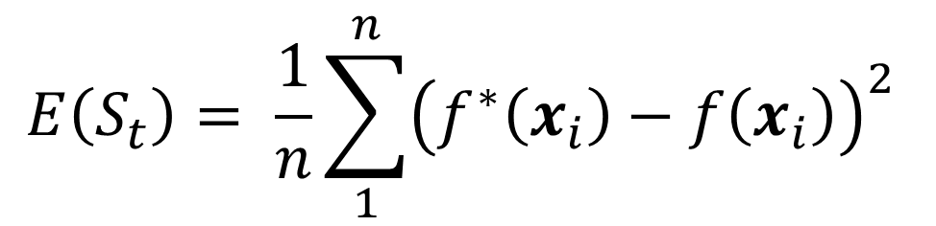
Using a GPU to Accelerate the Backpropagation Algorithm for Training Neural Networks
Department of Mathematics and Computer Science
Devin King
Supervisors:
James Logan Mayfield, Ph.D.
Marta Tucker, Ph.D.
RESEARCH QUESTION
IMAGE CLASSIFICATION PROBLEM
RESULTS & CONCLUSIONS
What performance benefits do GPUs offer in training time of a image classification feedforward convolutional neural network and how are these benefits achieved?
Given a set $S_{t}$ of images whose associated classification vectors are known that represents a classification function $f^{∗}\left(x\right)=y$ where $x$ is any image in the domain (i.e. images whose class exists) and $y$ is a classification vector of dimension 120 whose elements are predicates (in this case, one or zero) that describe the instance of a class in the image, design an approximation function $f\left(x\right)= y_{a}$ where $y_{a}$ is an approximation of $y$ for any $x$
The comparison for CPU vs GPU was completed with iteration counts of up to 3000 with a step size of 500. Each trial was performed for different learning rates but the results between these were negligible. Beyond 3000 iterations the CPU processing times became impractical and further trials were out of scope.
TRAINING
Validation Loss
Select Learning Rate/Epochs
Select a training set (or subset)
Adjust Weights and Biases
Compute Cost (error)
NVIDIA CUDA
Training Loss
FIGURE 1
Feedforward
The NVIDIA Compute Unified Device Architecture (CUDA) is used to simplify the process of writing parallel applications for NVIDIA GPUs. The feed forward and backpropagation operations use neural network primitives (like the dot product and error accumulation) that lend themselves well to implementation on a GPU.
The training process allows a neural network to learn the right and wrong answers to a problem via supervision. The learning rate and number of epochs determine the speed of classification and repetitions of the training set, respectively (Fig. 1).
Backpropagation
FIGURE 8
FIGURE 9
$$E\left(S_{t}\right)= \frac{1}{n}\sum_{1}^{n}{{\left(f^{∗}\left(x_{i}\right)−f\left(x_{i}\right)\right)}^{2}}$$
GPU REDUCTION OPERATION
Overall, the speedup factor remained in the vicinity of 98x to 110x, with an average speedup across all trials and iterations of about 100x. The utilization picture shown above (Fig 8) shows that the GPU is achieving maximum computational workload, which is inductive of good parallelization based on the principles in the GPU REDUCTION OPERATION section. Note that the speedups factors listed here are for one CPU core versus an entire GPU).
FIGURE 2
The adjustment of the weights and bias values of the network based on a known example and computation of the cost function is done via a process called backpropagation (Fig. 1). The cost function determines how correct the network’s classification is – the cost function used in the network used for this project is MSE or mean squared error (Fig. 2).
The NVIDIA CUDA structures its processing units in an a format illustrated by the image to the left. The primary construct of any processing unit is the grid. This grid contains a number of blocks, and each of these blocks contain a number of thread units. Due to the massive number of individual threads, the architecture must be organized this way (Fig. 6). The architecture also includes a number of constructs to assist the transfer of information from the host to the device and vice versa. Each level described above also has its own memory level.
The convergence for 6000 iterations is presented above as an example of the solution convergence in a reasonable training time; the results were obtained in 1.91 hours (Fig. 9).
PERCEPTRONS IN PRACTICE
x₁
Perceptrons, the building blocks of neural networks, consist of a set of inputs (usually conceptualized as a vector) and a single output or activation (Fig. 3).
Speedup (CPU vs. GPU) Distribution for 3000 iteration trial
x₂
…
Output
(Activation)
x
x
x
x
x_{j}
FIGURE 3
Speedup (CPU vs. GPU) Distribution for 1000 iteration trial
The value of any perceptron can be conceptualized mathematically as the summation of each input multiplied with its associated weight (Fig. 4).
$$\sum_{j}{w_{j}x_{j}}≡w∙x$$
x
x
x
FIGURE 6
FIGURE 11
FIGURE 4
The process of backpropagation involves the calculation of delta values for each processing element in the network. These delta values and the weights for every element are stored in the GPU global memory to assist in the reduction operation.
FIGURE 10
i₁
i₂
i₃
…
i_{k}
Act
The perceptron in practice consists of a local memory for storing intermediate delta values and a transfer function that computes the output of the perceptron using the values stored in the local memory as a catalyst (Fig. 5).
Figure 10 shows the GPU speed-up when compared with the CPU for each iteration checkpoint up to 200 iterations. Figure 11 shows the distribution of GPU speedup factors for 3000 iterations and for 1000 iterations. Note that the lower iteration count appears to experience a lower amount of speedup. From experimental data, it is reasonable to conclude that the GPU offers an immediate advantage to neural network training via backpropagation; this certainly due to its parallel architecture and the nature of neural network primitives (i.e. the dot product or sum reduction).
As an example of reduction, consider (Fig. 7). The green elements are thread memory, deep orange are global GPU memory, and light orange are blocks. The threads (organized in units called warps) shuffle their results down to the last thread. This process is then repeated on the block level, and the last block collects all of the values from global memory and places the final result in a spot in global memory (Fig 7). This general reduction scheme is what allows many examples to train in parallel and update weights in the network more efficiently.
Thread:
1
2
3
4
5
6
7
8
Transfer Function
Step 1:
1
1
1
1
1
1
1
1
Local Memory
The local memory allows for conceptualization of a perceptron as a literal processing element, which can be constructed out of physical parts rather than the abstract implementation which is described here.
Step 2:
2
2
2
2
X
X
X
X
u₁
Local Memory
Step 3:
4
4
X
X
X
X
X
X
…
$$w_{lij}^{old}$$
$$∆_{lij}^{old}$$
Step 4:
8
X
X
X
X
X
X
X
SOURCES
u₁
u₁
u₁
FIGURE 5b
1
2
3
4
…
n
FIGURE 5
- M. Minsky and S. Papert, Perceptrons, 3rd ed., Cambridge, Massachusetts: The MIT Press, 1988.
- M. Neilsen, "Neural Networks and Deep Learning," Determination Press, January 2016. [Online]. Available: http://neuralnetworksanddeeplearning.com/. [Accessed 04 September 2016].
- S. Russel and P. Norvig, Artificial Intelligence: A Modern Approach, 2nd ed., New Jersey: Pearson Education, 2003.
- J. D. Cowan and D. H. Sharp, "Neural Nets and Artificial Intelligence," Daedalus, vol. 177, no. 1, pp. 85-121, 1988.
- R. Hecht-Nielsen, Neurocomputing, Melo Park, California: Addison-Wesley Publishing Company, 1990.
- nVIDIA Corporation, "CUDA Toolkit Documentation," nVIDIA Corporation, 3 February 2017. [Online]. Available: http://docs.nvidia.com/cuda/. [Accessed 12 March 2017].
- Y. Jia and E. Shelhamer, "Caffe: Convolutional Architecture for Fast Feature Embedding," Berkeley Artificial Intelligence Research Lab, 2014. [Online]. Available: http://caffe.berkeleyvision.org/. [Accessed November 2016]./
In practice for this project however, the local memory of the perceptron will be stored in GPU device memory that is local to the unit of processing, whether that be a block or single thread. The granularity of parallelism depends on this organization (see GPU REDUCTION OPERATION).
Last Block
…
FIGURE 7

