Slide 1

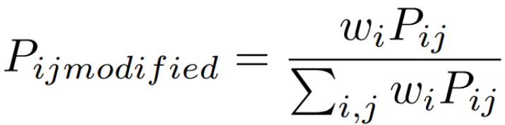
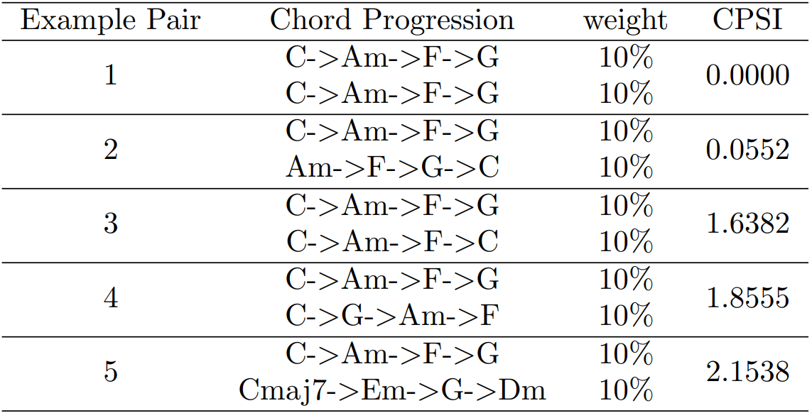
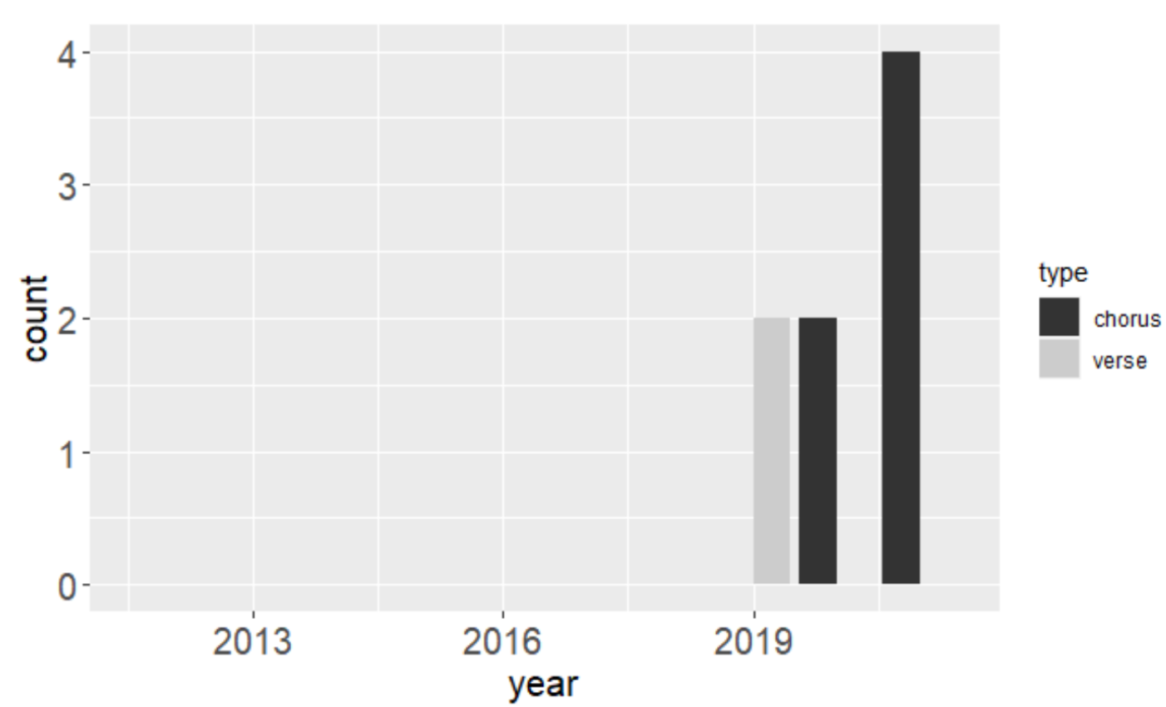
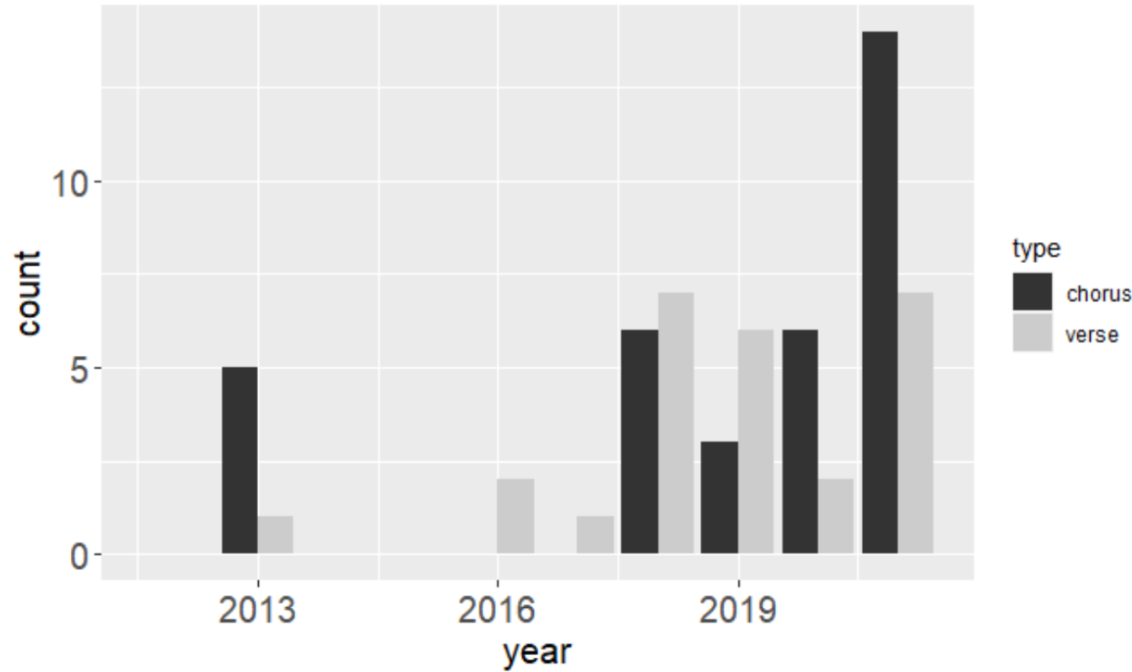
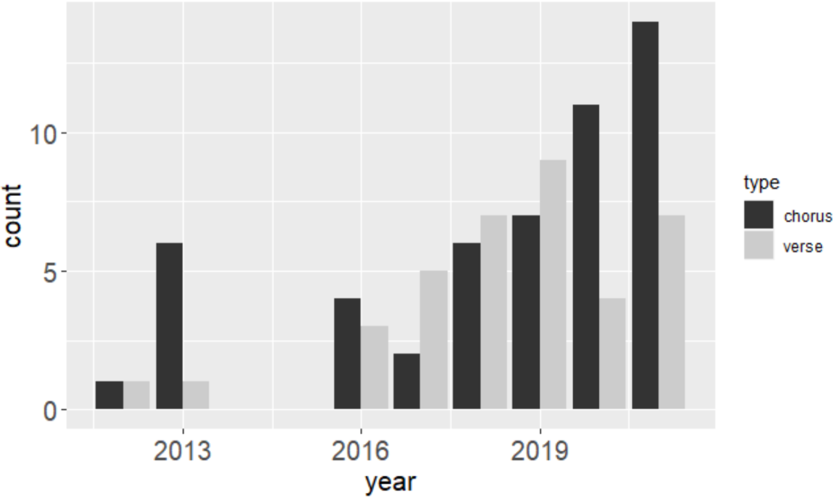
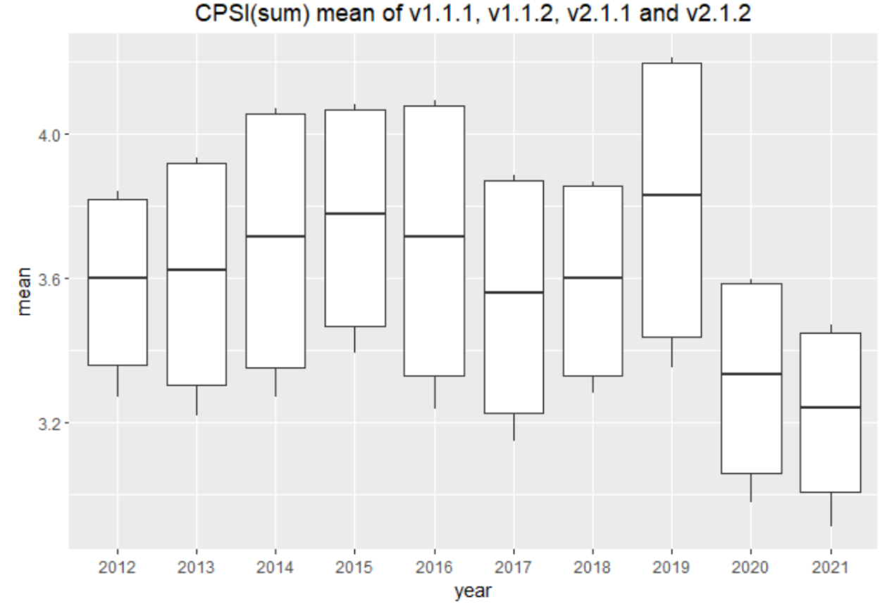
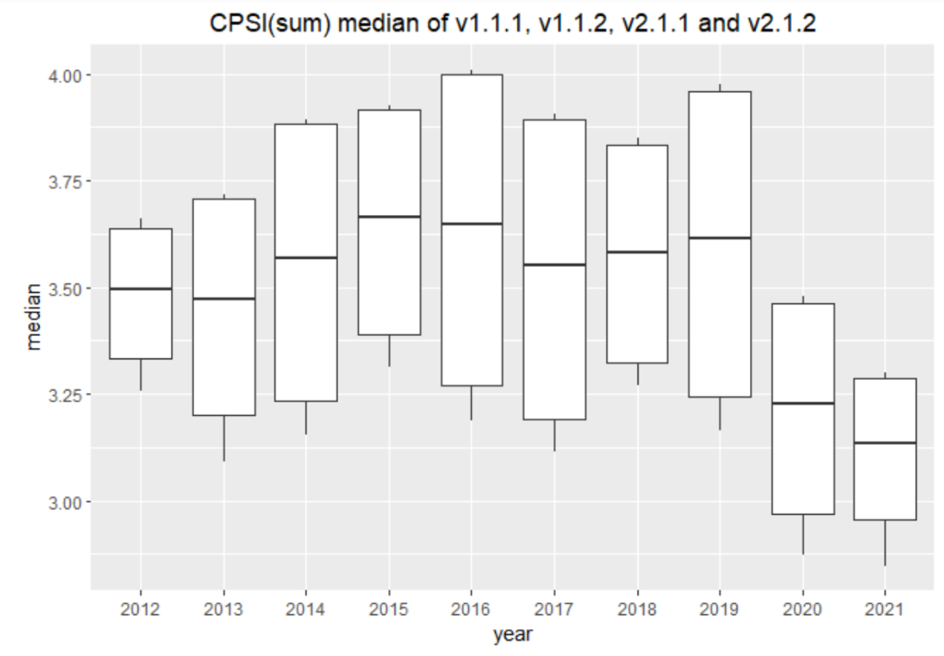
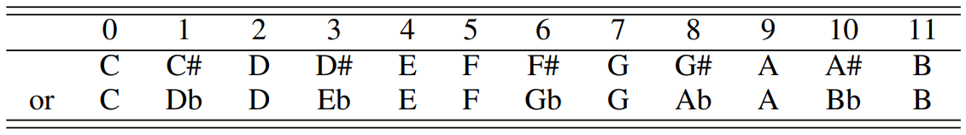
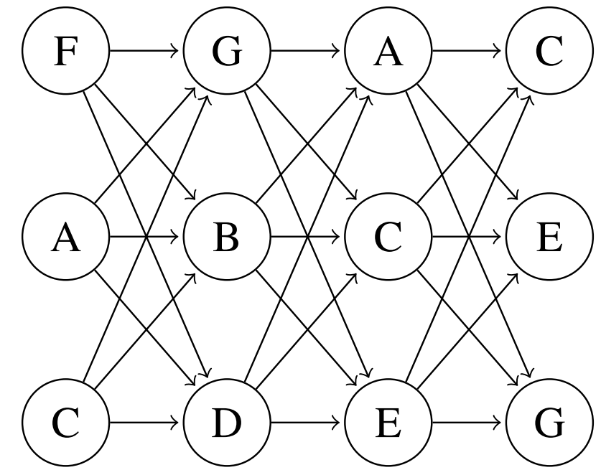
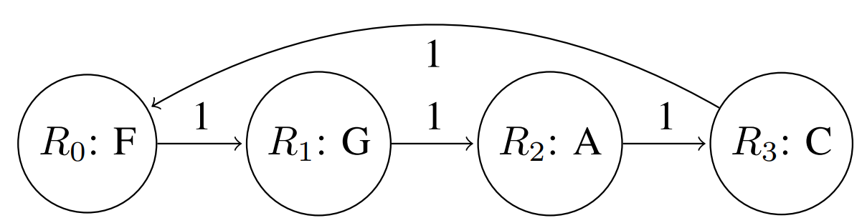
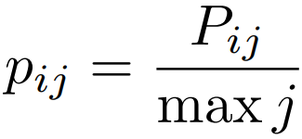
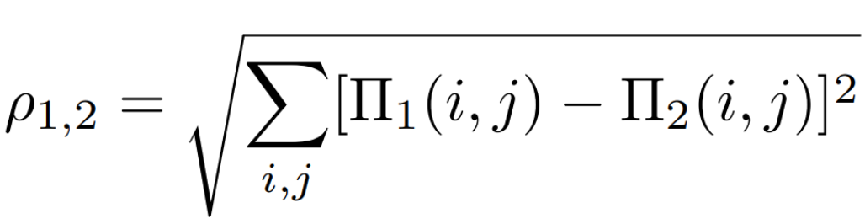
Four Chords Go a Long Way: Measuring Chord Progression Similarity in Chinese Popular Music
Jiaying Li¹ and Nat Condit-Schultz¹
¹Georgia Institute of Technology, Atlanta, GA, USA
INTRODUCTION
Assume that the practical human perception weights w_{i} for chord C_{i}, the transition matrix P is modified to:
Popular music is often criticized for “reusing” chord progressions---as famously parodied by the “Axis of Awesome” band. Chinese popular music in particular has seen a raft of criticism and controversy in the last decade surrounding the reuse of chord progressions from previous hits (cite or quote article)? But has Chinese pop really become more harmonically homogeneous?
We investigated the reuse of identical, and similar, chord progressions in Chinese popular music from the last decade. Based on the controversy and criticism, we hypothesized that harmonic similarity would increase in the last five years.
To afford nuanced comparison of similarity, we propose a novel Chord Progression Similarity Index (CPSI) based on a Markov Model of pitch content in consecutive chords. The CPSI model can be restricted/weighted to explore various musical interpretations.
CPSI EXAMPLES
Examples of chord progression pairs and corresponding CPSI
CHINESE POP MUSIC DATABASE
RESULTS
Sampling Method:
The 20 most popular Chinese pop songs from each year ∈ {2012, 2013, ..., 2021} were sampled based on a aggregate ratings from QQ Music, Kugou Music, and Kuwo Music, which represent 72.8% of Chinese streaming.
Chord Progression Notations:
We accessed existing chord-transcriptions of 200 sampled songs from the Echangwang website:
We encoded chords from the verses and choruses of each track;
We transpose all major pieces to C major and minor pieces to A minor.
We first investigate how often any of year’s top-20 songs actually use identical chord progressions:
For a more nuanced analysis, we compare the mean full-model CPSI score in each year, for verses, choruses, and both sections together.
Mann-Kendall test for monotonic trend analysis shows that the decreasing CPSI is significant in the past five years.
Comparing to the verse, chorus part more likely appears the same chord progressions.
Non-simplified version
Simplified version
Root version
CPSI MEASURING ALGORITHM BASED ON MARKOV MODEL
Each chord is represented as a set of equal tempered pitch classes (pc).
Complex chords (such as 7ths) may or may not be simplified to triads.
A 12 × 12 transition matrix represents transitions from pcs in each (antecedent chord) to the next (consequent) chord.
In the full model every pc in the antecedent chord is tallied as a transition to every pc in the consequent chord.
This approach effectively ignores voice-leading between chords.
In weighted/restricted versions of the model, transitions can be weighted (or removed based on various criteria; for example, prioritizing the chord roots or transitions that fall on stronger hypermetric positions.
Root-based Measuring Model:
For a chord progression K with chords {C_{i}}, where i represents its location index in K, we simplify it as a directed Markov chain based on its roots {R_{i}}. Denote the transition probability from root R_{i} to R_{j} as P_{ij}.
Construction of Chord Progression Transition Matrix:
For notes N_{ij} in chord C_{i}, their transition probabilities to the notes N_{i+1j} in the next chord C_{i+1} are the same;
The transition probability p_{ij} from note N_{ij} to N_{i+1j} is defined as:
CPSI:
For chord progression K₁ and chord progression K₂, define their similarity index as the Euclidean distance of their note transition matrix Π₁ and Π₂:
Metric Weighting:
Metric and hypermetric position are extremely important to musical organization and to music perception, especially the first note;
CPSI Data Analysis by Mean
CPSI Data Analysis by Median
PERCEPTUAL EXPERIMENT
We are currently gathering perceptual judgements of chord progression similarity. Please participate in our study if you have 20-30 free minutes! Simply navigate to:
https://ccml.gtcmt.gatech.edu/ChordSimilarity/interface.html
Our plan is to compare participants’ perceptual judgements to different versions of the CPSI metric, to determine which model assumptions best match perception, and to what degree.
We will compare twelve versions, representing different weightings (or restrictions) of the transition matrices.
Version 1.x.x: No weight for chords;
Version 2.x.x: Add weight to leading chord;
Version x.1.x: Non-simplified chords;
Version x.2.x: Simplified chords into triads;
Version x.3.x: Root-based model;
Version x.x.1: Progression group as basic analysis unit;
Version x.x.2: Combining all chord progressions together as basic analysis unit.
The relationship between notes and numbers
Example of chord progression “F->G->Am->C”
CONTACT INFORMATION
Jiaying Li, Computational & Cognitive Musicology Group, Georgia Tech Center for Music Technology
jli3269@gatech.edu
Dataset: https://github.com/JiayingLi0803/harmonicSimilarityProject_2022

