Slide 1
Welcome to the humdrum_{ℝ} Workshop 2023!
Hosts:
Nat Condit-Schultz, ncs@gatech.edu
Claire Arthur, claire.arthur@gatech.edu

Slide 2
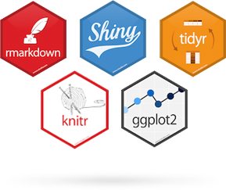

Music and Data Formats: Intro to Humdrum Kern Format
Day 0, Morning Session
R and Rstudio

Slide 3
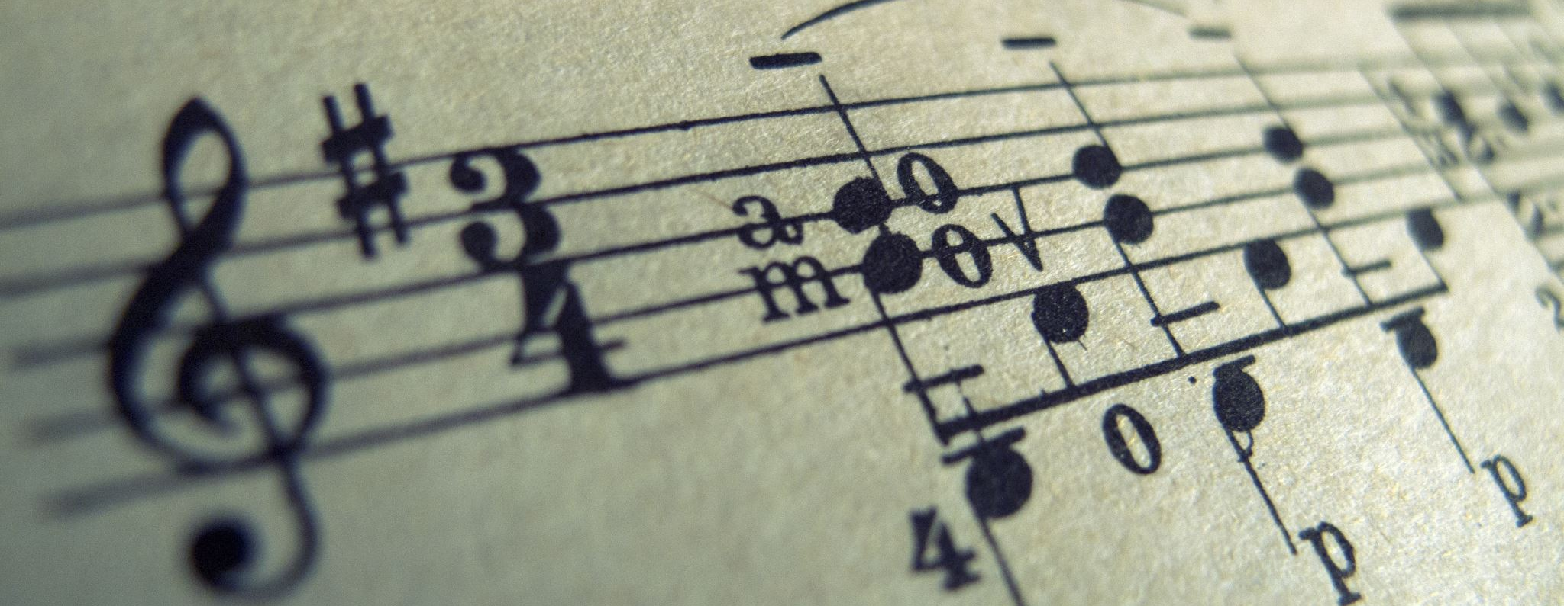
Music and Data Formats: Intro to Humdrum Kern Format
Day 0, Afternoon Session
Humdrum Representation & Syntax

Slide 4
Humdrum
Humdrum (David Huron, 1995) is a complete software system comprising of both a musical representation scheme (and file format) and a toolkit.
Today we will only discuss Humdrum as a representation:
Human readable (Plain ASCII text) & Computer readable
Tailor representations to user interests (established and user-defined representations)
Availability of large volume of high-quality encoded materials.

Slide 5
Humdrum
While Humdrum format can be used to store almost any form of data, we will focus later on extra-musical representations.
When using Humdrum to encode traditional Western notation, you will typically use its native kern format

Slide 6
Humdrum Data Structure
Basic structure uses columns (i.e., “spines”) and cells (like a spreadsheet) to organize data into parts with typically one spine per part
Set of symbols distinguish Humdrum data from different varieties of metadata

Slide 7
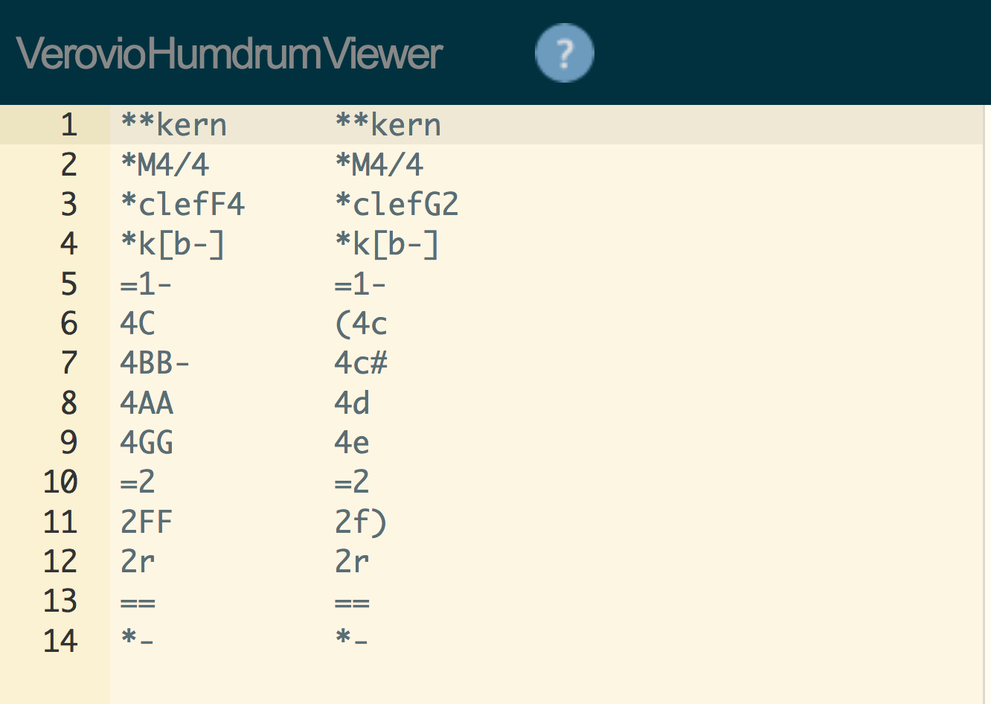
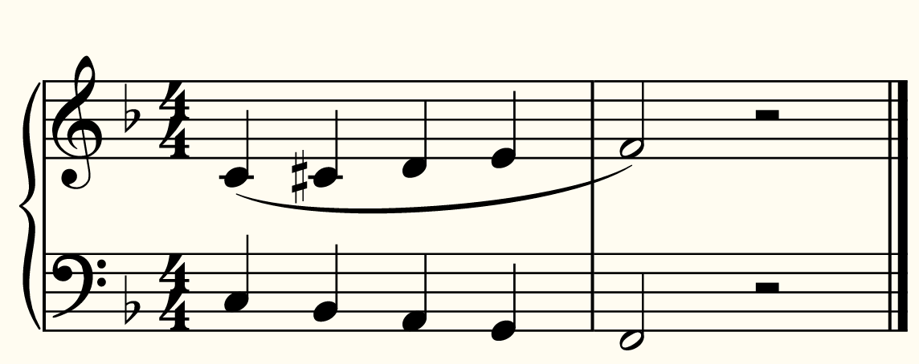

Slide 9
Minimum Criteria: What makes a humdrum file?
A humdrum-format file is a simple plain text file with data written in columnar format (called spines).
In order for a humdrum-format file to be properly encoded so that it is computer readable it needs a minimum of two things:
Each file needs an exclusive representation (for a kern file that would be: **kern ) at the top of each spine
A terminator token ( *- )

Slide 10
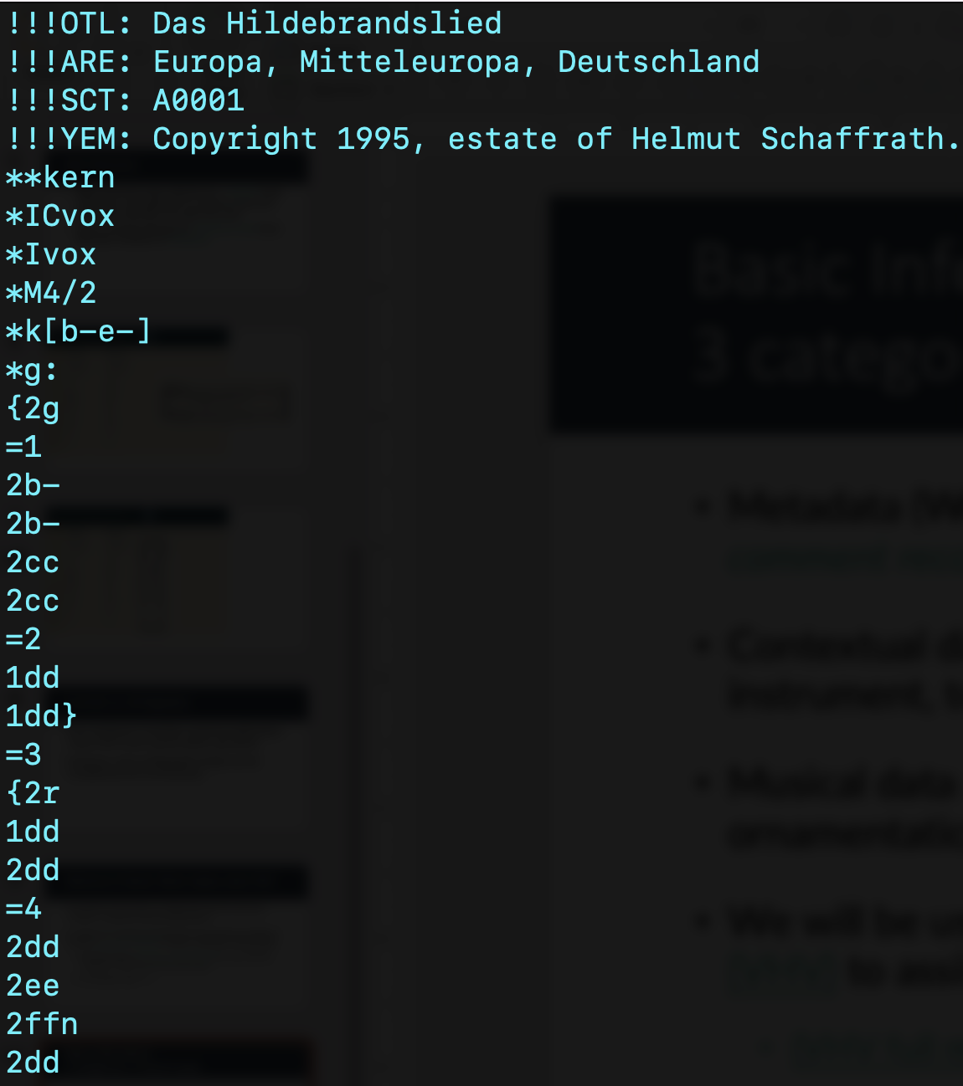
Humdrum Information: types
Metadata (Work, title, composer, year, etc.); placed in comment records
Notes:
Metadata: triple bang (show) – will follow later

Slide 11
Humdrum Information: types
Metadata (Work, title, composer, year, etc.); placed in comment records
The exclusive interpretation (**) tells us the representation scheme for the data in that spine (e.g., kern, mint, fret, harm, etc.)
Notes:
Metadata: triple bang (show) – will follow later

Slide 12
Humdrum Information: types
Metadata (Work, title, composer, year, etc.); placed in comment records
The exclusive interpretation (**) tells us the representation scheme for the data in that spine (e.g., kern, mint, fret, bhatke, etc.)
Type of data Contextual data (key signature, time signature, clef, instrument, tempo, etc.); placed in tandem interpretation records
Notes:
Metadata: triple bang (show) – will follow later

Slide 13
Humdrum Information: types
Metadata (Work, title, composer, year, etc.); placed in comment records
The exclusive interpretation (**) tells us the representation scheme for the data in that spine (e.g., kern, mint, fret, bhatke, etc.)
Type of data Contextual data (key signature, time signature, clef, instrument, tempo, etc.); placed in tandem interpretation records
Musical data (notes, rests, accidentals, barlines, ties, slurs, ornamentation, phrase groupings, etc.); placed in data records
Notes:
Metadata: triple bang (show) – will follow later

Slide 14
Kern Data: Cheatsheet
Musical data (for a cheatsheet, click here)
Rhythm
Follows denominator of traditional note values using American note names (e.g., quarter note (crotchet) = 4)
Pitch
Letter & octave, accidentals (always comes after rhythm)
Octaves switch at every C (ASA style) c4 = “c”
Sharp #, Flat -
Grouping (Phrasing)
Ties [ ], Phrases { }
Articulation
Slurs ( ), Stacato ‘ , Accents ^v
Bars & barlines
Single =, Double ==, Repeat back =:| , Repeat from =|:
Notes:
Metadata: triple bang (show) – will follow later

Slide 15
Function vs. Orthography
Kern (and other representations) designed to facilitate analytical applications rather than visual representations (primarily)
However, many orthographic details can be included but are not necessary.

Slide 16
Part 1: Kern data
We will be using the online tool, Verovio Humdrum Viewer (VHV) to assist with our encoding and learning of kern
(VHV full music encoding tutorial here)
A note about VHV & Orthography…

Slide 17
Exercise 1: Kern Encoding Practice
Open your “Day0_KernEncodingVHV.pdf” file
Using VHV, see how far you can get with the encoding practice (we’ll do the first one together)

Slide 18
AFTERNOON BREAK?
PLEASE BE BACK BY 3:30! :)

Slide 19
Multiple Spines, multiple stops
Humdrum data is encoded row-wise, meaning that items on the same row are occurring (musically) simultaneously.
For notes & rests, this can take different forms:
Multiple voices, (multi-stops)
Multiple parts, different staves

Slide 20
Humdrum data examples
Example files in VHV

Slide 21
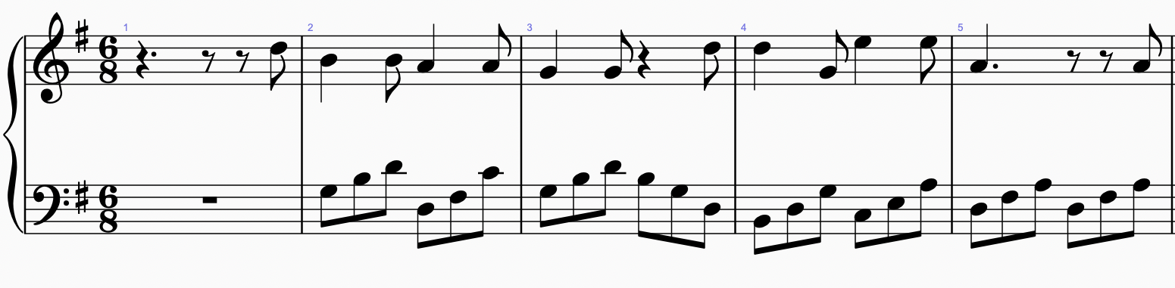
Exercise 2: Kern Encoding Practice
Using VHV, try to encode the following:

Slide 22
Multiple Spines, multiple stops
This situation is not limited to concurrent kern spines, it can be anything happening simultaneously that we need represented, e.g.,

Slide 23
Multiple Spines, multiple stops
This situation is not limited to concurrent kern spines, it can be anything happening simultaneously that we need represented, e.g.,
Notes and associated lyrics

Slide 24
Multiple Spines, multiple stops
This situation is not limited to concurrent kern spines, it can be anything happening simultaneously that we need represented, e.g.,
Notes and associated lyrics
Notes and chord labels

Slide 25
Multiple Spines, multiple stops
This situation is not limited to concurrent kern spines, it can be anything happening simultaneously that we need represented, e.g.,
Notes and associated lyrics
Notes and chord labels
Notes and timestamps…

Slide 26
Non-kern representations
Pre-existing exclusive interpretations & associated syntax defined in humdrum, e.g.,
**harm | Roman numerals
**silbe | Lyrics
**recip | Rhythm (isolated)
**mint | Melodic intervals
**hint | Harmonic intervals
**semits | Semitone distance from middle C
**deg | Scale degree numbers
**time | Timestamps (expressed in s or ms)

Slide 27
Non-kern representations
Can include custom defined interpretations of any kind, e.g.,
**function | Function labels (T, P, D) -- as used in the TAVERN corpus
**rhyme | Rhyme scheme information -- as used in the MCFLOW corpus
**cadence | Cadence labels (e.g., CC, IAC) – as used in the SWTC

Slide 28
Humdrum data examples
Example files in VHV

Slide 29
Getting humdrum/kern data
Existing repos
Conversion tools
humdrumR native capabilities from spreadsheet data

