Slide 1
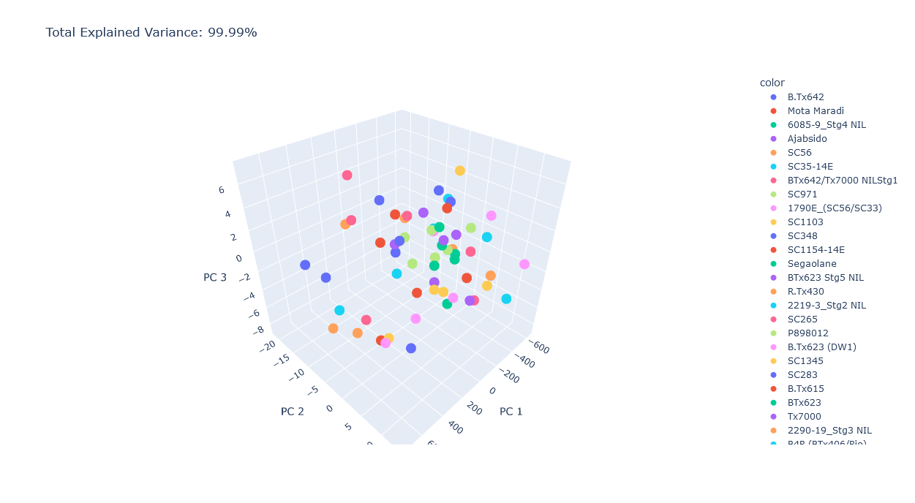
PCA analysis

Slide 2
Heritability
A statistical measurement of how much of a trait's variation in a population is due to genetic factors.

Slide 3
Heritability Comparison between Treatments (HI & LI)
A statistical measurement of how much of a trait's variation in a population is due to genetic factors.

Slide 4
Comparison between Treatments (Diameter & Angle)

Slide 5
Comparison between Treatments (Length & Volume)

Slide 6
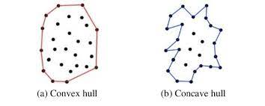
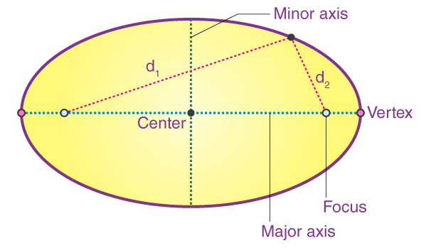
Comparison between Treatments (Eccentricity & Bushiness)

Slide 7
Normalized traits for HI

Slide 8
Normalized traits for LI

