Slide 1
Adaptive Mesh Refinement for Supersonic Flow
Mach 3 Cylinder at 50 km Altitude
OpenFOAM v2406 | Gradient-Based Adaptation | Unstructured Gmsh Mesh
Fahim Shahriyar
M.S. Mechanical Engineering
Advisor: Dr. Chonglin Zhang
Department of Mechanical Engineering, University of North Dakota

Slide 2
Outline
1.
Problem Statement & Motivation
2.
Flow Conditions (50 km Altitude)
3.
Computational Setup & Boundary Conditions
4.
Solver & Numerical Schemes
5.
AMR Pipeline Architecture
6.
Gradient-Based Sizing Formula
7.
Mesh Progression (Uniform through AMR 3)
8.
Pressure Contours
9.
Temperature Contours
10.
Velocity Contours
11.
Mesh & Results Comparison
12.
Key Findings & Conclusions
Fahim Shahriyar | University of North Dakota | Dr. Chonglin Zhang
2 / 17

Slide 3
Problem Statement & Motivation
Problem
Objective
Supersonic flows produce strong shock waves with steep gradients
Uniform meshes waste cells in smooth regions far from shocks
Fine uniform meshes are computationally expensive
Need automated refinement that focuses cells where needed
Develop automated AMR pipeline for unstructured meshes
Use pressure gradient as adaptation criterion
Demonstrate on Mach 3 cylinder at 50 km altitude
Pipeline: Gmsh + OpenFOAM + ParaView (fully automated)
Why This Matters
Supersonic/hypersonic vehicle design requires accurate shock resolution without excessive computational cost
Gradient-based adaptation automatically concentrates cells at bow shocks, wake regions, and stagnation points
The pipeline is solver-agnostic: works with OpenFOAM (CFD) and COMET (DSMC) through a unified input file
Single configuration file (amr_pipeline.input) controls the entire process; no script editing required
Fahim Shahriyar | University of North Dakota | Dr. Chonglin Zhang
3 / 17

Slide 4
Flow Conditions
1976 US Standard Atmosphere at 50 km Altitude
Parameter | Value | Unit
Altitude | 50 | km
Mach Number | 3.0 | -
Freestream Velocity | 990 | m/s
Freestream Pressure | 79.78 | Pa
Freestream Temperature | 270.65 | K
Freestream Density | 1.027 x 10^-3 | kg/m^3
Speed of Sound | 330 | m/s
Wall Temperature | 800 | K
Turbulence Model | Laminar | -
Notes
Density computed: rho = p / (R * T) = 79.78 / (287.05 * 270.65)
Speed of sound: a = sqrt(gamma * R * T) = sqrt(1.4 * 287.05 * 270.65) = 330 m/s
Mach number: M = V/a = 990/330 = 3.0
Reference: NASA-TM-X-74335 (1976 US Standard Atmosphere)
Domain Geometry
Rectangular domain: 1.0 m x 0.8 m
Cylinder diameter: 0.2 m, centered at (0.5, 0.4)
Quasi-2D: single cell in z-direction (0.01 m extrude)
Unstructured triangular mesh generated by Gmsh
Fahim Shahriyar | University of North Dakota | Dr. Chonglin Zhang
4 / 17

Slide 5
Computational Setup & Boundary Conditions
Boundary | Velocity (U) | Pressure (p) | Temperature (T)
Inlet (left) | fixedValue: (990, 0, 0) m/s | fixedValue: 79.78 Pa | fixedValue: 270.65 K
Outlet (bottom, right, top) | zeroGradient | zeroGradient | zeroGradient
Wall (cylinder) | noSlip | zeroGradient | fixedValue: 800 K
Front & Back | empty | empty | empty
Initial Conditions
Gas Properties (thermophysicalProperties)
Internal field initialized to freestream values
U = (990, 0, 0) m/s everywhere
p = 79.78 Pa everywhere
T = 270.65 K everywhere
Simulation starts from uniform initial state
Equation of state: Perfect gas (hePsiThermo)
Molecular weight: 28.9 g/mol (air)
Specific heat: Cp = 1005 J/(kg K)
Transport: Sutherland law (As=1.458e-6, Ts=110.4 K)
gamma = 1.4 (ratio of specific heats)
Fahim Shahriyar | University of North Dakota | Dr. Chonglin Zhang
5 / 17

Slide 6
Solver & Numerical Schemes
Solver: rhoCentralFoam
Reconstruction & Limiters
Density-based compressible solver
Kurganov-Tadmor central scheme for flux evaluation
Semi-discrete, non-staggered formulation
Suitable for high-speed flows with strong shocks
No Riemann solver needed (central differencing)
Density (rho): Minmod limiter
Velocity (U): MinmodV limiter (vector)
Temperature (T): Minmod limiter
Minmod is most diffusive but most stable for strong shocks
Prevents spurious oscillations near discontinuities
Parameter | Value
Time integration | Euler (1st order)
Initial time step | 1e-8 s
Max Courant number | 0.3
Max time step | 1e-5 s
End time | 0.001 s
Write interval | 0.0002 s
Adaptive time stepping | Yes
Why These Choices?
rhoCentralFoam: Only OpenFOAM solver that handles Mach 3 on unstructured mesh
sonicFoam crashes at ANY supersonic speed on triangular mesh
Minmod: Most stable limiter; vanLeer/vanAlbada produce oscillations at Mach 3
maxCo = 0.3: Required for stability with strong bow shock
Euler time integration: Sufficient for steady-state convergence
Fahim Shahriyar | University of North Dakota | Dr. Chonglin Zhang
6 / 17

Slide 7
AMR Pipeline Architecture
Automated Workflow: all_run.sh
Gmsh
Generate mesh (.geo -> .msh)
gmshToFoam
Convert mesh (.msh -> polyMesh)
Boundary Fix
Set patch types (empty, wall)
rhoCentralFoam
Run CFD solver (Kurganov scheme)
Loop Back to Step 1
Export .pos
Background sizing field for Gmsh
pvpython
Compute grad(p) Sizing formula
foamToVTK
Export results (-> .vtu files)
Configuration: amr_pipeline.input controls everything: loops=3, extraction_mode=gradient, gradient_field=p, sizing_min=0.002, sizing_max=0.015, sizing_scale=100.0, solver=rhoCentralFoam. No script editing required.
Fahim Shahriyar | University of North Dakota | Dr. Chonglin Zhang
7 / 17

Slide 8
Gradient-Based Mesh Sizing Formula
h(x) = h_min + (h_max - h_min) / (1 + alpha * |grad(p)| / |grad(p)|_max)
Frey & Alauzet (2005), Loseille & Alauzet (2011)
Symbol | Parameter | Value | Description
h_min | Minimum cell size | 0.002 m | Smallest allowed element in refined regions
h_max | Maximum cell size | 0.015 m | Largest allowed element in smooth regions
alpha | Scaling factor | 100.0 | Controls sensitivity to gradient magnitude
grad(p) | Gradient field | Pressure | Chosen adaptation criterion
How It Works
High pressure gradient (shock region): h approaches h_min = 0.002 m (fine cells concentrate at bow shock, wake, stagnation)
Low pressure gradient (smooth flow): h approaches h_max = 0.015 m (coarse cells save computation in freestream)
Fahim Shahriyar | University of North Dakota | Dr. Chonglin Zhang
8 / 17

Slide 9


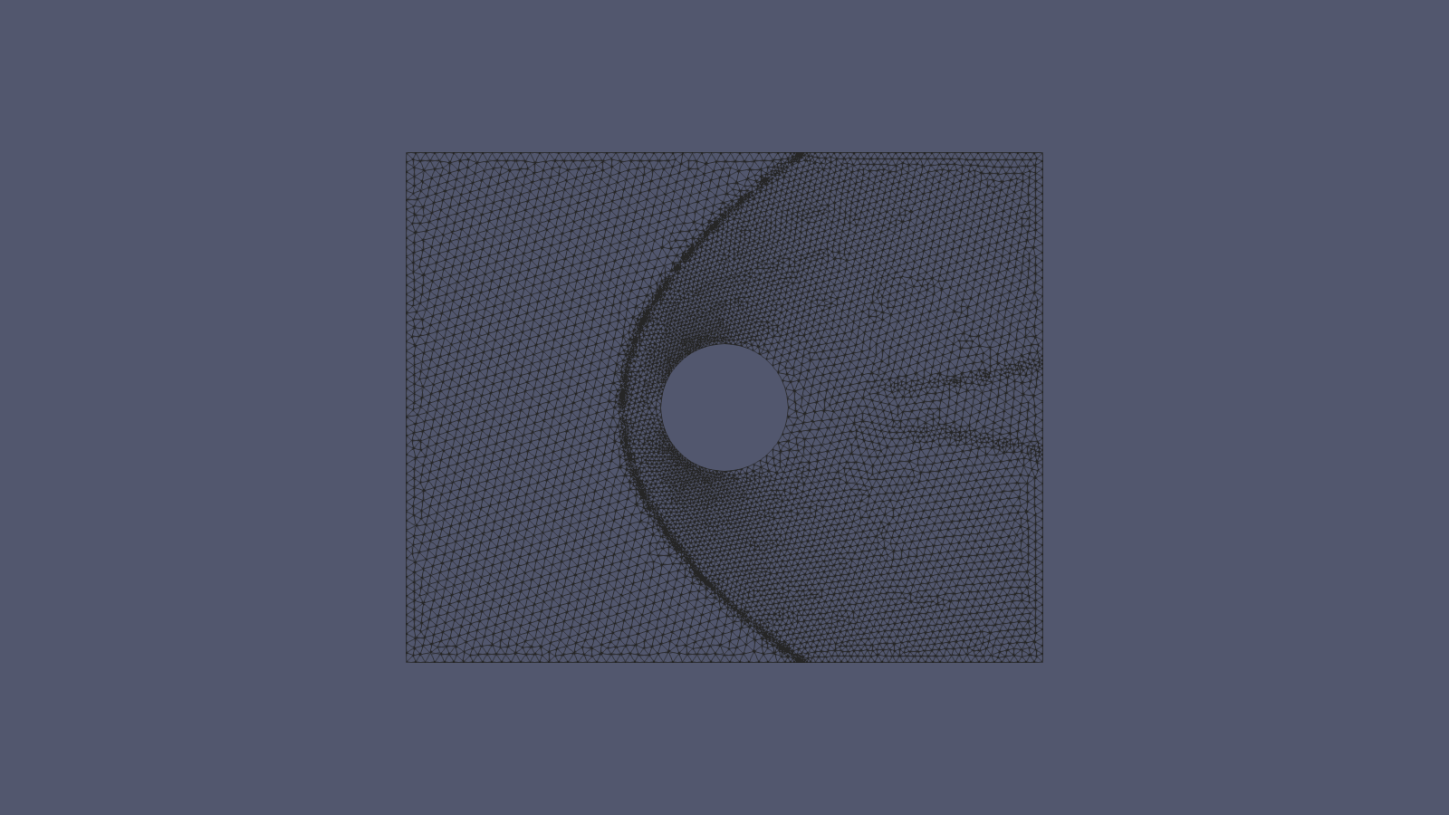
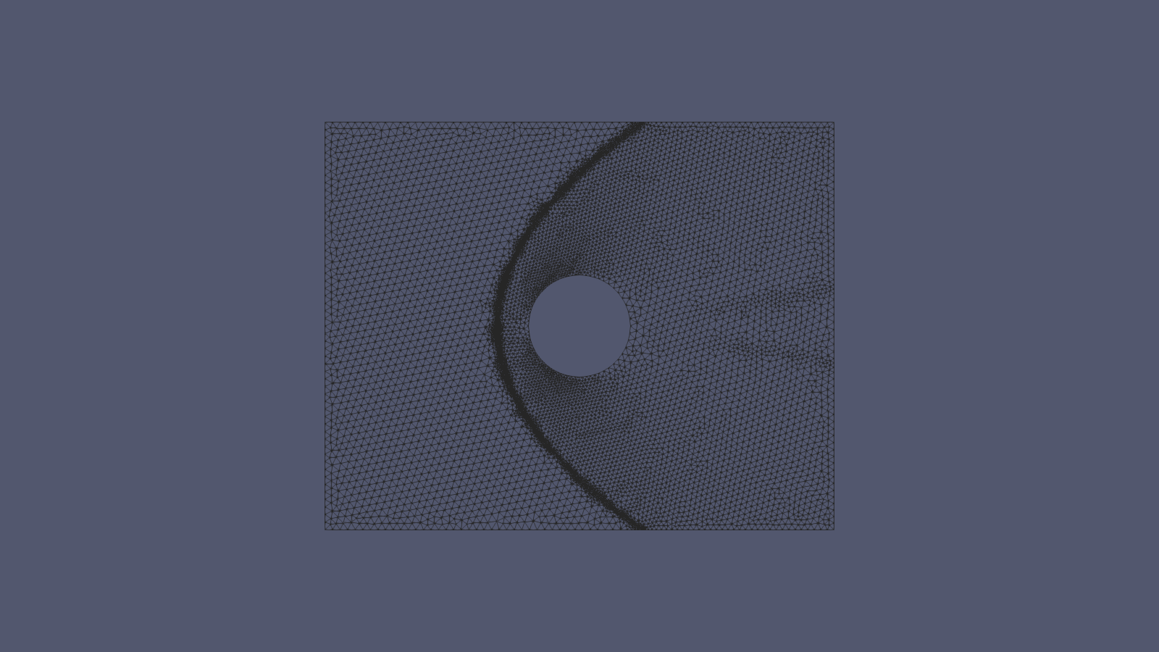
Mesh Progression
Uniform Mesh through 3 AMR Iterations
Uniform (4,804 nodes)
AMR 1 (71,904 nodes)
AMR 2 (14,888 nodes)
AMR 3 (17,500 nodes)
Fahim Shahriyar | University of North Dakota | Dr. Chonglin Zhang
9 / 17

Slide 10
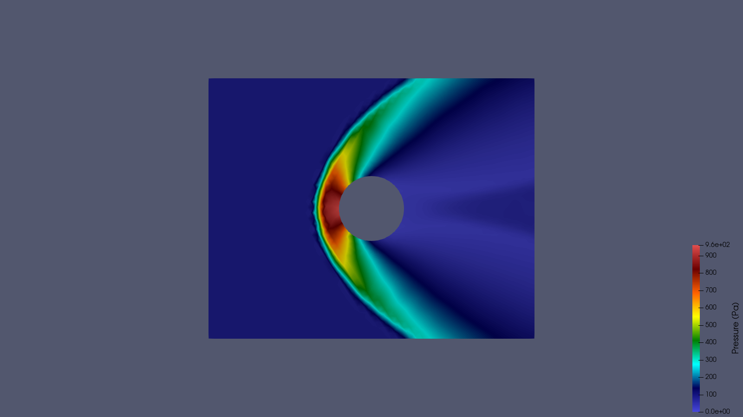
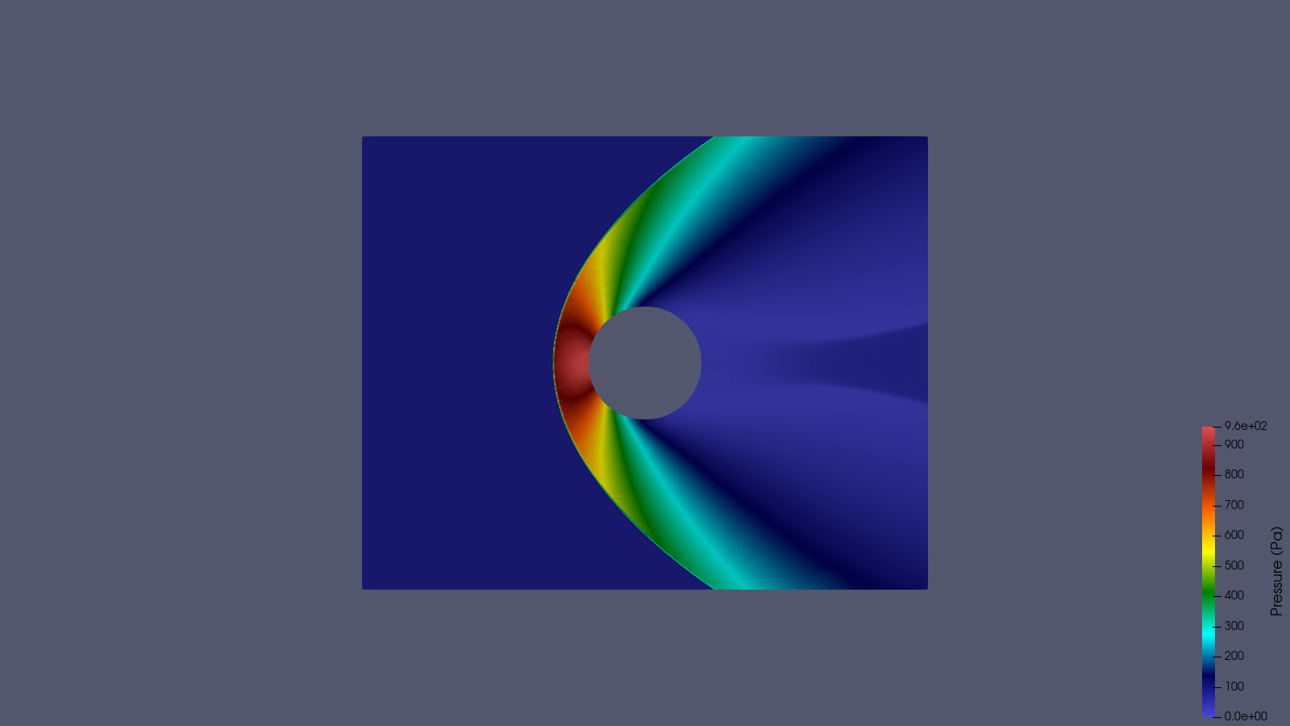
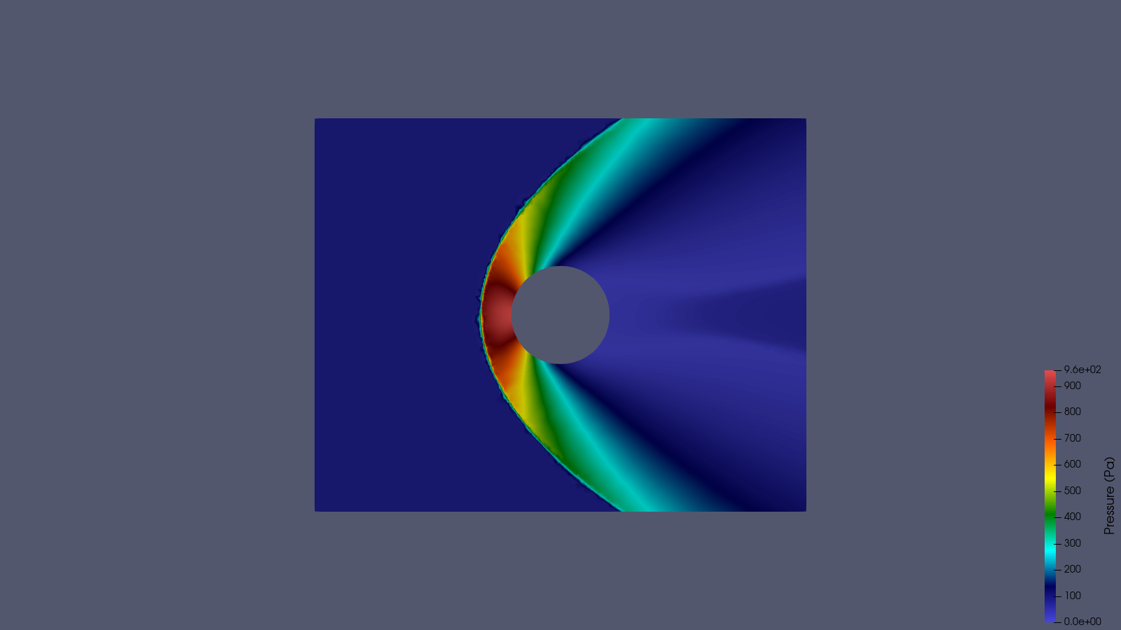
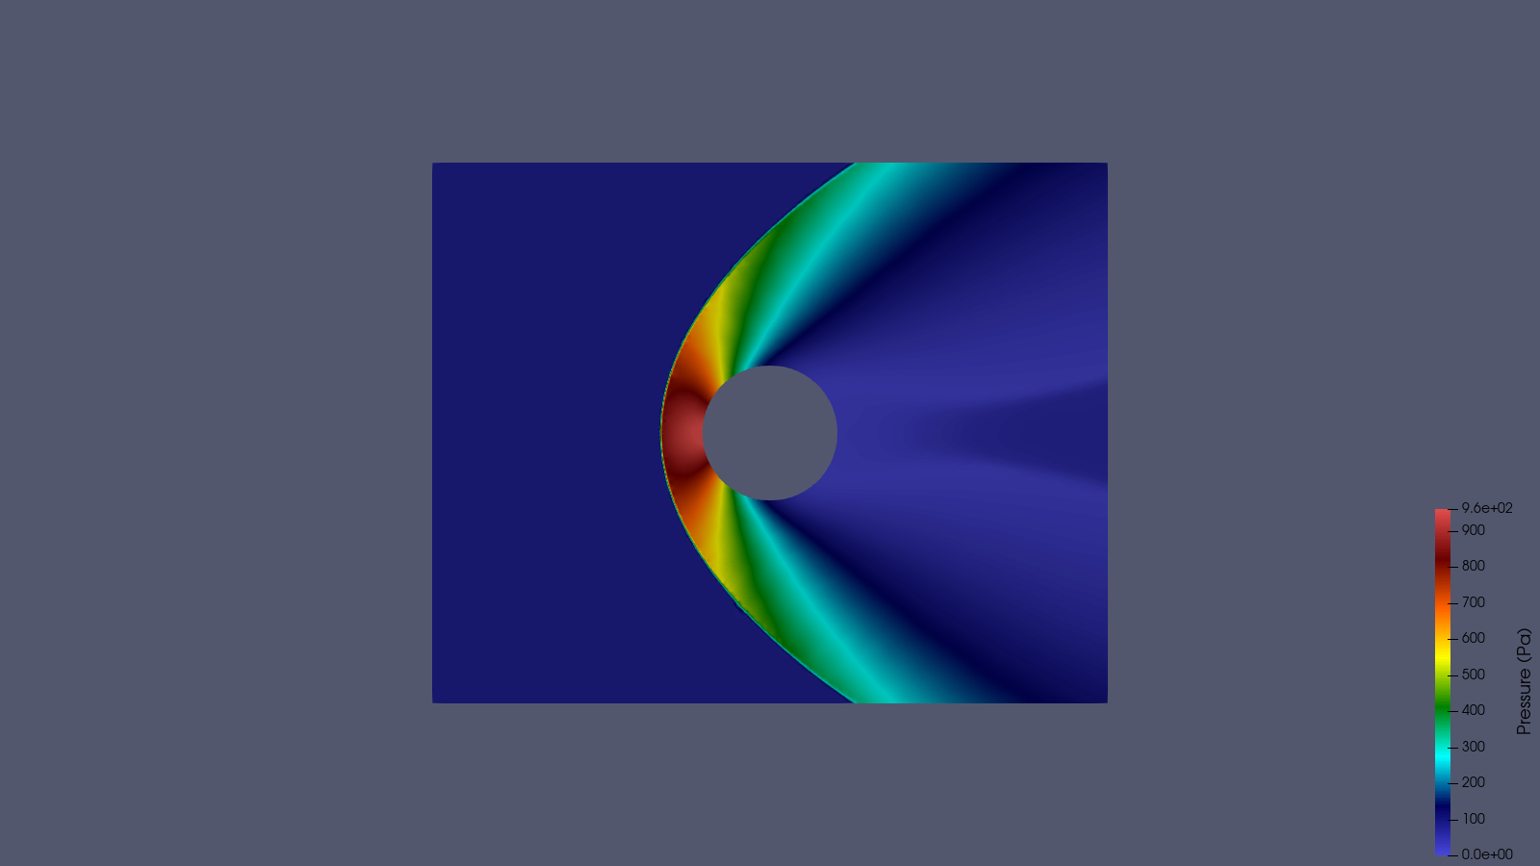
Pressure Field Comparison
Consistent scale: 0 - 960 Pa
Uniform Mesh
AMR 1
AMR 2
AMR 3
Fahim Shahriyar | University of North Dakota | Dr. Chonglin Zhang
10 / 17

Slide 11
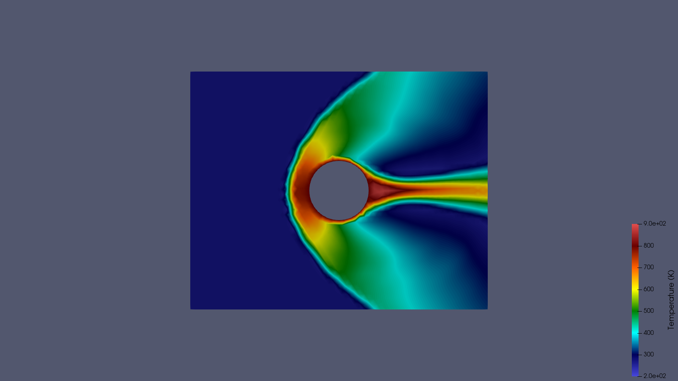
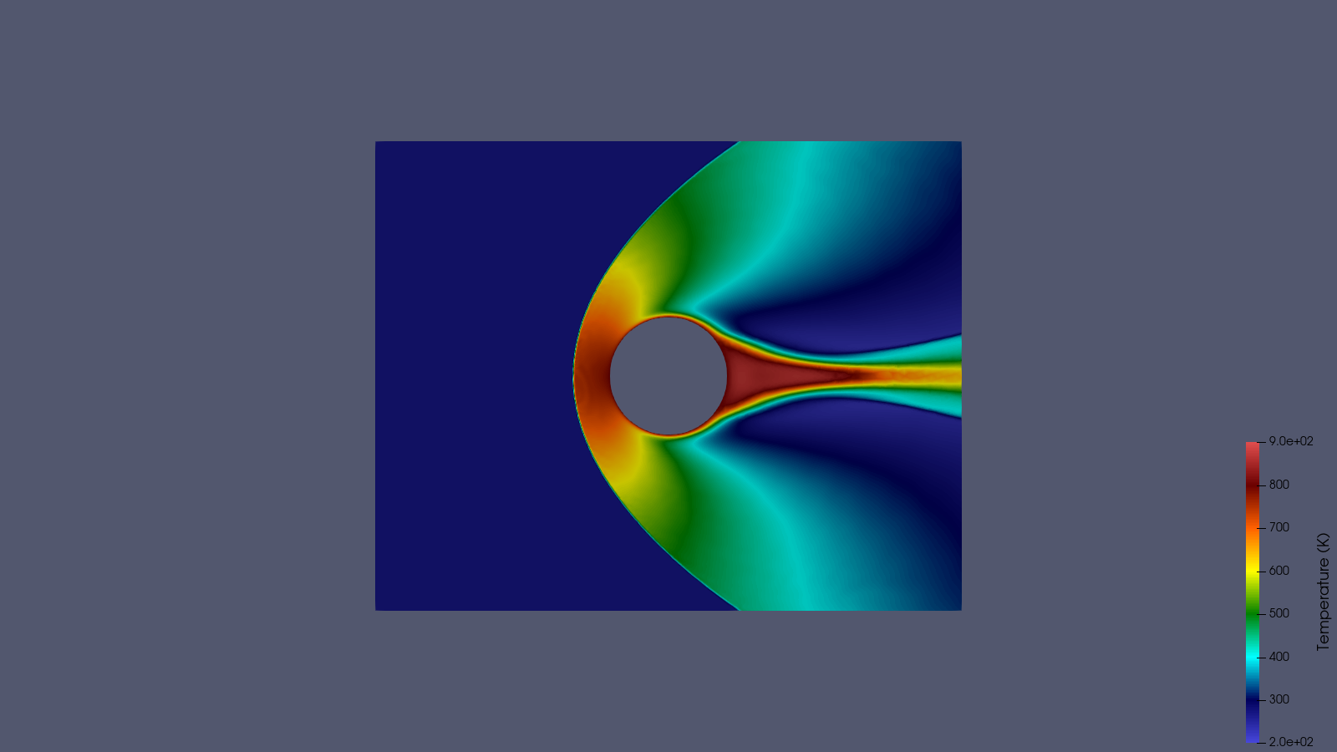
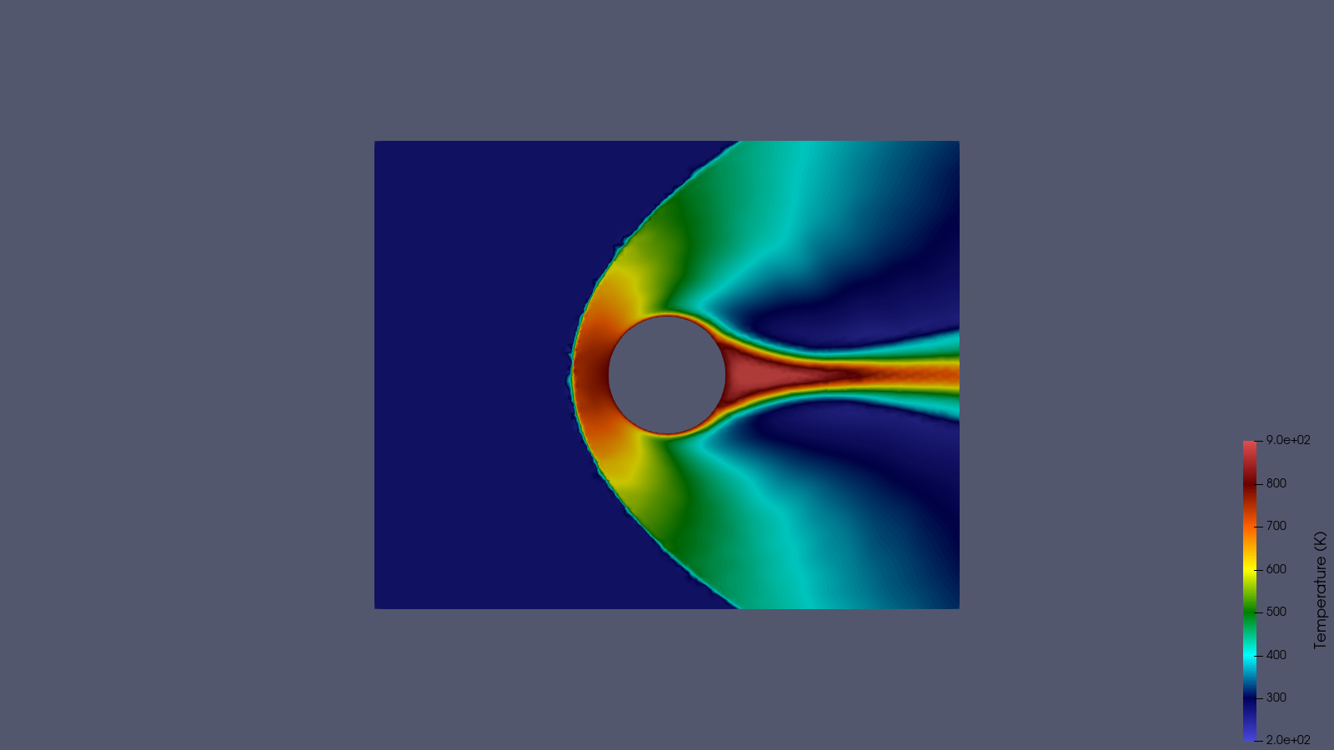
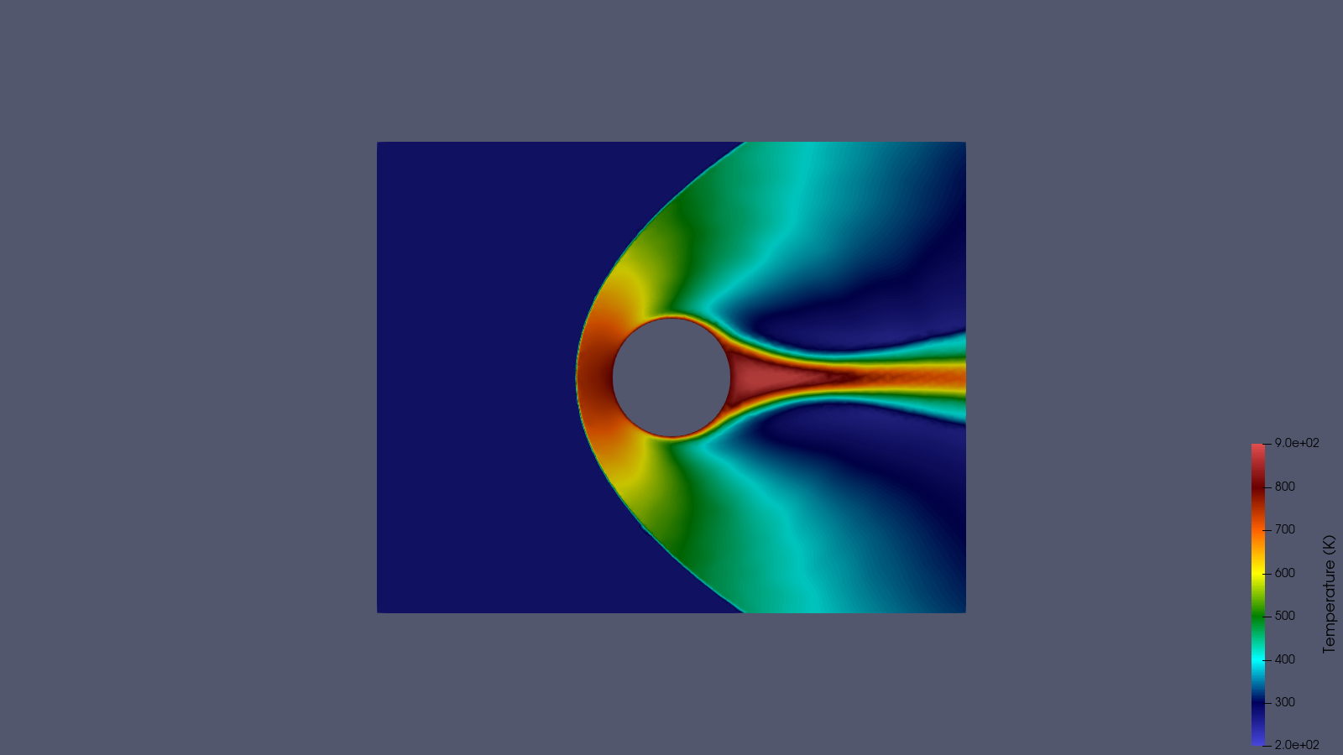
Temperature Field Comparison
Consistent scale: 200 - 900 K
Uniform Mesh
AMR 1
AMR 2
AMR 3
Fahim Shahriyar | University of North Dakota | Dr. Chonglin Zhang
11 / 17

Slide 12
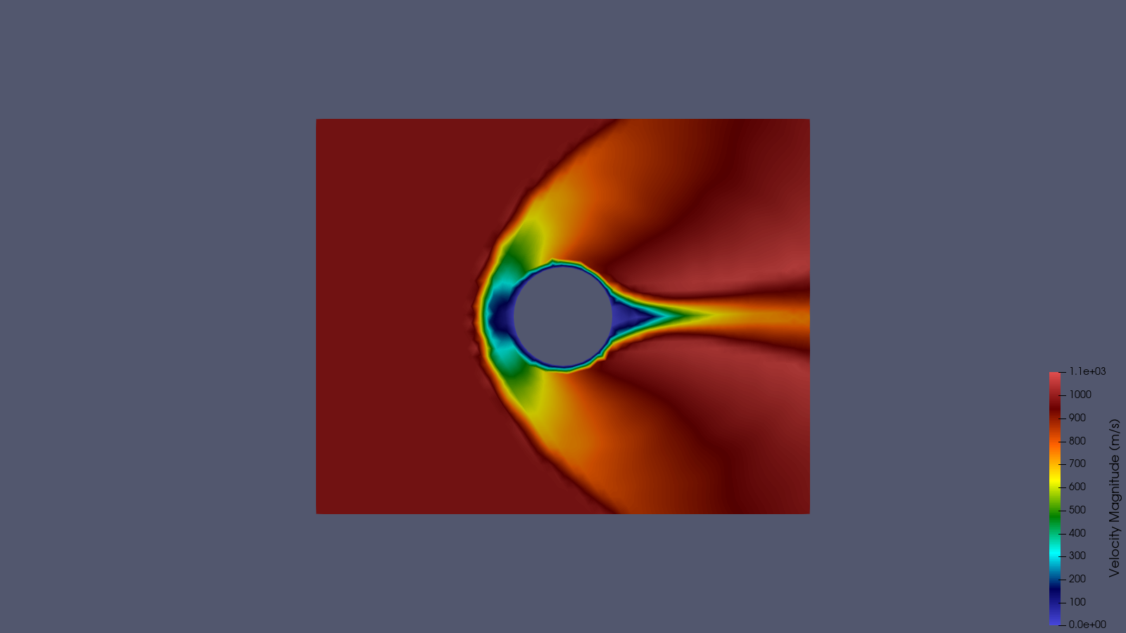
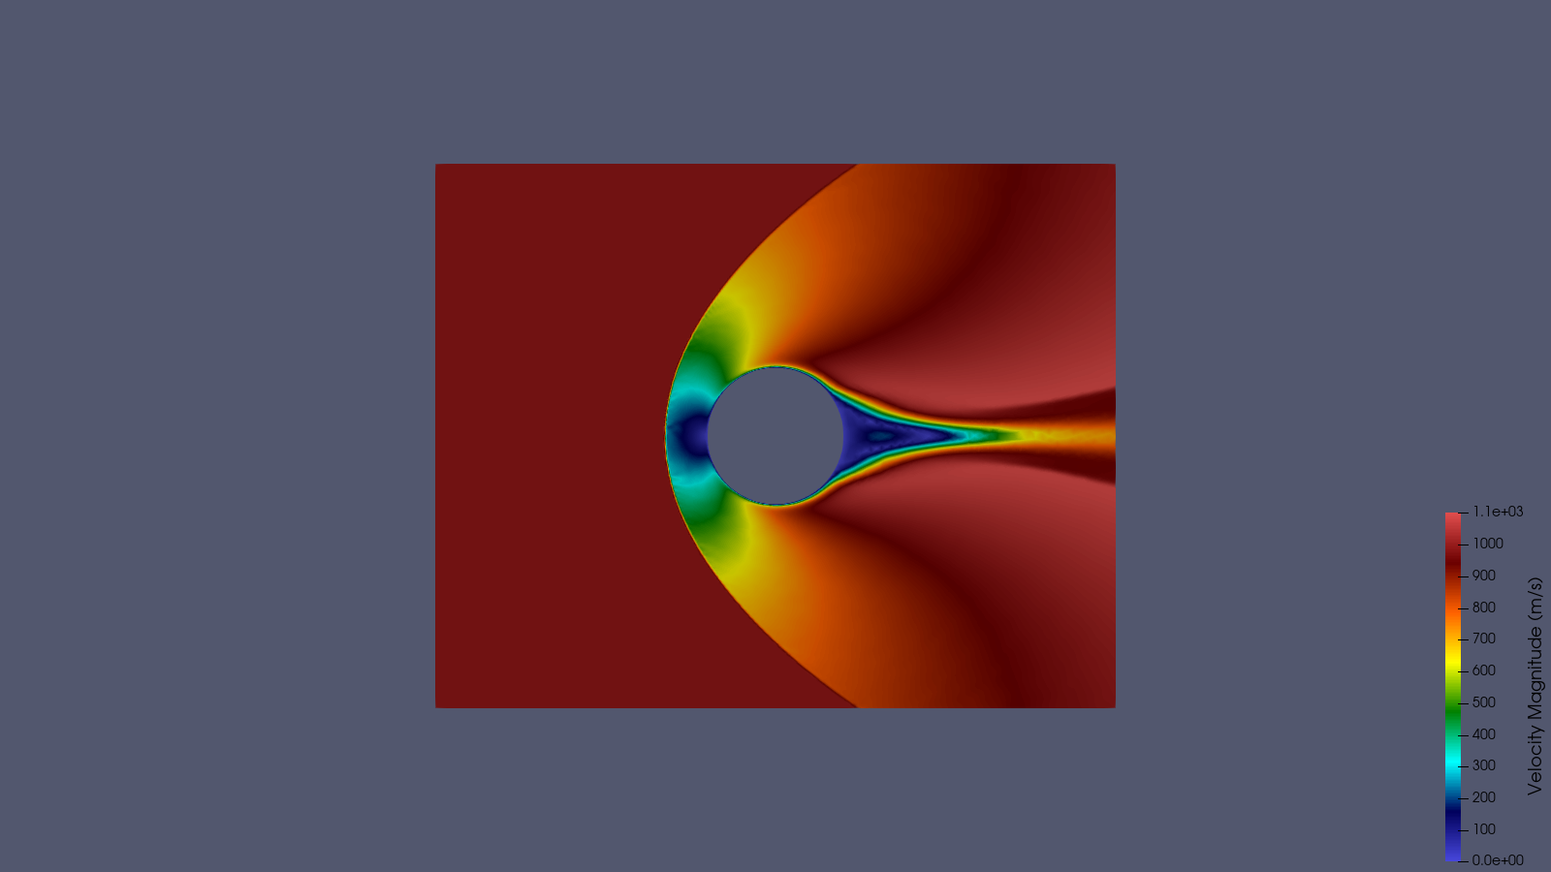
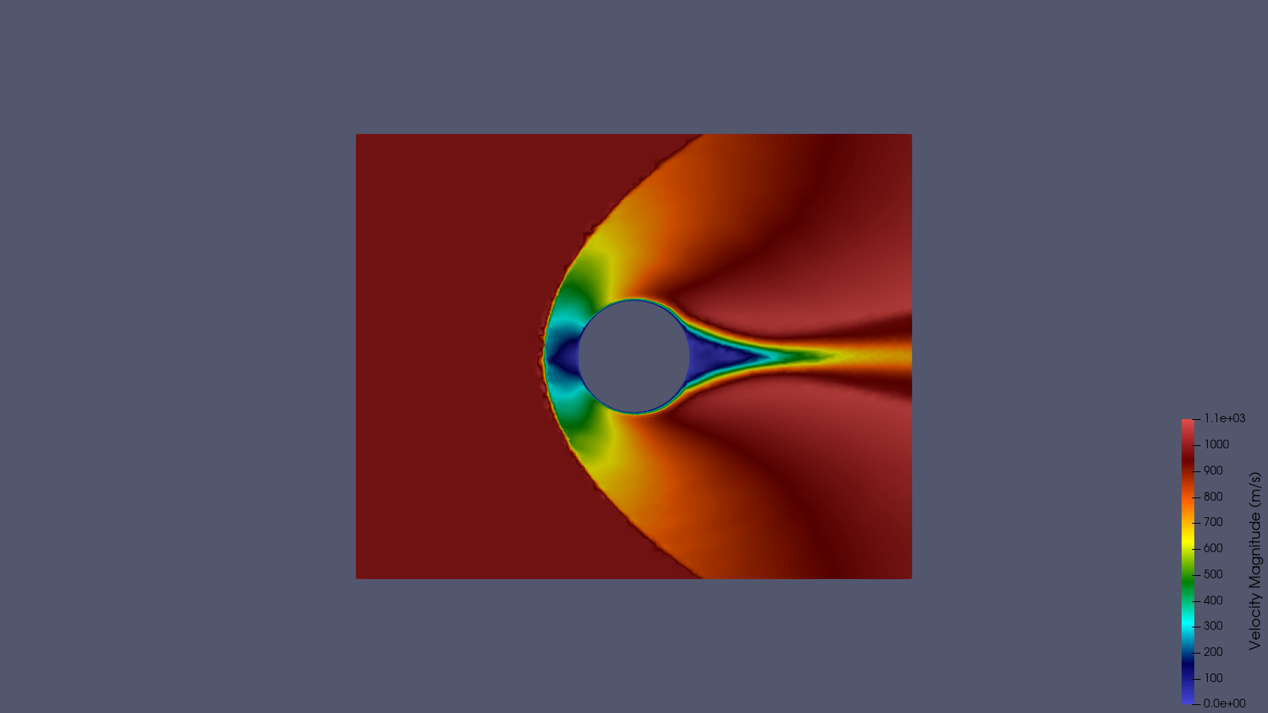
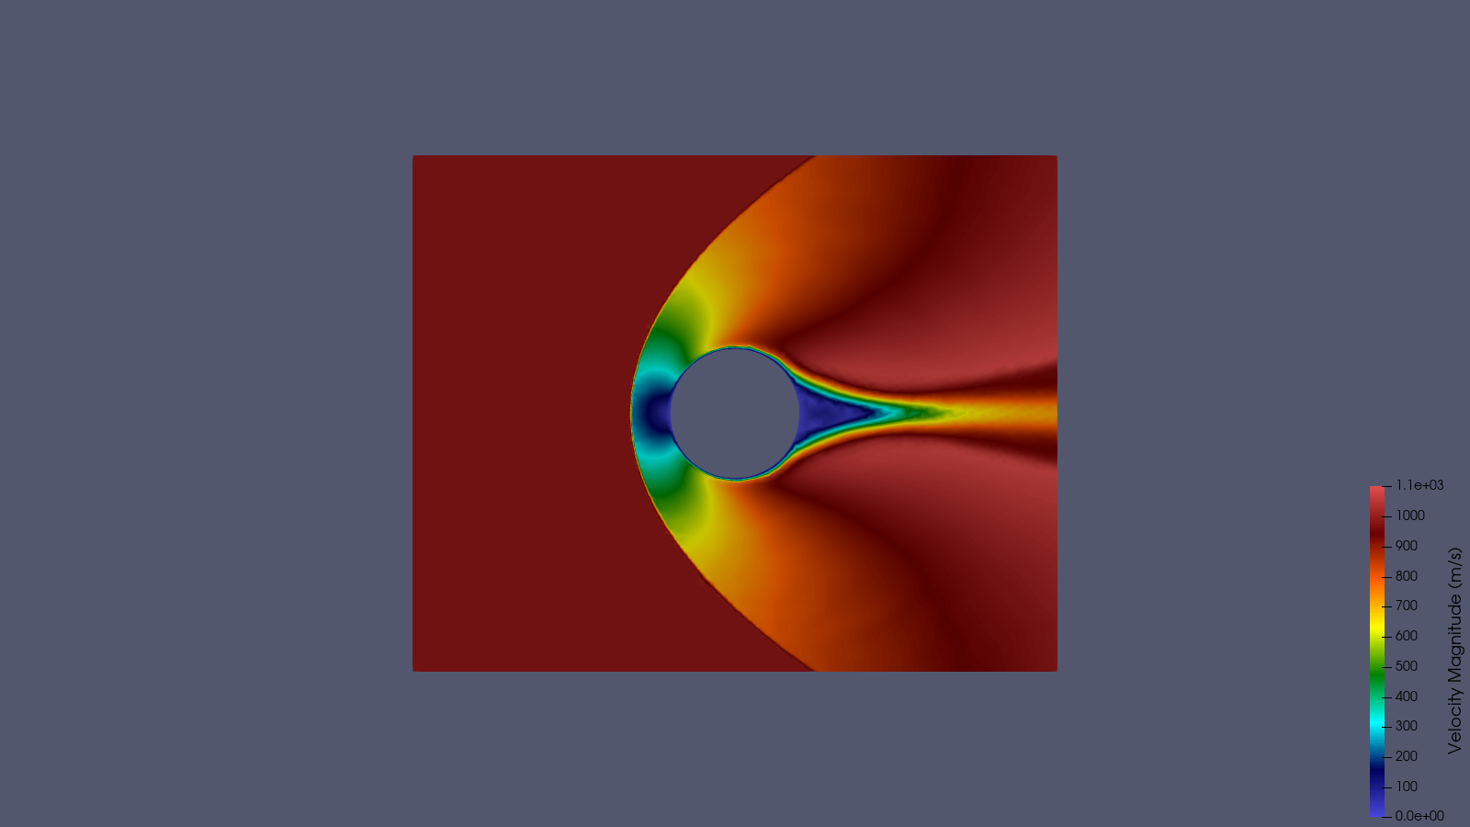
Velocity Magnitude Comparison
Consistent scale: 0 - 1100 m/s
Uniform Mesh
AMR 1
AMR 2
AMR 3
Fahim Shahriyar | University of North Dakota | Dr. Chonglin Zhang
12 / 17

Slide 13
Pressure: Uniform vs AMR 3
Shock resolution improvement with gradient-based adaptation
Uniform (4,804 nodes)
AMR 3 (17,500 nodes)
AMR 3 resolves the bow shock structure with sharper gradients using 3.6x more nodes concentrated at high-gradient regions
Fahim Shahriyar | University of North Dakota | Dr. Chonglin Zhang
13 / 17

Slide 14
Temperature: Uniform vs AMR 3
Thermal structure near cylinder wall and wake
Uniform (4,804 nodes)
AMR 3 (17,500 nodes)
Temperature peaks at stagnation point (~900 K) due to adiabatic compression; AMR captures thermal layer thickness more accurately
Fahim Shahriyar | University of North Dakota | Dr. Chonglin Zhang
14 / 17

Slide 15
Mesh & Results Summary
Mesh | Nodes | Cells | Mesh File Size | p Range (Pa) | T Range (K)
Uniform | 4,804 | 4,592 | 652 KB | 9.3 - 953.3 | 256.5 - 883.0
AMR 1 | 71,904 | 71,275 | 11 MB | 11.8 - 973.7 | 233.0 - 864.0
AMR 2 | 14,888 | 14,528 | 2.2 MB | 12.4 - 961.5 | 237.6 - 912.7
AMR 3 | 17,500 | 17,141 | 2.6 MB | 12.6 - 970.9 | 241.0 - 907.9
Observations
AMR Pipeline Parameters
AMR 1 over-refines (71k nodes) because initial gradients are everywhere
AMR 2 corrects by re-solving on AMR 1 mesh; now gradients are well-resolved
AMR 3 adds refinement only where residual gradients exist (17.5k nodes)
Final mesh (AMR 3) is 3.6x larger than uniform but 4.1x smaller than AMR 1
Pressure/temperature ranges converge across iterations
Adaptation criterion: Pressure gradient |grad(p)|
h_min = 0.002 m (finest cells at shock front)
h_max = 0.015 m (coarsest cells in freestream)
Scaling factor alpha = 100.0
Gmsh CharacteristicLengthMin = 0.002 (AMR geo)
Gmsh CharacteristicLengthMax = 0.015 (AMR geo)
3 AMR iterations (configurable in amr_pipeline.input)
Fahim Shahriyar | University of North Dakota | Dr. Chonglin Zhang
15 / 17

Slide 16
Key Findings
Solver Performance
AMR Effectiveness
rhoCentralFoam successfully handles Mach 3 on unstructured Gmsh mesh
sonicFoam crashes at ANY supersonic speed on this mesh type
Minmod limiter is essential; other limiters cause oscillations at Mach 3
maxCo = 0.3 required for stability with strong bow shock
Pressure gradient captures bow shock, stagnation, and wake accurately
3 AMR loops sufficient for mesh convergence (17.5k vs 4.8k nodes)
Self-correcting: AMR 1 over-refines, AMR 2-3 converge to optimal
Fully automated via all_run.sh with single config file
Limitations Discovered
Pipeline Features
Mach 3.5+ crashes: negative temperature from shock oscillations
Mach 27+ (re-entry): needs hy2Foam (hyStrath) for thermochemical non-equilibrium
hyStrath incompatible with OpenFOAM v2406
Subsonic flows (Mach 0.5): zero gradients make AMR meaningless
Universal: works with both OpenFOAM (CFD) and COMET (DSMC)
Two extraction modes: gradient (OpenFOAM) and direct (COMET MFP)
Solver-agnostic: reads VTU files, not solver-specific formats
Open-source ready: users configure ONLY amr_pipeline.input
Fahim Shahriyar | University of North Dakota | Dr. Chonglin Zhang
16 / 17

Slide 17
Conclusions & Future Work
Conclusions
Future Work
Successfully demonstrated gradient-based AMR for Mach 3 supersonic cylinder
Pressure gradient is an effective adaptation criterion for shock-dominated flows
The automated pipeline (Gmsh + OpenFOAM + ParaView) reduces manual meshing effort
AMR achieves better shock resolution than uniform mesh with moderate cell count increase
The pipeline is configurable, solver-agnostic, and ready for other flow problems
Apply pipeline to 3D DSMC (COMET) results using direct MFP extraction
Test with friend's RAMC-II (Mach 27) DSMC results when available
Investigate multi-criteria adaptation (combine grad(p) + grad(T))
Extend to higher Mach numbers with structured/hybrid meshes
Integrate pipeline into thesis as AMR chapter demonstration
Thank You
Fahim Shahriyar | fahim.shahriyar@und.edu | Advisor: Dr. Chonglin Zhang
Fahim Shahriyar | University of North Dakota | Dr. Chonglin Zhang
17 / 17

