Slide 1
Today
Announcements
Getting feedback on your models (~20 minutes)
Wrap up skydiver project (~30 minutes)
Monte Carlo integration (rest of class)

Slide 2
Announcements
Final choice of model is due tomorrow night
Homework 4 is due on Friday
Reminder: Prof. O’Shea does not have office hours this week (he’s out of town) – please email him if you have any questions
CMSE 202 has plenty of open seats in Spring 2017 – please think about enrolling!

Slide 3
Model feedback (~20 mins)
For each person in group:
Explain your two models. For each model, what is it trying to accomplish, what sorts of methods does it use, and why are you interested in it?
Group gives feedback after you explain both: Which one seems most viable to present on? Which one is more interesting?
Note: you will have to choose one of the two models and commit by tomorrow night! (Upload in “semester project” folder)

Slide 4
Skydiver project (~30 minutes)
Make sure you can do numerical integration/differentiation to get position and acceleration of human skydiver!
Don’t worry about the mouse/elephant unless you have time
Don’t overdo it – you can just use rectangle rule for integration if it’s simpler!

Slide 5
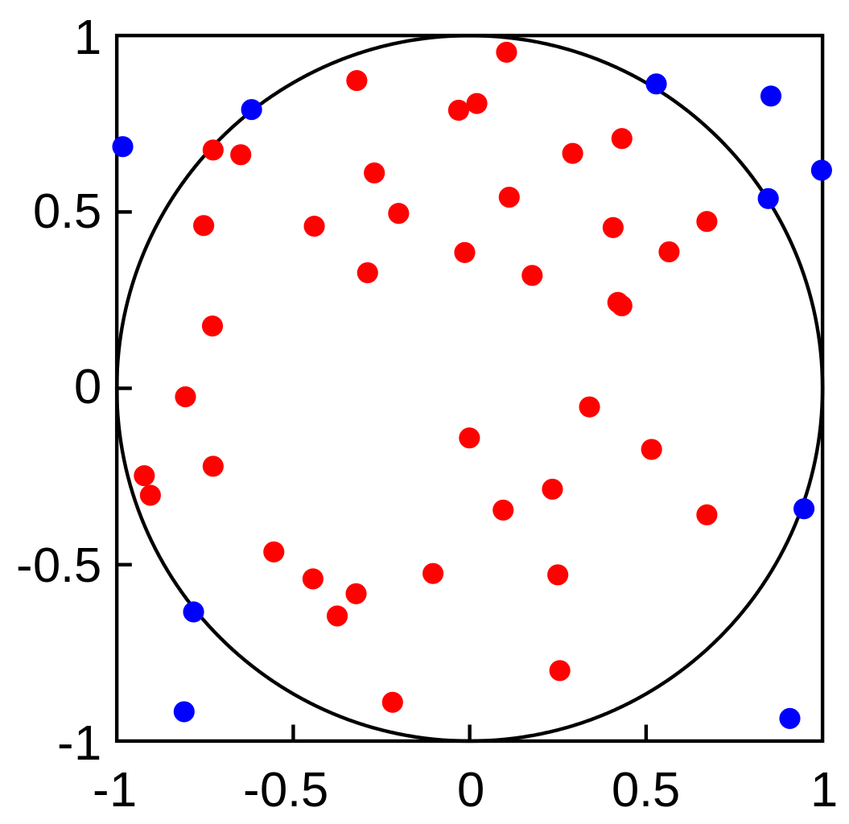
Monte Carlo integration
Image c/o Wikipedia

