Slide 1
Today
Announcements
Around the room: what was your final choice of model?
The Traveling Salesman problem

Slide 2
Announcements
Homework 4 due Friday
Initial research for your chosen model is due next Wednesday (11/23), right before Thanksgiving
Reminder: Prof. O’Shea does not have office hours this week (he’s out of town) – please email him if you have any questions
CMSE 202 has plenty of open seats in Spring 2017 – please think about enrolling!

Slide 3
Around the room
Which model did you pick?
Why did you pick it?
(Keep it to 30 seconds or so.)

Slide 4
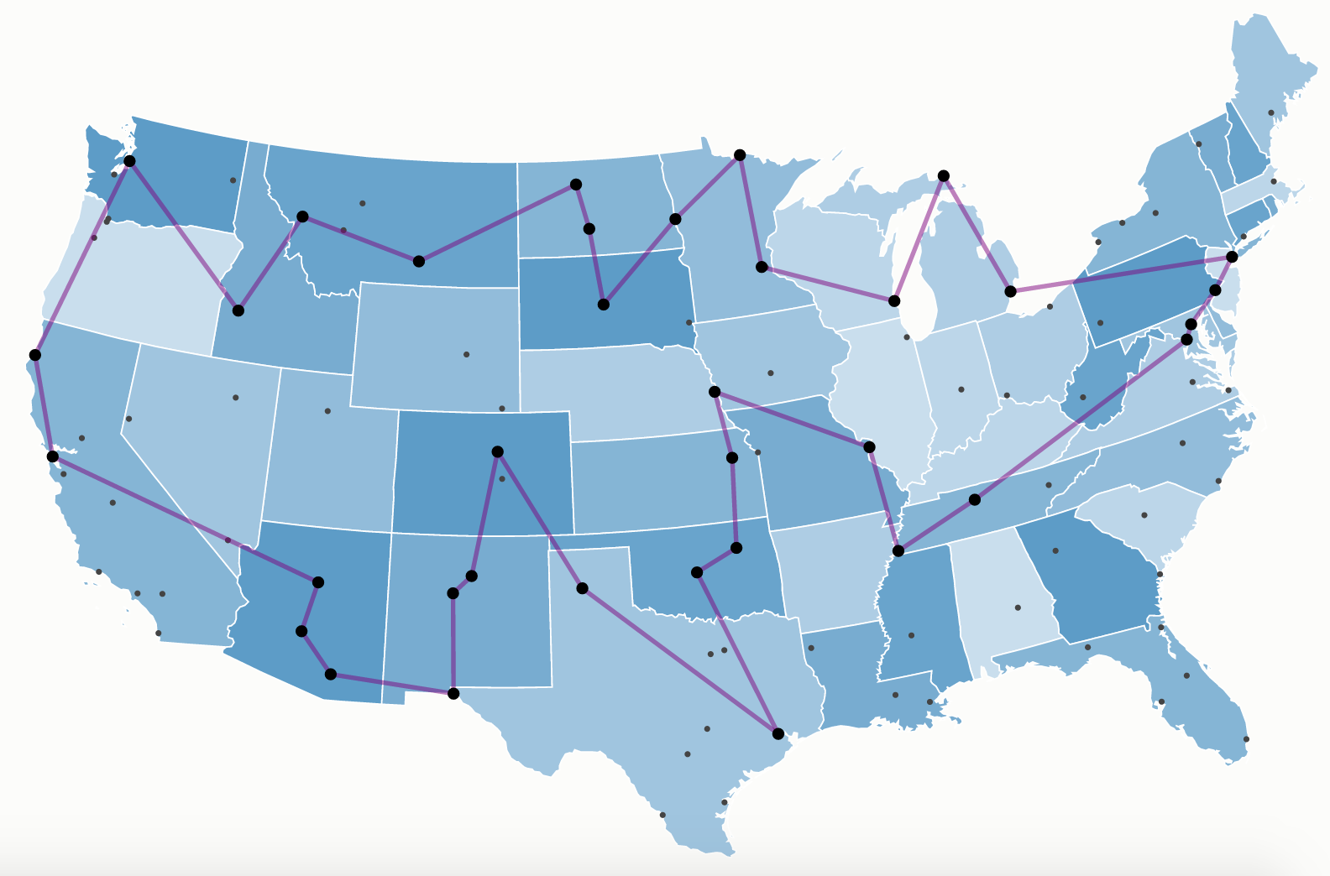
The Traveling Salesman Problem
Image: http://examples.gurobi.com/traveling-salesman-problem/

