Slide 1
Today
Announcements
Pre-class assignment (10 minutes)
Modeling forest fires (rest of today + next class)

Slide 2
Announcements
Final slides for the “tell me about a model” assignment are due on Friday (12/2) – powerpoint or PDF only!
Homework 5 is out and is due on the last day of class (12/9). Get started early – this is a big assignment!

Slide 3
Pre-class assignment
As small groups, share your solutions. What did people have trouble with?
Whole-class discussion on things that are bothering you. Possible topics:
How does slicing work?
How to work with neighborhoods?
What’s this animation thing anyway?

Slide 4
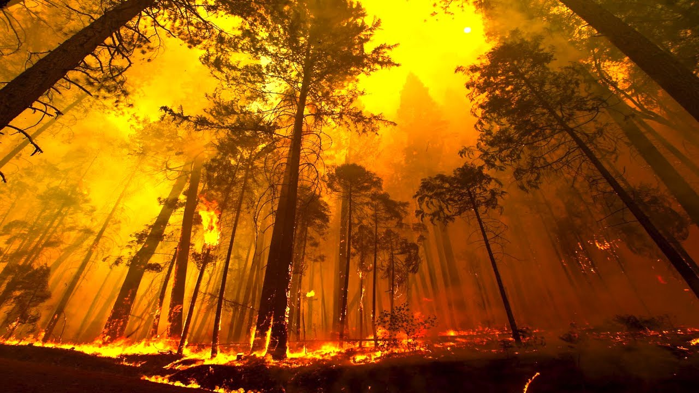
Modeling forest fires

