Slide 1
Today’s class
Announcements
Semester project: modeling
The Bechdel Test

Slide 2
Announcements
Modeling component of semester project due on Sunday 11/13 (we’ll explain momentarily)
Homework 4 posted today; due on Friday 11/18
There will be one more HW assignment (HW #5) assigned and due right before finals.
There is a pre-class assignment for the next class!

Slide 3
Semester project: modeling
We want you to find a model that you’re interested in, and do an in-depth job of explaining it.
This model should be related to your major or your interests – it does not have to be related to your data analysis project!

Slide 4
Semester project: modeling
Several components:
Find two models and references (due Sun. 11/13); get feedback from your group-mates and your instructor (in class after that)
Choose one of the models (by Tues. 11/15) and submit all of your background research (due Wed. 11/23)
Create a final writeup and slides (due 12/2) and give a talk to class (week of 12/5)

Slide 5
Semester project: modeling
First part: find two models online, and describe them as requested by the IPython Notebook in the “semester project” folder. Descriptions due Sunday 11/13.
Think about what sort of model you might be interested in, and talk to one of the instructors if you want to chat about ideas or get suggestions!

Slide 6
The Bechdel Test with Pirates of the Caribbean

Slide 7


Slide 8
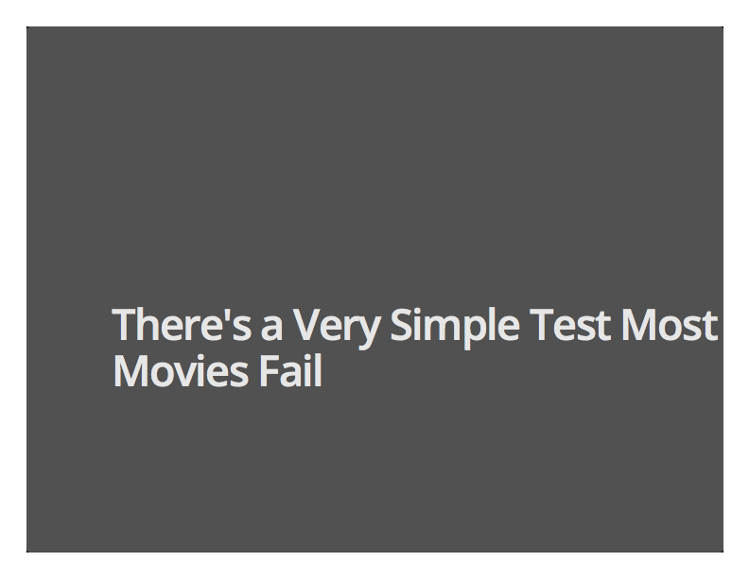

Slide 9
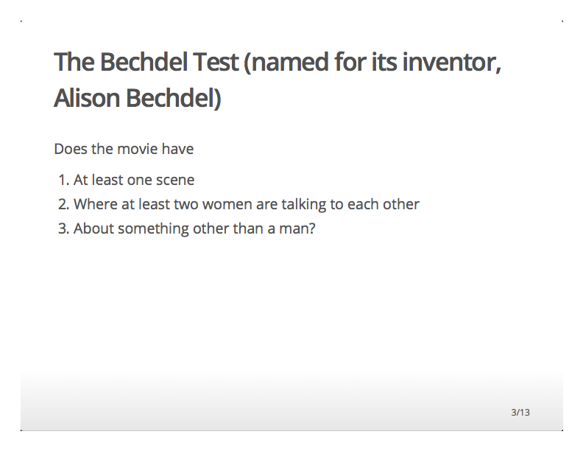

Slide 10
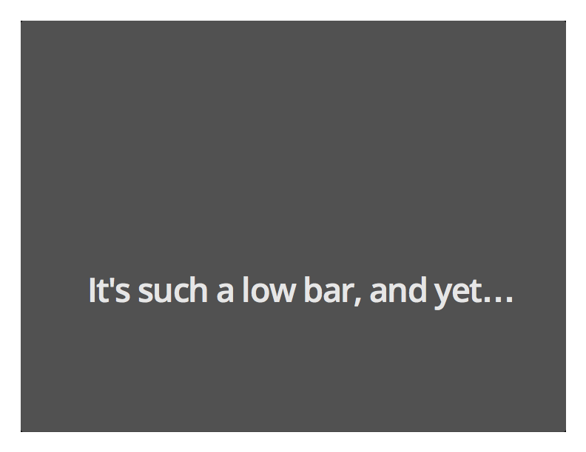

Slide 11
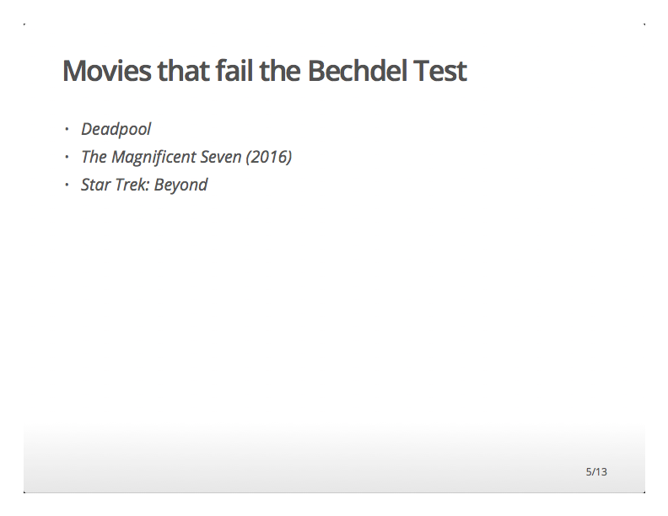

Slide 12
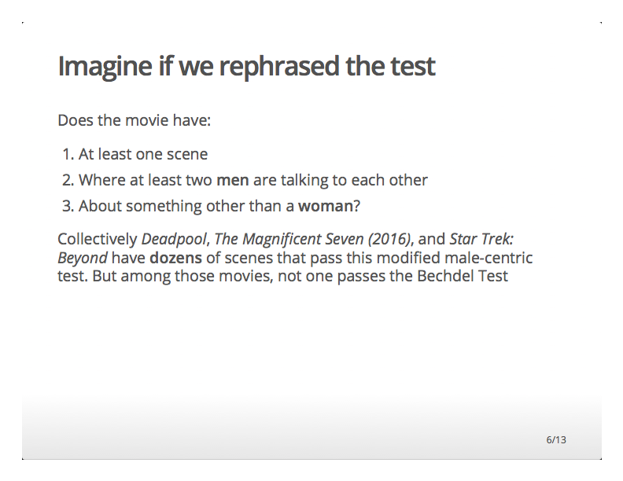

Slide 13
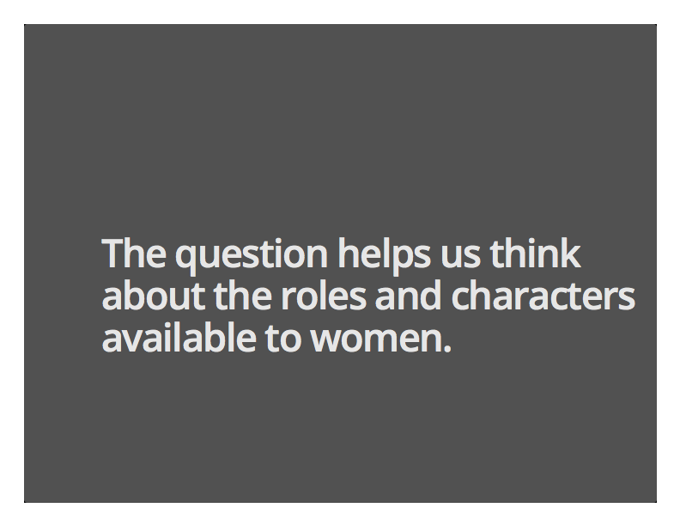

Slide 14
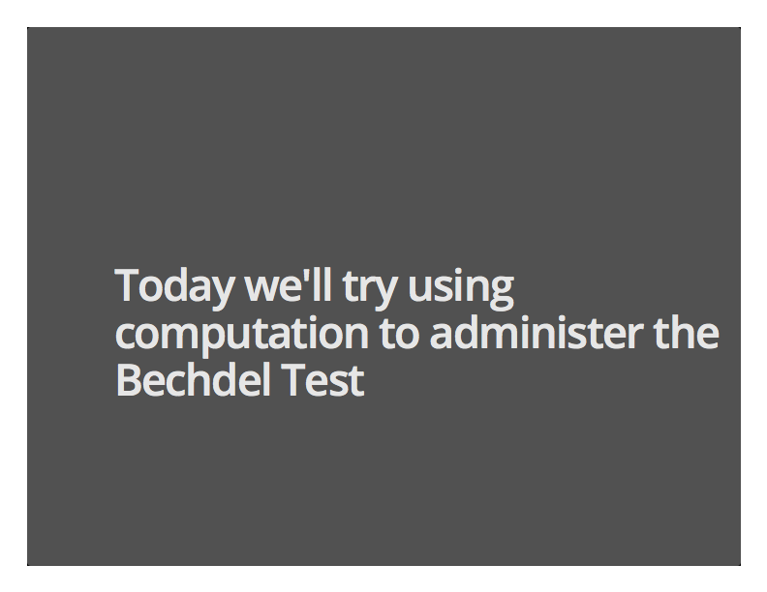

Slide 15
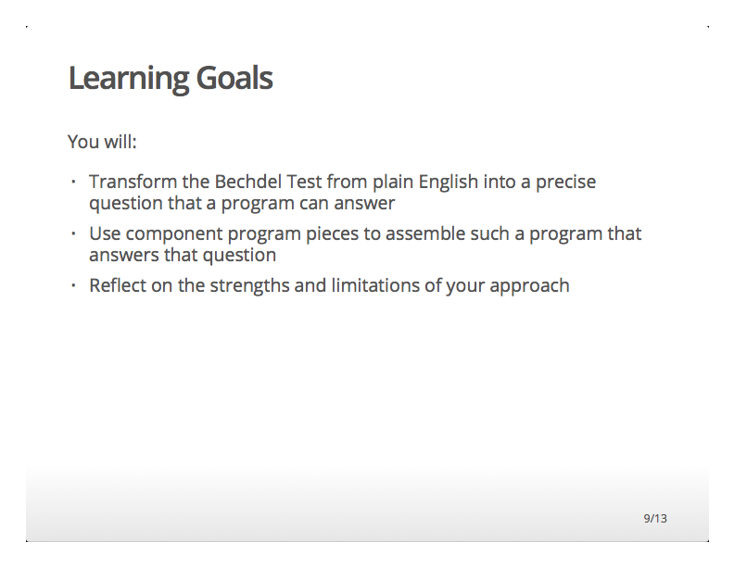

Slide 16
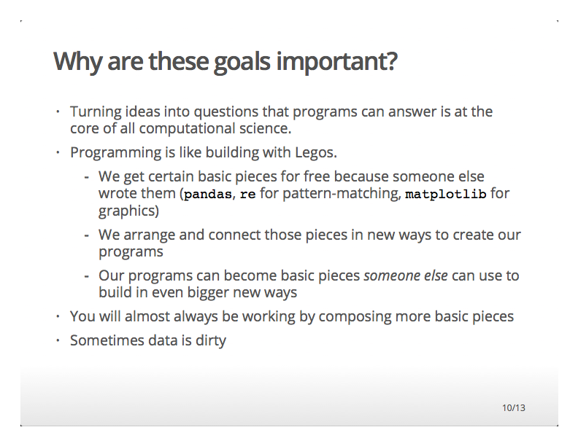

Slide 17
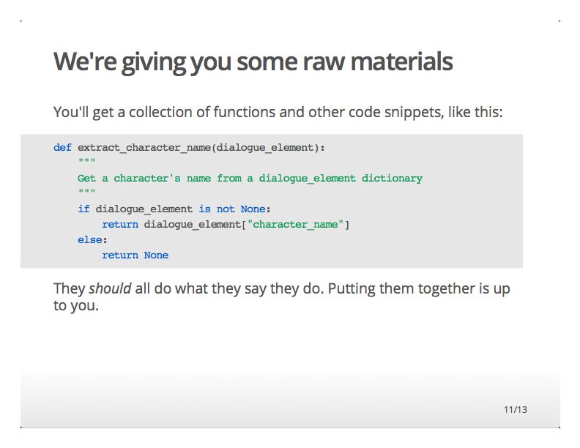

Slide 18
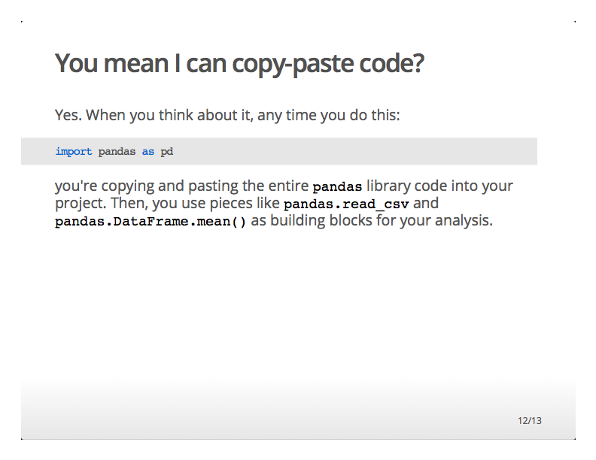

Slide 19
