Slide 1
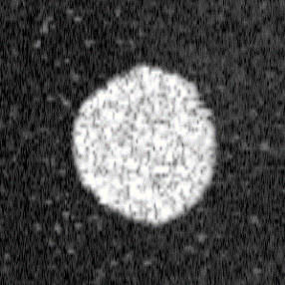
En face plane
of a single volume
Block 1
Block 2
…
Block 8
B-scan
location
…
…
1
Slow scan location
Step ×
16 locations × 32 repeats
Block 1
2
32 repeats
16
…
…
Step × 16 locations
Block 2
…
…
Slow scan
Fast scan
location
Saw-tooth × 16 locations × 32 repeats
Block 8
(y)
Saw-tooth × 16 locations
(x)
Fast scan
…
…
…
…
…
…
0
6.55
13.1
45.85
52.4
Frame separation time
12.8 ms
Time [s]
[El-Sadek et.al., Biomed. Opt. Express 12, 6844- (2021)]
Figure: Schematical scan protocol (El-Sadek2021BOE)

Slide 2
En face plane
of a single volume
En face plane
of a single volume
B-scan
location
1
2
3
4
500
repeats
B-scan
location
50 repeats
1
97
98
99
[Example-1]
100
[Example-2]
Figure: Examples of simple scan

Slide 3
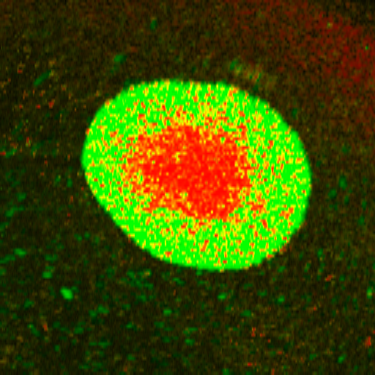
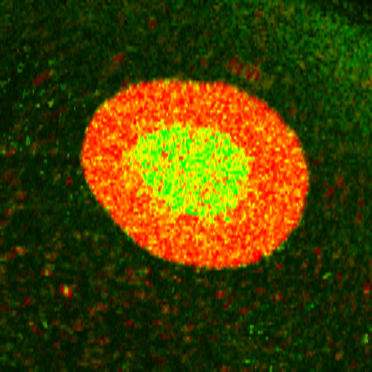
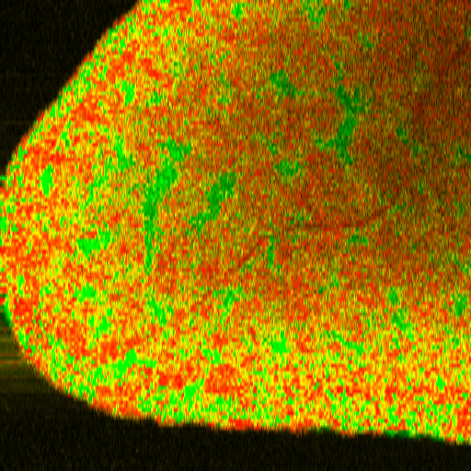
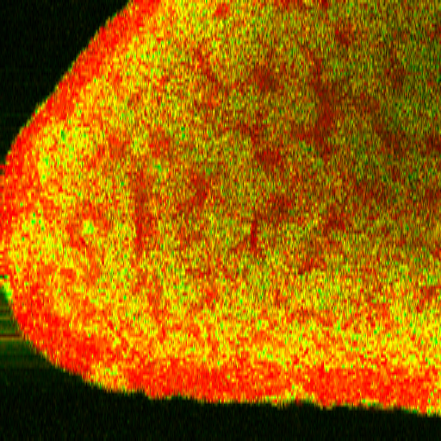
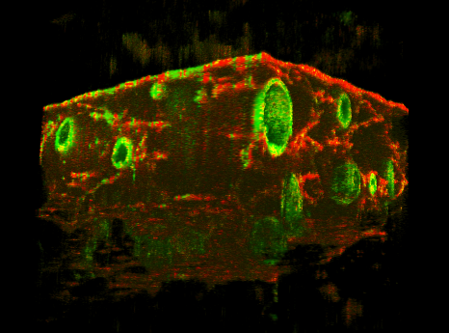


Slide 5
