Slide 1
Step by Step guide to add a new fit model function into the GPUFIT
We strongly recommend to follow the installation procedure in
Gpufit documentation:
https://gpufit.readthedocs.io/en/latest/index.html

Slide 2
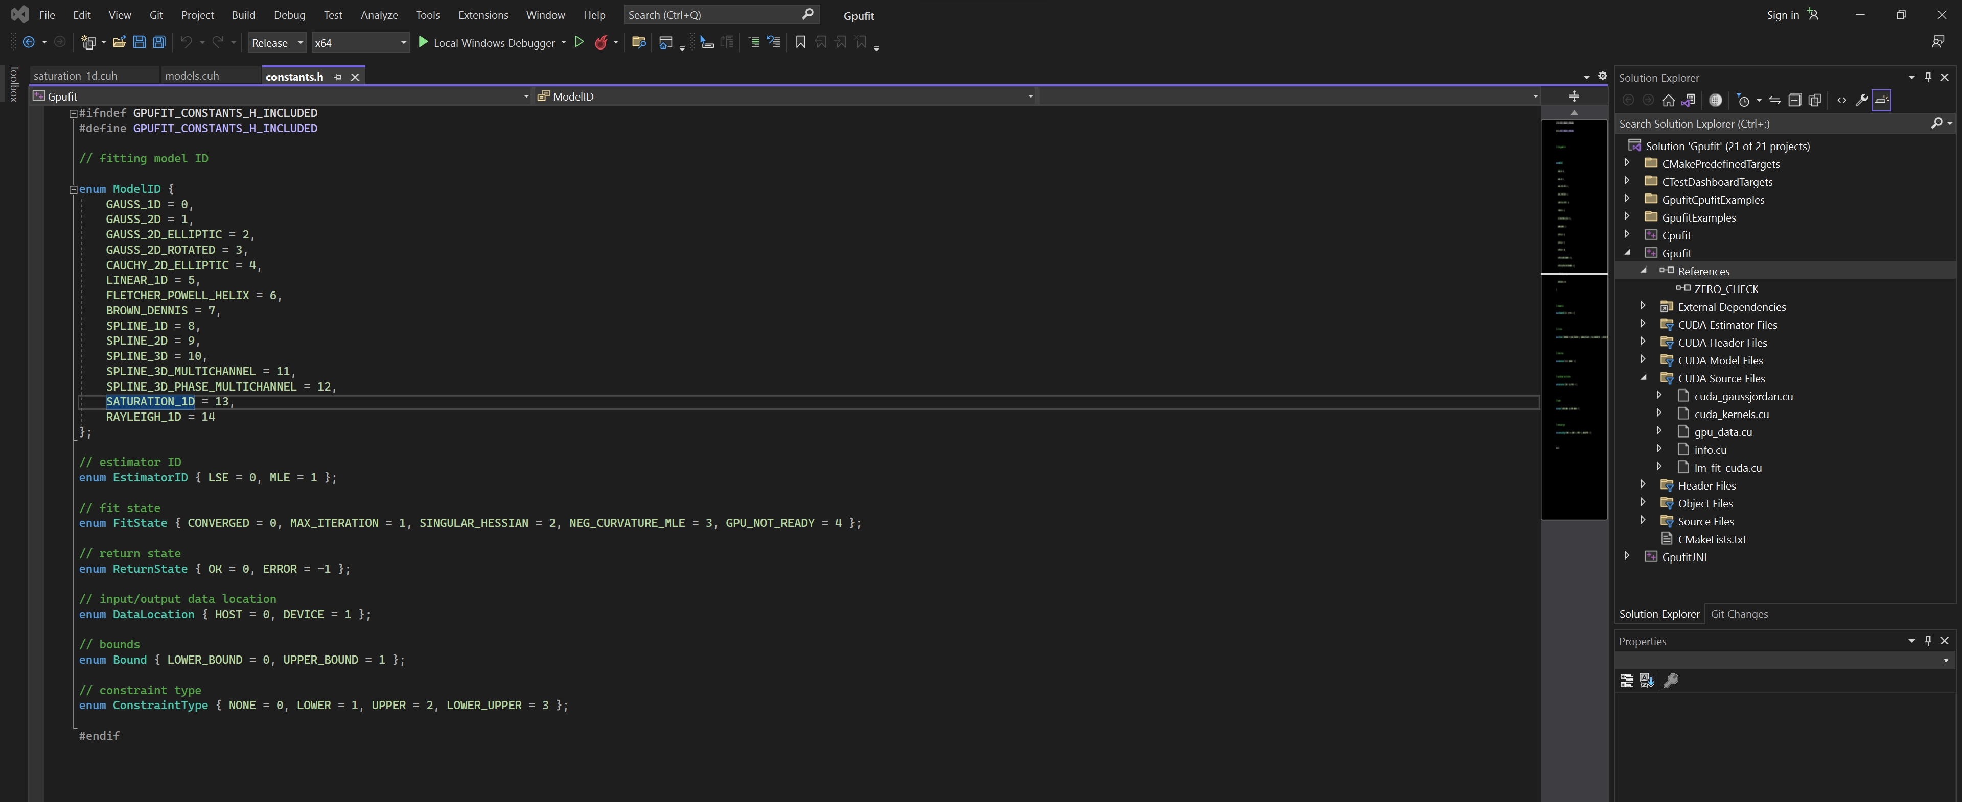
Steps:
Download CUDA
CUDA Toolkit 6.5 or later (tested with 6.5-11.4)
2. Download Visual Studio 2022
3. Define an additional model ID in file constants.h

Slide 3
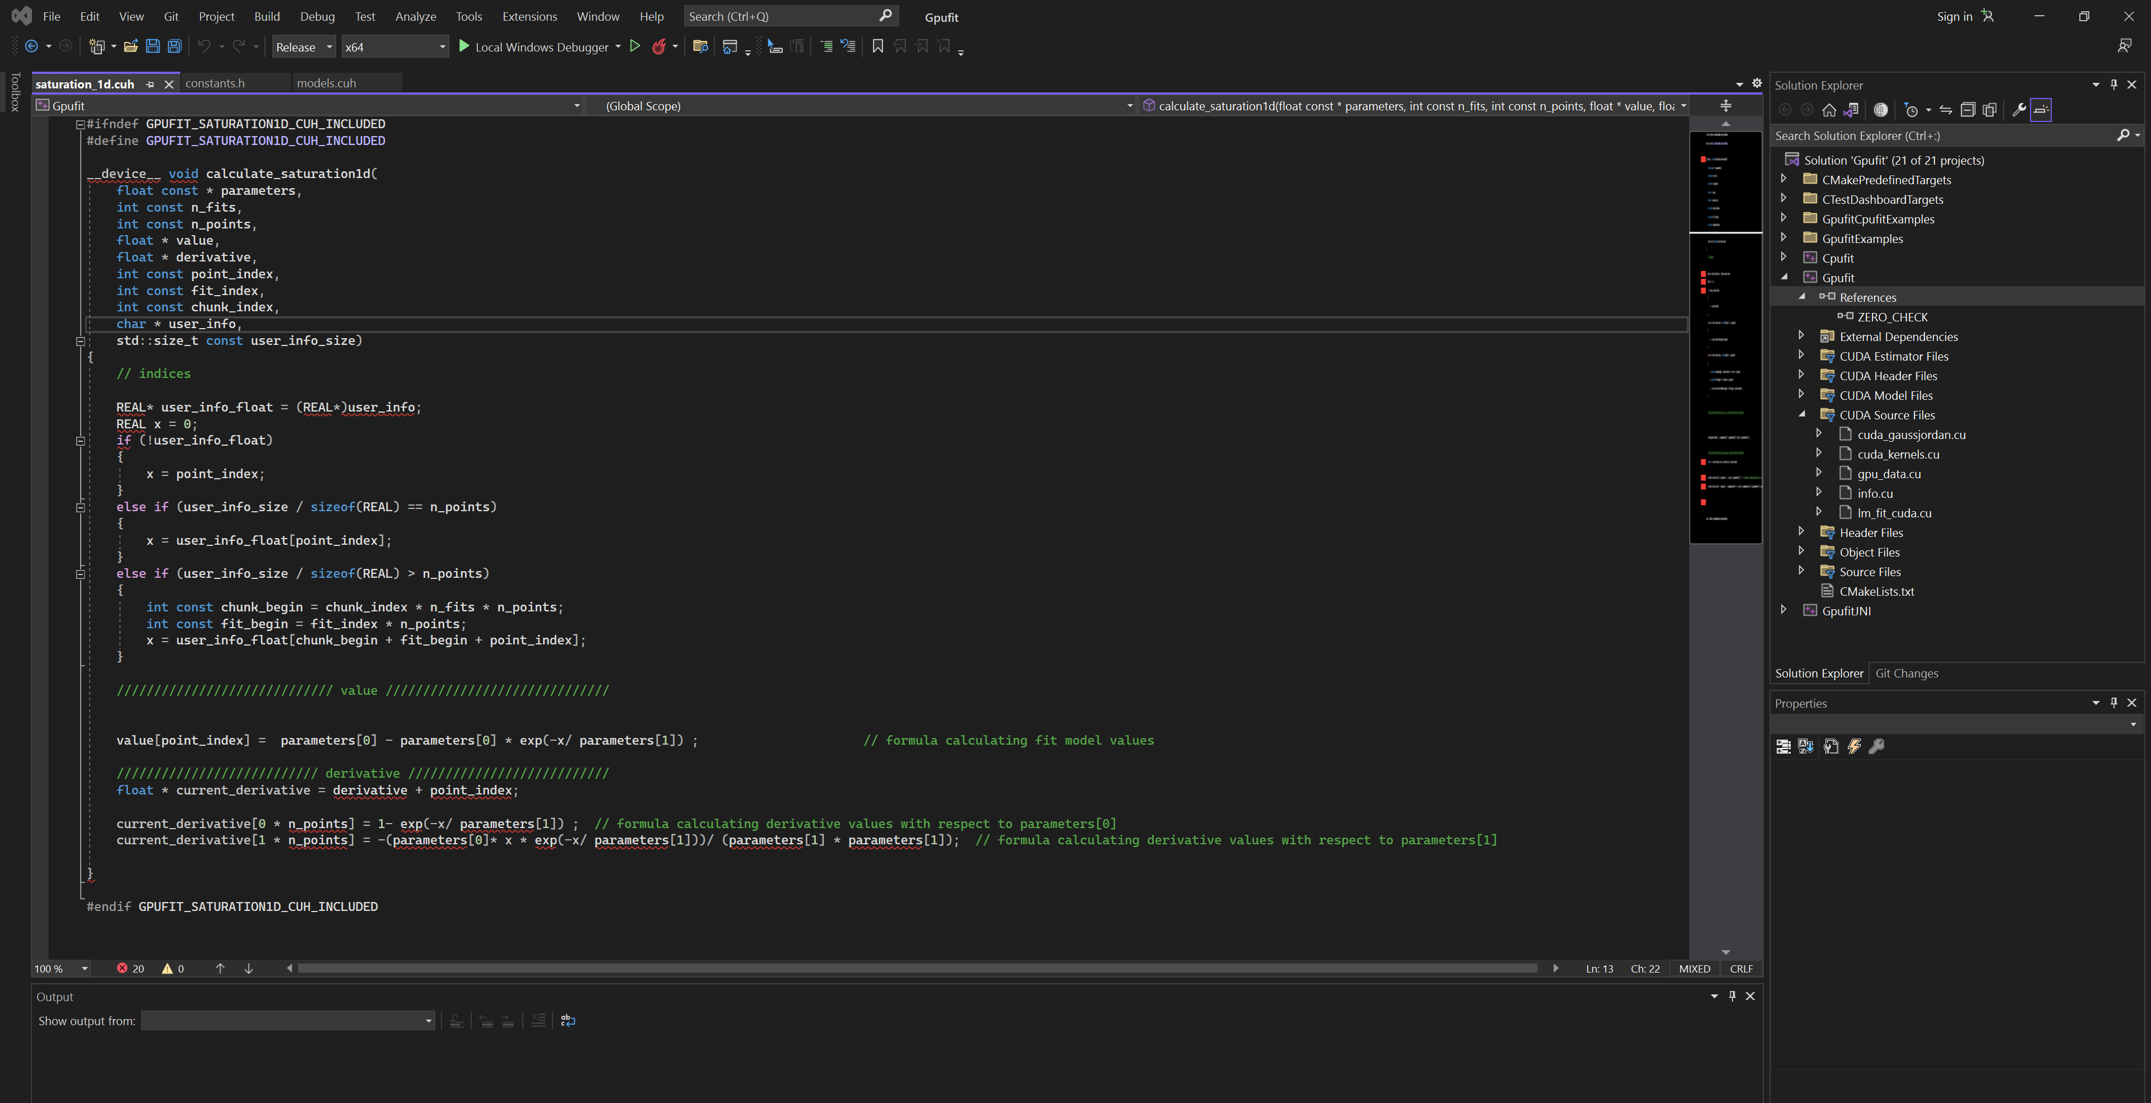
4. Implement a CUDA device function within a newly created .cuh file in folder Gpufit/Gpufit/models according to the following template.
partial derivatives of the model, with respect to the model parameters
See the examples model functions in thin link:
“/Gpufit/models"

Slide 4
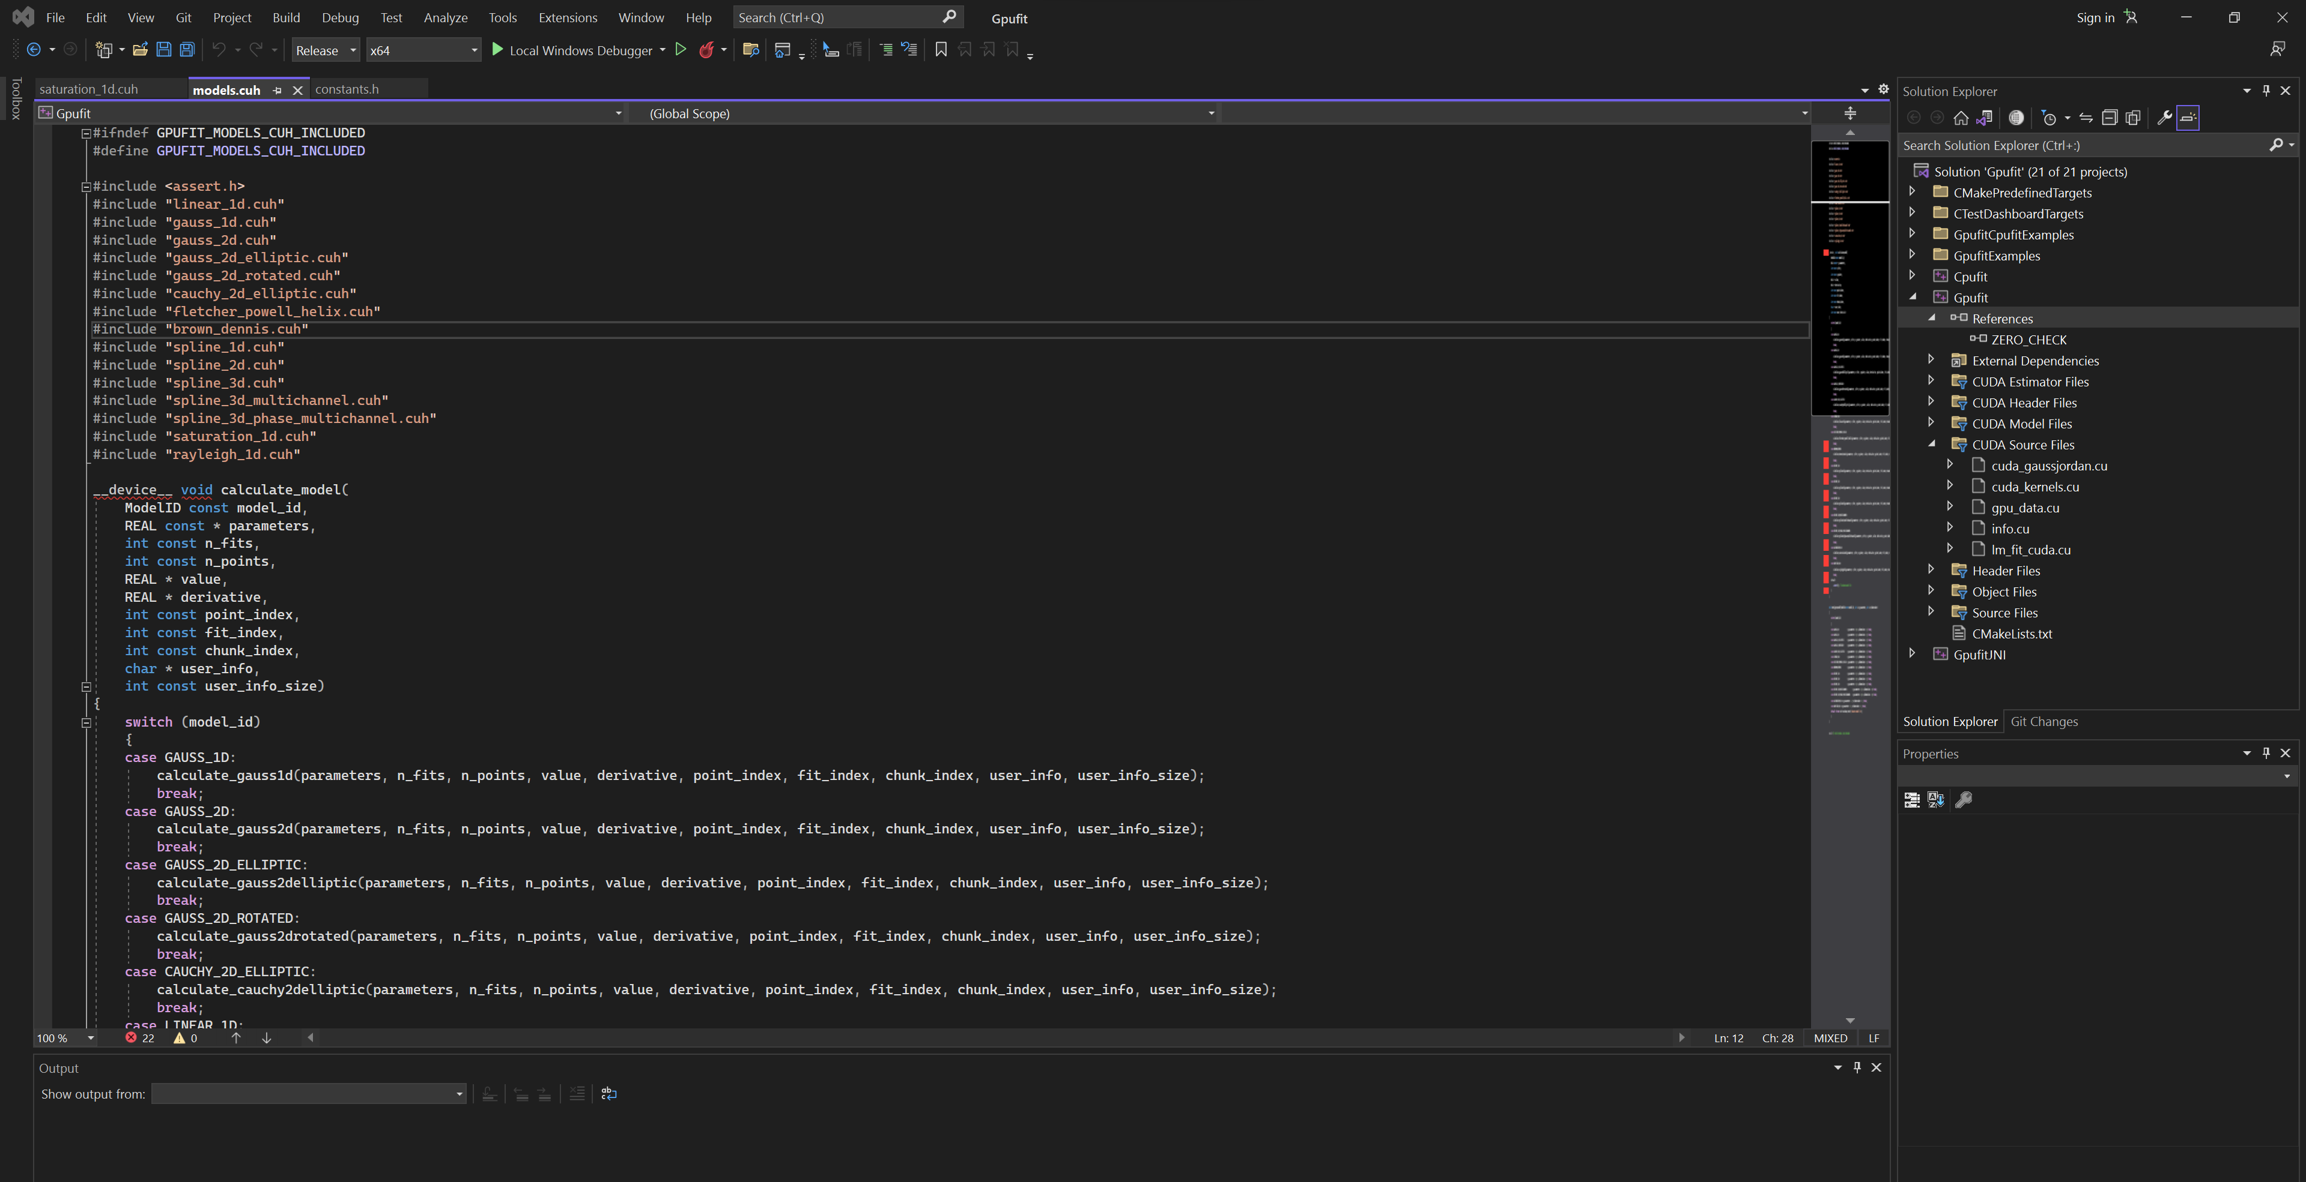
5. Include the newly created .cuh file in models.cuh
Add a switch case in the CUDA device function calculate_model() in file models.cuh to allow calling the newly added model function.
See the next page (Continued)

Slide 5
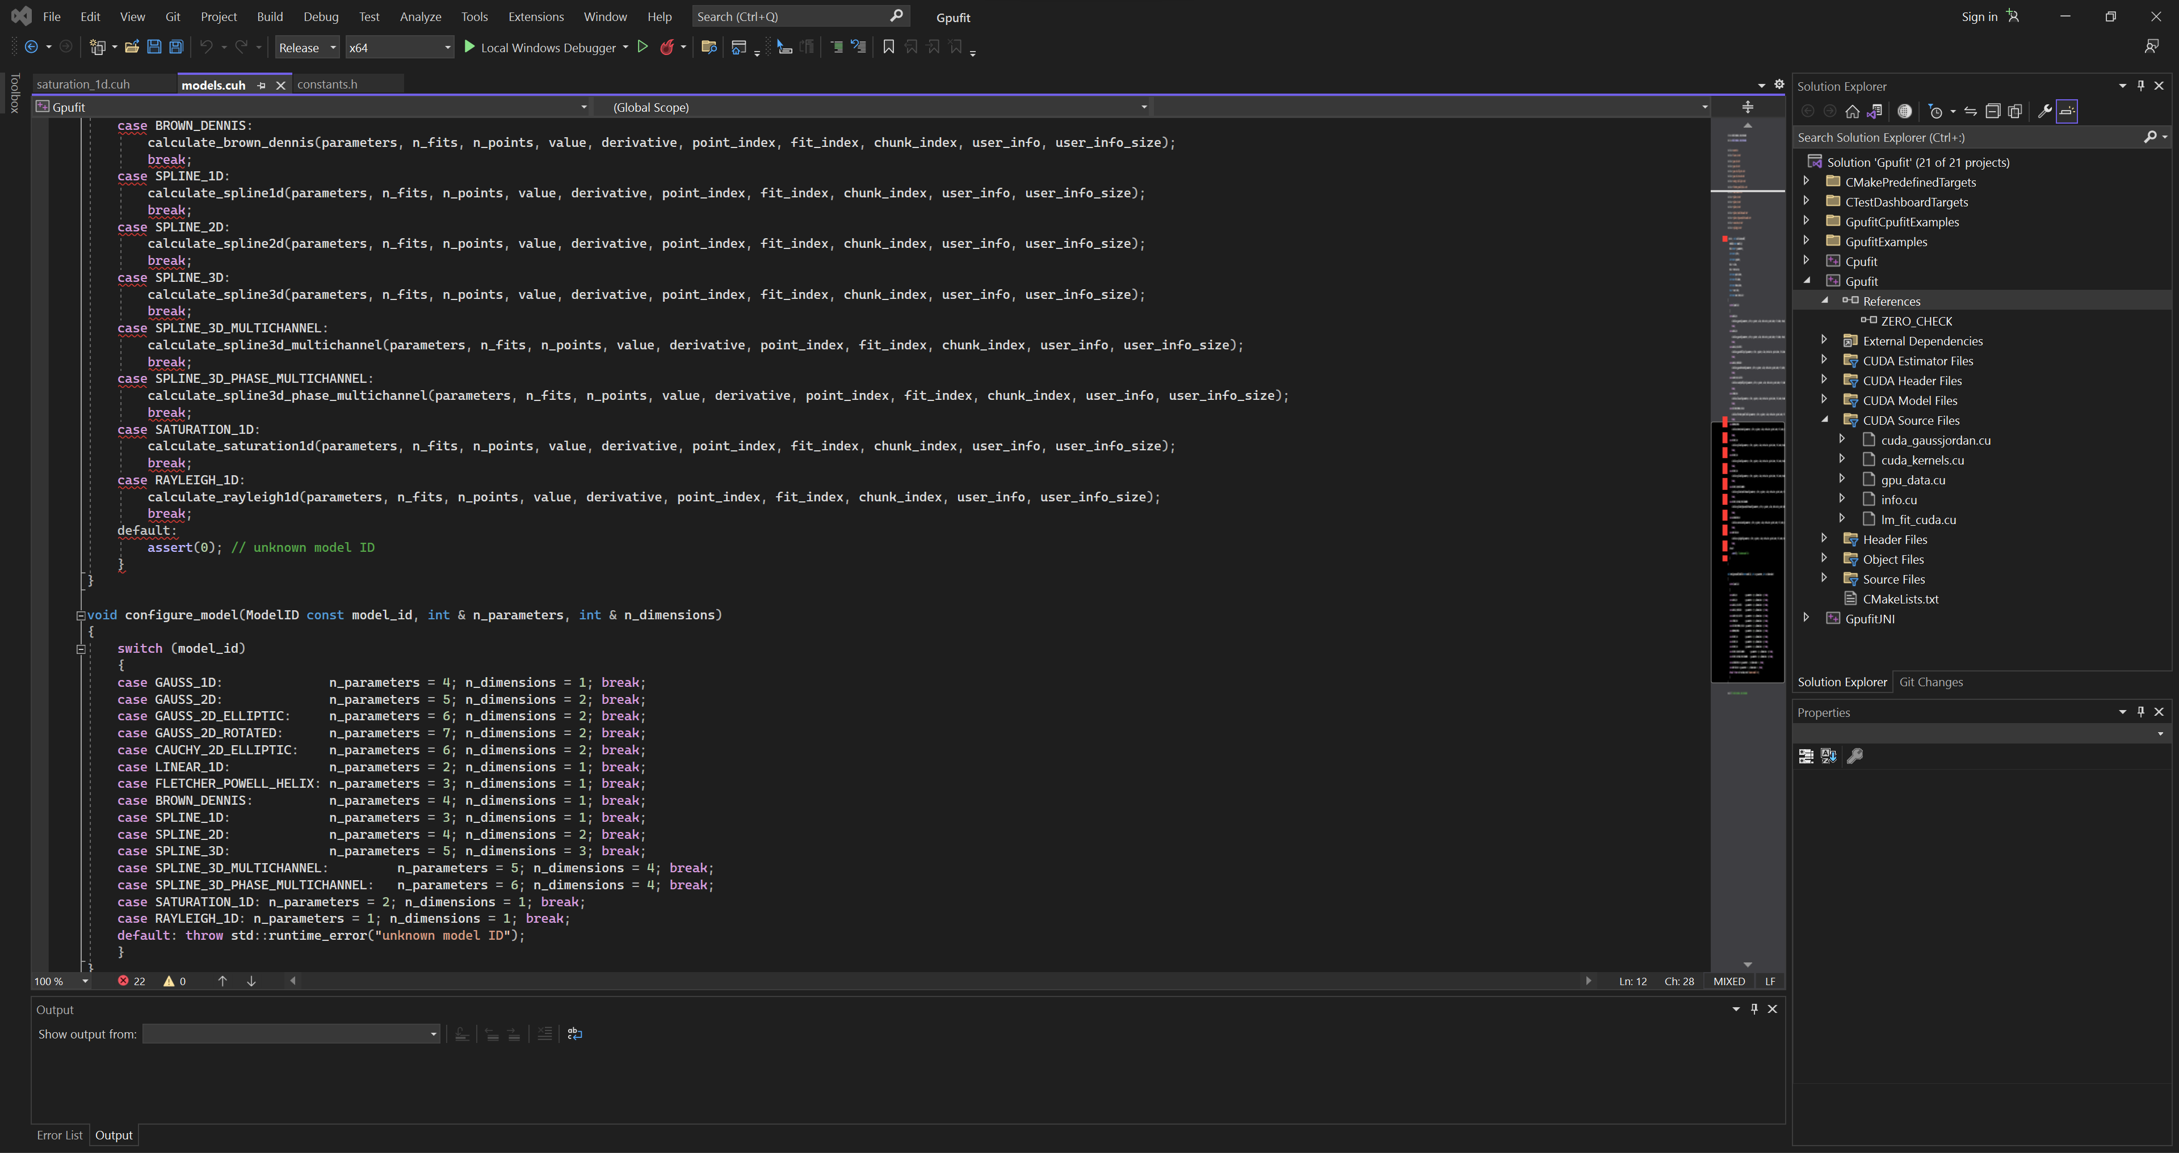
Add a switch case in function configure_model() in file models.cuh.

Slide 6
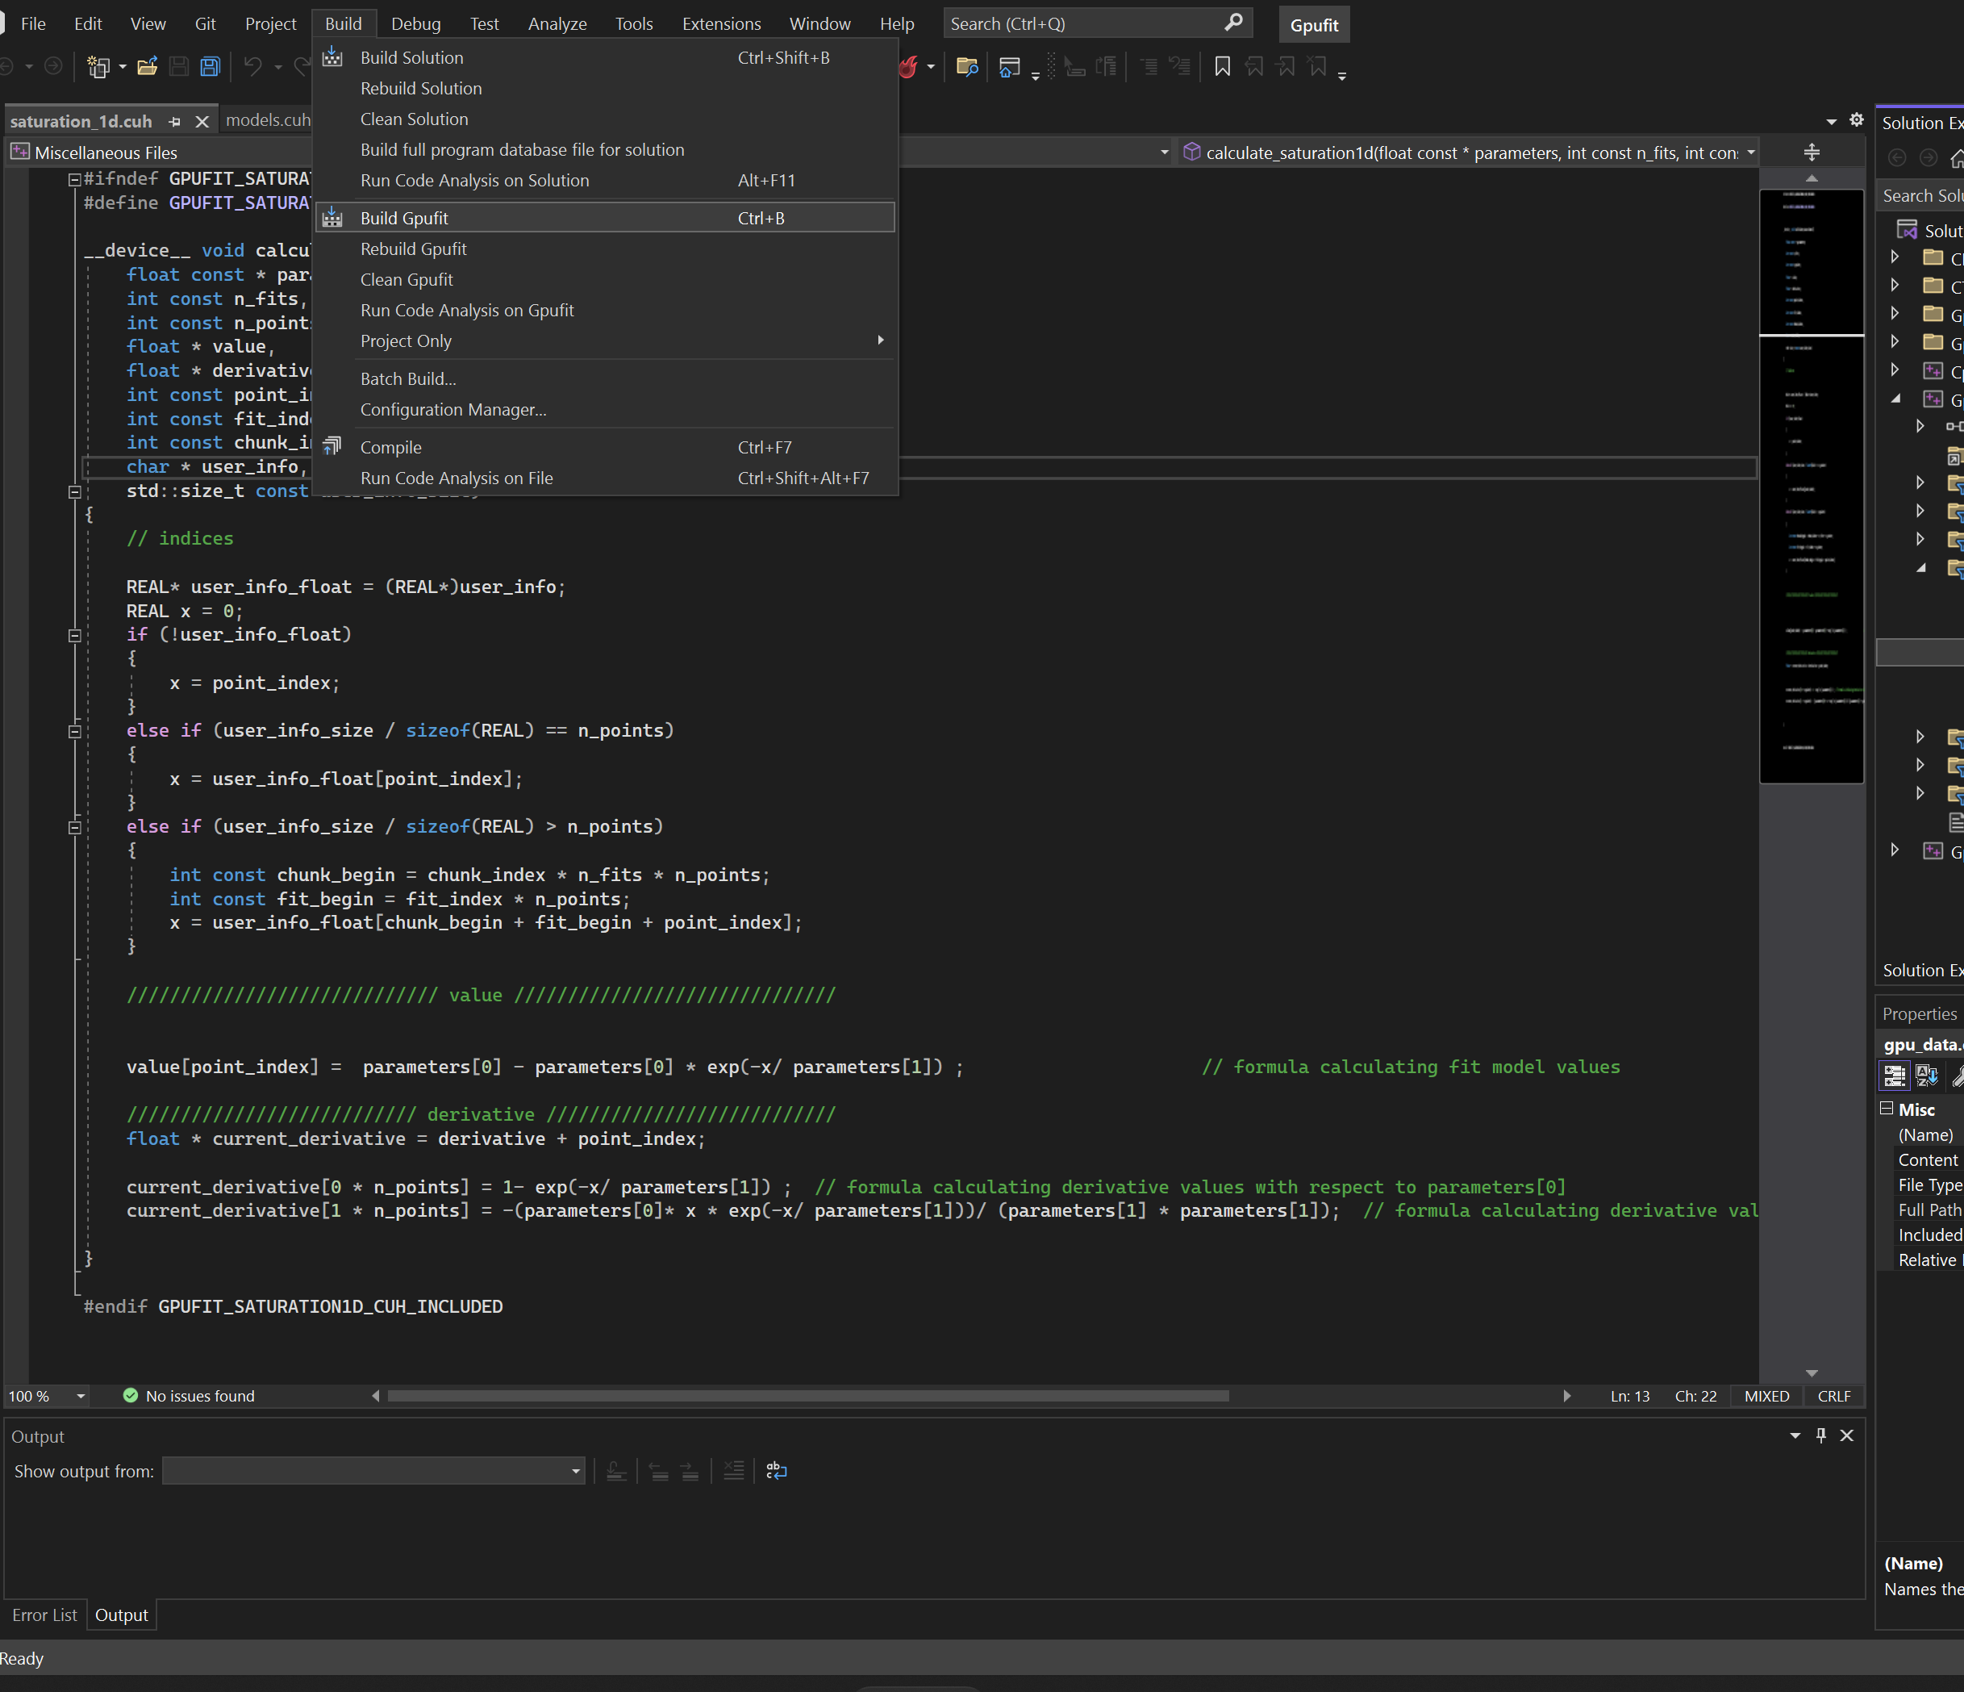
6. Re-build the Gpufit project.

Slide 7
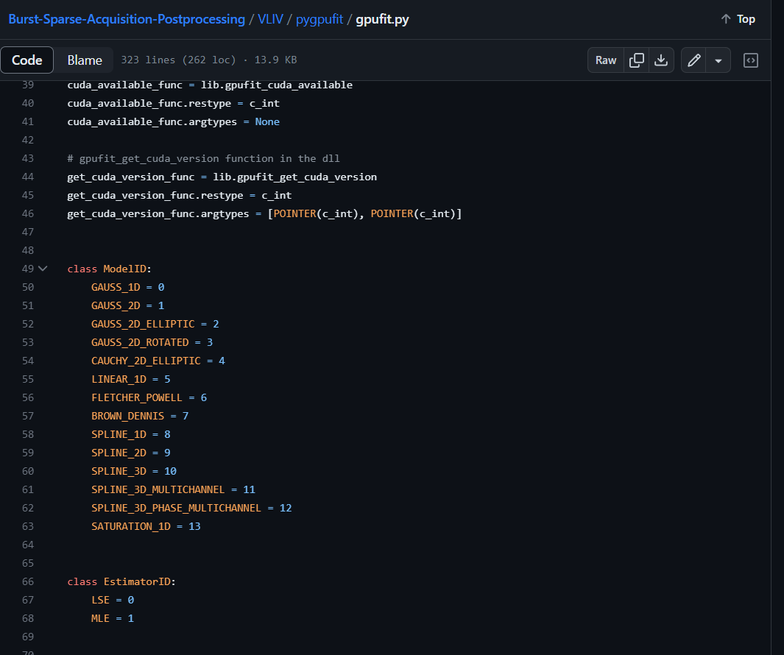
VLIV/pygpufit/gpufit.py
7. Add the model ID in file gpufit.py
8. Add (1) “Gpufit.dll”
(2) “gpufit.py”
in the location of “Program/VLIV/pygpufit/”.

