Slide 1

Computational Adaptive Optics OCT
Shuichi Makita
Computational Optics Group,
University of Tsukuba

Slide 2
Adaptive Optics methods
Adaptive optics (AO) | Sensorless AO | Computational (AO)
Real-time correction Cannot correct defocus Require additional hardware (deformable mirror, wavefront sensor) | Real-time correction Cannot correct defocus Require additional hardware (deformable mirror) | Post-processing No additional hardware Can correct defocus Configuration-depended
Complex OCT signal (amplitude + phase)
You can modify the complex point-spread function.

Slide 3
Computational Adaptive Optics methods
Inverse filter |  | ISAM |  | DAO
Apply phase inverse filter to cancel phase error due to aberrations. |  | Convert from optical frequency (k) to the sample spatial frequency (kz) |  | Estimate and correct phase error. Compare images of different frequency spaces.
Defocus + other aberrations |  | Defocus only |  | Defocus + other aberrations
Focused | Plane wave | Focused | Plane wave | [8, 9]
[1-2] | [4-5] | [6] | [7]
1. Y. Yasuno, J. Sugisaka, Y. Sando, Y. Nakamura, S. Makita, M. Itoh, and T. Yatagai, Opt. Express 14, 1006–1020 (2006).
2. L. Yu, B. Rao, J. Zhang, J. Su, Q. Wang, S. Guo, and Z. Chen, Opt. Express 15, 7634–7641 (2007).
4. Y. Nakamura, J. Sugisaka, Y. Sando, T. Endo, M. Itoh, T. Yatagai, and Y. Yasuno, Jpn. J. Appl. Phys. 46, 1774–1778 (2007).
5. D. Hillmann, H. Spahr, C. Hain, H. Sudkamp, G. Franke, C. Pfäffle, C. Winter, and G. Hüttmann, Sci. Rep. 6, 35209 (2016).
6. B. J. Davis, S. C. Schlachter, D. L. Marks, T. S. Ralston, S. A. Boppart, and P. S. Carney, J. Opt. Soc. Am. A 24, 2527–2542 (2007).
7. D. L. Marks, T. S. Ralston, S. A. Boppart, and P. S. Carney, J. Opt. Soc. Am. A 24, 1034–1041 (2007).
8. A. Kumar, L. M. Wurster, M. Salas, L. Ginner, W. Drexler, and R. A. Leitgeb, Biomed. Opt. Express 8, 3369–3382 (2017).
9. A. Kumar, W. Drexler, and R. A. Leitgeb, Opt. Express 21, 10850–10866 (2013).

Slide 4
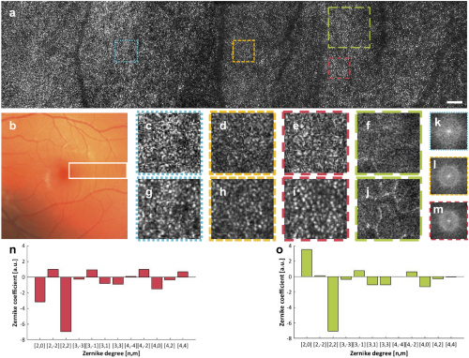
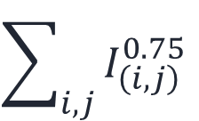
Full-field swept-source CAO-OCT (Inverse filter)
Computational aberration correction in in vivo human retina.
Image metric
$$\sum_{i,j}{I_{\left(i,j\right)}^{0.75}}$$
Phase error model
Zernike polynomial
Correct five sub-volumes
H. Sudkamp, D. Hillmann, P. Koch, M. vom Endt, H. Spahr, M. Münst, C. Pfäffle, R. Birngruber, and G. Hüttmann, "Simple approach for aberration-corrected OCT imaging of the human retina," Opt. Lett. 43, 4224–4227 (2018).

Slide 5
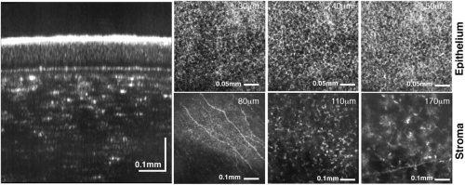
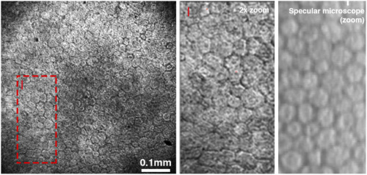
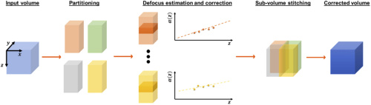
Full-field swept-source CAO-OCT (Inverse filter)
Computational defocus correction in in vivo human cornea.
Image metric
Kurtosis
Phase error model
Only defocus
Space-dependent defocus correction
E. Auksorius, D. Borycki, P. Stremplewski, K. Liżewski, S. Tomczewski, P. Niedźwiedziuk, B. L. Sikorski, and M. Wojtkowski, Biomed. Opt. Express 11, 2849–2865 (2020).

Slide 6
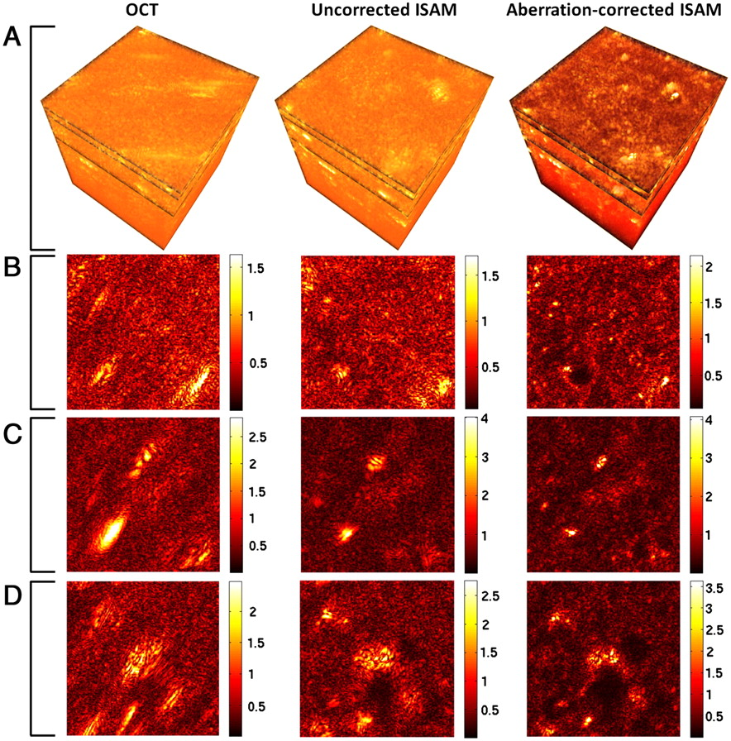
Point-scanning CAO-OCT, ISAM + inverse filter
Computational aberration correction of astigmatism in ex vivo rat lung tissue.
Image metric
Peak intensity
Ratio of mid- to high-spatial frequency energy
Phase error model
Zernike polynomial
Space-invariant aberration correction
Astigmatism is introduced by a cylindrical lens.
S. G. Adie, B. W. Graf, A. Ahmad, P. S. Carney, and S. A. Boppart, Proc. Natl. Acad. Sci. U. S. A. 109, 7175–7180 (2012).

Slide 7

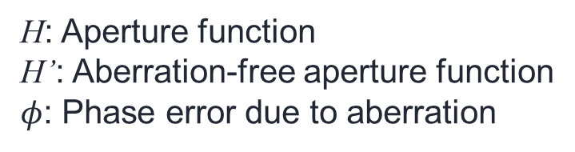

Phase error due to aberration
Plane wave illumination
Focused beam illumination
$$S_{FF}\left(ξ,ψ\right)≅H_{out}\left(ξ,ψ\right)η\left(ξ,ψ\right)$$
$$S_{PS}\left(ξ,ψ\right)=\left[H_{in}\left(ξ,ψ\right)⊗H_{out}\left(ξ,ψ\right)\right]η\left(ξ,ψ\right)$$
$$H\left(ξ,ψ\right)=H^{′}\exp{iφ\left(ξ,ψ,z\right)}$$
H: Aperture function
H’: Aberration-free aperture function
$φ$: Phase error due to aberration
In the case of point scanning system,
significant phase errors might be depth dependent?

Slide 8
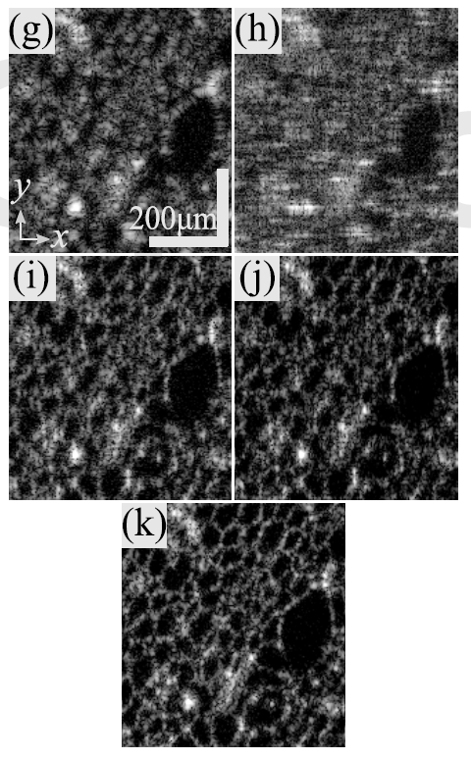
Separate 1D corrections, Point-scanning swept-source OCT
Image metric
Entropy of image
original
2D CAO
Phase error model
1D Legendre polynomials
Depth-dependent coefficients
(linear)
x-correct
xy-correct
Complex inverse filter
xy-correct with roll back
Sebastian Ruiz Lopera, René Restrepo, Carlos Cuartas Vélez, Brett Bouma, and Néstor Uribe-Patarroyo
Opt. Lett. accepted.
DOI: 10.1364/OL.401283

Slide 9
Summary
Model of phase error due to aberrations depends on the optical configuration.
There is still room for improvement in point-scanning CAO-OCT.

