Slide 1

Modeling of PS-OCT
Shuichi Makita
Computational Optics Group,
University of Tsukuba

Slide 2
Applications of OCT signal simations
Investigate behaviors of OCT signals
OCT signals with multiple scattering
G. Yao and L. V. Wang, Phys. Med. Biol. 44, 2307–2320 (1999).
Doppler OCT signals
T. Lindmo et al, Phys. Med. Biol. 43, 3045–3064 (1998).
Emulate OCT signals
Learning DNN with simulated dataset
S. Ostvar et al, BioRxiv, 2020. (10.1101/2020.10.26.355180)

Slide 3
Modeling of light propagation in inhomogeneous tissues
Rigorous
Structures are larger than wavelength
Scalar field
Maxwell’s equation
Material equation
Huygens-Fresnel
L. Thrane et al, J. Opt. Soc. Am. A 17, 484–490 (2000).
Finite-differential time-domain
Pseudo-spectral time-domain
Scalar diffraction theory
First Born approximation
P. R. T. Munro, Opt. Express 24, 27016–27031 (2016).
B. J. Davis et al, J. Opt. Soc. Am. A 24, 2527–2542 (2007).

Slide 4
Model of polarization-sensitive OCT
Beam
Pencil beam
Single backscattering
Tissues
Stratified media
S. Sugiyama et al, Biomed. Opt. Express 6, 4951–4974 (2015).

Slide 5

Definitions of polarization vector and transformation matrix
Pol. vector
Trans. matrix
x₁y₁z₁-x₂y₂z₂
(Wave Co.)
Jones vector
Stokes vector
Jones
Mueller
Sinclair
Kennaugh
x₁y₁z₁-x₃y₃z₃
(Lab. Co.)
H. Mott, Remote Sensing with Polarimetric Radar (Wiley-IEEE Press, 2006).
$${\text{T}}_{b}={\text{T}}_{f}^{T}$$
R. C. Jones, J. Opt. Soc. Am. 31, 488–493 (1941).

Slide 6
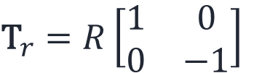

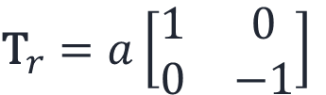

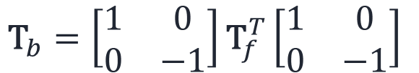

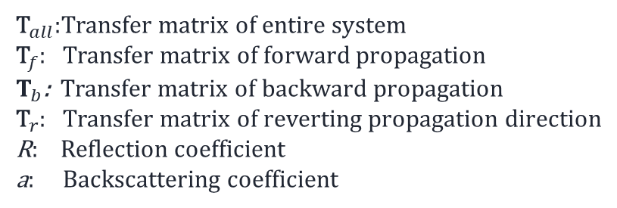

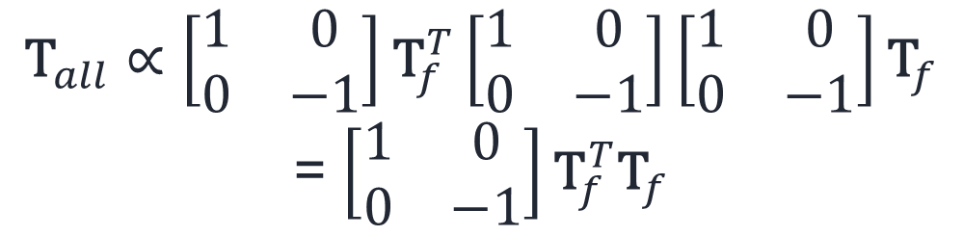
Round-trip propagation (wave coordinate)
$${\text{T}}_{all}=T_{b}{\text{T}}_{r}{\text{T}}_{f}$$
$${\text{T}}_{b}=\left[\begin{matrix}1 & 0 \\ 0 & −1\end{matrix}\right]{\text{T}}_{f}^{T}\left[\begin{matrix}1 & 0 \\ 0 & −1\end{matrix}\right]$$
$${\text{T}}_{f}$$
For back reflection
$${\text{T}}_{r}$$
$${\text{T}}_{r}=R\left[\begin{matrix}1 & 0 \\ 0 & −1\end{matrix}\right]$$
$${\text{T}}_{b}$$
For small scatters, backscattering
J. Li and J. F. de Boer, Opt. Express 22, 21382–21392 (2014).
$${\text{T}}_{r}=a\left[\begin{matrix}1 & 0 \\ 0 & −1\end{matrix}\right]$$
$${\text{T}}_{all}∝\left[\begin{matrix}1 & 0 \\ 0 & −1\end{matrix}\right]{\text{T}}_{f}^{T}\left[\begin{matrix}1 & 0 \\ 0 & −1\end{matrix}\right]\left[\begin{matrix}1 & 0 \\ 0 & −1\end{matrix}\right]{\text{T}}_{f}$$
= $\left[\begin{matrix}1 & 0 \\ 0 & −1\end{matrix}\right]{\text{T}}_{f}^{T}{\text{T}}_{f}$
${\text{T}}_{all}$:Transfer matrix of entire system
${\text{T}}_{f}$: Transfer matrix of forward propagation
$T_{b}$: Transfer matrix of backward propagation
${\text{T}}_{r}$: Transfer matrix of reverting propagation direction
R: Reflection coefficient
a: Backscattering coefficient

Slide 7
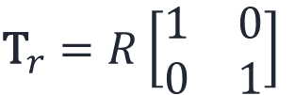
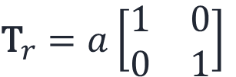

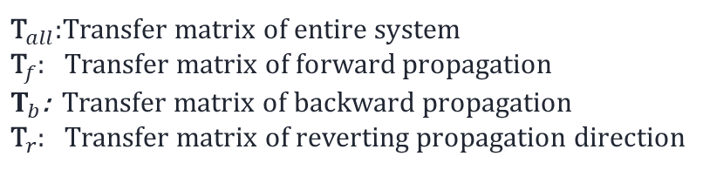
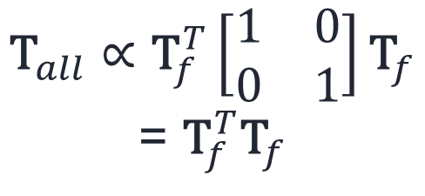
Round-trip propagation (Laboratory coordinate)
$${\text{T}}_{all}=T_{b}{\text{T}}_{r}{\text{T}}_{f}$$
$${\text{T}}_{b}={\text{T}}_{f}^{T}$$
$${\text{T}}_{f}$$
For back reflection
$${\text{T}}_{r}$$
$${\text{T}}_{r}=R\left[\begin{matrix}1 & 0 \\ 0 & 1\end{matrix}\right]$$
$${\text{T}}_{b}$$
For small scatters, backscattering
$${\text{T}}_{r}=a\left[\begin{matrix}1 & 0 \\ 0 & 1\end{matrix}\right]$$
$${\text{T}}_{all}∝{\text{T}}_{f}^{T}\left[\begin{matrix}1 & 0 \\ 0 & 1\end{matrix}\right]{\text{T}}_{f}$$
= ${\text{T}}_{f}^{T}{\text{T}}_{f}$
${\text{T}}_{all}$:Transfer matrix of entire system
${\text{T}}_{f}$: Transfer matrix of forward propagation
$T_{b}$: Transfer matrix of backward propagation
${\text{T}}_{r}$: Transfer matrix of reverting propagation direction

Slide 8
Toward more realistic model of PS-OCT
The integro-differential equations of electromagnetic scattering theory
Born, Max; Wolf, Emil. Principles of Optics. Cambridge University Press.
Dielectric constant tensor
Intrinsic birefringence + form birefringence
Focused beam (vector field)
Vector Gaussian beam
C. G. Chen et al, J. Opt. Soc. Am. A 19, 404–412 (2002).

Slide 9
Summary
Improvements of modeling and simulation of OCT signals will proceed the researches of property estimations and tissue classifications.

