Slide 1
Tractography using OCT
Daisuke Oida
Notes:
In this paper club, I introduce several papers in the field of tractography using OCT.

Slide 2
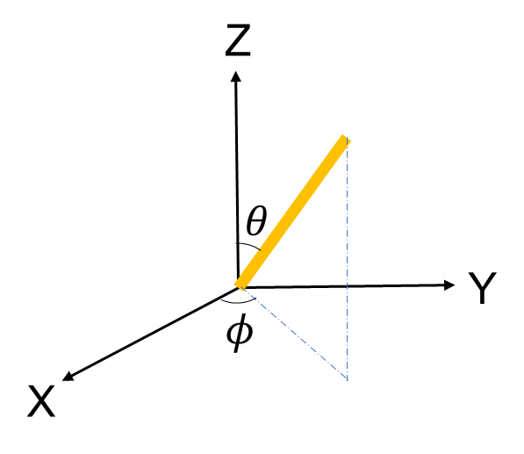
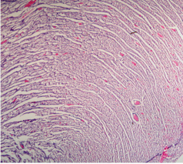
What is Tractography?
= Quantifying the organization of fiber structure in biological sample.
Main target: Myocardial fiber
Myocardial fiber
→ Heart functions
Fig: Fiber structure represented in three dimensions.
Sosnovik, J. Cardiovasc. Magn. Reson., 11, 47- (2009).
Notes:
Tractography is a method for quantifying the organization of fiber structure in biological sample. The main target is myocardial fiber since its organization is highly related with mechanical and electrical function of the heart.

Slide 3
Tractography in OCT
OCT intensity-based tractography
PS-OCT tractography
Notes:
Since OCT provides high resolution image, tractography has been utilized in OCT. The tractography method is roughly divided into two; OCT-intensity based tractography and PS-OCT tractography. I will explain the OCT-intensity tractography at first.

Slide 4
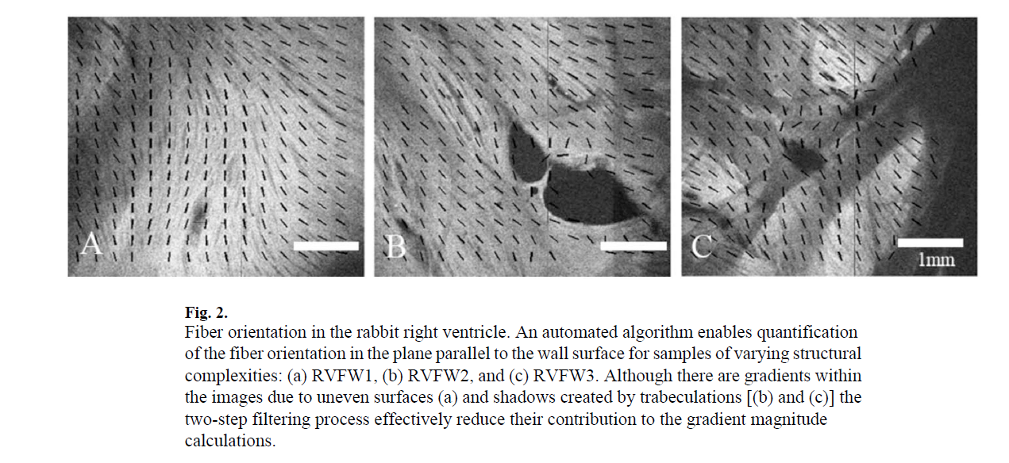
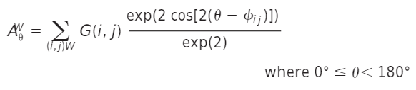

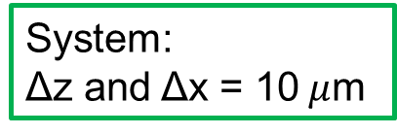
OCT intensity-based tractography
Fleming, C. P., Ripplinger, C. M., Webb, B., Efimov, I. R. and Rollins, A. M., “Quantification of cardiac fiber orientation using optical coherence tomography,” J Biomed Opt 13(3), 030505 (2008).
Method: (Intensity Gradient)
Apply 3 × 3 Sobel filters to the en face OCT image.
2. Calculate the magnitude of the gradient, G(i, j) = (G_{x}²+G_{y}²)^{1/2} and the gradient direction, Φ(i, j) = arctan(G_{y}/G_{x}) for each pixel.
3. Compute the dominant fiber orientation within a small window from the maximum of the angular distribution function.
System:
Δz and Δx = 10$μ$m
$G_{x}= \left[\begin{matrix}\begin{matrix}−1 & 0 \\ −2 & 0\end{matrix} & \begin{matrix} 1 \\ 2\end{matrix} \\ \begin{matrix}−1 & 0\end{matrix} & 1\end{matrix}\right]$, $G_{y}=\left[\begin{matrix}−1 & −2 & −1 \\ 0 & 0 & 0 \\ 1 & 2 & 1\end{matrix}\right]$
Fiber orientation in the rabbit right ventricle.
⇒ Only 2D
[1]
A^{W}
[1] Karlon et al. The Anatomical Record 252(4), 612– (1998).
Degree
Notes:
WS: 563×563 μm²
# of vector: 256
Fleming et al presented OCT intensity-based tractography which visualized 2D fiber tracts of myocardial fiber of the rabbit (heart) right ventricular. It uses the intensity gradient method to extract en face fiber orientation. (Read method). Right Figure shows the 2D vectors of fiber orientation overlaid on the OCT image. These vectors successfully quantified the local fiber orientation. But the limit of this method is visualization for only 2D.

Slide 5
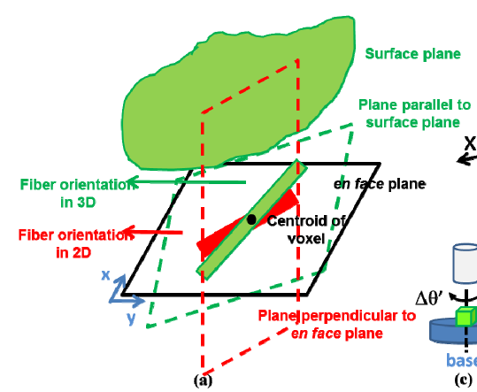
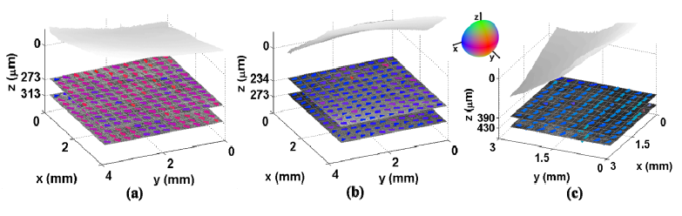
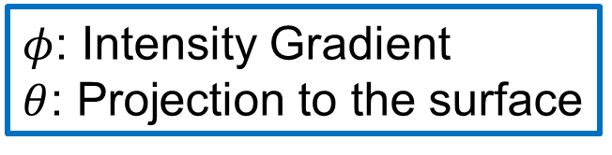
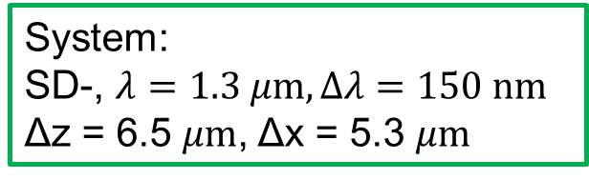
OCT intensity-based tractography extended to 3D
Gan, Y. and Fleming, C. P., “Extracting three-dimensional orientation and tractography of myofibers using optical coherence tomography,” Biomed Opt Express 4(10), 2150–2165 (2013).
System:
SD-, $λ=1.3 μm,Δλ=150 nm$
Δz = 6.5 $μm$, Δx = 5.3 $μm$
$φ$: Intensity Gradient
$θ$: Projection to the surface
3D fiber orientation of the porcine heart.
⇒ Not for abnormal heart
Notes:
One paper tried to extend to 3D visualization of the porcine heart. In the left Figure, the red solid line represents the dominant fiber orientation in en face plane computed from the intensity gradient. Then for the 3D visualization, it used the prior knowledge of the heart that the myofibers are approximately parallel to the surface plane expressed as green region. So, the 3D orientation is acquired by projecting the en face fiber orientation with respect to the surface plane. Right Figure shows the result. Each vector in the en face plane visualized the three-dimensional fiber orientation. Since this method doesn’t reflect the information of fiber itself, it cannot be utilized for quantifying abnormal heart tissue which causes corruption of fiber organization.

Slide 6
Tractography in OCT
OCT intensity-based tractography
PS-OCT tractography
Disadvantage
Difficulty for 3D.
Necessity of image processing.
Limitation of resolution.
Notes:
As described above, the OCT intensity-based tractography has been developed. But there are some disadvantages. So, the new tractography based on PS-OCT emerged.

Slide 7
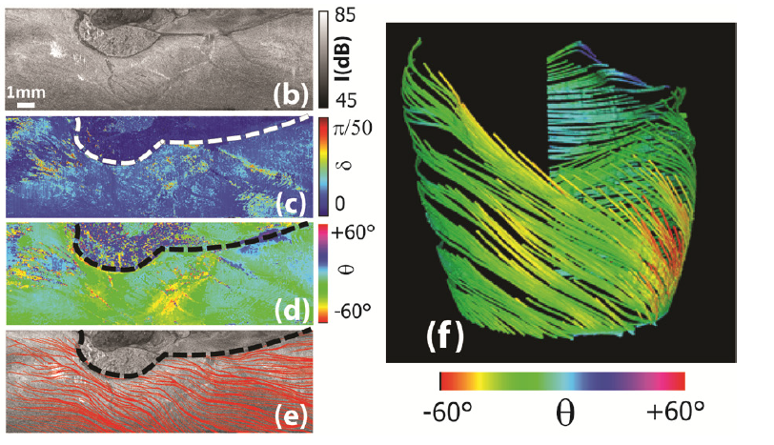
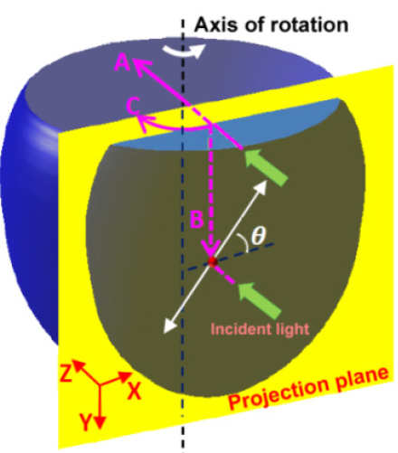
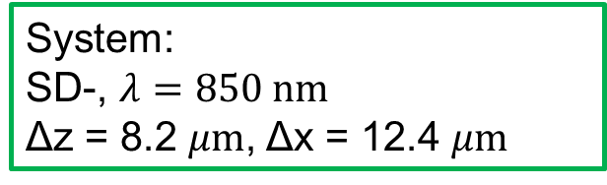
PS-OCT tractography
Wang, Y. and Yao, G., “Optical tractography of the mouse heart using polarization-sensitive optical coherence tomography,” Biomed. Opt. Express, BOE 4(11), 2540–2545 (2013).
System:
SD-, $λ=850 nm$
Δz = 8.2 $μm$, Δx = 12.4 $μm$
OCT
Expand
PR
OA
SL
Form
3D fiber orientation of the mouse heart.
Notes:
This method provides 3D fiber orientation by using the polarization property of the tissue; mainly the optical axis, which is sensitive to the fiber orientation. The left Figure shows imaging geometry. Incident light is aligned with Z axis and B-scan is aligned with Y axis. And sample is rotated for C-scan. By using this scanning, depth-resolved en face image can be constructed from all pixels at a certain depth from the surface. The right figure shows the representative OCT, phase retardation and optical axis of en face image of the mouse heart. By using the optical axis, the streamline representation of fiber tracts is obtained. Finally, this streamline is transformed into 3D coordinates by polar transmission. And we can obtain the 3D tractography of the mouse as shown in (f). This 3D tractography is well agreement with the knowledge of the heart.

Slide 8
Summary
Tractography is a method for quantifying the fiber orientation of biological sample and combined with OCT.
OCT intensity-based tractography and PS-OCT tractography have developed to visualize the fiber orientation of the heart.

