Slide 1
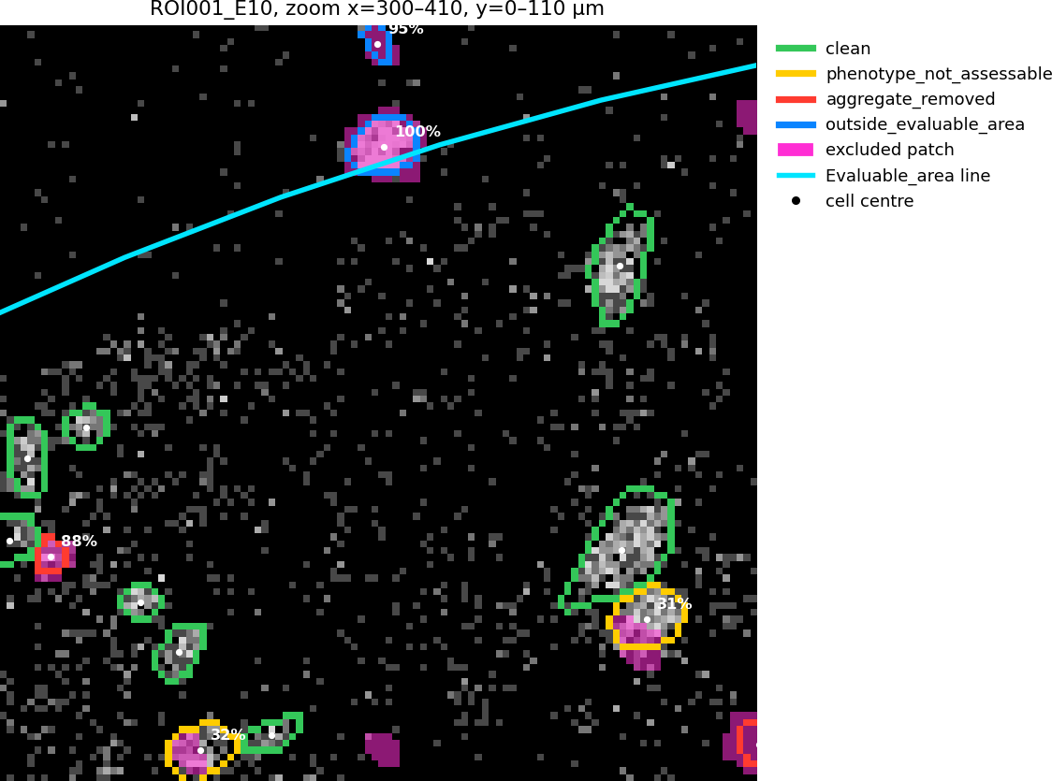
Applying the manual review to the cells (script 10)
For every core, the pathologist's shapes are laid over the Cellpose mask:
1. Check the review files are unchanged (fingerprints in MANIFEST.sha256)
2. Paint the shapes onto the pixel grid: one image for the evaluable area, one for all excluded patches together
3. For each cell: its centre point, and the share of its pixels on excluded patches
4. Give each cell a label
5. Area for densities = evaluable area minus excluded area
Labels
centre outside the evaluable area → outside_evaluable_area
more than 75% on patches → aggregate_removed
more than 0%, up to 75% → phenotype_not_assessable
0% → clean
The rules are the reviewer's own code (apply_manual_review.py), used unchanged. Only shapes and positions are used, no marker values.
ROI001_E10, 110 × 110 µm crop. Outline colour = label; pink = excluded patch; cyan = evaluable area edge.
Checks: 145 review files unchanged · area for densities identical to the release in all 136 cores · all 79,739 cells of cells.csv labelled once, same area · no errors.

Slide 2
cell_flags.csv: one row per cell (79,739 rows)
Column | Meaning | Example
Image | Core (ROI) name, without .tiff | ROI001_E10
mask_file | Mask file the cell comes from | ROI001_E10.tiff
Object | Cell number in the mask; same as Object in cells.csv | 18
area_px | Number of pixels of the cell (1 px = 1 µm²) | 31
centroid_x | Centre of the cell, column (x) + 0.5 | 605.21
centroid_y | Centre of the cell, row (y) + 0.5 | 34.79
in_evaluable_area | Is the centre inside the evaluable area polygon? | True
frac_in_evaluable | Share of the cell's pixels inside the evaluable area (0–1) | 1.0
frac_in_excluded | Share of the cell's pixels on excluded patches (0–1) | 0.3226
cell_status | Label: clean / phenotype_not_assessable / aggregate_removed / outside_evaluable_area | phenotype_not_assessable
Example: ROI001_E10, cell 18. Its centre is inside the evaluable area and 10 of its 31 pixels (32%) lie on an excluded patch, so it is counted but not phenotyped.

Slide 3
core_areas.csv: one row per core (136 rows)
Column | Meaning | ROI001_E10
roi | Core (ROI) name | ROI001_E10
height_px, width_px | Image size in pixels | 1000, 1000
evaluable_area_px | Pixels inside the evaluable area | 771,984
excluded_in_evaluable_px | Excluded pixels inside the evaluable area | 7,315
denominator_px / _mm2 | Area for densities = evaluable − excluded | 764,669 / 0.765
denominator_matches_release | Same as the pathologist's own area table? | True
clean … outside_evaluable_area | Number of cells with each label (4 columns) | 989 · 104 · 20 · 20
facility_position | Position on the TMA slide | E10
patient_id | Patient number (16 − facility column) | 6
region | Sampling region expected from the TMA row | High inflammatory
dna_status | Nuclear staining of the core: valid / intermediate / dna_negative | intermediate
he_core | Core on H&E: present / partial | present
evaluable_for_IMC | Core included in the analysis? (yes 121, no 15) | yes
exclusion_reason | Why a core is excluded | (blank)
matrix_pct | % of the core that is chondroid matrix on H&E | 10
special_area_flag | H&E finding not drawn on IMC: hemorrhage / necrosis / fold | hemorrhage_not_drawn
The last nine columns are copied from the pathologist's core review sheet; the rest are computed by script 10.

