Slide 1
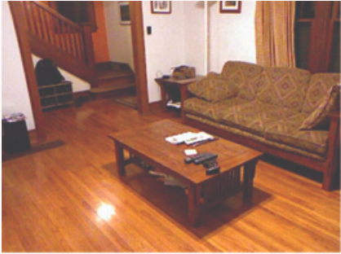
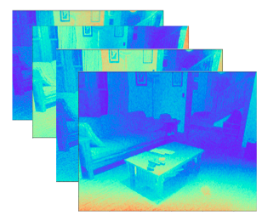
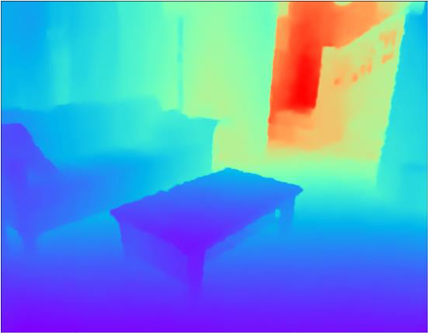





Differential Physical
Imaging Model
Dual-branch Neural Network
Scene
Light Falloff
Measurements
Recovered
Depth
Power
Constraint
Positive Constraint
Bandwidth Limit
Noises
Modulation Parameters
Base Sinusoid Functions
Fisher Guidance Loss
$$a_{i}^{m}$$
+
$$φ_{i}^{m}$$
Learned
Coding
Functions
Discriminative Loss
Demodulation Parameters
+
Fidelity Loss
$$a_{i}^{d}$$
Groundtruth
$$φ_{i}^{d}$$
Learnable Coding Functions
Discriminative Fisher Loss
Modulation1
Demodulation1
Demodulation2
Demodulation3
Demodulation4

