Slide 1
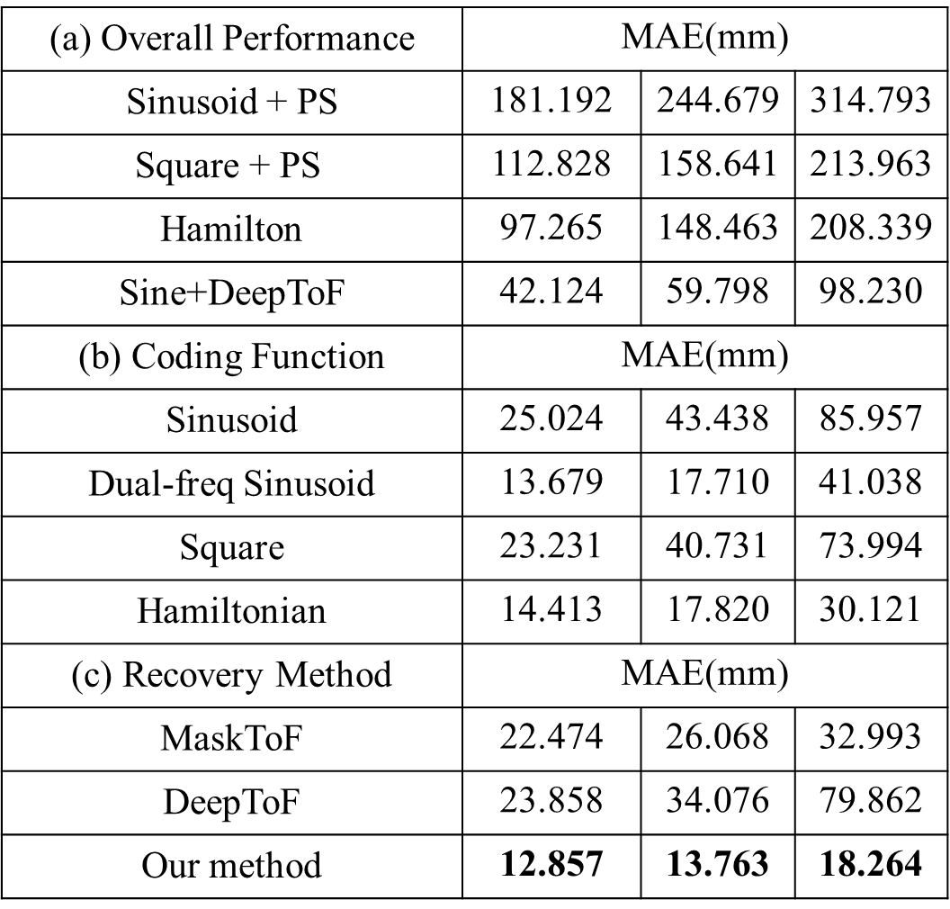
(a) Overall Performance | MAE(mm)
Sinusoid + PS | 181.192 | 244.679 | 314.793
$$\text{Square}\text{ + }\text{PS}$$ | 112.828 | 158.641 | 213.963
Hamilton | 97.265 | 148.463 | 208.339
Sine+DeepToF | 42.124 | 59.798 | 98.230
(b) Coding Function | MAE(mm)
Sinusoid | 25.024 | 43.438 | 85.957
Dual-freq Sinusoid | 13.679 | 17.710 | 41.038
Square | 23.231 | 40.731 | 73.994
Hamiltonian | 14.413 | 17.820 | 30.121
(c) Recovery Method | MAE(mm)
MaskToF | 22.474 | 26.068 | 32.993
DeepToF | 23.858 | 34.076 | 79.862
Our method | 12.857 | 13.763 | 18.264
Notes:
To demonstrate the performance superiority, we compare our method with the existing iToF imaging methods,The qualitative results of different methods are shown in Tab(a), and our method enables to reconstruct depth of the lowest mean squared error (MAE) across different noise levels.
Three different noisy scenarios, from high SNR to low SNR ,are shown in figure and our method performs the best.
To further demonstrate the superiority of the learned coding functions, we compare our method with the other coding functions.As can be seen, Under small noise, the reconstruction errors of different coding functions are very close，But as the noise level increases, the improvement of the learned coding function is large , further demonstrating the noise robustness of the learned coding functions.
We demonstrate the efficiency of the proposed neural network with the existing deep learning based ToF reconstruction network, the performance comparisons are shown in Tab. 1(c).The reconstruction error of our two-branch network is lowest.

