Slide 1
Student Project Python CUDA C++ Bindings
S.Ehrig, Dr. Nico Hoffman
December 15th 2020
Research Group Computer Assisted Radiation Physics · FWKT · Simeon Ehrig · s.ehrig@hzdr.de · www.hzdr.de

Slide 2
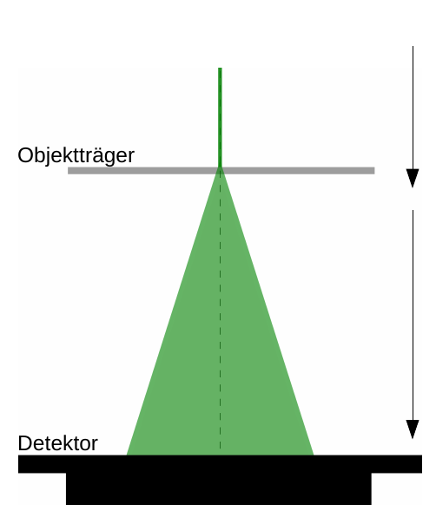
Motivation
Ptychography – lensless microscopy

Slide 3
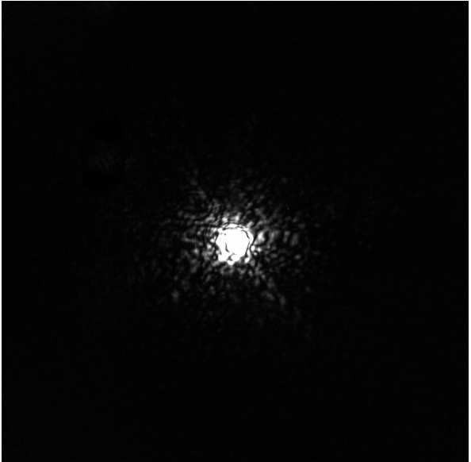
Motivation
Ptychography – lensless microscopy
got

Slide 4
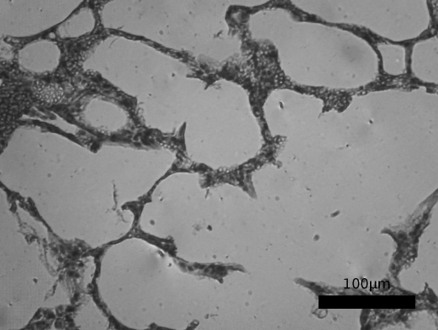
Motivation
Ptychography – lensless microscopy
got
wanted

Slide 5
Motivation
Ptychography – lensless microscopy
got
wanted
?

Slide 6
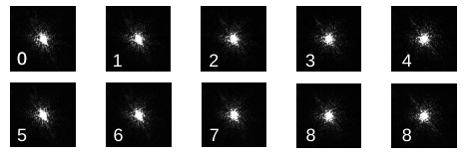
Motivation
Ptychography – lensless microscopy
got
wanted
?

Slide 7
Motivation
Ptychography – lensless microscopy
Developing library for Ptychography
    Python Interface for easy reconstruction
    Kernels implemented in C++ to run fast on GPU und CPU
    (alpaka – accelerator abstraction library)
    Python bindings with pybind11
got
wanted
?

Slide 8
Motivation
Ptychography – lensless microscopy
Developing library for Ptychography
    Python Interface for easy reconstruction
    Kernels implemented in C++ to run fast on GPU und CPU
    (alpaka – accelerator abstraction library)
    Python bindings with pybind11
    Missing experience for effective usage of pybind11 with GPUs
got
wanted
?

Slide 9
Tasks
    Implement the algorithm in CUDA C++ and add Python bindings

Slide 10
Tasks
    Implement the algorithm in CUDA C++ and add Python bindings
    Develop Python bindings with pybind11 in different fashions
  a single Python function call for the main loop
  m Python function calls for each iteration
  m*n Python function calls for each kernel

Slide 11
Tasks
    Implement the algorithm in CUDA C++ and add Python bindings
    Develop Python bindings with pybind11 in different fashions
  a single Python function call for the main loop
  m Python function calls for each iteration
  m*n Python function calls for each kernel
    analyze performance overhead of the Python bindings
    Analyze GPU memory behavior (ownership and copies)
    Optimize code

Slide 12
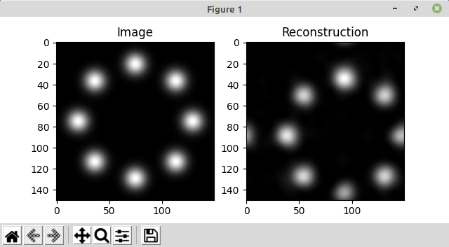
Algorithm
    Gerchberg–Saxton algorithm
    Reconstruction of greyscale images only from measurements of the magnitudes.
    Python implementation exists: https://github.com/tuelwer/phase-retrieval

Slide 13
Algorithm
def Gerchberg–Saxton(Magnitude, Initial_Phase, numIters = 1000):
"
Magnitude: experimentally acquired diffraction image
Initial_Phase: first guess of phase
returns:
A: real-domain reconstruction
"
A := Magnitude × exp(i × Initial_Phase)
while i in range(numIters):
B := IFT(A)
B[B<0] = 0
C := FT(B)
A := Magnitude × exp(i × Phase(C))
return A

Slide 14
Repository
    Project Repository (privat): https://github.com/ComputationalRadiationPhysics/student_project_python_bindings/

