Slide 1



Required and optional software for the shortcourse
https://julialang.org/downloads/
Allow to install and use MAGEMinApp and MAGEMin_C
Visual Studio Code – Code editor https://code.visualstudio.com/
Allow Windows user to connect to Linux WSL and get the best performance for MAGEMin
https://inkscape.org/fr/
Allow to open MAGEMinApp figure vector format (svg)
Illustrator works too…

Slide 2
Julia installation
Windows,
Mac and Linux

Slide 3
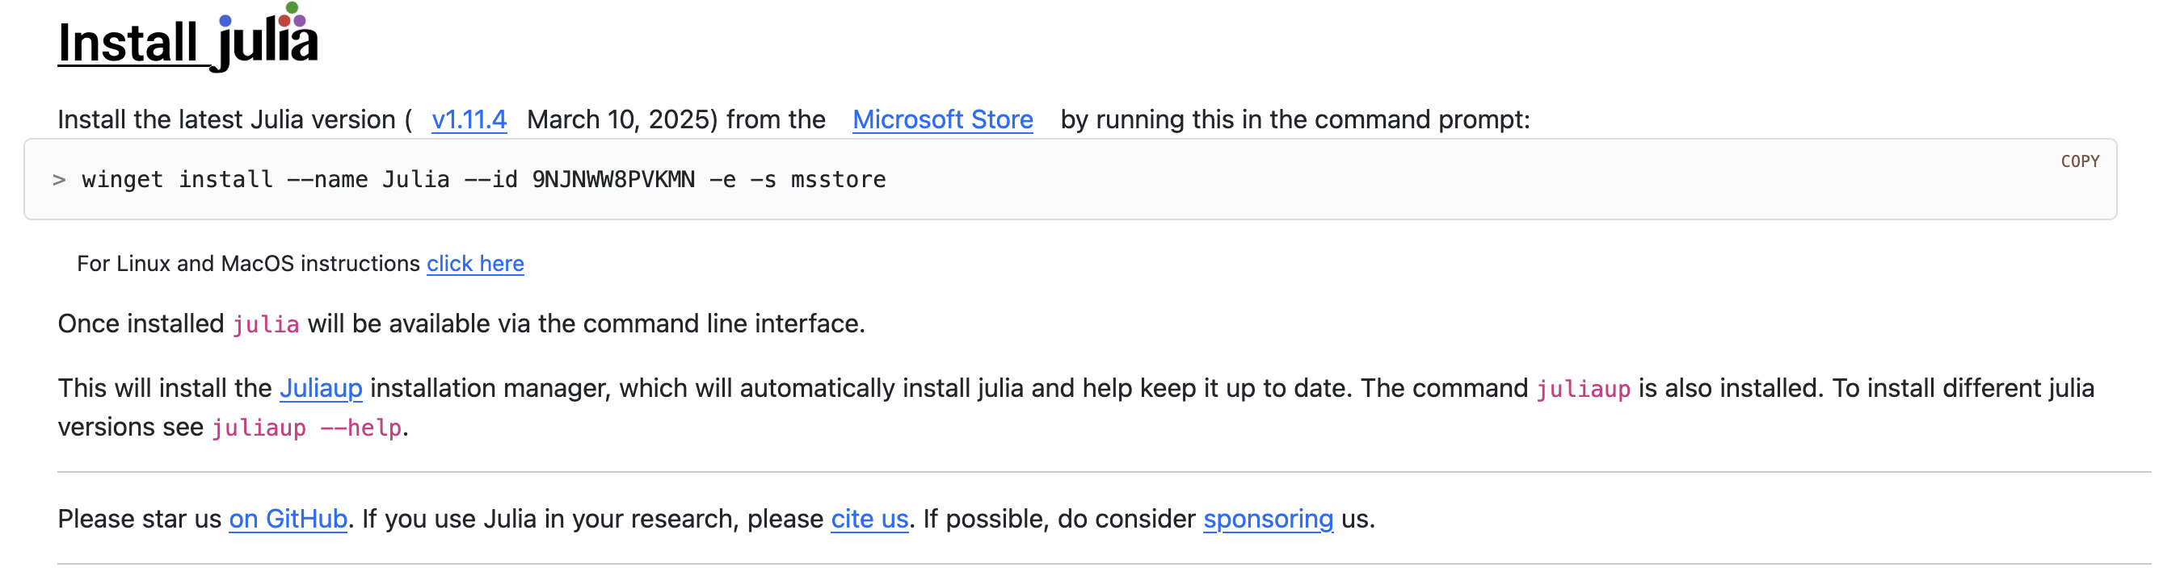
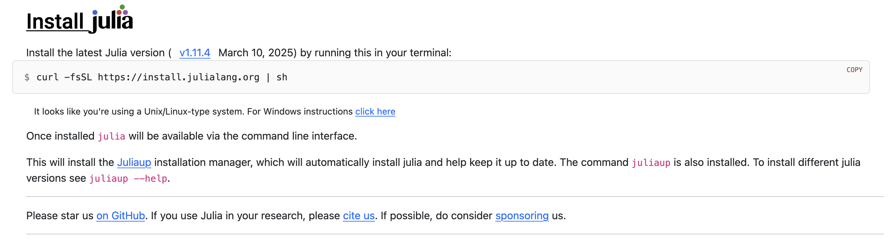
Julia installation - https://julialang.org/downloads/
Windows
Powershell
Linux/Mac
Terminal

Slide 4
MAGEMinApp & MAGEMin_C
installation
Windows Mac and Linux

Slide 5
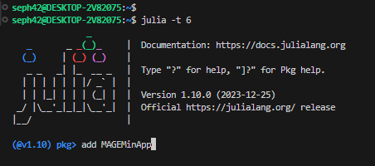
Install MAGEMinApp
Open a new terminal (vscode for those who use it, or terminal/powershell for others)
Type: julia –t 6 # where 6 is the number of core you want to use (depends on your machine, type # ‘versioninfo()’ to get more informations)
In the terminal type ‘]’, this will open the package manager
Type ‘add MAGEMinApp’, this will download and install MAGEMinApp
Once installed, quite the package manager by typing ‘BACKSPACE’ key

Slide 6
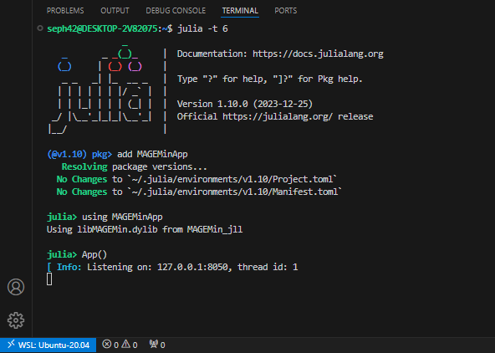
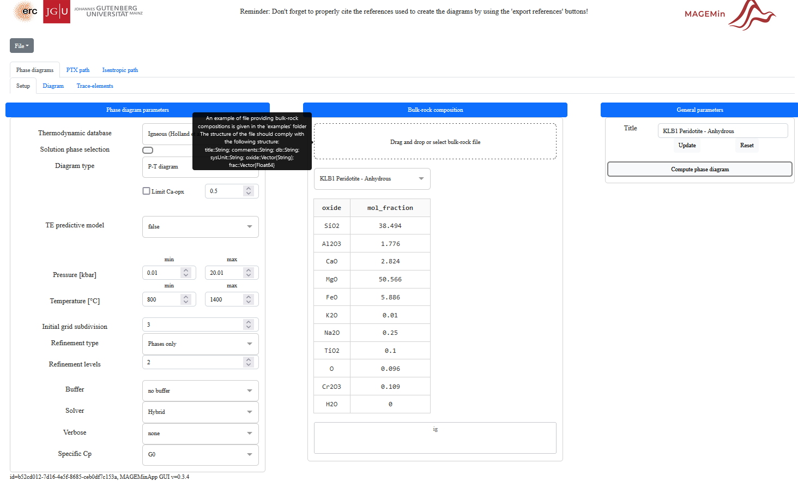
Launch MAGEMinApp
In the Julia terminal, type:
‘using MAGEMinApp’
Then
‘App()’
The following text will be displayed in the terminal:
Copy and paste the address in your web-brower:

Slide 7

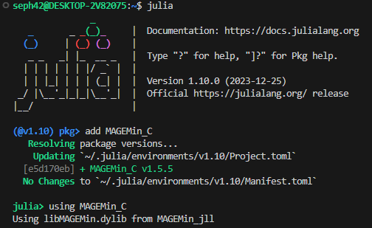

MAGEMin_C, the julia interface: installation
https://github.com/ComputationalThermodynamics/MAGEMin_C.jl
Install MAGEMin_C
julia> ] # opens the package manager pkg> add MAGEMin_C # MAGEMin_C
Load MAGEMin_C
julia> using MAGEMin_C # load MAGEMin_C
7
7
7

