Slide 1


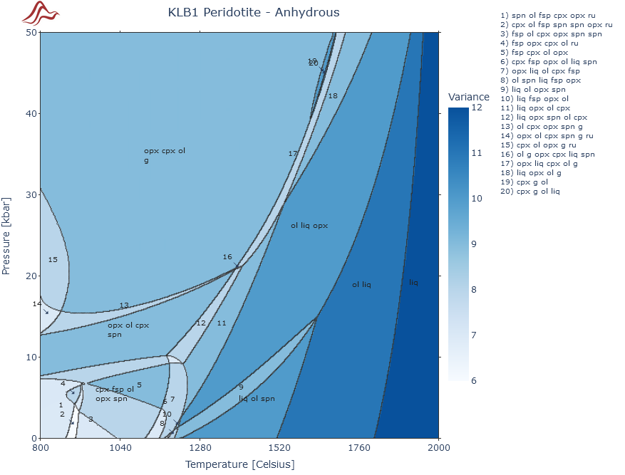
MAGEMinApp: introduction
MAGEMinApp main contributors B. Kaus H. Ranocha, J-F. Moyen H. Dominguez P. Lanari J. Forshaw T. Holland S. Schorn
1

Slide 2

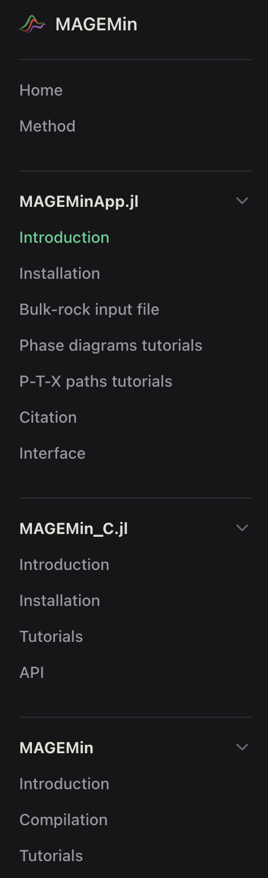

MAGEMin github: ComputationalThermodynamics
First, access the online documentation:
https://computationalthermodynamics.github.io/MAGEMin_C.jl/dev/
2

Slide 3
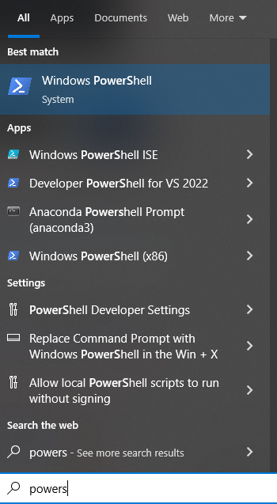
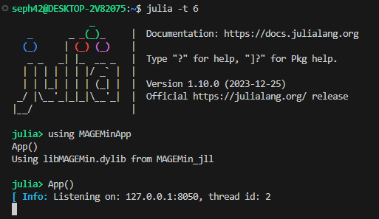
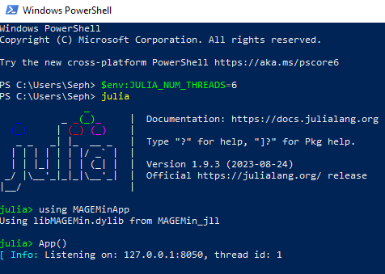
MAGEMinApp: launching the App in parallel
Visual Studio Code / Terminal Mac, Linux
PowerShell Windows
julia –t 6 using MAGEMinApp App()
$env:JULIA_NUM_THREADS=6 julia using MAGEMinApp App()
3

Slide 4
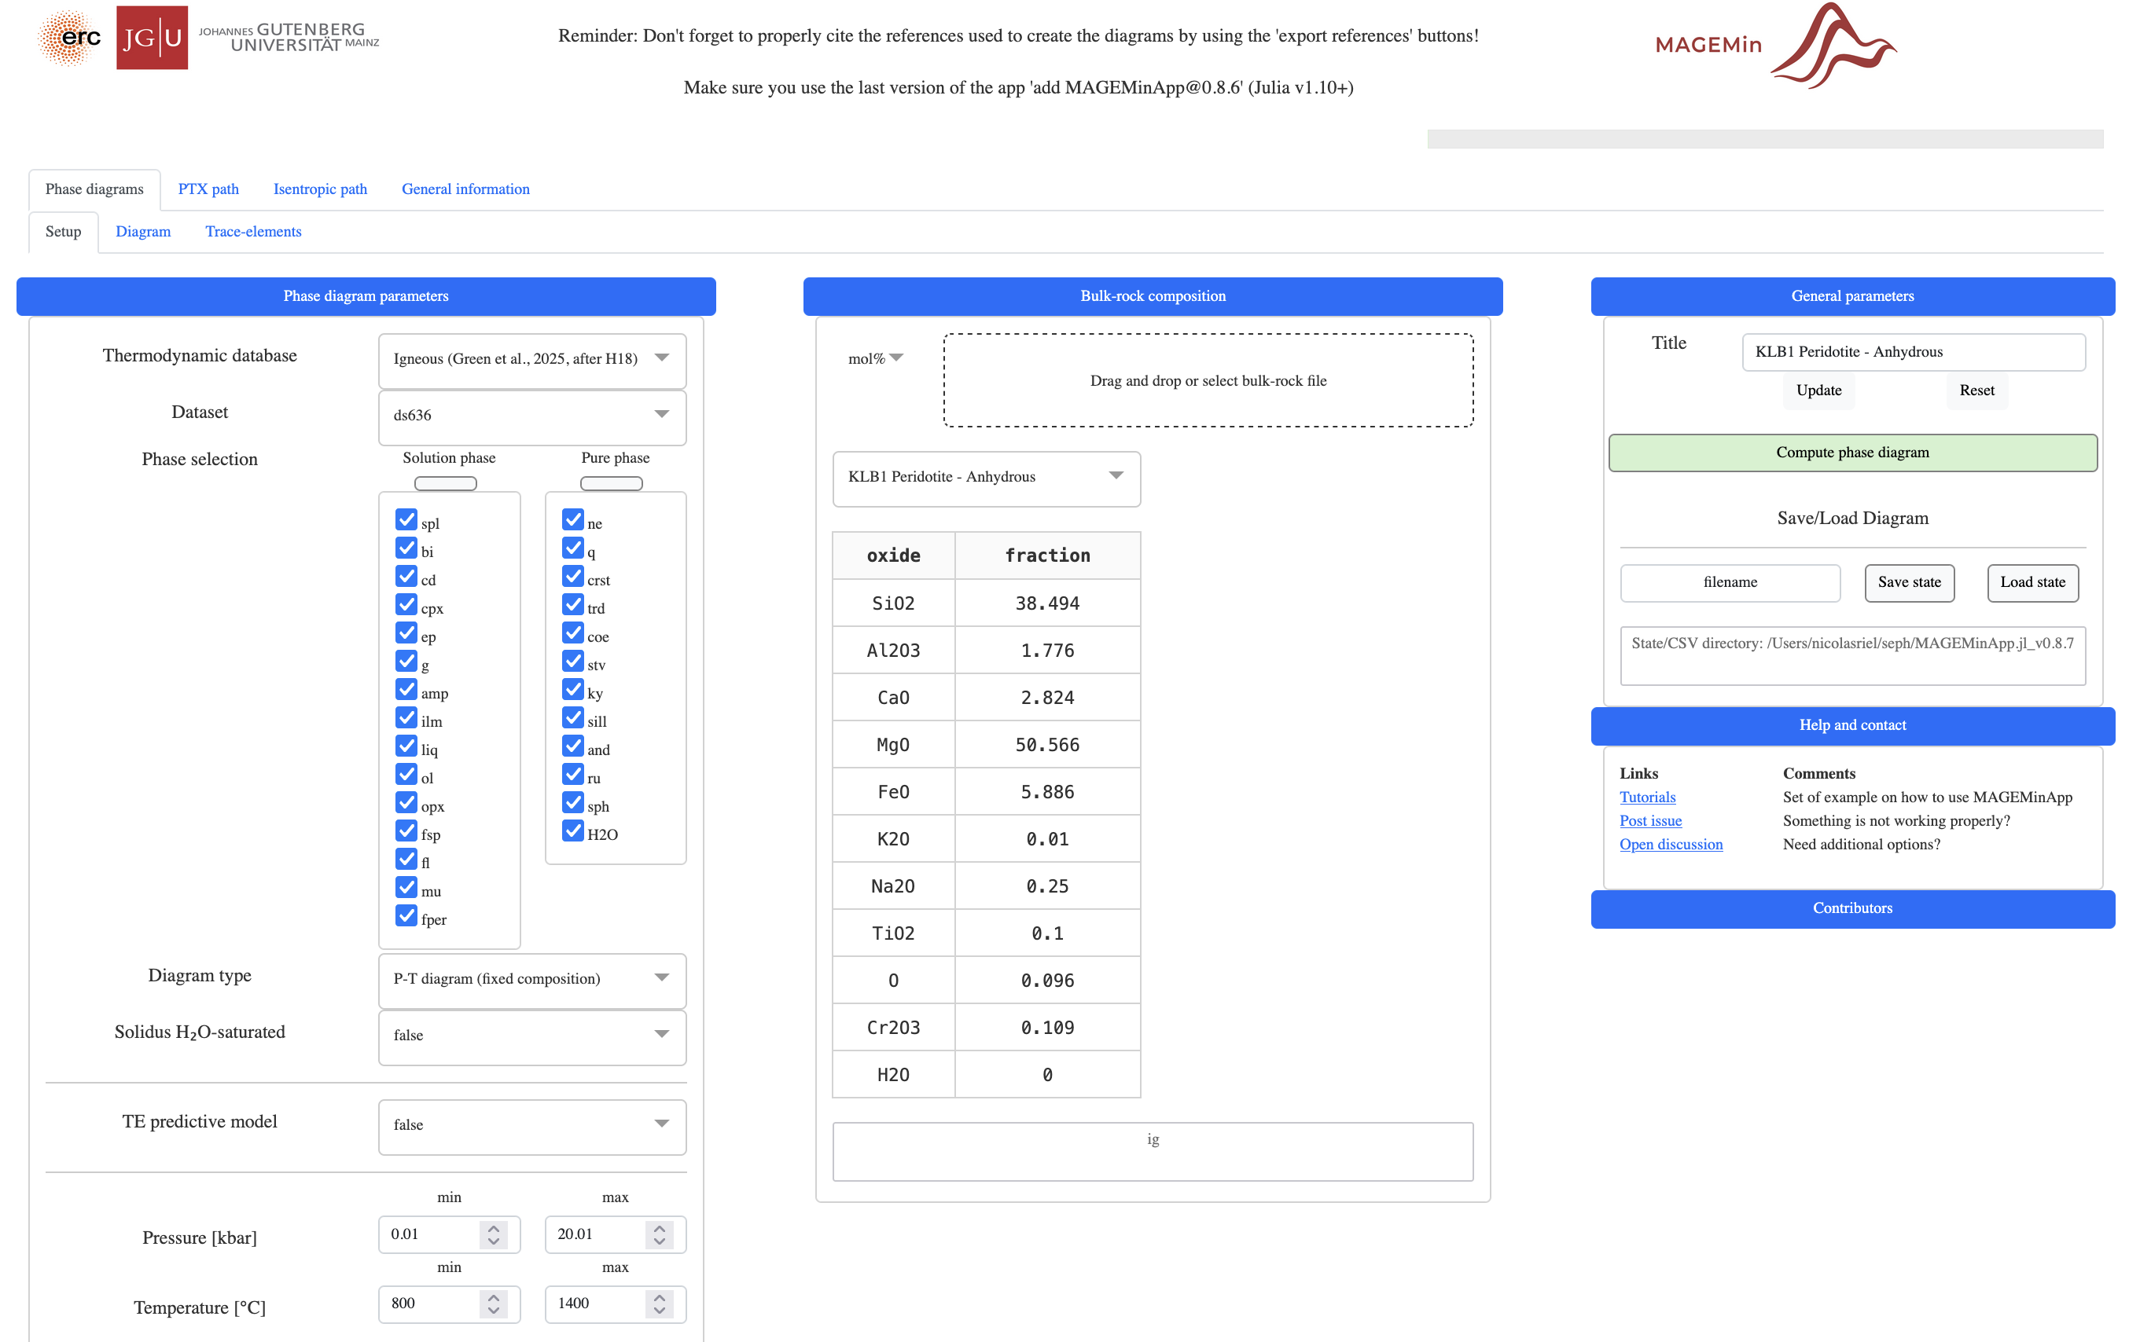
MAGEMinApp: interface (Phase diagrams)
4

Slide 5
MAGEMinApp: interface (Phase diagrams)
Progress bar
Save/load state
Compute diagram
Bulk rock composition(s)
Grid properties
5

Slide 6
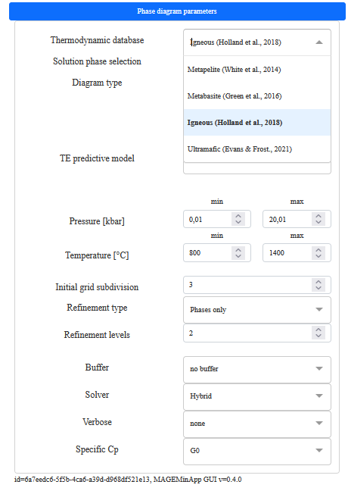
MAGEMinApp: Thermodynamic database
Mantle (Holland et al., 2013) NCFMAS
Metapelite (White et al., 2014) MnNCKFMASHTO
Metabasite (Green et al., 2016) NCKFMASHTO
Igneous (Green et al., 2025 after Holland et al., 2018) NCKFMASHTOCr
Ultramafic (Evans & Frost, 2021) FMASOSH
Dry igneous alkaline (Weller et al., in review) NCKFMASHTOCr
Mantle (Stixrude and Lithgow-Bertelloni, 2011, 2021) NCFMAS (upcoming)
6

Slide 7
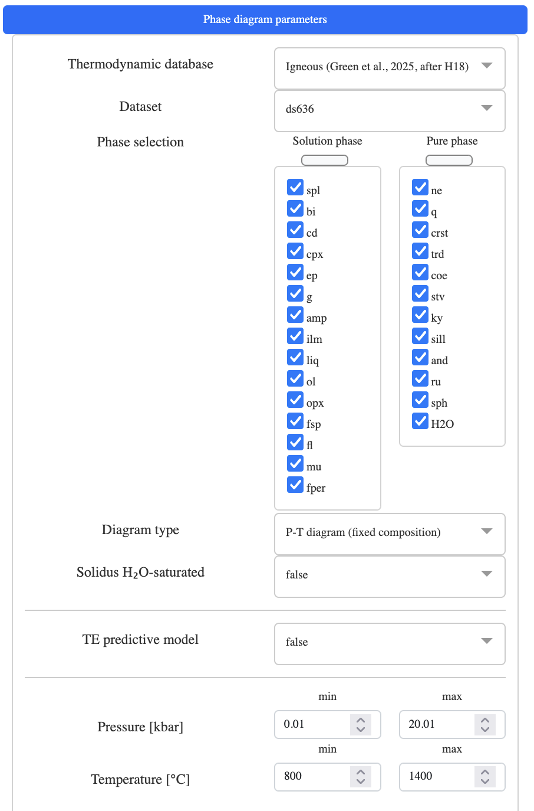
MAGEMinApp: solution phase selection
Allow to deactivate phase
Note that solution phase models from different dataset cannot be mixed (yet)
7

Slide 8
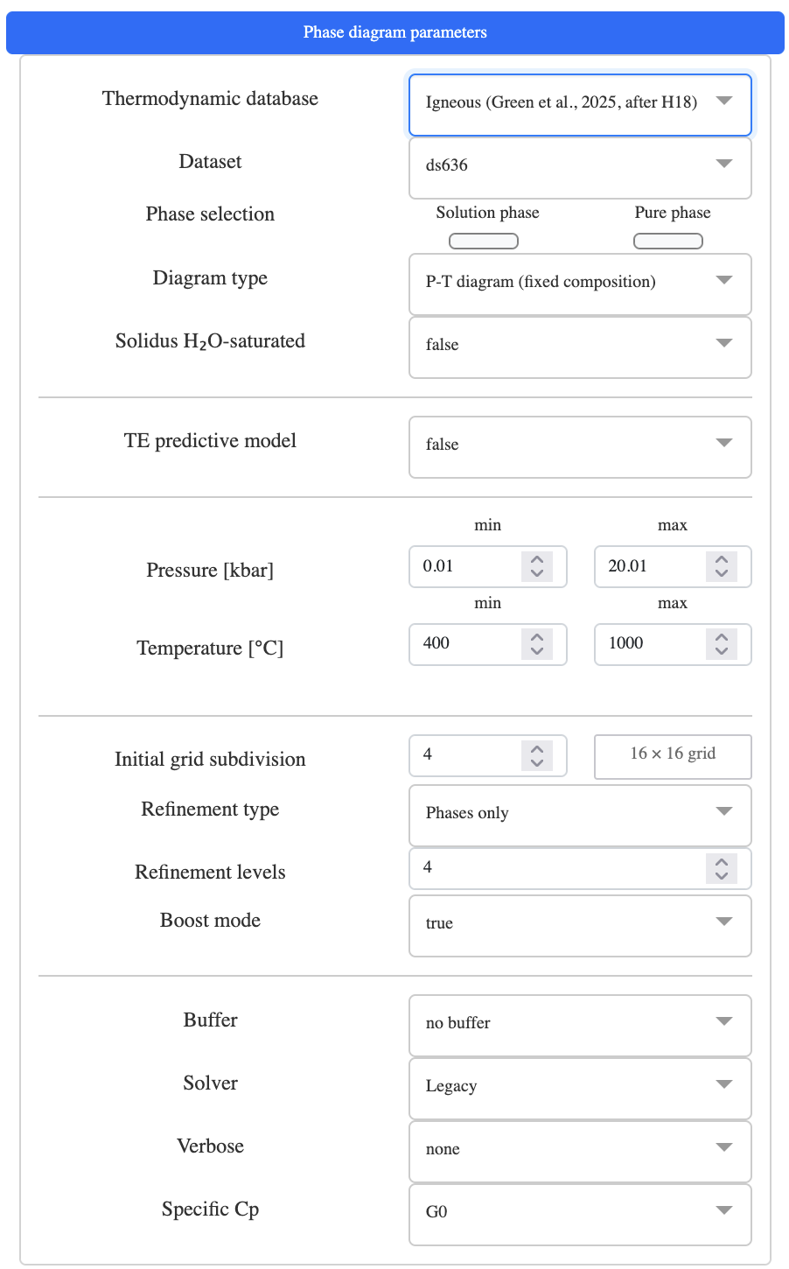
MAGEMinApp: diagram types
P-T
P-X
Pressure [kbar]
Pressure [kbar]
Fixed
temperature
Temperature [°C]
Composition [bulk1-bulk2]
T-X
PT-X
Fixed
pressure
Temperature [°C]
PT path
Composition [bulk1-bulk2]
Composition [bulk1-bulk2]
8

Slide 9
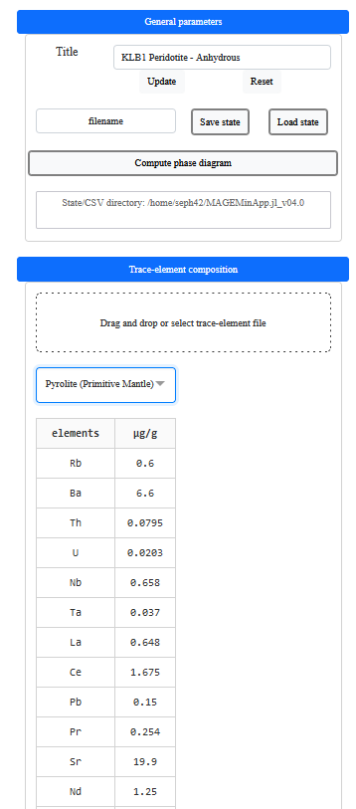
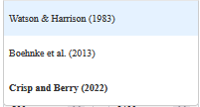
MAGEMinApp: Trace element predictive model
Implemented with the help of J-F Moyen (LMV) and H. Dominguez (Uni - Bern)
Activate trace-element partitioning at supra-solidus conditions
Displays trace element bulk panel on the right
Gives the option to select among 3 zirconium saturation models
9

Slide 10



MAGEMinApp: grid subdivision and refinement
1 initial grid subdivision
2 initial grid subdivisions
3 initial grid subdivisions
10

Slide 11
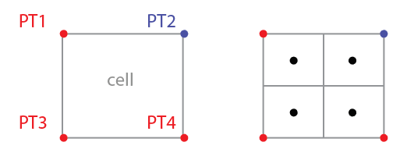
MAGEMinApp: grid subdivision and refinement
Phase only refines (split) cells when a phase change is recorded in one of the four corners
Dominant end-member refines (split) cells when the dominant end-member of any solution phase model changes in one of the four corners
Refinement levels Number of successive grid refinements
.
.
.
.
.
.
.
.
.
.
New
points
.
.
11

Slide 12
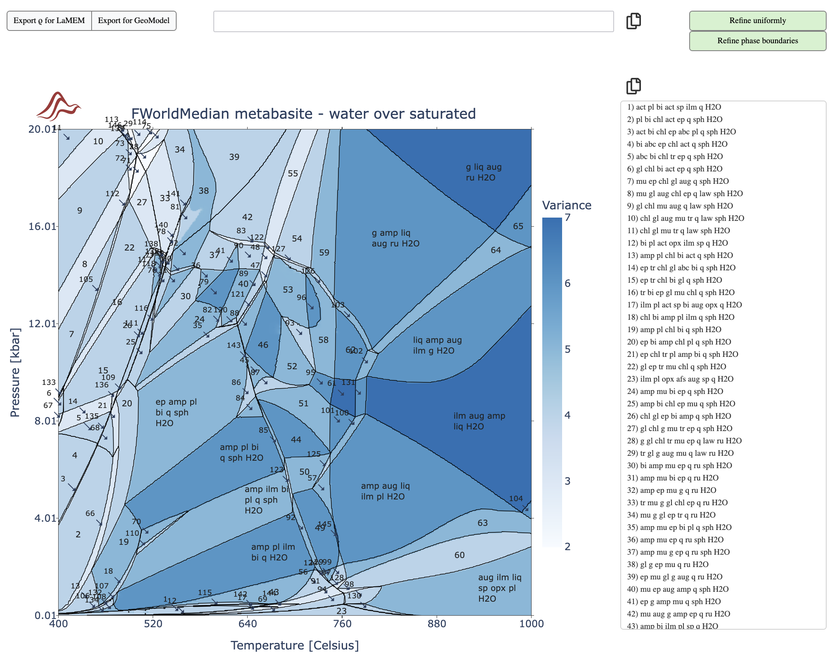
MAGEMinApp: grid refinement
12

Slide 13
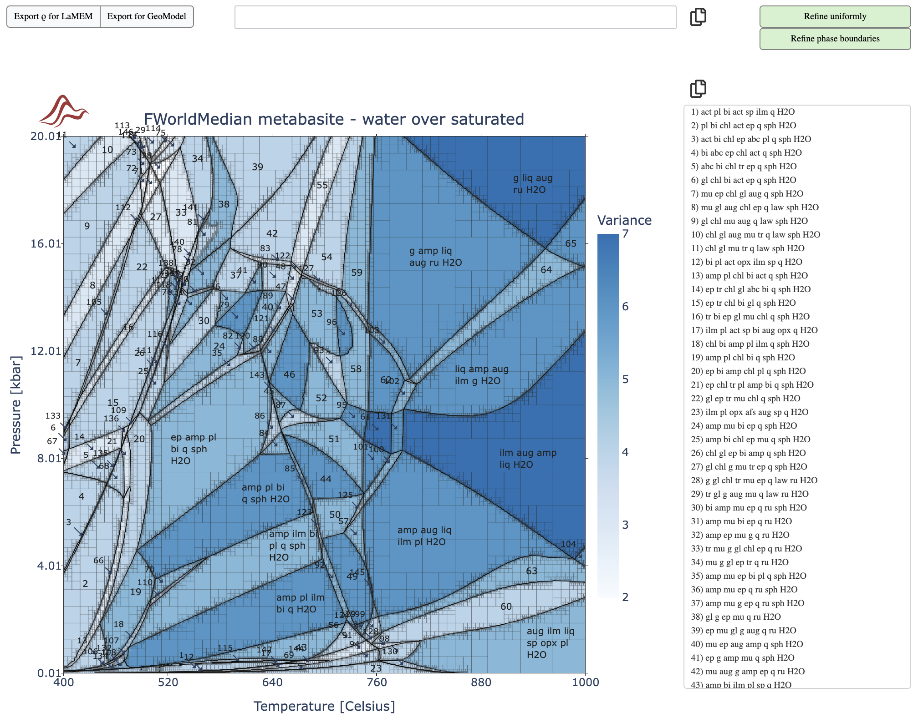
MAGEMinApp: grid refinement
13

Slide 14
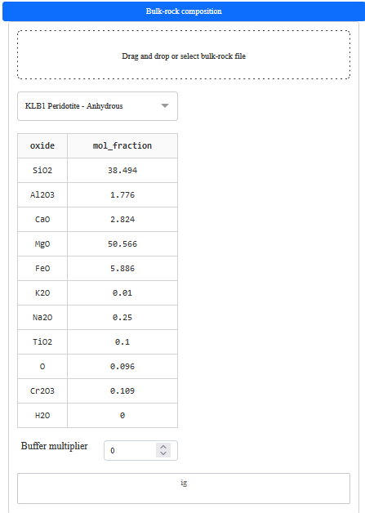
MAGEMinApp: buffers
Oxygen buffers QFM, MW, QIF, CCO, HM, NNO, IW
Fix system activity H2O, O2, SiO2, FeO, MgO, Al2O3, TiO2
Selecting a buffer displays the option to apply a shift in the RTlog scale e.g., +2 QFM
Allow to provide the activity value in case activity is selected
14

Slide 15

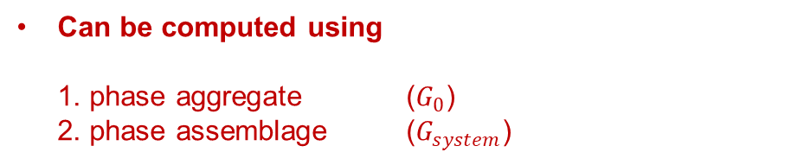
MAGEMinApp: Specific heat capacity (latent heat of reaction)
Method to compute specific heat capacity
$$Cp=−T \frac{Δ^{2}G}{ΔT^{2}}=−T \frac{G^{(T+δT)}+G^{(T−δT)}−{2G}^{(T)}}{δT^{2}}$$
where $Cp$ is the specific heat capacity, $T$ is the temperature
*
Can be computed using 1. phase aggregate ($G_{0}$) 2. phase assemblage ($G_{system}$)
Without reactions
With reactions
Note that when G_system is selected, solver must be set to legacy higher accuracy at suprasolidus conditions is needed to compute Gibbs second derivative
15

Slide 16
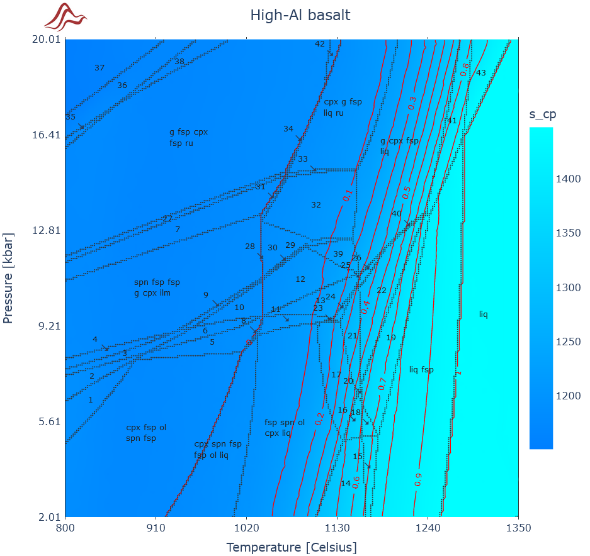
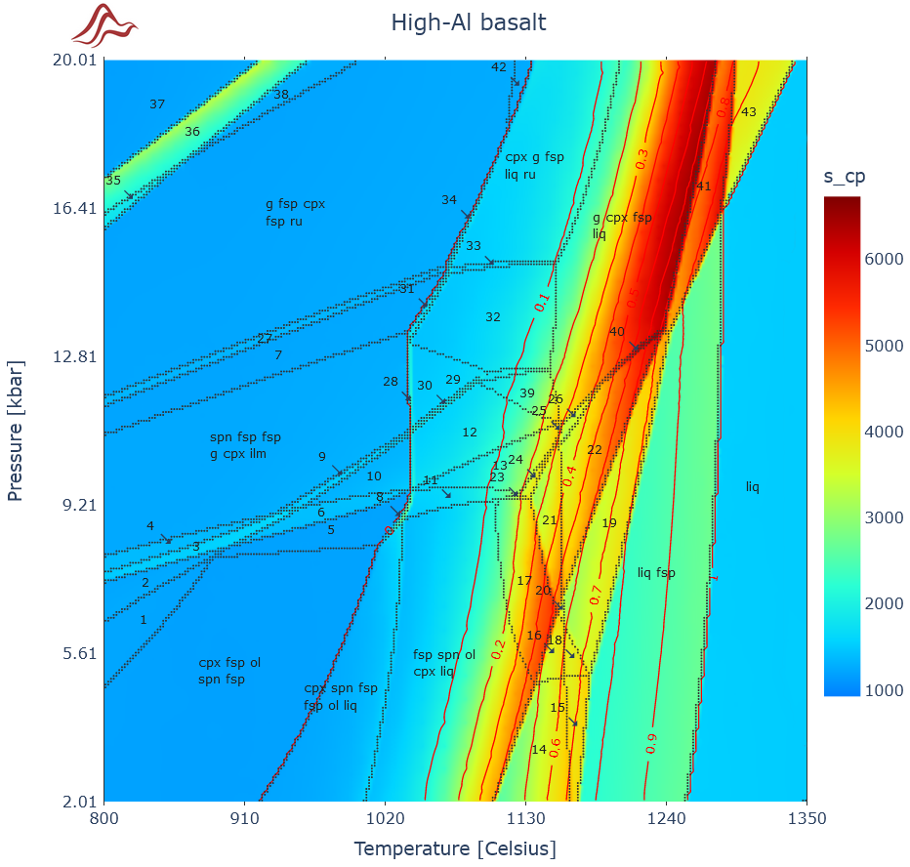
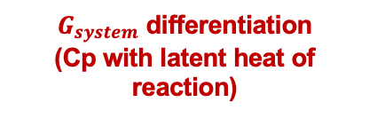
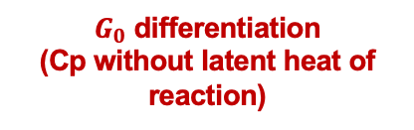
Specific heat capacity: what difference does it make?
$G_{0}$ differentiation
(Cp without latent heat of reaction)
$G_{system}$ differentiation
(Cp with latent heat of reaction)
[J/kg/K]
[J/kg/K]
Cheap to compute
Ignores latent heat
Slightly more expensive to compute
Correct heat budget
16

Slide 17
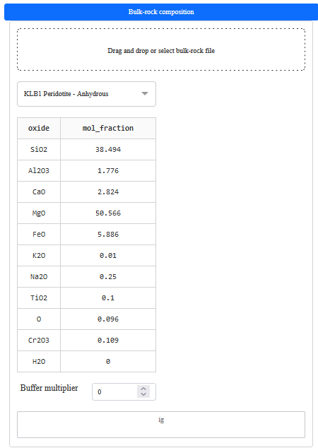
MAGEMinApp: bulk rock composition
Load custom bulk rock composition(s)
Select predefined bulk rock composition for testing
Bulk rock composition displayed in mol% note that only the oxides taken into account in the database are displayed
17

Slide 18
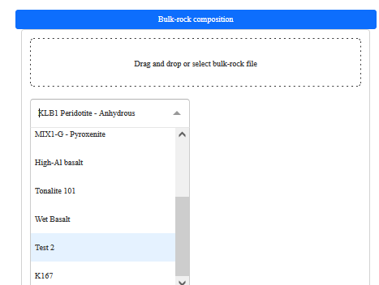
MAGEMinApp: bulk rock input file format
Example of input file provided in:
https://github.com/ComputationalThermodynamics/Resources/GG2024/bulkrock_composition_input_files/
Note that either [..., Fe2O3, FeO,...] or [..., FeO, O, ...] must me provided for the database accounting for O
Once loaded, the bulk-rock composition appear in the dropdown menu Note that the bulk are attached to a database, this is why only Test 2 and K167 appear in the dropdown menu
18

