Slide 1
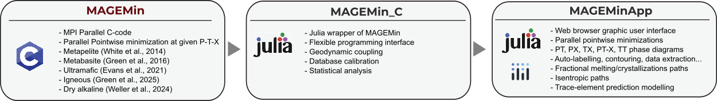
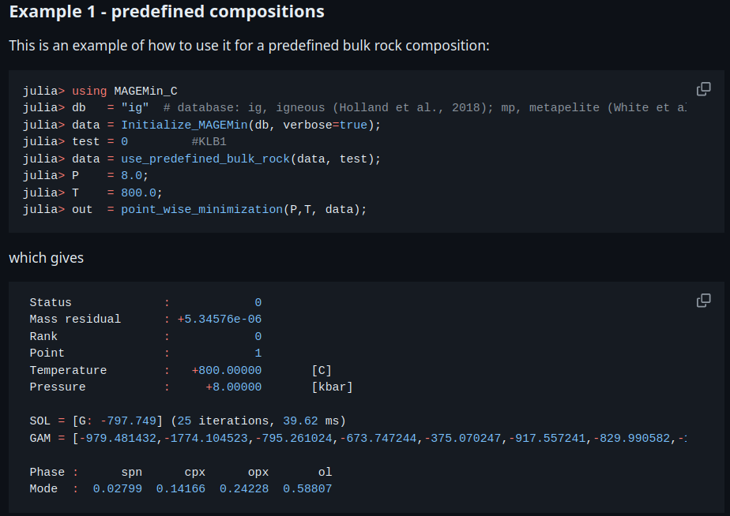
MAGEMin_C, the Julia interface: introduction
MAGEMin_C contributors B. Kaus H. Dominguez P. Lanari
1
1

Slide 2

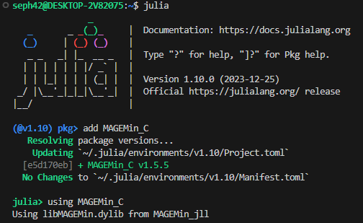

MAGEMin_C, the Julia interface: installation
https://github.com/ComputationalThermodynamics/MAGEMin_C.jl
Install MAGEMin_C
julia> ] # opens the package manager pkg> add MAGEMin_C # MAGEMin_C
Load MAGEMin_C
julia> using MAGEMin_C # load MAGEMin_C
2
2
2

Slide 3
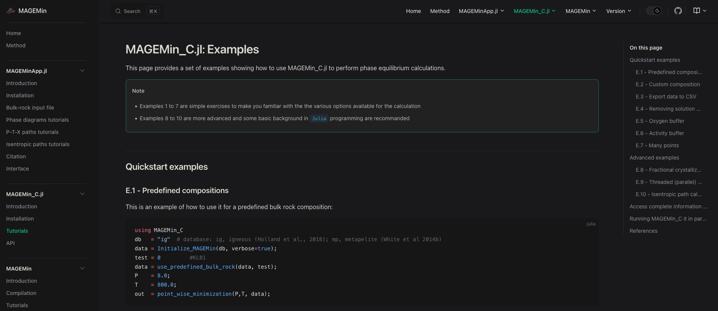
MAGEMin_C, the julia interface: online documentation
https://computationalthermodynamics.github.io/MAGEMin_C.jl/dev/MAGEMin_C/tutorials
Numerous examples outside what will be presented during the short course are given in the doc
Moreover, the testing framework can provide more knowledge: https://github.com/ComputationalThermodynamics/MAGEMin_C.jl/blob/main/test/tests.jl
3

Slide 4
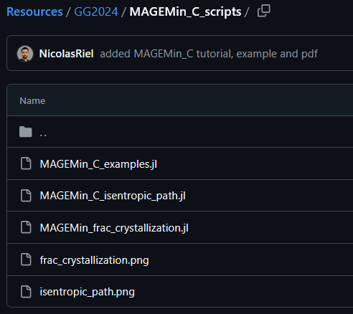
MAGEMin_C, the Julia interface: quick start!
MAGEMin_C allow you to write phase equilibrium Julia scripts fitted to your needs
Numerous resources to learn Julia can be found online e.g., https://julialang.org/learning/tutorials/
Overall, Julia programming style is quite like Matlab and being a Matlab user will help to write in Julia
Here we are going to explore the basic functionality MAGEMin_C and we will go through fractional crystallization and isentropic decompression..
Note that if you struggle, the scripts presented in this tutorial are available in the resources, in the MSG2025 folder
4
4

Slide 5
MAGEMin_C, simple example
The following example performs an equilibrium given the igneous database “ig” and the predefined test for KLB-1 peridotite Note that: “ig”, igneous; “mp”, metapelite; “mb”, metabasite; “um”, ultramafic
using MAGEMin_C # load MAGEMin
# Initialize database
data = Initialize_MAGEMin("ig", verbose=true);
test = 0 #KLB1
data = use_predefined_bulk_rock(data, test);
# Call optimization routine for given P & T & bulk_rock
P = 8.0
T = 800.0
out = single_point_minimization(P,T, data); Finalize_MAGEMin(data)
Initialize MAGEMin with “ig” database
Selects test 0, i.e., KLB-1 peridotite
Set pressure and temperature
Performs the calculation
Deallocate memory
This snippet can be copied
“out” is a structure that stores all the information about the equilibrium. We will see how to create a vector of structure to stores multiple equilibrium point information
5

Slide 6
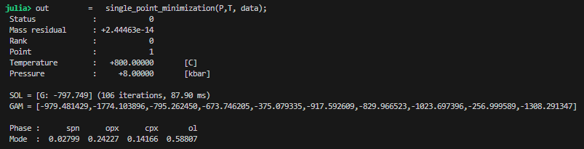

MAGEMin_C, first example
Executing the previous set of commands gives a summary of the computed equilibrium
Note that “GAM” stands for gamma and the array is the chemical potential of the oxides of the system
To access the information store in “out” within the terminal simply type “out.” then hit the “tab” key
6

Slide 7
MAGEMin_C, output structure
“out” structure is of type
Some details about information stored in “out”
MAGEMin_C.gmin_struct{Float64, Int64}
out.dataset
out.oxides
out.Gamma
out.bulk
out.bulk_M out.bulk_S
out.ph
out.ph_frac
out.frac_M out.frac_S
…
Dataset used for the calculation
List of oxides
Chemical potential of oxides
Bulk rock composition in mol
Bulk composition of melt if any
Bulk composition of solid part if any
Stable phases names
Stable phases fraction in mol
Melt fraction in mol
Solid fraction in mol
out.bulk_wt
out.bulk_M_wt
out.bulk_S_wt
out.ph_frac_wt
out.frac_M_wt
out.frac_S_wt
in wt
in wt
in wt
in wt
in wt
in wt
7

Slide 8
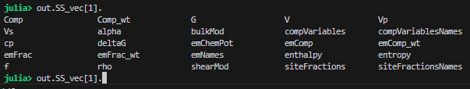
MAGEMin_C, output structure
Phases information can be access as:
out.n_SS
out.n_PP
out.SS_vec
out.PP_Vec
Number of stable solution phases
Number of stable pure phases
Vector{MAGEMin_C.LibMAGEMin.SS_data} Vector{MAGEMin_C.LibMAGEMin.SS_data}
You can access the details of solution phase 1 as:
out.SS_vec[1].
then hit the “tab” key
Then you can access any content of the solution model as
out.SS_vec[1].Comp
out.SS_vec[1].emNames
out.SS_vec[1].emFrac
…
Composition of the solution in mol fraction
End-member names
End-member fraction
8

Slide 9
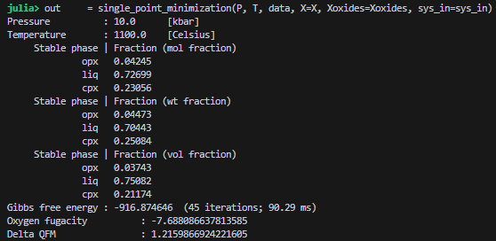
MAGEMin_C, custom bulk-rock composition
Equilibrium calculation with custom bulk-rock composition is straigthforward
data = Initialize_MAGEMin("ig", verbose=false);
P,T = 10.0, 1100.0
Xoxides = ["SiO2"; "Al2O3"; "CaO"; "MgO"; "FeO"; "Fe2O3"; "K2O"; "Na2O"; "TiO2"; "Cr2O3"; "H2O"];
X = [48.43; 15.19; 11.57; 10.13; 6.65; 1.64; 0.59; 1.87; 0.68; 0.0; 3.0];
sys_in = "wt"
out = single_point_minimization(P, T, data, X=X, Xoxides=Xoxides, sys_in=sys_in)
Finalize_MAGEMin(data)
This snippet can be copied
Xoxides → string array of oxides names
X → bulk-rock composition, provide either FeO,O or FeO,Fe2O3
sys_in → system unit: mol or wt
9

Slide 10
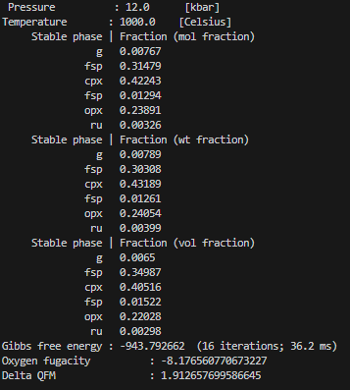
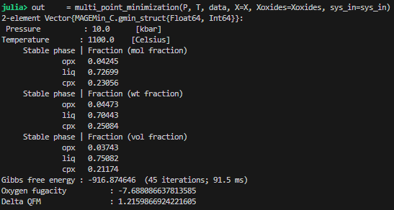
MAGEMin_C, parallel calculation
When Julia is launched in parallel, one can perform equilibrium calculation of several points in parallel:
data = Initialize_MAGEMin("ig", verbose=false);
P = [10.0, 12.0]
T = [1100.0, 1000.0]
Xoxides = ["SiO2"; "Al2O3"; "CaO"; "MgO"; "FeO"; "Fe2O3"; "K2O"; "Na2O"; "TiO2"; "Cr2O3"; "H2O"];
X1 = [48.43; 15.19; 11.57; 10.13; 6.65; 1.64; 0.59; 1.87; 0.68; 0.0; 3.0];
X2 = [49.43; 14.19; 11.57; 10.13; 6.65; 1.64; 0.59; 1.87; 0.68; 0.0; 0.0];
X = [X1,X2]
sys_in = "wt"
out = multi_point_minimization(P, T, data, X=X, Xoxides=Xoxides, sys_in=sys_in)
Finalize_MAGEMin(data)
This snippet can be copied
10

Slide 11

MAGEMin_C, parallel calculation: reading output
Vector{MAGEMin_C.gmin_struct{Float64, Int64}}
For multi point minimization the outputs are store as
To access individual point information simply do
The number of points can be retrieved using
Information of each minimization can otherwise be accessed as described in slides 7-8
length(out)
11

Slide 12
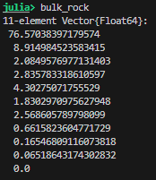
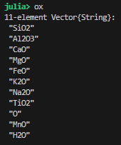
MAGEMin_C, some useful commands
Bulk-rock composition can be converted to MAGEMin system unit (mol) with
bulk_in_ox = ["SiO2"; "Al2O3"; "CaO"; "MgO"; "FeO"; "Fe2O3"; "K2O"; "Na2O"; "TiO2"; "MnO"; "H2O"];
bulk_in = [69.64; 13.76; 1.77; 1.73; 4.32; 0.4; 2.61; 2.41; 0.80; 0.07; 0.0];
bulk_rock,ox = convertBulk4MAGEMin(bulk_in,bulk_in_ox,"wt","mp");
Note that here, we convert for the “mp” (metapelite) database from wt to mol and transforming FeO,Fe2O3 to FeO,O
Declaring an “array of output structure” to store results of several minimizations can be done with
n = 10
out = Vector{MAGEMin_C.gmin_struct{Float64, Int64}}(undef, n)
Note that n can be any size
12

Slide 13
MAGEMin_C, fractional crystallization: definition
In the following example we are going the fractionate a basaltic composition using the igneous database. We are also going to use “Plots” package to visualize the results
First declare the database, initialize MAGEMin and provide bulk-rock composition, oxide list and system unit
using MAGEMin_C
using Plots
dtb = "ig"
data = Initialize_MAGEMin(dtb);
Xoxides = ["SiO2", "Al2O3", "CaO", "MgO", "FeO", "K2O", "Na2O", "TiO2", "O", "Cr2O3", "H2O"]
X = [50.0, 8.7, 11.7, 12.14, 7.7, 0.2, 2.5, 1.0, 0.5, 0.01, 10.0]
sys_in = "mol";
This snippet can be copied
Pressure
Number of fractionation steps
Starting temperature
Ending temperature
Define temperature range
Declare output vector
P = 5.0
n_steps = 64
Ts = 1200.0
Te = 600.0
T = Array(range(Ts, stop=Te, length=n_steps))
out = Vector{MAGEMin_C.gmin_struct{Float64, Int64}}(undef, n_steps)
This snippet can be copied
13

Slide 14
MAGEMin_C, fractional crystallization: calculation
In its simplest form, fractional crystallization uses the composition of the stable melt at a given temperature, as the starting bulk-rock composition for a decreased temperature
for i in 1:n_steps
out[i] = deepcopy(single_point_minimization(P, T[i], data, X=X, Xoxides=Xoxides, sys_in=sys_in))
if "liq" in out[i].ph # If liquid phase is
X = deepcopy(out[i].bulk_M)
end
end
This snippet can be copied
In the above code:
We loop through all defined steps (64 as defined in previous slide)
Perform the equilibrium calculation given the temperature array T[i] and the bulk composition X. Note that the result are stored in “out[i]”
If “liq” is stable, we then update the bulk-rock composition X to be equal to the composition of the melt “out[i].bulk_M” otherwise, the bulk is unchanged
14

Slide 15
MAGEMin_C, fractional crystallization: data extraction
Now that the calculation is performed, we need to be able to transform the saved data in a useful way to be plotted. The code snippet below, gives you some hints on how it can be done
frac_M = [out[i].frac_M for i in 1:n_steps]
frac_M_tot = accumulate(*, frac_M)
SiO2_id = findfirst(out[1].oxides .== "SiO2
dry_id = findall(out[1].oxides .!= "H2O")
SiO2_M_dry = [ (out[i].bulk_M[SiO2_id] / sum(out[i].bulk_M[dry_id])*100.0) for i in 1:n_steps]
rho_M = [ (out[i].rho_M) for i in 1:n_steps] rho_M[rho_M .== 0.0] .= NaN;
This snippet can be copied
In the code above, we extract and clean several information
The fraction of stable melt in mol
The accumulated stable melt fraction with respect to the starting mol quantity
We retrieve the array index of SiO2 and the indices of all oxides excluding water, this for anhydrous normalization
We compute the SiO2 content of the melt on an anhydrous basis
We retrieve the melt density and set to NaN the values equal to 0.0 (when melt is not stable)
15

Slide 16
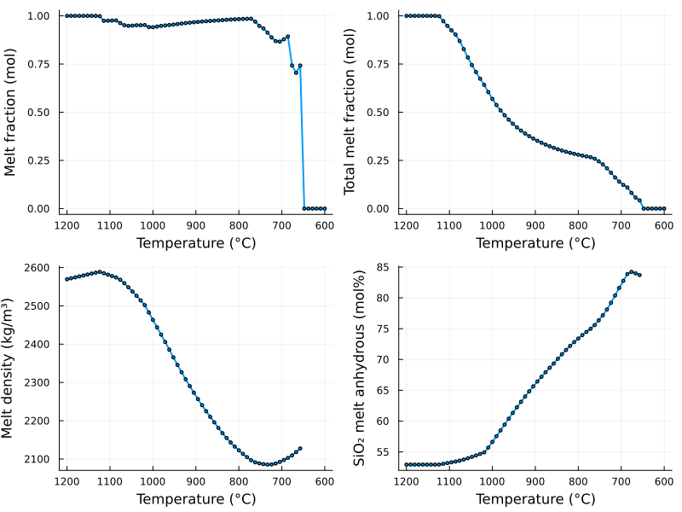
MAGEMin_C, fractional crystallization: visualization
Now that some data have been converted, we can visualize it. Here is provided one example of visualization using Plots, you are of course welcome to use any other package
p1 = plot(T,frac_M, xflip=true, xlabel="Temperature (°C)", marker = :circle, markersize = 2, lw=2, ylabel="Melt fraction (mol)", legend=false)
p2 = plot(T,frac_M_tot, xflip=true, xlabel="Temperature (°C)", marker = :circle, markersize = 2, lw=2, ylabel="Total melt fraction (mol)", legend=false)
p3 = plot(T,rho_M, xflip=true, xlabel="Temperature (°C)", marker = :circle, markersize = 2, lw=2, ylabel="Melt density (kg/m³)", legend=false)
p4 = plot(T,SiO2_M_dry, xflip=true, xlabel="Temperature (°C)", marker = :circle, markersize = 2, lw=2, ylabel="SiO₂ melt anhydrous (mol%)", legend=false)
fig = plot(p1, p2, p3, p4, layout=(2, 2), size=(800, 600))
savefig(fig,"frac_crystallization.png")
This snippet can be copied
Which yields
16

Slide 17
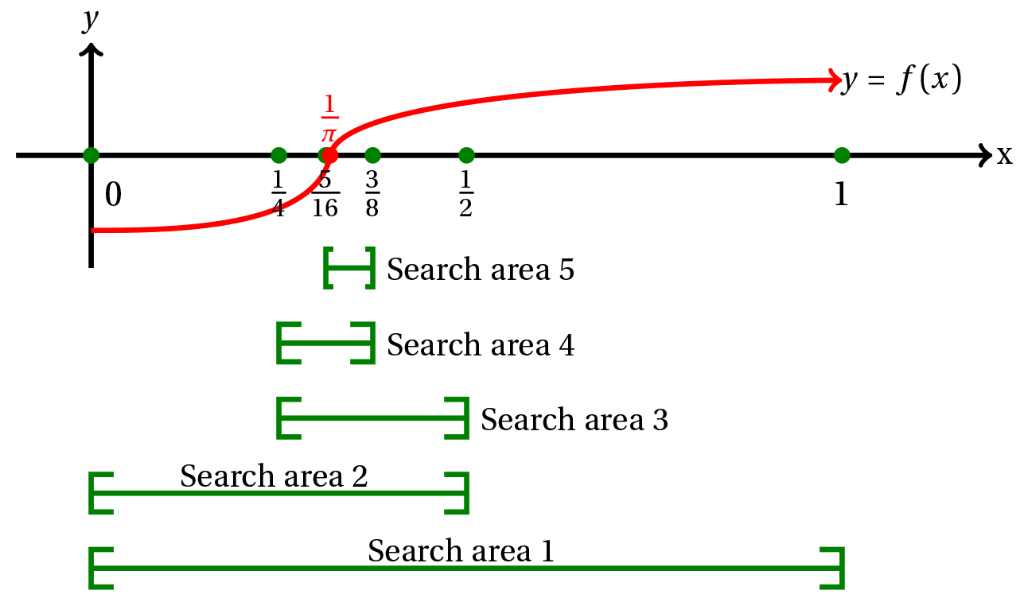
MAGEMin_C, advanced example: isentropic path
Isentropic paths (Adiabatic decompression) can be generated directly in MAGEMinApp, but here we are going to see how this can be achieved using MAGEMin_C
The objective is to provide a starting PT condition, compute the entropy of the system, then gradually decrease pressure while keeping entropy constant and computing the corresponding temperature
Because the temperature at decreased pressure that keeps entropy constant is unknown, we need a strategy to constrain it. Here we are going to use the bisection method.
The idea is to reformulate the problem as a root finding problem and use the bisection method as described below:
f(x) = Sref – Sx where x is temperature Sref is entropy of reference Sx is the entropy at tentative temperature x
17

Slide 18
MAGEMin_C, isentropic path: definition
using MAGEMin_C
using Plots
using ProgressMeter
dtb = "ig"
data = Initialize_MAGEMin(dtb,verbose=-1)
test = 0 # KLB-1
data = use_predefined_bulk_rock(data, test)
MPT = 1350.0
adiabat = 0.55
Depth = 100.0
rho_Mantle = 3300.0
Ts = MPT + adiabat*Depth
Ps = Depth*1e3*9.81*rho_Mantle/1e5/1e3
Pe = 0.001
n_steps = 32
n_max = 32
tolerance = 0.1
P = Array(range(Ps, stop=Pe, length=n_steps))
out = Vector{MAGEMin_C.gmin_struct{Float64, Int64}}(undef, n_steps)
out_tmp = MAGEMin_C.gmin_struct{Float64, Int64};
out[1] = deepcopy( single_point_minimization(Ps,Ts, data));
Sref = out[1].entropy
ProgressMeter to display a progress bar
Igneous database
Initialize MAGEMin while deactivating verbose
Select predefined KLB-1 test
Load predefined test
Mantle potential temperature
Adiabatic gradient
Starting depth
Mantle density
Starting temperature
Starting pressure
Ending pressure
Number of steps
Maximum number of bisection iterations
Tolerance in K
Pressure range for the isentropic path
Output structure Vector
Temporary output structure
Compute reference point at Ts and Ps
Reference entropy
18
This snippet can be copied

Slide 19
MAGEMin_C, isentropic path: calculation
This code snippet uses the bisection method to find the temperature fitting the entropy of reference within given tolerance
The command “@showprogress” place before the pressure loop allow to display the progress bar in the Julia terminal
a and b define the starting temperature bounds n is the number of bisection c is the bisected temperature result is the misfit (f(x) = Sref – Sx) sign_c is the sign of the misfit a T = c
@showprogress for j = 2:n_steps
a = out[j-1].T_C - 50.0
b = out[j-1].T_C
n = 1
conv = 0
n = 0
sign_a = -1
while n < n_max && conv == 0
c = (a+b)/2.0
out_tmp = deepcopy( single_point_minimization(P[j],c, data));
result = out_tmp.entropy - Sref
sign_c = sign(result)
if abs(b-a) < tolerance
conv = 1
else
if sign_c == sign_a
a = c
sign_a = sign_c
else
b = c
end
end
n += 1
end
out[j] = deepcopy(out_tmp)
end
Finalize_MAGEMin(data)
If the bounds distance is < tolerance, then solution is accepted else, the bounds are updated
19
This snippet can be copied

Slide 20
MAGEMin_C, isentropic path: data extraction
Similarly to the factional crystallization example, data output need to be reformatted.
S = [out[i].entropy for i in 1:n_steps]
frac_M = [out[i].frac_M for i in 1:n_steps]
frac_M[frac_M .== 0.0] .= NaN
T = [out[i].T_C for i in 1:n_steps] SiO2_id = findfirst(out[1].oxides .== "SiO2")
dry_id = findall(out[1].oxides .!= "H2O")
SiO2_M_dry = [ (out[i].bulk_M[SiO2_id] / sum(out[i].bulk_M[dry_id])*100.0) for i in 1:n_steps];
rho_M = [ (out[i].rho_M) for i in 1:n_steps];
rho_M[rho_M .== 0.0] .= NaN;
This snippet can be copied
In the code above, we extract and clean several information
The entropy of all points for checking
The fraction of stable melt in mol and we set to NaN the values equal to 0.0 (when melt is not stable)
We retrieve the array index of SiO2 and the indices of all oxides excluding water, this for anhydrous normalization
We compute the SiO2 content of the melt on an anhydrous basis
We retrieve the melt density and set to NaN the values equal to 0.0 (when melt is not stable)
20

Slide 21
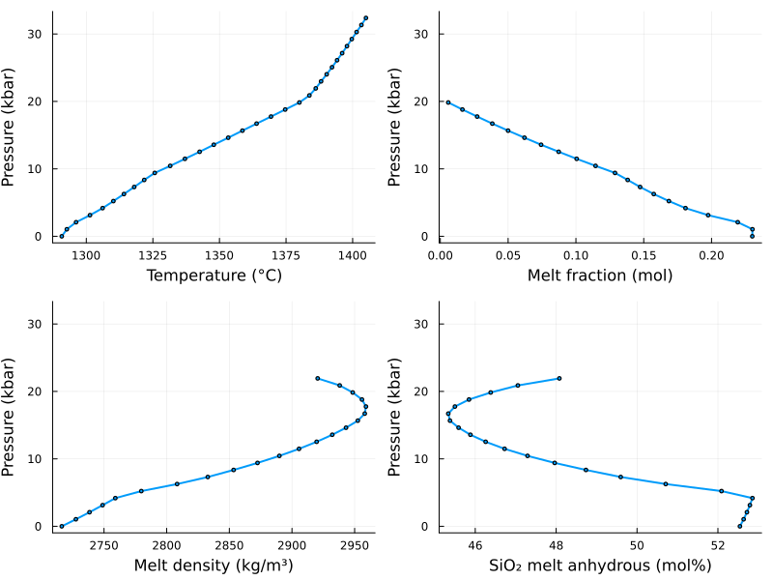
MAGEMin_C, isentropic path: visualization
Visualization is achieved in a similar way as for the fractional crystallization example
p1 = plot(T,P, xlabel="Temperature (°C)", marker = :circle, markersize = 2, lw=2, ylabel="Pressure (kbar)", legend=false)
p2 = plot(frac_M,P, xlabel="Melt fraction (mol)", marker = :circle, markersize = 2, lw=2, ylabel="Pressure (kbar)", legend=false)
p3 = plot(rho_M,P, xlabel="Melt density (kg/m³)", marker = :circle, markersize = 2, lw=2, ylabel="Pressure (kbar)", legend=false)
p4 = plot(SiO2_M_dry,P, xlabel="SiO₂ melt anhydrous (mol%)", marker = :circle, markersize = 2, lw=2, ylabel="Pressure (kbar)", legend=false)
fig = plot(p1, p2, p3, p4, layout=(2, 2), size=(800, 600))
savefig(fig,"isentropic_path.png")
This snippet can be copied
Which yields
21

