Slide 1
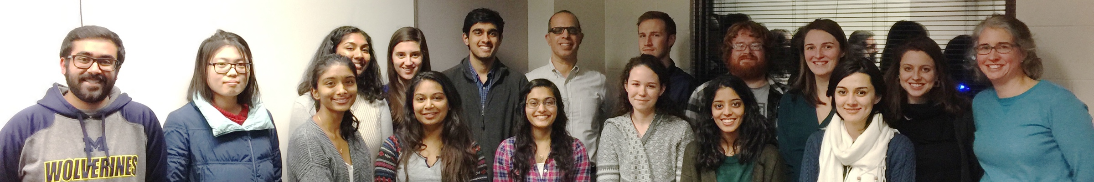
Compute-to-Learn
CHEM 230 & 260
Honors Studio
Dr. Eitan Geva, Dr. Amy Gottfried, Yifan Lai, Kristina Lenn, Shiba Dandpat, Ellen Mulvihill, Blair Winograd
Mina Jafari, Dr. Alicia Welden, Dr. Kyle Williams, Yanbing Zhao, Michael Lenard, Dr. Heidi Hendrickson, Dr. Anne Vazquez,
Dr. Porscha McRobbie
http://umich.edu/~pchem/compute-to-learn.html

Slide 2
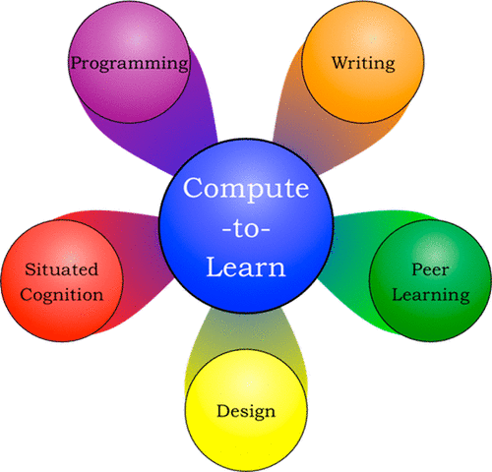
How it works
Supplemental, peer-led weekly 2 hour session for honors credit
FF-GSIs and peer leaders pitch the class to CHEM 260 and 230 students
Studio environment and action-based learning activities
Guided by senior undergraduate students as peer leaders
FF-GSIs guide activities and help the students remain focused on these activities during studio time
Pass/Fail → H/no H

Slide 3
CHEM 260 and 230
CHEM 260 (Chemical Principles) | CHEM 230 (Physical Chemical Principles & Applications)
Chemistry Majors | Non-majors
YES quantum | NO quantum
Calculus-based | Algebra-based
~50 students per semester | ~300 students per semester

Slide 4
Schedule of C2L Studio and Activities
Week | Activity
1-3 | Mathematica training via homemade interactive tutorial (developed by FF-GSIs) Choose and research prompt for demo
4 | Present storyboard depiction of demo (peer reviewed)
5-8 | Design and code proposed demo
9-10 | Present progress report (peer reviewed)
11-12 | Submit to the Wolfram Demonstrations Project (expedited review process (Sy Blinder)) Revise based on reviewers comments
13 | Presentations of published demos to peers

Slide 5

Notes:
LiveSlide Site
http://demonstrations.wolfram.com/

Slide 6
Notes:
LiveSlide Site
http://umich.edu/~pchem/demos.html

Slide 7
Statistics
Semester | F15 | F16 | W17 | F17 | W18 | F18 | Overall
# students | 6 | 9 | 19 | 23 | 9 | 9 | 75
260/230 | 6/0 | 2/7 | 6/13 | 13/10 | 7/2 | 5/4 | 39/36
# demos | 6 | 4 | 9 | 11 | 4 | 3 | 37
# published demos | 1 | 3 | 9 | 10 | 4 | 3 | 30
M/F | 5/1 | 3/6 | 5/14 | 13/10 | 4/5 | 3/6 | 33/42
# peer leaders | 2 | 2 | 3 | 2 | 2 | 2 | 13

Slide 8
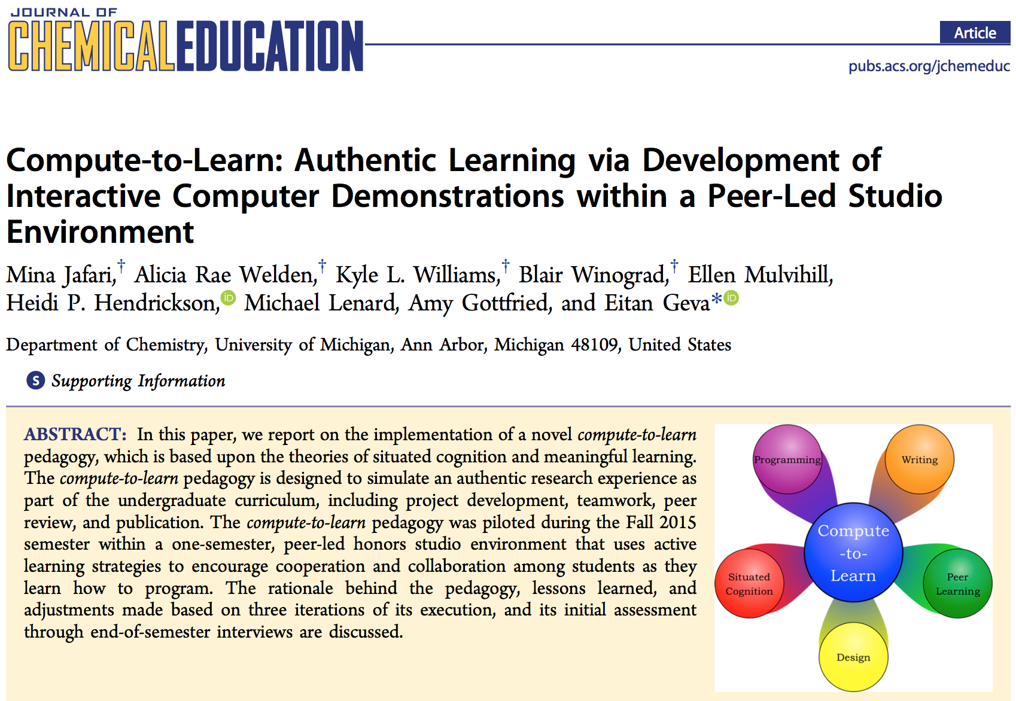
J. Chem. Educ. 2017, 94, 1896−1903

Slide 9
Student Outcomes
Based on voluntary exit interviews composed of 10 general questions about the students’ experience in the studio
The interviews were conducted by studio peer leaders from the previous semester
Audio recordings of the interviews were transcribed and then coded to identify commonalities and overarching themes

Slide 10
Interview Questions
What were the reasons that (made you want to join) you joined the honors studio?
What was the biggest challenge that you encountered through your participation in the honors studio, and how did you overcome it?
What was your biggest accomplishment in the honors studio?
What advice would you give to future participants regarding how to be successful at producing a publishable demo?
What are the most important skills that you learned through your participation in the honors studio?
What are the most important lessons that you learned through your participation in the honors studio?
Did participation in the studio have an impact on your view of scientific research, and if so in what way?
Did participation in the studio change in any way your view of your own strengths and weaknesses as a scientist? And if so how?
Did participation in the studio have an impact your future professional plans, and if so in what way?
In your opinion, how did your participation in the studio impact your performance in Chem260/230?
Do you have any idea for future prompts or concepts from Chem 230/260 that you would like to see as a demonstration?
Do you have anything else you would like to add or any feedback for the studio that was not addressed in the earlier questions?

Slide 11
The themes most commonly mentioned by students as motivational and beneficial:
Programming “Just learning what code really is, and how it works, because I had no interaction with that before.”
Peer review “It was really useful when we would present our storyboard and then everyone else would tell us what they thought about it.”
Independent learning “I learned how to teach myself.”
Learning to ask questions.
Team work.
Hands-on activities.
Perseverance.

