Slide 1


Compute To Learn Workshop
November 2, 2018
Lafayette College

Slide 2
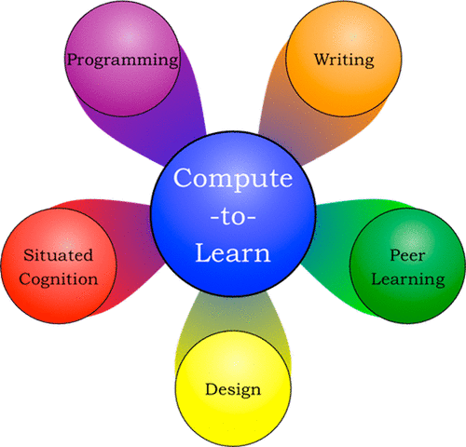
Compute-to-Learn
Students develop practical programming skills for use within and beyond the course
Students engage deeply with material to construct and integrate new knowledge
Learning occurs as a social process within authentic disciplinary practices
Students learn from interacting with peers through shared experience and understanding
Students use a design process approach to create functional demonstrations for broad use
J. Chem. Educ. 2017, 94, 1896-1903.

Slide 3
Compute-to-Learn “Studio” Philosophy
The main goal in C2L is to master a topic or concept in physical chemistry more deeply by engaging in a creative activity relevant to the material.
Adopt an educational strategy more commonly found in the realms of theatre, music, and art: the concept of a studio, in which “performance” is more explicitly recognized as an outcome.
Superimposing this strategy onto a chemistry course allows us to have our own studio, where new skills and understanding can be ‘rehearsed’ amongst peers and under the supervision of more experienced individuals.

Slide 4
Compute-to-Learn History
CHEM 260H first implemented in F08 and offered continuously ever since
Prior to F15: “Writing-to-Teach” Students worked in small groups to develop supplemental explanatory texts for concepts covered in CHEM 260 (wiki-pages, a student-written textbook, etc.).
F15 – present: “Compute-to-Learn” Students work in small groups to develop interactive computer demos of concepts covered in CHEM 260. Products are reviewed & published on Wolfram Demonstrations Project website.
F16 – present: Expanded to joint CHEM 230/260H studio.
S18 – present: C2L offered at Lafayette in CHEM 324 Fourth Hour

Slide 5
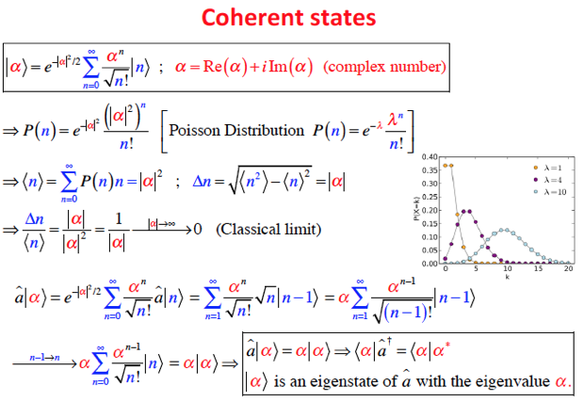
Compute-to-Learn

Slide 6
Compute-to-Learn

Slide 7
The Wolfram Demonstrations Project
Addresses dissemination and transferability
Mimics an authentic research experience of expert-reviewed, publishable, and citable products
Open source: All codes and demonstrations are accessible to the general public, and can be used even without a Mathematica License!
Pedagogy is expandable to ANY discipline that can use visualization, from K12 to graduate school:
Physical Sciences
Mathematics
Engineering
Business
Social Sciences
Art and Architecture

Slide 8
Learning Mathematica Demonstrations
Compute-to-Learn takes place in weekly “studio” sessions
Peers collaborate to create explanatory demonstrations
Peers critique each others’ explanations/demos
Tutorial on creating demonstrations in Mathematica
Provided at the beginning of the semester
Carried out over the first three sessions
Let’s check out a condensed version of the tutorial now!

