Slide 1
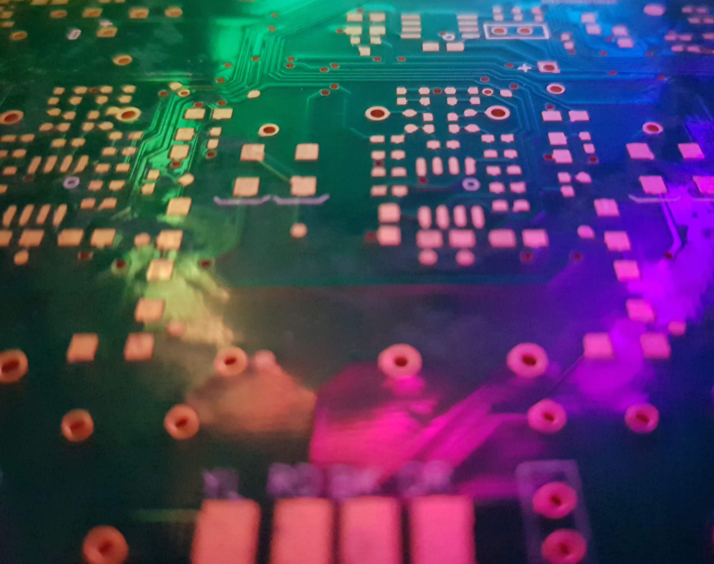
CPU Caches
A rough overview

Slide 2
Who am I?
Steve Humphries
Principal Programmer (Low-Level / Platform / Graphics)
Founder & Technical Director @ Compute Unit Limited
I’ve worked on a few different bits of HW over 30 years+
ZX Spectrum, C64, BBC Micro, Atari ST, Amiga, PC, Raspberry Pi
PS1, PS2, PS3, PS4, Xbox/360/One/X, Switch, Mobile
I’ve worked on a few games over the years in various roles
TT Superbikes, MotorStorm 1/2/3, Driveclub, Onrush, Narcos, …

Slide 3
CPU Cache
Who is this talk for?
Programmers of all levels
Why does a programmer need to know about caches?
Because they are key to extracting best CPU performance
How will this talk make my code better and faster?
Hopefully a better understanding of how CPU uses data

Slide 4
CPU Cache – Why?
CPU Clock Speeds improved faster than DRAM Speeds
CPU @ 4GHz = 0.25 nanoseconds (ns) per cycle
CPU cores can process 4-16 instructions / ns
DDR3 RAM latency worst case ~100ns / access (*1)
1 Instruction every 100ns is ~10 MHz CPU speed
Worst case wasting ~1600 CPU inst per 100ns RAM access
(*1) https://ece.uwaterloo.ca/~rpellizz/techreps/worstcaseanalysis.pdf

Slide 5
CPU Cache – Why?
Consider wanting an apple from a lovely orchard in EU
Every time you want an apple, you could drive/fly to the farm
But that seems costly and time consuming
Instead, there is a supply chain for the apples
Wholesaler buys tons of lovely apples from Farmer
Store/Market requests crates of apples from Wholesaler
You buy a box of apples from Store and place in fruit bowl

Slide 6
CPU Cache – Why?
Each time you want an apple, you now do the following
Check in the fruit bowl for any apples (L1)
Relatively quick as it’s in your house or apartment (<1 min)
Check local store/market for any apples (L2)
Slightly slower, trip to local store (10+ mins)
Store/Market checks wholesaler centre for any apples (L3)
A lot slower, road/rail involved (hours)
Farmer is requested to send lots of lovely apples (RAM)
Much much slower, road/rail/shipping/airline (days)

Slide 7
CPU Cache – Why?
Each stage of supply chain anticipates demand (prefetching!)
You notice apples running low so buy more before empty
Local Store/Market monitors sales (empty shelves is bad)
Wholesaler monitors demand (empty warehouse is bad)
Farmer tries to grow enough to meet demand, always selling
But sometimes, demand outstrips supply, bottlenecks/stalls

Slide 8
CPU Cache – What?
Usually a Hierarchy of Cache Levels
Closest to CPU is typically, smaller, faster and more costly
Farthest from CPU is typically larger, slower and cheaper
Level1 (L1$) ~16KB - 32KB with ~5 Cycles / Access
Level2 (L2$) ~256KB - 512KB with ~25 Cycles / Access
Level3 (L3$) ~1MB - 4MB with ~50 Cycles / Access

Slide 9
CPU Cache – What?
Reg
L1
L2
L3
RAM
~1 KB
~1 Cycle
~32 KB
~5 Cycles
~512 KB
~25 Cycles
~2 MB
~50 Cycles
~16 GB
~500 Cycles

Slide 10
CPU Cache – Where?
CPU usually has 2 x L1 Caches
Separate Caches for Instructions (I$) and Data (D$)
L1 I$ is Read-Only – Individual per CPU core
Sometimes includes special logic for branches
L1 D$ is Read/Write - Individual per CPU core
Usually supports more Reads than Writes per cycle
L2$ / L3$ is Read/Write – Could be shared by multiple cores
Varies ‘inclusive/exclusive’ so will/won’t keep a copy of L1 I$/D$ or L2$

Slide 11
CPU Cache – Where?
Core0
Core1
Core2
Core3
~1 KB
~1 Cycle
Registers
Registers
Registers
Registers
L1 I$
L1 D$
L1 I$
L1 D$
L1 I$
L1 D$
L1 I$
L1 D$
~32 KB
~5 Cycles
L2$
L2$
~512 KB
~25 Cycles
L3$
~2 MB
~50 Cycles

Slide 12
CPU Cache – Where?
Core0
Core1
Core2
Core3
~1 KB
~1 Cycle
Registers
Registers
Registers
Registers
L1 I$
L1 D$
L1 I$
L1 D$
L1 I$
L1 D$
L1 I$
L1 D$
~32 KB
~5 Cycles
L2$
L2$
L2$
L2$
~256 KB
~15 Cycles
L3$
~2 MB
~50 Cycles

Slide 13
CPU Cache – Where?
RAM
Core0
Core1
Core2
Core3
RAM
L3$
RAM
RAM
Core4
Core5
Core6
Core7

Slide 14
CPU Cache – How?
Cache is divided into blocks – Cache Lines
64B is the most typical size at present (2020)
PS3 used 128B lines as do some current L3$ (Samsung)
Cache lines are organised in a 2D array [Sets][Ways]
n-Sets = n-Lines / n-Ways
The ‘n-Sets’ is referred to as the cache ‘Associativity’
This is usually tuned for each CPU architecture and cache Level

Slide 15
CPU Cache – Prefetching
L1 and L2 usually have HW prefetchers
Repeated access patterns/strides detected
Most likely next cache line is pre-fetched in advance
CPU usually has instructions for manual prefetching
These should be used with care, can adversely affect perf
HW prefetchers can be a big performance win
Usually takes 3-4 accesses before it kicks in
Useful when doing long sequential runs over data

Slide 16
CPU Cache – Associativity
Each level of cache may use different Associativity
This is where Cache designers earn the $$$
Cache line lookup is partly indexed and searched
Indexed using ‘Set’ and multiple ‘Ways’ searched
Each ‘Way’ is checked in parallel
More ‘Ways’ can improve performance for certain access patterns

Slide 17
CPU Cache - Associativity
32KB L1 D$ (8-Way Associative)
32,768B / 64B = 512 Cache Lines
8-Way means 8 x 64B Cache Lines / Set
512 / 8 = 64 Sets (6-Bit Index)
512KB L2 D$ (16-Way Associative)
524,288B / 64B = 8192 Cache Lines
16-Way means 16 x 64B Cache Lines / Set
8192 / 16 = 512 Sets (9-Bit Index)

Slide 18
CPU Cache – 64-Bit Pointers?
x86-64 typically only uses 40-48 Bits of Address Space
Some Server-class CPUs like Xeon use 56 bits
Early versions of Windows 8 only used 36 Bits
Cache logic splits the 64-Bit address into chunks
Upper 24/16 Bits of 64-Bit pointer are not used
2-3 Bytes are pure zeros (wasted) on Desktop CPUs*
Lowest 6-Bits (64B Line) are the offset into the Cache Line
Middle Bits are used for Set, PageTable, VirtualMem indexing

Slide 19
CPU Cache – 40/48 Bit Address Space
48 Bits
Tag
Set
Offset
35 Bits
7 Bits
6 Bits
40 Bits
Tag
Set
Offset
27 Bits
7 Bits
6 Bits

Slide 20
CPU Cache – Logic
Extract the ‘Set’ index from 64Bit address
(if Fully Associative) set = 0
Check for address match of all ‘n‘ Ways in the ‘Set’
This is typically all done in parallel and is performance hotspot
‘Tag’ usually in separate array to save power / cycles
(V)alid bit may be check before Tags
Page-Tables (TLB) and Virtual Memory lookups
Could do whole other talk about these, but handled similarly

Slide 21
CPU Cache – Logic
if (tagFound) CacheHit++
‘Way’ index is used to fetch Cache Line from Data RAM
LRU counter is updated
if (writingData)
(D)irty Bit is updated

Slide 22
CPU Cache – Logic
if (!tagFound) CacheMiss++
‘Way’ index is determined from Tag Data
Is a Cache Line free? - Checks the (V)alid bit
Else, LRU counter is checked to find line to Evict
If (D)irty, evict Cache Line to next Cache Level or Main RAM
if (writingData)
(D)irty Bit is updated, (V)alid Bit is updated, LRU is reset

Slide 23
CPU Cache – Direct Mapped
1-Way with multiple Sets
Cache Line is Directly indexed using the Set index
No searching of multiple ‘Ways’ is needed
Much simpler logic, therefore usually faster/cheaper
Many addresses will map to the same Set/Way
64KB Direct Mapped = 1024 Sets (10-Bit Index)
Addresses spaced 64KB apart map to same Set
1/1 Cache Lines are evicted per conflicted access

Slide 24
CPU Cache – Direct Mapped
Set | Tag RAM (Way 0) | Data RAM (Way 0)
0 | Tag:V:D:LRU | 64B Data
1 | Tag:V:D:LRU | 64B Data
2 | Tag:V:D:LRU | 64B Data
3 | Tag:V:D:LRU | 64B Data
4 | Tag:V:D:LRU | 64B Data
5 | Tag:V:D:LRU | 64B Data
6 | Tag:V:D:LRU | 64B Data
7 | Tag:V:D:LRU | 64B Data
8 | Tag:V:D:LRU | 64B Data
9 | Tag:V:D:LRU | 64B Data
10 | Tag:V:D:LRU | 64B Data
11 | Tag:V:D:LRU | 64B Data
12 | Tag:V:D:LRU | 64B Data
13 | Tag:V:D:LRU | 64B Data
14 | Tag:V:D:LRU | 64B Data
15 | Tag:V:D:LRU | 64B Data

Slide 25
CPU Cache – Fully Associative
n-Ways within single Set
Cache Line is not indexed
Searching of multiple ‘Ways’ is needed
Complex logic, therefore usually slower/expensive
Any address will map to the same Set
64KB Fully Associative = 1 Set with 1024 Ways
1/1024 Cache Lines are evicted per conflicted access

Slide 26
CPU Cache – Fully Associative
Set | Tag RAM Way 0 | Tag RAM Way 1 | Tag RAM Way ~ | Tag RAM Way n | Data RAM Way 0 | Data RAM Way 1 | Data RAM Way ~ | Data RAM Way n
0 | Tag Data | Tag Data | Tag Data | Tag Data | 64B | 64B | 64B | 64B

Slide 27
CPU Cache – 4-Way Associative
4 Cache Lines per Set
Cache Line is partly indexed using the Set index
All 4 ‘Ways’ are checked in parallel
Balance of logic, therefore usually fast-ish/cheap-ish
Some addresses will map to the same Set
64KB 4-Way = 256 Sets (8-Bit Index)
Addresses spaced 16KB apart map to same Set
1/4 Cache Lines are evicted per conflicted access

Slide 28
CPU Cache – 4-Way Associative
Set | Way
0 | 64B | 64B | 64B | 64B
1 | 64B | 64B | 64B | 64B
2 | 64B | 64B | 64B | 64B
3 | 64B | 64B | 64B | 64B
4 | 64B | 64B | 64B | 64B
5 | 64B | 64B | 64B | 64B
6 | 64B | 64B | 64B | 64B
7 | 64B | 64B | 64B | 64B
8 | 64B | 64B | 64B | 64B
9 | 64B | 64B | 64B | 64B
10 | 64B | 64B | 64B | 64B
11 | 64B | 64B | 64B | 64B
12 | 64B | 64B | 64B | 64B
13 | 64B | 64B | 64B | 64B
14 | 64B | 64B | 64B | 64B
15 | 64B | 64B | 64B | 64B

Slide 29
CPU Cache – Sequential accesses
0xC0DE0000
0xC0DE0040
0xC0DE0080
0xC0DE00C0
0xC0DE0100
0xC0DE0140
0xC0DE0180
0xC0DE01C0
Set | Way
0 | 64B | 64B | 64B | 64B
1 | 64B | 64B | 64B | 64B
2 | 64B | 64B | 64B | 64B
3 | 64B | 64B | 64B | 64B
4 | 64B | 64B | 64B | 64B
5 | 64B | 64B | 64B | 64B
6 | 64B | 64B | 64B | 64B
7 | 64B | 64B | 64B | 64B
8 | 64B | 64B | 64B | 64B
9 | 64B | 64B | 64B | 64B
10 | 64B | 64B | 64B | 64B
11 | 64B | 64B | 64B | 64B
12 | 64B | 64B | 64B | 64B
13 | 64B | 64B | 64B | 64B
14 | 64B | 64B | 64B | 64B
15 | 64B | 64B | 64B | 64B

Slide 30
CPU Cache – Stride Accesses
0xC0DE0000
0xC0DE1000
0xC0DE2000
0xC0DE3000
0xC0DE4000
0xC0DE5000
0xC0DE6000
0xC0DE7000
Set | Way
0 | 64B | 64B | 64B | 64B
1 | 64B | 64B | 64B | 64B
2 | 64B | 64B | 64B | 64B
3 | 64B | 64B | 64B | 64B
4 | 64B | 64B | 64B | 64B
5 | 64B | 64B | 64B | 64B
6 | 64B | 64B | 64B | 64B
7 | 64B | 64B | 64B | 64B
8 | 64B | 64B | 64B | 64B
9 | 64B | 64B | 64B | 64B
10 | 64B | 64B | 64B | 64B
11 | 64B | 64B | 64B | 64B
12 | 64B | 64B | 64B | 64B
13 | 64B | 64B | 64B | 64B
14 | 64B | 64B | 64B | 64B
15 | 64B | 64B | 64B | 64B
Cache Line
Conflicts
Lines Evicted
Non-optimal
Cache Usage

Slide 31
CPU Cache – Summary
Caches are built with 2 types of locality in mind
Spatial and Temporal
Spatial
Assumes that commonly accessed data is nearby
Structures, Classes, Stack, etc
Temporal
Assumes that the same/nearby data is accessed soon after earlier access
Stack, common functions, loop counters, ‘this’ pointer, etc

Slide 32
CPU Cache – Summary
Multiple levels of Cache
Increasing in size and time to access
Cache misses are bad (L1), Bad(L2), BAD(L3)
RAM is very far away in terms of CPU cycles
CPUs can do a lot of work in those cycles
Knowing actual Cache sizes and layouts is useful
Especially on fixed HW such as Consoles
HW Prefetching can be your friend
Think in terms of 2-4 ‘streams’ of data accessess

Slide 33
CPU Cache – Questions?

