Slide 1
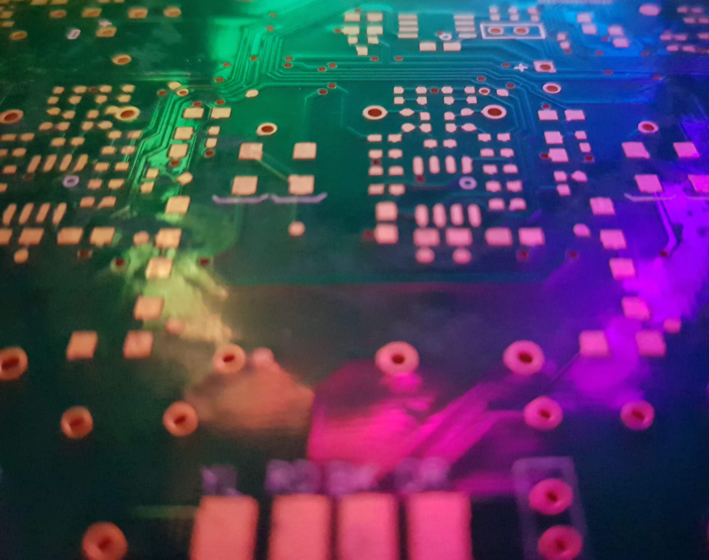
Cache Friendly Code
A rough guide

Slide 2
Who am I?
Steve Humphries
Principal Programmer (Low-Level / Platform / Graphics)
Founder & Technical Director @ Compute Unit Limited
I’ve worked on a few different bits of HW over 30 years+
ZX Spectrum, C64, BBC Micro, Atari ST, Amiga, PC, Raspberry Pi
PS1, PS2, PS3, PS4, Xbox/360/One/X, Switch, Mobile
I’ve worked on a few games over the years in various roles
TT Superbikes, MotorStorm 1/2/3, Driveclub, Onrush, Narcos, …

Slide 3
What is this talk about?
Aimed at programmers of all levels
Graduate, Junior, Mid, Senior
Mainly aimed at C/C++ Game Developers
Discuss how CPU performance is affected by Data access
Not just about Data layout but how Code accesses the data
What options are available to improve code performance
Some simple examples are provided to encourage thought

Slide 4
What is Cache Friendly Code?
There are 3 parts to writing Cache Friendly code
The Code, The Data, The Access Pattern (Algorithm)
Code reads, modifies, writes the Data
The same ‘problem’ can be tackled in many ways
e.g. Lots of different sorting algorithms achieve same result
Data layout doesn’t govern how Code accesses the data
It can help or hinder
Structures, Arrays, Linked-Lists, Maps, etc

Slide 5
RAM is far away from CPU
CPU Caches are built for sequential streams of Data
Registers, SIMD, Cache lines, RAM Banks are contiguous bytes
Caches might prefetch Data it thinks may be accessed next
Next in terms of +/- Cache Line/s from where the last access was
RAM access is slow when compared to #CPU cycles
Access to RAM is ~100ns because of physics (capacitors, wires)
A modern CPU can process 1000+ instructions in ~100ns

Slide 6
Caches are key to performance
Caches help keep data closer to CPU to minimise RAM access
Many levels of Cache (L1,L2,L3), increase in size but take longer to access
First access of the data will have to be fetched from RAM in ~100ns
Referred to as a ‘Compulsory’ cache miss – Cannot avoid them
Once you have fetched data from RAM, make the most of it
Each CPU generation tends to increase Cache sizes and speeds
But RAM doesn’t see the same uplift… Physics…
Try to limit the amount of data you are working on - ‘Working Set’
Aim to keep ‘Working Set’ as small as possible and within L1/L2/L3 sizes

Slide 7
What is Cache Friendly Code?
Cache friendly code should begin with cache friendly data
Group data this is commonly used together, closest in memory
Accessing 1B actually means a whole 64B cache line is read
That 64B cache line travels from RAM->L3->L2->L1->Registers
Think about how frequently data is accessed
Keep frequently accessed data closest together
Think about your data-types
Keep them as small as needed
Why use a 32Bit int for ‘playerIndex’ if <256 players – use a uint8_t
Why use a 64Bit pointer, when a 32/16Bit index will do

Slide 8
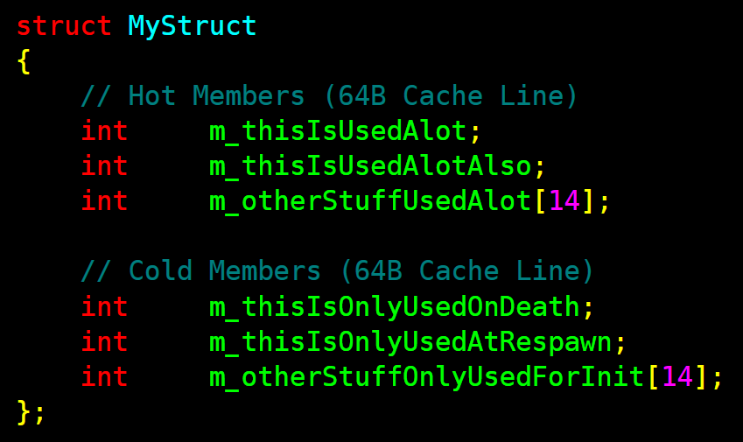
What is Cache Friendly Code?
Consider annotating struct/class members as Hot/Cold
Used every frame
Used occasionally
Used soon after var above

Slide 9
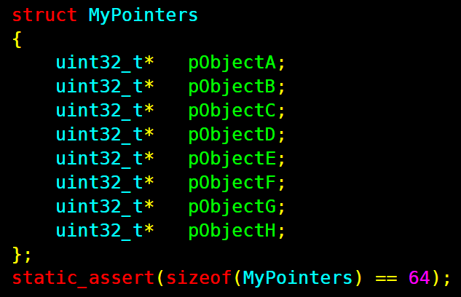
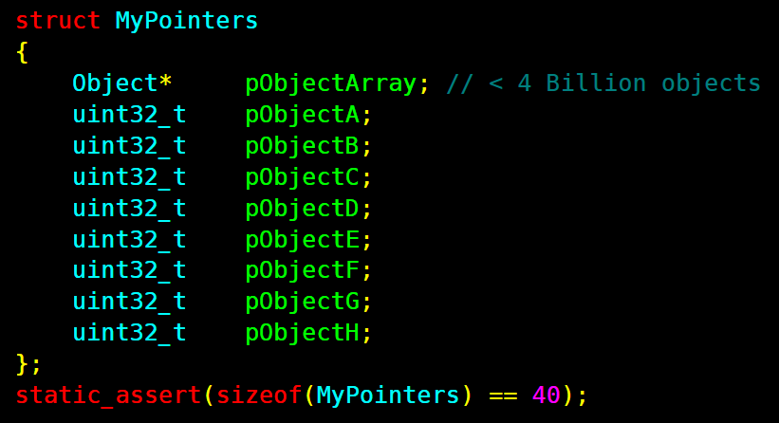
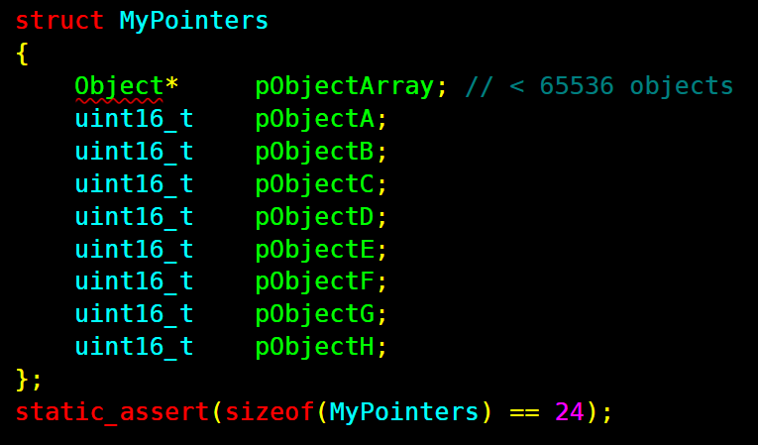
What is Cache Friendly Code?
Pointers are especially wasteful
64Bit pointer – Only 48/40bits are used on PC/Consoles
2-3 Bytes are wasted in each pointer
Imagine a structure that has thousands of instances
16B
(2B x 8)
wasted
~40% smaller
~60% smaller

Slide 10
What is Cache Friendly Code?
x86 has dedicated hardware for indexed addressing
Each core has Multiple Address Generation Units (AGU)
Calculates [pBase + (Index*1/2/4/8) + Offset]
AGU calculates address in parallel with other instructions
Consider storing just a single base pointer for system/array
Essentially a very cheap 64Bit Add+Shift+Add

Slide 11
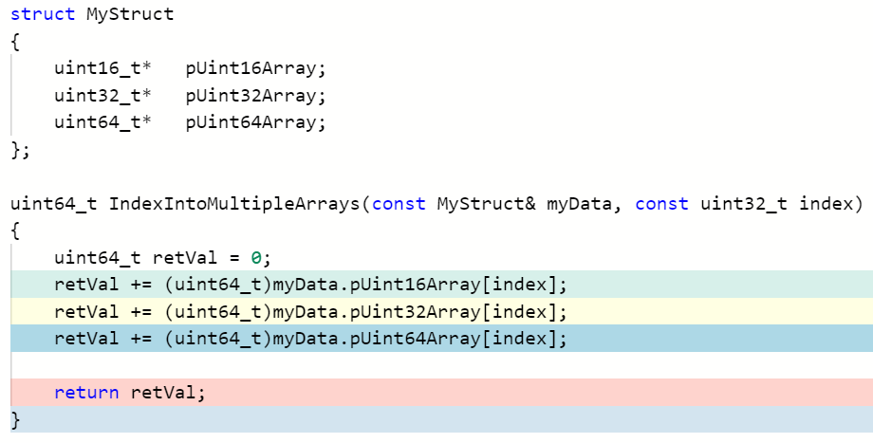
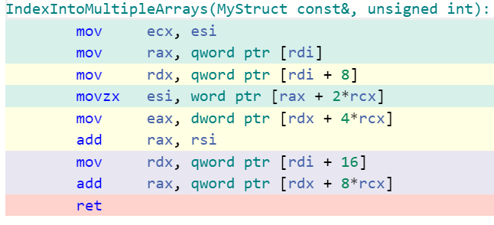
What is Cache Friendly Code?
https://godbolt.org/z/PPrMz7
x86 has dedicated hardware for indexed addressing

Slide 12
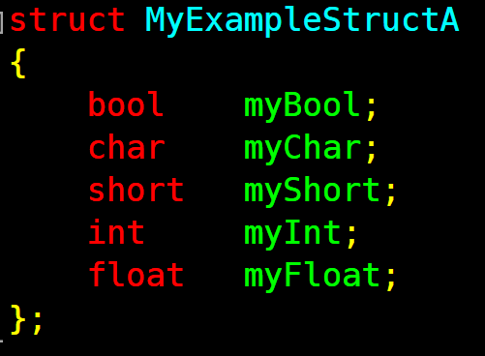
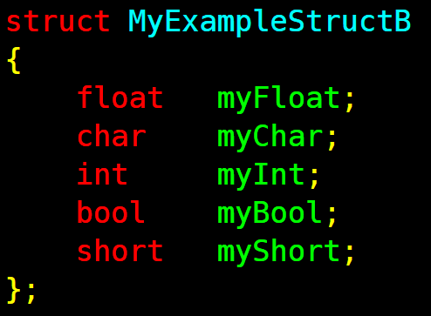

What is Cache Friendly Data?
Think in terms of Cache Lines (64B)
Check padding and alignment in structs

Slide 13
Static Asserts
Use ‘static_assert’
Alerts you to breaking changes made by other
Can notify others of your data layout intentions
Ensure struct is a multiple of cache lines
static_assert((sizeof(myStruct) % 64)==0,”Should be in cache lines”);
Notify intent
static_assert((sizeof(myStruct) == 128,”This should be 2 cache lines!”)

Slide 14
Keep data size in mind
https://godbolt.org/z/akHzUy
Favour the smallest data type possible
Less than 256 players in a game - use a ‘uint8_t’ for PlayerIndex
Less than 65536 items in an array – use a ‘uint16_t’ index
Make use of bit packing - uint32_t my7BitIndex:7
Try not to put ‘temp’ variables in structs/classes
float m_tmpCalcForLater;
Could be cheaper to re-calc when needed
The later Cache Miss could be 100s of CPU cycles

Slide 15
Un/necessary cache access
Do you need uniform initialisers ‘MyStruct newStruct = {}’
Are you actually going to set members straight after init?
The compiler may optimise the defaults away if values set later
But, if you don’t need to do it, then you don’t need to check
Why waste cycles doing twice the work you need to
Be careful to guard or test code against uninitialized members
Guarding is extra runtime work
#ifdef DEBUG might be more appropriate

Slide 16
Data pipeline
Are you iterating through a list and updating data for later?
Is this temporary data in the same class/struct?
Try to keep the ‘src’ and ‘dst’ data separated
Ideally, ‘dst’ data would be written out sequentially
Next stage of processing then iterates through sequential data
Likely (depending on working set) to still be in L1$, L2$, L3$
Could take advantage of HW pre-fetching reducing cost of D$ misses

Slide 17
Avoid Branches
Branches are bad (pipe), Bad(uOps), BAD(L1I$)
CPU Pipeline (pipe) stalls for mis-prediction are 10s of cycles
Micro-Ops (uOps) cache flushes are 20+ cycles
L1 I$ Miss, L2 Miss, L3 Miss, RAM might be 100s -> 1000s of cycles
Branches are a major issue for CPUs
Modern CPUs try to speculate about what to do next
CPU tries a best guess about why way a branch will go
Goes off and starts running code that may be wrong
An I$ miss that goes to RAM will almost stop the CPU core in it’s tracks
This is why ‘Hyper-threading’ was invented – Each core appears as multiple processors to OS
If one HW thread stalls on I$/D$ miss, another HW thread tries to do useful work

Slide 18
Avoid Branches
Try and avoid Branches where possible
Think carefully about using ‘branchy’ structures liked Linked-lists
Think carefully about using smart_ptr<> and virtual functions
Consider ternary expressions
float myVal = (someCondition) ? newVal : oldVal;
Most compilers try to optimise these to not use Branch instructions
x86,arm,powerpc have conditional move instructions for this type of optimisation
Write your own ‘ConditionalSelect(bCondition,valTrue,ValFalse)’ functions
Consider using maths instead of conditionals
Instead of “if (isTooFast) newSpeed = 0.0f;”
float killSpeed = (isTooFast) ? 0.0f : 1.0f;
newSpeed = oldSpeed * killSpeed;

Slide 19
Favour sequential access
Are some structs/classes always access sequentially?
Consider Structure of Arrays (SoA) vs Array of Structures (AoS)
Small member variables coalesce into small arrays of data types
Takes advantage of how CPUs Load/Store data
Less wasted space due to padding, alignment, etc
Potentially less compulsory cache misses

Slide 20
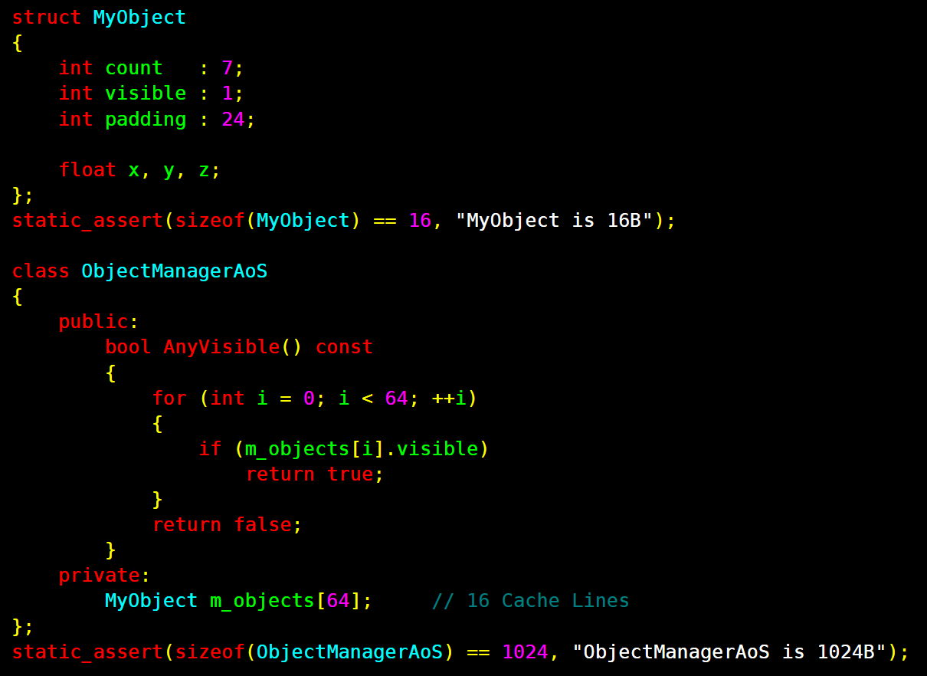
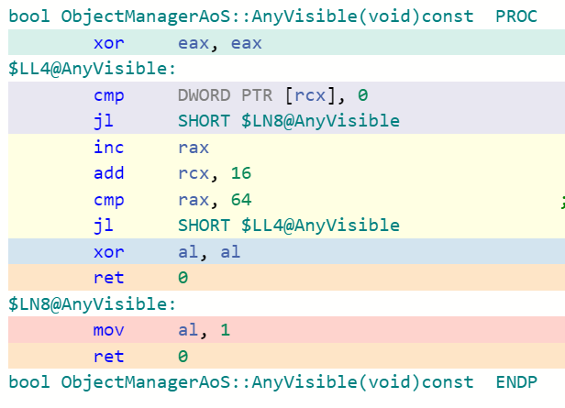
Array of Structures (AoS)
16 L1$ Misses = ~80 Cycles
16 L2$ Misses = ~240 Cycles
16 L3$ Misses = 10000+ Cycles

Slide 21
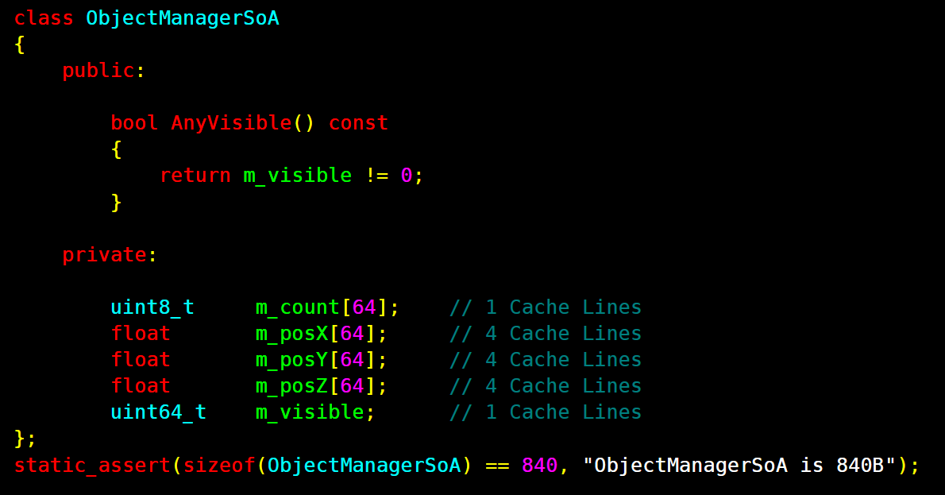
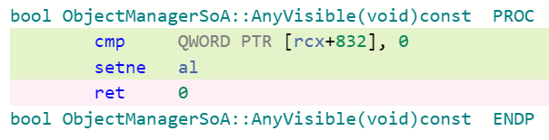
Structure of Arrays (SoA)
1 L1$ Miss = ~5 Cycles
1 L2$ Miss = ~15 Cycles
1 L3$ Miss = 1000+ Cycles

Slide 22
Summary
Keep data as small as possible
Keep data that is used together, close together
Keep frequently accessed data near each other
Think in terms of Cache Lines accessed
Consider re-organising data
Use ‘static_assert’ to alert you to changes, describe intent
Try to minimise or avoid conditionals and branches

Slide 23
What is Cache Friendly Code?
Questions?

