Slide 1
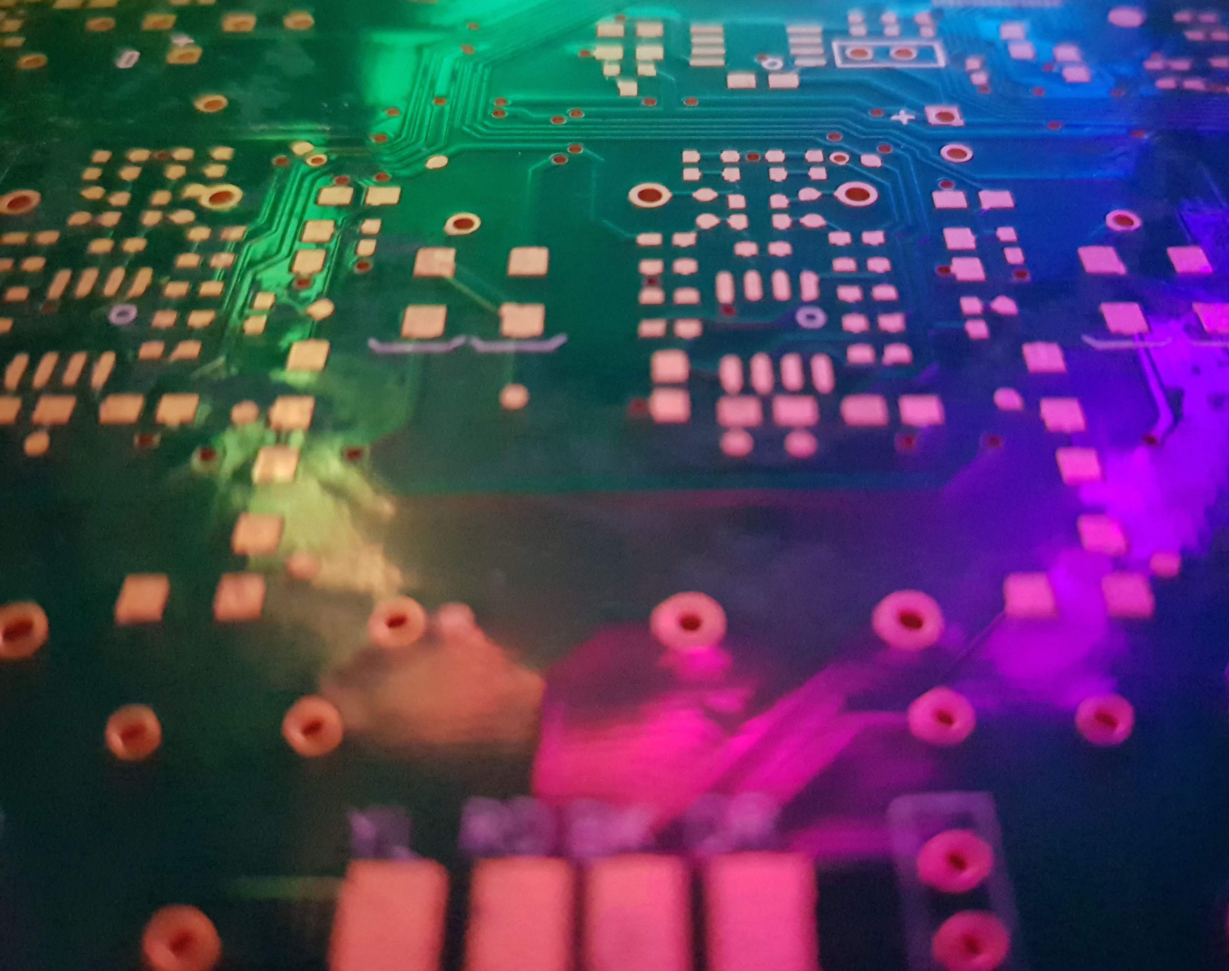
SIMD
A quick overview

Slide 2
Who am I?
Steve Humphries
Principal Programmer (Low-Level / Graphics)
Technical Director (Compute Unit Limited)
I’ve worked on a few different types of gaming hardware
Spectrum, AtariST, Amiga, PC, RaspberryPi
PlayStation1/2/3/4, Xbox/360/One, Switch
I’ve worked on a few games over the years
Music2000, TT Superbikes, MotorStorm 1/2/3, Driveclub, Onrush, …

Slide 3
What is SIMD?
Single Instruction Multiple Data
Aka - ‘Vector’ Instructions
SSE, Neon, VMX, SPU, AVX/512, GPU
Vector Registers ‘pack’ multiple ‘data’ values
Execute same operation on all values packed in register

Slide 4
What is SIMD?
Single Instruction Multiple Data
4 x float (SSE/Neon/VMX)
8 x float (AVX)
16 x float (AVX-512)
32 x float (NVidia Core)
64 x float (AMD Core)

Slide 5
Why SIMD?
Instruction Decode is usually expensive
Lots of transistor logic before you actually do useful work
Instructions per Cycle (IPC) key performance metric
How much work can be done per CPU clock cycle
How can IPC be increased?
Pack Instructions together – VLIW (Very Long Instruction Word)
Do more work for each Instruction decoded

Slide 6
Why SIMD?
Instruction Decode is usually expensive
Therefore, how much work could one instruction do?
Enter SIMD
Each instruction operates on multiple data items in parallel
Execute same operation multiple times
In a single cycle across many data items

Slide 7
Why SIMD?
More work for same # Instructions per Clock
Commonly (marketing) measured in FLOPS
FLOPS -> FLoating-point Operations Per Second
D = A + B = 1 Add = 1 FLOP
D = (A * B) + C = 1 Multiply and 1 Add = 2 FLOP
Multiply-Add on 8-Way SIMD unit = 16 x FLOP / cycle
ALU is relatively cheap compared to cache, registers, etc

Slide 8
Why SIMD?
Do more work per memory access
Read 2 x SIMD Registers + Write 1 x SIMD Register per instruction
SIMD can execute multiple operations (4,8,16,32) per R/W access
Data Caches are usually tuned to SIMD width
SIMD TYPE | Register Size | Read / Cycle | Write / Cycle
SSE | 16B | 2 x 16B | 16B
AVX | 32B | 2 x 32B | 32B
AVX-512 | 64B | 2 x 64B | 64B

Slide 9
Register Layout
Most SIMD instruction sets allow type aliasing
Using the same register viewed as different types
double / float / int32 / uint32 / int16 / int8
Can allow for ‘tricks’ such as masking bit31 of a float for sign
A few instructions can allow for moving data within register
Known as ‘Shuffle’ or ‘Permute’ or ‘Swizzle’
Useful for re-arranging fields, ie RGBA to BGRA or XYZW to XYXY

Slide 10
Register Layout
Data Type Aliasing - AVX
4 x double
8 x float
8 x int
16 x uint16
32 x uint8

Slide 11
Data-type Aliasing
Vector Register
double |  |  |  |  |  |  |  | double
float |  |  |  | float |  |  |  | float |  |  |  | float
int |  |  |  | int |  |  |  | int |  |  |  | int
int16 |  | int16 |  | int16 |  | int16 |  | int16 |  | int16 |  | int16 |  | int16
int8 | int8 | int8 | int8 | int8 | int8 | int8 | int8 | int8 | int8 | int8 | int8 | int8 | int8 | int8 | int8

Slide 12
SIMD Lanes
Think in terms of ‘Lanes’
4 x Lanes of ‘float’
8 x Lanes of ‘int16’
16 Lanes of ‘int8’
Most instructions operate on lanes individually
A few ‘cross-lane’ instructions like Shuffle

Slide 13
SIMD Lanes
Lane 0
Lane 1
Lane 2
Lane 3
float
float
float
float
int32
int32
int16
int8
int8
int32
int16
int8
int8
int32
int16
int8
int8
int16
Int8
int16
int16
int16
int16
int8
Int8
int8
int8
int8
int8
int8
int8
int8

Slide 14
SIMD Lanes
Lane 0
Lane 1
Lane 2
Lane 3
Lane 4
Lane 5
Lane 6
Lane 7
float
float
float
float
int32
int32
int16
int8
int8
int32
int16
int8
int8
int32
int16
int8
int8
int16
Int8
int16
int16
int16
int16
int8
Int8
int8
int8
int8
int8
int8
int8
int8

Slide 15
SIMD Lanes
Lane 0
Lane 1
Lane 2
Lane 3
Lane 4
Lane 5
Lane 6
Lane 7
Lane 8
Lane 9
Lane 10
Lane 11
Lane 12
Lane 13
Lane 14
Lane 15
float
float
float
float
int32
int32
int16
int8
int8
int32
int16
int8
int8
int32
int16
int8
int8
int16
Int8
int16
int16
int16
int16
int8
Int8
int8
int8
int8
int8
int8
int8
int8

Slide 16
Example instruction - vaddps
Vector Add Packed Scalar (float)
Vec Reg A
A0
A1
Vec Reg B
B0
B3
Vec Reg D
D0
D1
A2
A3
B1
B2
D2
D3
A4
A5
A6
A7
B4
B5
B6
B7
D4
D5
D6
D7
+ | + | + | + | + | + | + | +
= | = | = | = | = | = | = | =

Slide 17
Example instruction – vfmad213ps
Vector Fused-Multiply-Add Packed Scalar (ymm2, ymm1, ymm3)
Vec Reg A
A0
A1
Vec Reg B
B0
B3
Vec Reg D
D0
D1
A2
A3
B1
B2
D2
D3
Vec Reg C
C0
C1
C2
C3
A4
A5
A6
A7
B4
B5
B6
B7
C4
C5
C6
C7
D4
D5
D6
D7
x | x | x | x | x | x | x | x
+ | + | + | + | + | + | + | +
= | = | = | = | = | = | = | =

Slide 18
How to use SIMD?
Assembly
vfmadd213ps ymm1, ymm2, ymm3
Not very portable, difficult to maintain/refactor
Intrinsics
vecD = __mm256_fmadd_ps(vecA, vecB, vecC);
More portable, slightly easier to maintain/refactor
Compiler (Auto-Vectoriser)
float vecD = (vecA * vecB) + vecC;
Quite portable, very easy to maintain/refactor

Slide 19
What about compiler?
Compilers can ‘auto-vectorise’ code
But you need to help them
Favour ptr[] array access over Pointer Maths (ptr++)
ptr[index + offset]
Compiler can determine that ‘ptr’ is invariant
Auto-vectoriser doesn’t like conditionals / branches
Use Masks e.g. uint32 val = (trueVal & 0xffffffff) | (falseVal & 0x00000000)
Use Maths e.g. float val = (trueVal * 1.0f) + (falseVal * 0.0f)

Slide 20
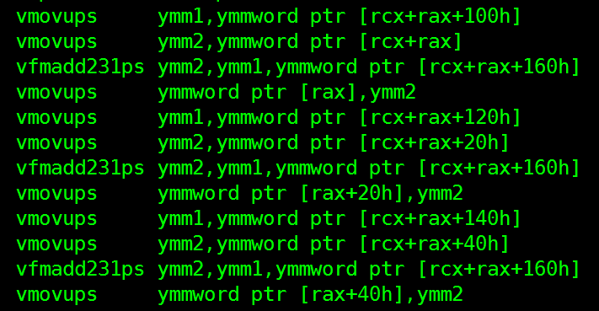
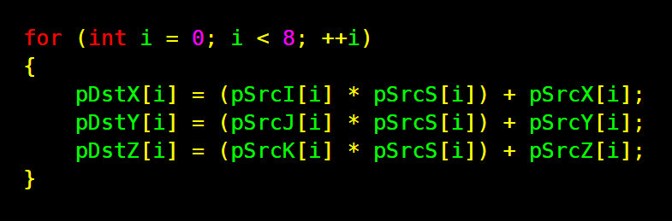
Example ‘auto-vectorisation’
x64 msvc v19.24 ‘cl.exe /arch:AVX2 /fp:fast’

Slide 21
Summary
Vector Instructions operate on multiple data items at once
A single instruction can do lots of ‘work’
Think in terms of ‘lanes’
Only a few special instructions for ‘changing lanes’
Compilers can auto-vectorise code
If written simply enough, favour ptr[] accesses and no branches

Slide 22
Questions?

