Slide 1
Chapter 22
Software Testing Strategies
Slide Set to accompany Software Engineering: A Practitioner’s Approach, 8/e
by Roger S. Pressman and Bruce R. Maxim
Slides copyright © 1996, 2001, 2005, 2009, 2014 by Roger S. Pressman
For non-profit educational use only
May be reproduced ONLY for student use at the university level when used in conjunction with Software Engineering: A Practitioner's Approach, 8/e. Any other reproduction or use is prohibited without the express written permission of the author.
All copyright information MUST appear if these slides are posted on a website for student use.
These slides are designed to accompany Software Engineering: A Practitioner’s Approach, 8/e (McGraw-Hill 2014). Slides copyright 2014 by Roger Pressman.
‹#›

Slide 2
Software Testing
Testing is the process of exercising a program with the specific intent of finding errors prior to delivery to the end user.
These slides are designed to accompany Software Engineering: A Practitioner’s Approach, 8/e (McGraw-Hill 2014). Slides copyright 2014 by Roger Pressman.
‹#›

Slide 3
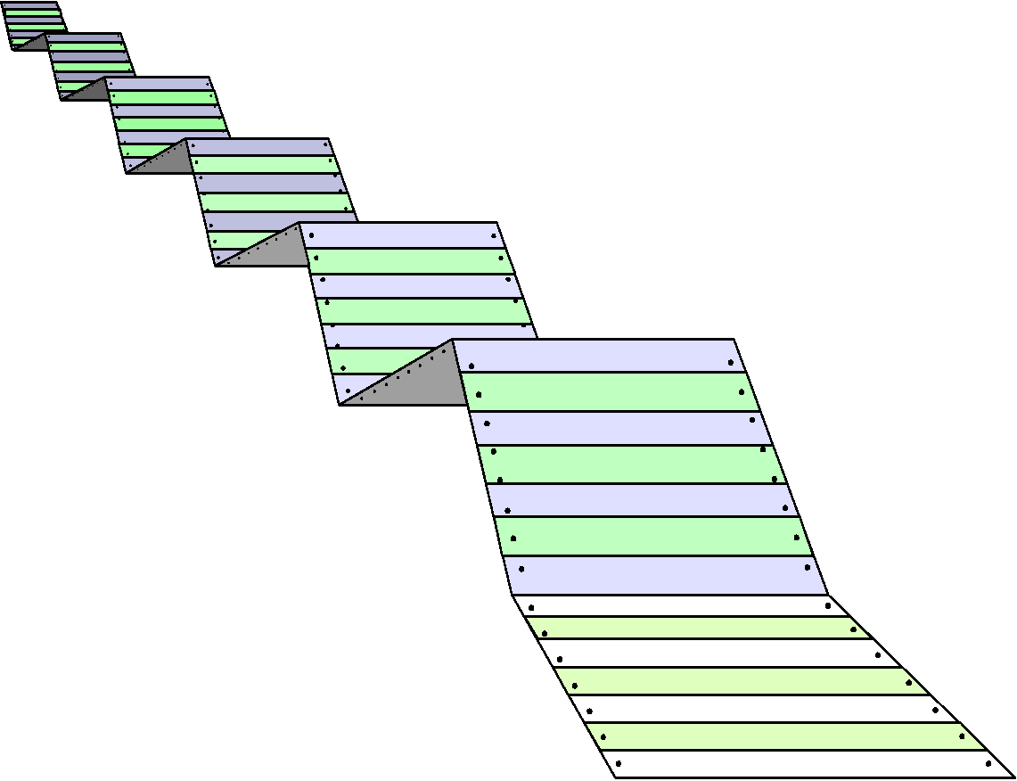
What Testing Shows
errors
requirements conformance
performance
an indication
of quality
These slides are designed to accompany Software Engineering: A Practitioner’s Approach, 8/e (McGraw-Hill 2014). Slides copyright 2014 by Roger Pressman.
‹#›

Slide 4
Strategic Approach
To perform effective testing, you should conduct effective technical reviews. By doing this, many errors will be eliminated before testing commences.
Testing begins at the component level and works "outward" toward the integration of the entire computer-based system.
Different testing techniques are appropriate for different software engineering approaches and at different points in time.
Testing is conducted by the developer of the software and (for large projects) an independent test group.
Testing and debugging are different activities, but debugging must be accommodated in any testing strategy.
These slides are designed to accompany Software Engineering: A Practitioner’s Approach, 8/e (McGraw-Hill 2014). Slides copyright 2014 by Roger Pressman.
‹#›

Slide 5
V & V
Verification refers to the set of tasks that ensure that software correctly implements a specific function.
Validation refers to a different set of tasks that ensure that the software that has been built is traceable to customer requirements. Boehm [Boe81] states this another way:
Verification: "Are we building the product right?"
Validation: "Are we building the right product?"
These slides are designed to accompany Software Engineering: A Practitioner’s Approach, 8/e (McGraw-Hill 2014). Slides copyright 2014 by Roger Pressman.
‹#›

Slide 6


Who Tests the Software?
developer
independent tester
Understands the system
Must learn about the system,
but, will test "gently"
but, will attempt to break it
and, is driven by "delivery"
and, is driven by quality
These slides are designed to accompany Software Engineering: A Practitioner’s Approach, 8/e (McGraw-Hill 2014). Slides copyright 2014 by Roger Pressman.
‹#›

Slide 7
Testing Strategy
System engineering
Analysis modeling
Design modeling
Code generation
Unit test
Integration test
Validation test
System test
These slides are designed to accompany Software Engineering: A Practitioner’s Approach, 8/e (McGraw-Hill 2014). Slides copyright 2014 by Roger Pressman.
‹#›

Slide 8
Testing Strategy
We begin by ‘testing-in-the-small’ and move toward ‘testing-in-the-large’
For conventional software
The module (component) is our initial focus
Integration of modules follows
For OO software
our focus when “testing in the small” changes from an individual module (the conventional view) to an OO class that encompasses attributes and operations and implies communication and collaboration
These slides are designed to accompany Software Engineering: A Practitioner’s Approach, 8/e (McGraw-Hill 2014). Slides copyright 2014 by Roger Pressman.
‹#›

Slide 9
Strategic Issues
Specify product requirements in a quantifiable manner long before testing commences.
State testing objectives explicitly.
Understand the users of the software and develop a profile for each user category.
Develop a testing plan that emphasizes “rapid cycle testing.”
Build “robust” software that is designed to test itself
Use effective technical reviews as a filter prior to testing
Conduct technical reviews to assess the test strategy and test cases themselves.
Develop a continuous improvement approach for the testing process.
These slides are designed to accompany Software Engineering: A Practitioner’s Approach, 8/e (McGraw-Hill 2014). Slides copyright 2014 by Roger Pressman.
‹#›

Slide 10


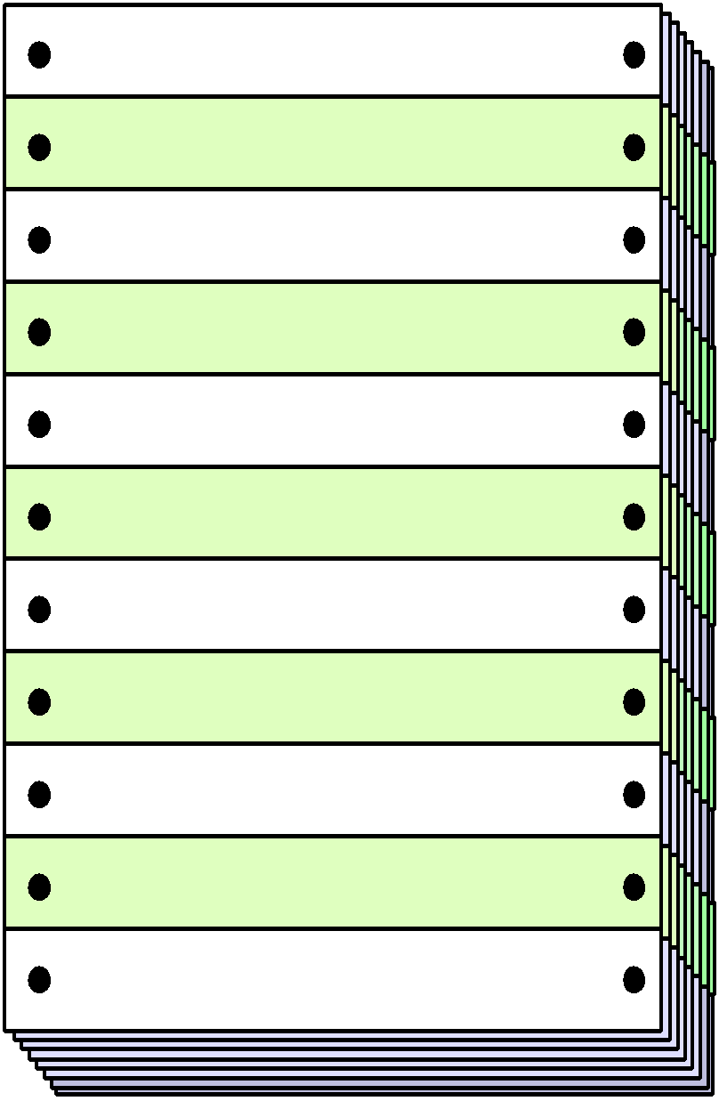
Unit Testing
module
to be
tested
results
software
engineer
test cases
These slides are designed to accompany Software Engineering: A Practitioner’s Approach, 8/e (McGraw-Hill 2014). Slides copyright 2014 by Roger Pressman.
‹#›

Slide 11
Unit Testing
module
to be
tested
interface
local data structures
boundary conditions
independent paths
error handling paths
test cases
These slides are designed to accompany Software Engineering: A Practitioner’s Approach, 8/e (McGraw-Hill 2014). Slides copyright 2014 by Roger Pressman.
‹#›

Slide 12
Unit Test Environment
driver
interface
local data structures
Module
boundary conditions
independent paths
error handling paths
stub
stub
test cases
RESULTS
These slides are designed to accompany Software Engineering: A Practitioner’s Approach, 8/e (McGraw-Hill 2014). Slides copyright 2014 by Roger Pressman.
‹#›

Slide 13
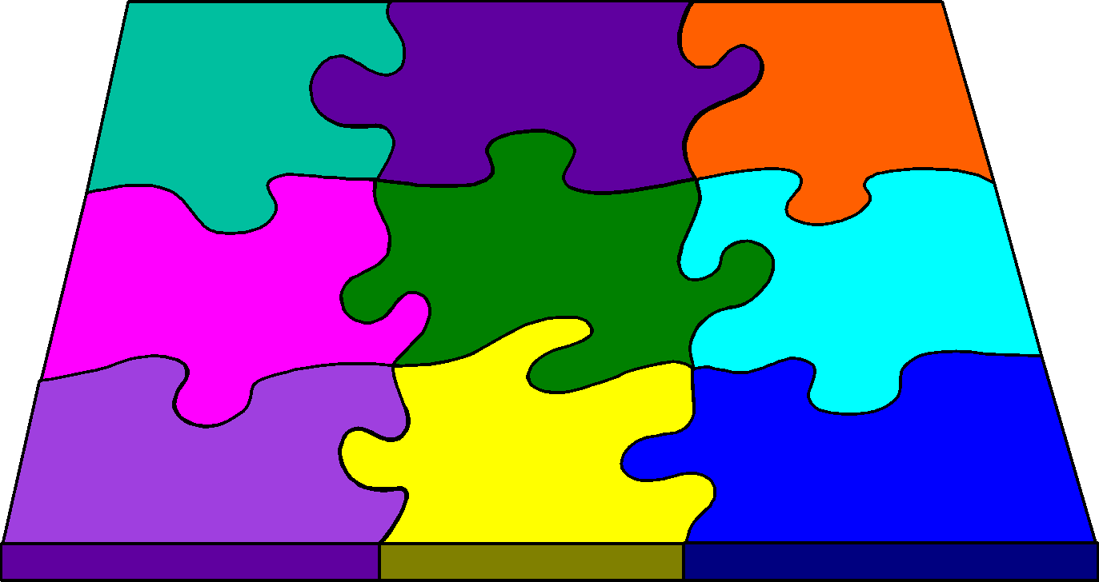
Integration Testing Strategies
Options:
• the “big bang” approach
• an incremental construction strategy
These slides are designed to accompany Software Engineering: A Practitioner’s Approach, 8/e (McGraw-Hill 2014). Slides copyright 2014 by Roger Pressman.
‹#›

Slide 14
Top Down Integration
A
top module is tested with
stubs
B
F
G
stubs are replaced one at
a time, "depth first"
C
as new modules are integrated,
some subset of tests is re-run
D
E
These slides are designed to accompany Software Engineering: A Practitioner’s Approach, 8/e (McGraw-Hill 2014). Slides copyright 2014 by Roger Pressman.
‹#›

Slide 15
Bottom-Up Integration
A
B
F
G
drivers are replaced one at a
time, "depth first"
C
worker modules are grouped into
builds and integrated
D
E
cluster
These slides are designed to accompany Software Engineering: A Practitioner’s Approach, 8/e (McGraw-Hill 2014). Slides copyright 2014 by Roger Pressman.
‹#›

Slide 16
Sandwich Testing
A
Top modules are
tested with stubs
B
F
G
C
Worker modules are grouped into
builds and integrated
D
E
cluster
These slides are designed to accompany Software Engineering: A Practitioner’s Approach, 8/e (McGraw-Hill 2014). Slides copyright 2014 by Roger Pressman.
‹#›

Slide 17
Regression Testing
Regression testing is the re-execution of some subset of tests that have already been conducted to ensure that changes have not propagated unintended side effects
Whenever software is corrected, some aspect of the software configuration (the program, its documentation, or the data that support it) is changed.
Regression testing helps to ensure that changes (due to testing or for other reasons) do not introduce unintended behavior or additional errors.
Regression testing may be conducted manually, by re-executing a subset of all test cases or using automated capture/playback tools.
These slides are designed to accompany Software Engineering: A Practitioner’s Approach, 8/e (McGraw-Hill 2014). Slides copyright 2014 by Roger Pressman.
‹#›

Slide 18
Smoke Testing
A common approach for creating “daily builds” for product software
Smoke testing steps:
Software components that have been translated into code are integrated into a “build.”
A build includes all data files, libraries, reusable modules, and engineered components that are required to implement one or more product functions.
A series of tests is designed to expose errors that will keep the build from properly performing its function.
The intent should be to uncover “show stopper” errors that have the highest likelihood of throwing the software project behind schedule.
The build is integrated with other builds and the entire product (in its current form) is smoke tested daily.
The integration approach may be top down or bottom up.
These slides are designed to accompany Software Engineering: A Practitioner’s Approach, 8/e (McGraw-Hill 2014). Slides copyright 2014 by Roger Pressman.
‹#›

Slide 19
General Testing Criteria
Interface integrity – internal and external module interfaces are tested as each module or cluster is added to the software
Functional validity – test to uncover functional defects in the software
Information content – test for errors in local or global data structures
Performance – verify specified performance bounds are tested
These slides are designed to accompany Software Engineering: A Practitioner’s Approach, 8/e (McGraw-Hill 2014). Slides copyright 2014 by Roger Pressman.
‹#›

Slide 20
Object-Oriented Testing
begins by evaluating the correctness and consistency of the analysis and design models
testing strategy changes
the concept of the ‘unit’ broadens due to encapsulation
integration focuses on classes and their execution across a ‘thread’ or in the context of a usage scenario
validation uses conventional black box methods
test case design draws on conventional methods, but also encompasses special features
These slides are designed to accompany Software Engineering: A Practitioner’s Approach, 8/e (McGraw-Hill 2014). Slides copyright 2014 by Roger Pressman.
‹#›

Slide 21
Broadening the View of “Testing”
It can be argued that the review of OO analysis and design models is especially useful because the same semantic constructs (e.g., classes, attributes, operations, messages) appear at the analysis, design, and code level. Therefore, a problem in the definition of class attributes that is uncovered during analysis will circumvent side effects that might occur if the problem were not discovered until design or code (or even the next iteration of analysis).
These slides are designed to accompany Software Engineering: A Practitioner’s Approach, 8/e (McGraw-Hill 2014). Slides copyright 2014 by Roger Pressman.
‹#›

Slide 22
Testing the CRC Model
1. Revisit the CRC model and the object-relationship model.
2. Inspect the description of each CRC index card to determine if a delegated responsibility is part of the collaborator’s definition.
3. Invert the connection to ensure that each collaborator that is asked for service is receiving requests from a reasonable source.
4. Using the inverted connections examined in step 3, determine whether other classes might be required or whether responsibilities are properly grouped among the classes.
5. Determine whether widely requested responsibilities might be combined into a single responsibility.
6. Steps 1 to 5 are applied iteratively to each class and through each evolution of the analysis model.
These slides are designed to accompany Software Engineering: A Practitioner’s Approach, 8/e (McGraw-Hill 2014). Slides copyright 2014 by Roger Pressman.
‹#›

Slide 23
OO Testing Strategy
class testing is the equivalent of unit testing
operations within the class are tested
the state behavior of the class is examined
integration applied three different strategies
thread-based testing—integrates the set of classes required to respond to one input or event
use-based testing—integrates the set of classes required to respond to one use case
cluster testing—integrates the set of classes required to demonstrate one collaboration
These slides are designed to accompany Software Engineering: A Practitioner’s Approach, 8/e (McGraw-Hill 2014). Slides copyright 2014 by Roger Pressman.
‹#›

Slide 24
WebApp Testing - I
The content model for the WebApp is reviewed to uncover errors.
The interface model is reviewed to ensure that all use cases can be accommodated.
The design model for the WebApp is reviewed to uncover navigation errors.
The user interface is tested to uncover errors in presentation and/or navigation mechanics.
Each functional component is unit tested.
These slides are designed to accompany Software Engineering: A Practitioner’s Approach, 8/e (McGraw-Hill 2014). Slides copyright 2014 by Roger Pressman.
‹#›

Slide 25
WebApp Testing - II
Navigation throughout the architecture is tested.
The WebApp is implemented in a variety of different environmental configurations and is tested for compatibility with each configuration.
Security tests are conducted in an attempt to exploit vulnerabilities in the WebApp or within its environment.
Performance tests are conducted.
The WebApp is tested by a controlled and monitored population of end-users. The results of their interaction with the system are evaluated for content and navigation errors, usability concerns, compatibility concerns, and WebApp reliability and performance.
These slides are designed to accompany Software Engineering: A Practitioner’s Approach, 8/e (McGraw-Hill 2014). Slides copyright 2014 by Roger Pressman.
‹#›

Slide 26
MobileApp Testing
User experience testing – ensuring app meets stakeholder usability and accessibility expectations
Device compatibility testing – testing on multiple devices
Performance testing – testing non-functional requirements
Connectivity testing – testing ability of app to connect reliably
Security testing – ensuring app meets stakeholder security expectations
Testing-in-the-wild – testing app on user devices in actual user environments
Certification testing – app meets the distribution standards
These slides are designed to accompany Software Engineering: A Practitioner’s Approach, 8/e (McGraw-Hill 2014). Slides copyright 2014 by Roger Pressman.
‹#›

Slide 27
High Order Testing
Validation testing
Focus is on software requirements
System testing
Focus is on system integration
Alpha/Beta testing
Focus is on customer usage
Recovery testing
forces the software to fail in a variety of ways and verifies that recovery is properly performed
Security testing
verifies that protection mechanisms built into a system will, in fact, protect it from improper penetration
Stress testing
executes a system in a manner that demands resources in abnormal quantity, frequency, or volume
Performance Testing
test the run-time performance of software within the context of an integrated system
These slides are designed to accompany Software Engineering: A Practitioner’s Approach, 8/e (McGraw-Hill 2014). Slides copyright 2014 by Roger Pressman.
‹#›

Slide 28

Debugging: A Diagnostic Process
These slides are designed to accompany Software Engineering: A Practitioner’s Approach, 8/e (McGraw-Hill 2014). Slides copyright 2014 by Roger Pressman.
‹#›

Slide 29
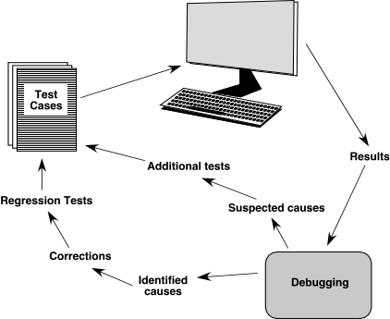
The Debugging Process
These slides are designed to accompany Software Engineering: A Practitioner’s Approach, 8/e (McGraw-Hill 2014). Slides copyright 2014 by Roger Pressman.
‹#›

Slide 30
Debugging Effort
time required
to diagnose the
symptom and
determine the
cause
time required
to correct the error
and conduct
regression tests
These slides are designed to accompany Software Engineering: A Practitioner’s Approach, 8/e (McGraw-Hill 2014). Slides copyright 2014 by Roger Pressman.
‹#›

Slide 31
Symptoms & Causes
symptom and cause may be
geographically separated
symptom may disappear when
another problem is fixed
cause may be due to a
combination of non-errors
cause may be due to a system
or compiler error
symptom
cause may be due to
assumptions that everyone
cause
believes
symptom may be intermittent
These slides are designed to accompany Software Engineering: A Practitioner’s Approach, 8/e (McGraw-Hill 2014). Slides copyright 2014 by Roger Pressman.
‹#›

Slide 32
Consequences of Bugs
infectious
damage
catastrophic
extreme
serious
disturbing
annoying
mild
Bug Type
Bug Categories:
function-related bugs,
system-related bugs, data bugs, coding bugs,
design bugs, documentation bugs, standards
violations, etc.
These slides are designed to accompany Software Engineering: A Practitioner’s Approach, 8/e (McGraw-Hill 2014). Slides copyright 2014 by Roger Pressman.
‹#›

Slide 33
Debugging Techniques
brute force / testing
backtracking
induction
deduction
These slides are designed to accompany Software Engineering: A Practitioner’s Approach, 8/e (McGraw-Hill 2014). Slides copyright 2014 by Roger Pressman.
‹#›

Slide 34
Correcting the Error
Is the cause of the bug reproduced in another part of the program? In many situations, a program defect is caused by an erroneous pattern of logic that may be reproduced elsewhere.
What "next bug" might be introduced by the fix I'm about to make? Before the correction is made, the source code (or, better, the design) should be evaluated to assess coupling of logic and data structures.
What could we have done to prevent this bug in the first place? This question is the first step toward establishing a statistical software quality assurance approach. If you correct the process as well as the product, the bug will be removed from the current program and may be eliminated from all future programs.
These slides are designed to accompany Software Engineering: A Practitioner’s Approach, 8/e (McGraw-Hill 2014). Slides copyright 2014 by Roger Pressman.
‹#›

Slide 35
Final Thoughts
Think -- before you act to correct
Use tools to gain additional insight
If you’re at an impasse, get help from someone else
Once you correct the bug, use regression testing to uncover any side effects
These slides are designed to accompany Software Engineering: A Practitioner’s Approach, 8/e (McGraw-Hill 2014). Slides copyright 2014 by Roger Pressman.
‹#›

