Slide 1
Chapter 24
Testing Object-Oriented Applications
Slide Set to accompany Software Engineering: A Practitioner’s Approach, 8/e
by Roger S. Pressman and Bruce R.Maxim
Slides copyright © 1996, 2001, 2005, 2009, 2014 by Roger S. Pressman
For non-profit educational use only
May be reproduced ONLY for student use at the university level when used in conjunction with Software Engineering: A Practitioner's Approach, 8/e. Any other reproduction or use is prohibited without the express written permission of the author.
All copyright information MUST appear if these slides are posted on a website for student use.
These slides are designed to accompany Software Engineering: A Practitioner’s Approach, 8/e (McGraw-Hill 2014). Slides copyright 2014 by Roger Pressman.
‹#›

Slide 2
OO Testing
To adequately test OO systems, three things must be done:
the definition of testing must be broadened to include error discovery techniques applied to object-oriented analysis and design models
the strategy for unit and integration testing must change significantly, and
the design of test cases must account for the unique characteristics of OO software.
These slides are designed to accompany Software Engineering: A Practitioner’s Approach, 8/e (McGraw-Hill 2014). Slides copyright 2014 by Roger Pressman.
‹#›

Slide 3
‘Testing’ OO Models
The review of OO analysis and design models is especially useful because the same semantic constructs (e.g., classes, attributes, operations, messages) appear at the analysis, design, and code level
Therefore, a problem in the definition of class attributes that is uncovered during analysis will circumvent side affects that might occur if the problem were not discovered until design or code (or even the next iteration of analysis).
These slides are designed to accompany Software Engineering: A Practitioner’s Approach, 8/e (McGraw-Hill 2014). Slides copyright 2014 by Roger Pressman.
‹#›

Slide 4
Correctness of OO Models
During analysis and design, semantic correctness can be asesssed based on the model’s conformance to the real world problem domain.
If the model accurately reflects the real world (to a level of detail that is appropriate to the stage of development at which the model is reviewed) then it is semantically correct.
To determine whether the model does, in fact, reflect real world requirements, it should be presented to problem domain experts who will examine the class definitions and hierarchy for omissions and ambiguity.
Class relationships (instance connections) are evaluated to determine whether they accurately reflect real-world object connections.
These slides are designed to accompany Software Engineering: A Practitioner’s Approach, 8/e (McGraw-Hill 2014). Slides copyright 2014 by Roger Pressman.
‹#›

Slide 5
Class Model Consistency
Revisit the CRC model and the object-relationship model.
Inspect the description of each CRC index card to determine if a delegated responsibility is part of the collaborator’s definition.
Invert the connection to ensure that each collaborator that is asked for service is receiving requests from a reasonable source.
Using the inverted connections examined in the preceding step, determine whether other classes might be required or whether responsibilities are properly grouped among the classes.
Determine whether widely requested responsibilities might be combined into a single responsibility.
These slides are designed to accompany Software Engineering: A Practitioner’s Approach, 8/e (McGraw-Hill 2014). Slides copyright 2014 by Roger Pressman.
‹#›

Slide 6
OO Testing Strategies
Unit testing
the concept of the unit changes
the smallest testable unit is the encapsulated class
a single operation can no longer be tested in isolation (the conventional view of unit testing) but rather, as part of a class
Integration Testing
Thread-based testing integrates the set of classes required to respond to one input or event for the system
Use-based testing begins the construction of the system by testing those classes (called independent classes) that use very few (if any) of server classes. After the independent classes are tested, the next layer of classes, called dependent classes
Cluster testing [McG94] defines a cluster of collaborating classes (determined by examining the CRC and object-relationship model) is exercised by designing test cases that attempt to uncover errors in the collaborations.
These slides are designed to accompany Software Engineering: A Practitioner’s Approach, 8/e (McGraw-Hill 2014). Slides copyright 2014 by Roger Pressman.
‹#›

Slide 7
OO Testing Strategies
Validation Testing
details of class connections disappear
draw upon use cases (Chapters 5 and 6) that are part of the requirements model
Conventional black-box testing methods (Chapter 18) can be used to drive validation tests
These slides are designed to accompany Software Engineering: A Practitioner’s Approach, 8/e (McGraw-Hill 2014). Slides copyright 2014 by Roger Pressman.
‹#›

Slide 8
OOT Methods
Berard [Ber93] proposes the following approach:
1. Each test case should be uniquely identified and should be explicitly associated with the class to be tested,
2. The purpose of the test should be stated,
3. A list of testing steps should be developed for each test and should contain [BER94]:
a. a list of specified states for the object that is to be tested
b. a list of messages and operations that will be exercised as a consequence of the test
c. a list of exceptions that may occur as the object is tested
d. a list of external conditions (i.e., changes in the environment external to the software that must exist in order to properly conduct the test)
e. supplementary information that will aid in understanding or implementing the test.
These slides are designed to accompany Software Engineering: A Practitioner’s Approach, 8/e (McGraw-Hill 2014). Slides copyright 2014 by Roger Pressman.
‹#›

Slide 9
Testing Methods
Fault-based testing
The tester looks for plausible faults (i.e., aspects of the implementation of the system that may result in defects). To determine whether these faults exist, test cases are designed to exercise the design or code.
Class Testing and the Class Hierarchy
Inheritance does not obviate the need for thorough testing of all derived classes. In fact, it can actually complicate the testing process.
Scenario-Based Test Design
Scenario-based testing concentrates on what the user does, not what the product does. This means capturing the tasks (via use-cases) that the user has to perform, then applying them and their variants as tests.
These slides are designed to accompany Software Engineering: A Practitioner’s Approach, 8/e (McGraw-Hill 2014). Slides copyright 2014 by Roger Pressman.
‹#›

Slide 10
OOT Methods: Random Testing
Random testing
identify operations applicable to a class
define constraints on their use
identify a minimum test sequence
an operation sequence that defines the minimum life history of the class (object)
generate a variety of random (but valid) test sequences
exercise other (more complex) class instance life histories
These slides are designed to accompany Software Engineering: A Practitioner’s Approach, 8/e (McGraw-Hill 2014). Slides copyright 2014 by Roger Pressman.
‹#›

Slide 11
OOT Methods: Partition Testing
Partition Testing
reduces the number of test cases required to test a class in much the same way as equivalence partitioning for conventional software
state-based partitioning
categorize and test operations based on their ability to change the state of a class
attribute-based partitioning
categorize and test operations based on the attributes that they use
category-based partitioning
categorize and test operations based on the generic function each performs
These slides are designed to accompany Software Engineering: A Practitioner’s Approach, 8/e (McGraw-Hill 2014). Slides copyright 2014 by Roger Pressman.
‹#›

Slide 12
OOT Methods: Inter-Class Testing
Inter-class testing
For each client class, use the list of class operators to generate a series of random test sequences. The operators will send messages to other server classes.
For each message that is generated, determine the collaborator class and the corresponding operator in the server object.
For each operator in the server object (that has been invoked by messages sent from the client object), determine the messages that it transmits.
For each of the messages, determine the next level of operators that are invoked and incorporate these into the test sequence
These slides are designed to accompany Software Engineering: A Practitioner’s Approach, 8/e (McGraw-Hill 2014). Slides copyright 2014 by Roger Pressman.
‹#›

Slide 13
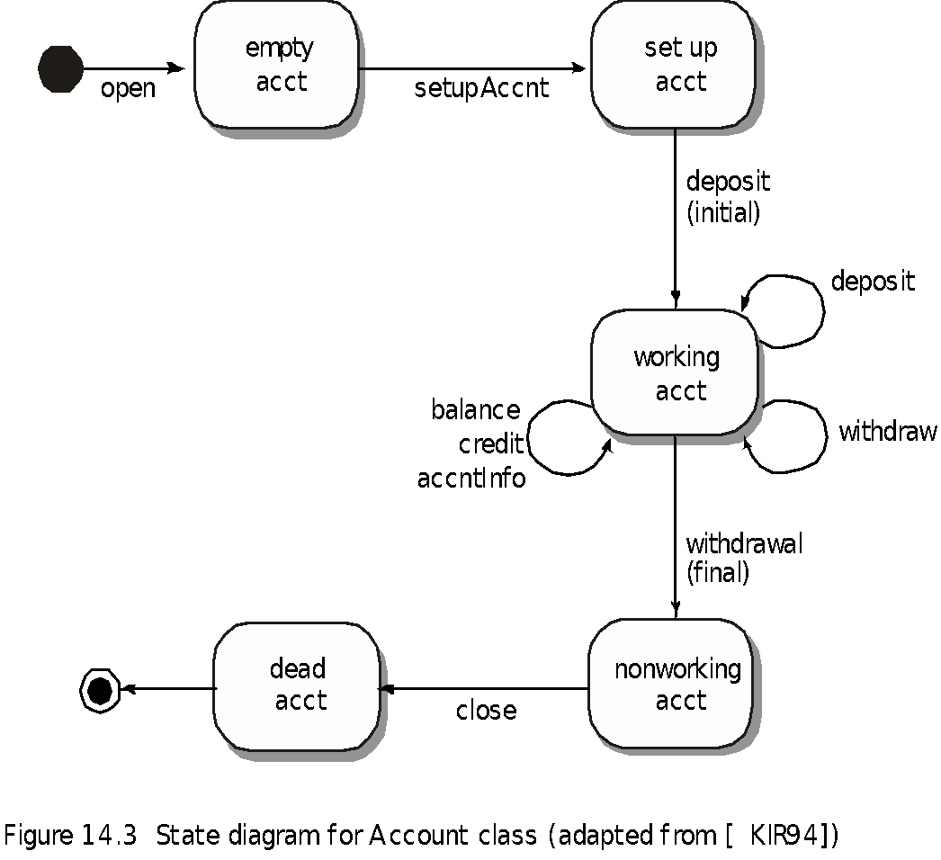
OOT Methods: Behavior Testing
The tests to be designed should achieve all state coverage [KIR94]. That is, the operation sequences should cause the Account class to make transition through all allowable states
These slides are designed to accompany Software Engineering: A Practitioner’s Approach, 8/e (McGraw-Hill 2014). Slides copyright 2014 by Roger Pressman.
‹#›

