Slide 1
Chapter 25
Testing Web Applications
Slide Set to accompany Software Engineering: A Practitioner’s Approach, 8/e
by Roger S. Pressman and Bruce R. Maxim
Slides copyright © 1996, 2001, 2005, 2009, 2014 by Roger S. Pressman
For non-profit educational use only
May be reproduced ONLY for student use at the university level when used in conjunction with Software Engineering: A Practitioner's Approach, 8/e. Any other reproduction or use is prohibited without the express written permission of the author.
All copyright information MUST appear if these slides are posted on a website for student use.
These slides are designed to accompany Software Engineering: A Practitioner’s Approach, 8/e (McGraw-Hill 2014). Slides copyright 2014 by Roger Pressman.
‹#›

Slide 2
Testing Quality Dimensions-I
Content is evaluated at both a syntactic and semantic level.
syntactic level—spelling, punctuation and grammar are assessed for text-based documents.
semantic level—correctness (of information presented), consistency (across the entire content object and related objects) and lack of ambiguity are all assessed.
Function is tested for correctness, instability, and general conformance to appropriate implementation standards (e.g.,Java or XML language standards).
Structure is assessed to ensure that it
properly delivers WebApp content and function
is extensible
can be supported as new content or functionality is added.
These slides are designed to accompany Software Engineering: A Practitioner’s Approach, 8/e (McGraw-Hill 2014). Slides copyright 2014 by Roger Pressman.
‹#›

Slide 3
Testing Quality Dimensions-II
Usability is tested to ensure that each category of user
is supported by the interface
can learn and apply all required navigation syntax and semantics
Navigability is tested to ensure that
all navigation syntax and semantics are exercised to uncover any navigation errors (e.g., dead links, improper links, erroneous links).
Performance is tested under a variety of operating conditions, configurations, and loading to ensure that
the system is responsive to user interaction
the system handles extreme loading without unacceptable operational degradation
These slides are designed to accompany Software Engineering: A Practitioner’s Approach, 8/e (McGraw-Hill 2014). Slides copyright 2014 by Roger Pressman.
‹#›

Slide 4
Testing Quality Dimensions-III
Compatibility is tested by executing the WebApp in a variety of different host configurations on both the client and server sides.
The intent is to find errors that are specific to a unique host configuration.
Interoperability is tested to ensure that the WebApp properly interfaces with other applications and/or databases.
Security is tested by assessing potential vulnerabilities and attempting to exploit each.
Any successful penetration attempt is deemed a security failure.
These slides are designed to accompany Software Engineering: A Practitioner’s Approach, 8/e (McGraw-Hill 2014). Slides copyright 2014 by Roger Pressman.
‹#›

Slide 5
Errors in a WebApp
Because many types of WebApp tests uncover problems that are first evidenced on the client side, you often see a symptom of the error, not the error itself.
Because a WebApp is implemented in a number of different configurations and within different environments, it may be difficult or impossible to reproduce an error outside the environment in which the error was originally encountered.
Although some errors are the result of incorrect design or improper HTML (or other programming language) coding, many errors can be traced to the WebApp configuration.
Because WebApps reside within a client/server architecture, errors can be difficult to trace across three architectural layers: the client, the server, or the network itself.
Some errors are due to the static operating environment (i.e., the specific configuration in which testing is conducted), while others are attributable to the dynamic operating environment (i.e., instantaneous resource loading or time-related errors).
These slides are designed to accompany Software Engineering: A Practitioner’s Approach, 8/e (McGraw-Hill 2014). Slides copyright 2014 by Roger Pressman.
‹#›

Slide 6
WebApp Testing Strategy-I
The content model for the WebApp is reviewed to uncover errors.
The interface model is reviewed to ensure that all use-cases can be accommodated.
The design model for the WebApp is reviewed to uncover navigation errors.
The user interface is tested to uncover errors in presentation and/or navigation mechanics.
Selected functional components are unit tested.
These slides are designed to accompany Software Engineering: A Practitioner’s Approach, 8/e (McGraw-Hill 2014). Slides copyright 2014 by Roger Pressman.
‹#›

Slide 7
WebApp Testing Strategy-II
Navigation throughout the architecture is tested.
The WebApp is implemented in a variety of different environmental configurations and is tested for compatibility with each configuration.
Security tests are conducted in an attempt to exploit vulnerabilities in the WebApp or within its environment.
Performance tests are conducted.
The WebApp is tested by a controlled and monitored population of end-users
the results of their interaction with the system are evaluated for content and navigation errors, usability concerns, compatibility concerns, and WebApp reliability and performance.
These slides are designed to accompany Software Engineering: A Practitioner’s Approach, 8/e (McGraw-Hill 2014). Slides copyright 2014 by Roger Pressman.
‹#›

Slide 8
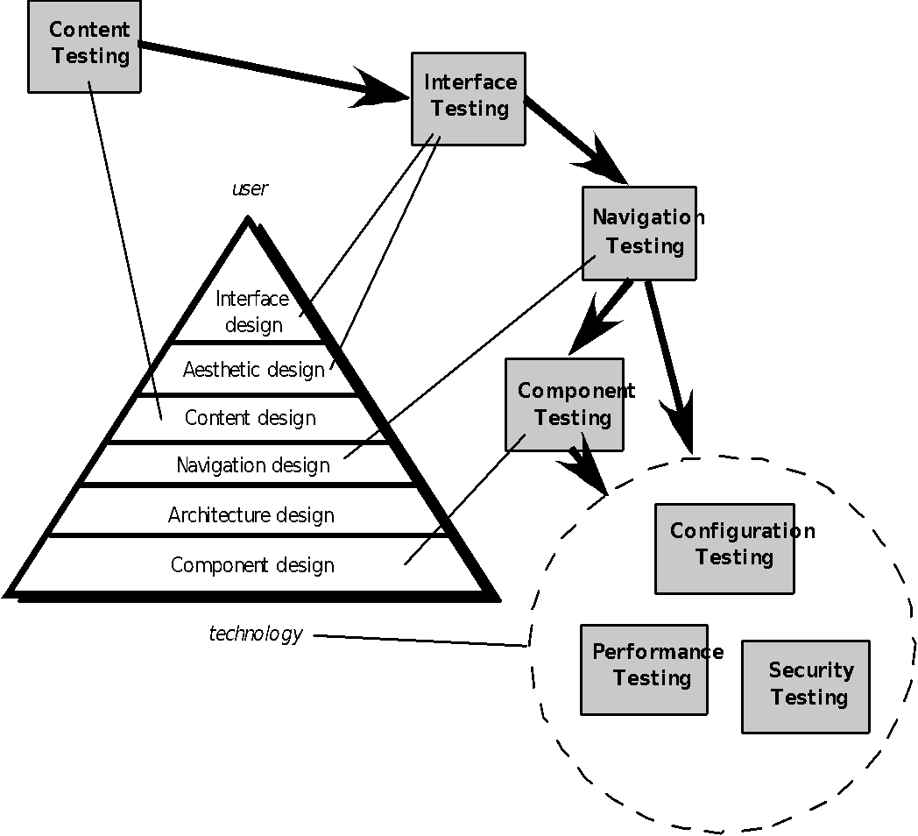
The Testing Process
These slides are designed to accompany Software Engineering: A Practitioner’s Approach, 8/e (McGraw-Hill 2014). Slides copyright 2014 by Roger Pressman.
‹#›

Slide 9
Content Testing
Content testing has three important objectives:
to uncover syntactic errors (e.g., typos, grammar mistakes) in text-based documents, graphical representations, and other media
to uncover semantic errors (i.e., errors in the accuracy or completeness of information) in any content object presented as navigation occurs, and
to find errors in the organization or structure of content that is presented to the end-user.
These slides are designed to accompany Software Engineering: A Practitioner’s Approach, 8/e (McGraw-Hill 2014). Slides copyright 2014 by Roger Pressman.
‹#›

Slide 10
Assessing Content Semantics
Is the information factually accurate?
Is the information concise and to the point?
Is the layout of the content object easy for the user to understand?
Can information embedded within a content object be found easily?
Have proper references been provided for all information derived from other sources?
Is the information presented consistent internally and consistent with information presented in other content objects?
Is the content offensive, misleading, or does it open the door to litigation?
Does the content infringe on existing copyrights or trademarks?
Does the content contain internal links that supplement existing content? Are the links correct?
Does the aesthetic style of the content conflict with the aesthetic style of the interface?
These slides are designed to accompany Software Engineering: A Practitioner’s Approach, 8/e (McGraw-Hill 2014). Slides copyright 2014 by Roger Pressman.
‹#›

Slide 11
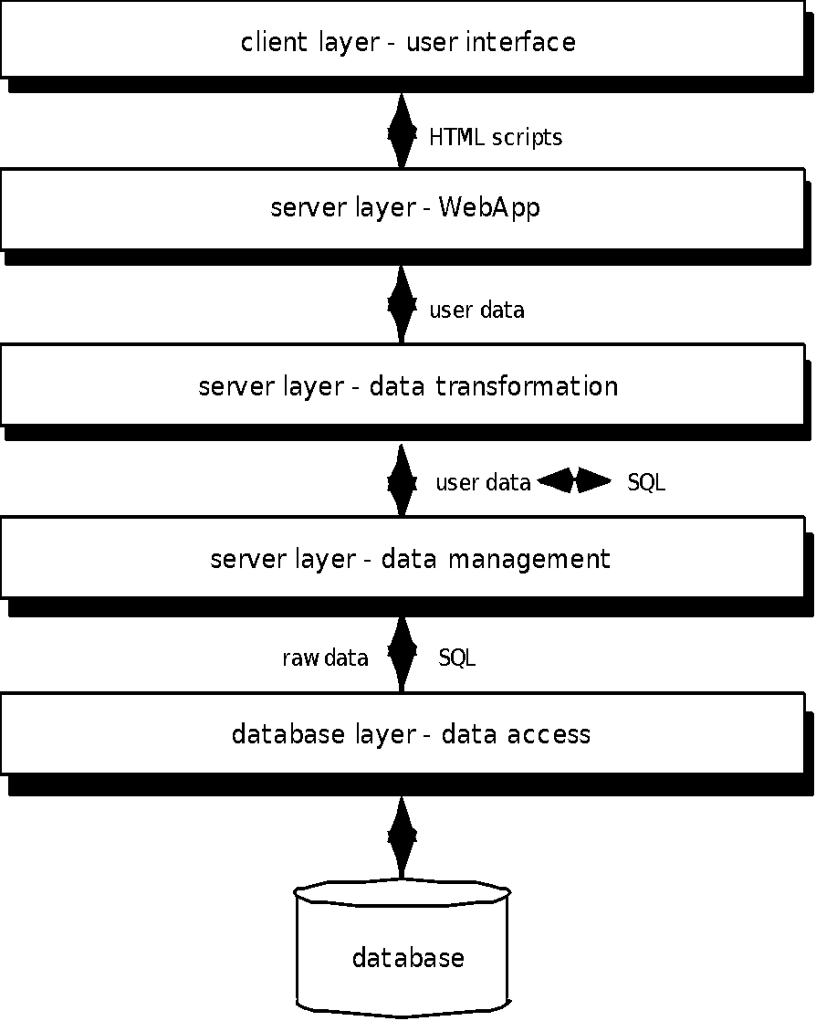
Database Testing
Tests are defined for
each layer
These slides are designed to accompany Software Engineering: A Practitioner’s Approach, 8/e (McGraw-Hill 2014). Slides copyright 2014 by Roger Pressman.
‹#›

Slide 12
User Interface Testing
Interface features are tested to ensure that design rules, aesthetics, and related visual content is available for the user without error.
Individual interface mechanisms are tested in a manner that is analogous to unit testing.
Each interface mechanism is tested within the context of a use-case or NSU for a specific user category.
The complete interface is tested against selected use-cases and NSUs to uncover errors in the semantics of the interface.
The interface is tested within a variety of environments (e.g., browsers) to ensure that it will be compatible.
These slides are designed to accompany Software Engineering: A Practitioner’s Approach, 8/e (McGraw-Hill 2014). Slides copyright 2014 by Roger Pressman.
‹#›

Slide 13
Testing Interface Mechanisms-I
Links—navigation mechanisms that link the user to some other content object or function.
Forms—a structured document containing blank fields that are filled in by the user. The data contained in the fields are used as input to one or more WebApp functions.
Client-side scripting—a list of programmed commands in a scripting language (e.g., Javascript) that handle information input via forms or other user interactions
Dynamic HTML—leads to content objects that are manipulated on the client side using scripting or cascading style sheets (CSS).
Client-side pop-up windows—small windows that pop-up without user interaction. These windows can be content-oriented and may require some form of user interaction.
These slides are designed to accompany Software Engineering: A Practitioner’s Approach, 8/e (McGraw-Hill 2014). Slides copyright 2014 by Roger Pressman.
‹#›

Slide 14
Testing Interface Mechanisms-II
CGI scripts—a common gateway interface (CGI) script implements a standard method that allows a Web server to interact dynamically with users (e.g., a WebApp that contains forms may use a CGI script to process the data contained in the form once it is submitted by the user).
Streaming content—rather than waiting for a request from the client-side, content objects are downloaded automatically from the server side. This approach is sometimes called “push” technology because the server pushes data to the client.
Cookies—a block of data sent by the server and stored by a browser as a consequence of a specific user interaction. The content of the data is WebApp-specific (e.g., user identification data or a list of items that have been selected for purchase by the user).
Application specific interface mechanisms—include one or more “macro” interface mechanisms such as a shopping cart, credit card processing, or a shipping cost calculator.
These slides are designed to accompany Software Engineering: A Practitioner’s Approach, 8/e (McGraw-Hill 2014). Slides copyright 2014 by Roger Pressman.
‹#›

Slide 15
Usability Tests
Design by WebE team … executed by end-users
Testing sequence …
Define a set of usability testing categories and identify goals for each.
Design tests that will enable each goal to be evaluated.
Select participants who will conduct the tests.
Instrument participants’ interaction with the WebApp while testing is conducted.
Develop a mechanism for assessing the usability of the WebApp
Different levels of abstraction:
the usability of a specific interface mechanism (e.g., a form) can be assessed
the usability of a complete Web page (encompassing interface mechanisms, data objects and related functions) can be evaluated
the usability of the complete WebApp can be considered.
These slides are designed to accompany Software Engineering: A Practitioner’s Approach, 8/e (McGraw-Hill 2014). Slides copyright 2014 by Roger Pressman.
‹#›

Slide 16
Compatibility Testing
Compatibility testing is to define a set of “commonly encountered” client side computing configurations and their variants
Create a tree structure identifying
each computing platform
typical display devices
the operating systems supported on the platform
the browsers available
likely Internet connection speeds
similar information.
Derive a series of compatibility validation tests
derived from existing interface tests, navigation tests, performance tests, and security tests.
intent of these tests is to uncover errors or execution problems that can be traced to configuration differences.
These slides are designed to accompany Software Engineering: A Practitioner’s Approach, 8/e (McGraw-Hill 2014). Slides copyright 2014 by Roger Pressman.
‹#›

Slide 17
Component-Level Testing
Focuses on a set of tests that attempt to uncover errors in WebApp functions
Conventional black-box and white-box test case design methods can be used
Database testing is often an integral part of the component-testing regime
These slides are designed to accompany Software Engineering: A Practitioner’s Approach, 8/e (McGraw-Hill 2014). Slides copyright 2014 by Roger Pressman.
‹#›

Slide 18
Navigation Testing
The following navigation mechanisms should be tested:
Navigation links—these mechanisms include internal links within the WebApp, external links to other WebApps, and anchors within a specific Web page.
Redirects—these links come into play when a user requests a non-existent URL or selects a link whose destination has been removed or whose name has changed.
Bookmarks—although bookmarks are a browser function, the WebApp should be tested to ensure that a meaningful page title can be extracted as the bookmark is created.
Frames and framesets—tested for correct content, proper layout and sizing, download performance, and browser compatibility
Site maps—Each site map entry should be tested to ensure that the link takes the user to the proper content or functionality.
Internal search engines—Search engine testing validates the accuracy and completeness of the search, the error-handling properties of the search engine, and advanced search features
These slides are designed to accompany Software Engineering: A Practitioner’s Approach, 8/e (McGraw-Hill 2014). Slides copyright 2014 by Roger Pressman.
‹#›

Slide 19
Testing Navigation Semantics-I
Is the NSU achieved in its entirety without error?
Is every navigation node (defined for a NSU) reachable within the context of the navigation paths defined for the NSU?
If the NSU can be achieved using more than one navigation path, has every relevant path been tested?
If guidance is provided by the user interface to assist in navigation, are directions correct and understandable as navigation proceeds?
Is there a mechanism (other than the browser ‘back’ arrow) for returning to the preceding navigation node and to the beginning of the navigation path.
Do mechanisms for navigation within a large navigation node (i.e., a long web page) work properly?
If a function is to be executed at a node and the user chooses not to provide input, can the remainder of the NSU be completed?
These slides are designed to accompany Software Engineering: A Practitioner’s Approach, 8/e (McGraw-Hill 2014). Slides copyright 2014 by Roger Pressman.
‹#›

Slide 20
Testing Navigation Semantics-II
If a function is executed at a node and an error in function processing occurs, can the NSU be completed?
Is there a way to discontinue the navigation before all nodes have been reached, but then return to where the navigation was discontinued and proceed from there?
Is every node reachable from the site map? Are node names meaningful to end-users?
If a node within an NSU is reached from some external source, is it possible to process to the next node on the navigation path. Is it possible to return to the previous node on the navigation path?
Does the user understand his location within the content architecture as the NSU is executed?
These slides are designed to accompany Software Engineering: A Practitioner’s Approach, 8/e (McGraw-Hill 2014). Slides copyright 2014 by Roger Pressman.
‹#›

Slide 21
Configuration Testing
Server-side
Is the WebApp fully compatible with the server OS?
Are system files, directories, and related system data created correctly when the WebApp is operational?
Do system security measures (e.g., firewalls or encryption) allow the WebApp to execute and service users without interference or performance degradation?
Has the WebApp been tested with the distributed server configuration (if one exists) that has been chosen?
Is the WebApp properly integrated with database software? Is the WebApp sensitive to different versions of database software?
Do server-side WebApp scripts execute properly?
Have system administrator errors been examined for their affect on WebApp operations?
If proxy servers are used, have differences in their configuration been addressed with on-site testing?
These slides are designed to accompany Software Engineering: A Practitioner’s Approach, 8/e (McGraw-Hill 2014). Slides copyright 2014 by Roger Pressman.
‹#›

Slide 22
Configuration Testing
Client-side
Hardware—CPU, memory, storage and printing devices
Operating systems—Linux, Macintosh OS, Microsoft Windows, a mobile-based OS
Browser software—Internet Explorer, Mozilla/Netscape, Opera, Safari, and others
User interface components—Active X, Java applets and others
Plug-ins—QuickTime, RealPlayer, and many others
Connectivity—cable, DSL, regular modem, T1
The number of configuration variables must be reduced to a manageable number
These slides are designed to accompany Software Engineering: A Practitioner’s Approach, 8/e (McGraw-Hill 2014). Slides copyright 2014 by Roger Pressman.
‹#›

Slide 23
Security Testing
Designed to probe vulnerabilities of the client-side environment, the network communications that occur as data are passed from client to server and back again, and the server-side environment
On the client-side, vulnerabilities can often be traced to pre-existing bugs in browsers, e-mail programs, or communication software.
On the server-side, vulnerabilities include denial-of-service attacks and malicious scripts that can be passed along to the client-side or used to disable server operations
These slides are designed to accompany Software Engineering: A Practitioner’s Approach, 8/e (McGraw-Hill 2014). Slides copyright 2014 by Roger Pressman.
‹#›

Slide 24
Performance Testing
Does the server response time degrade to a point where it is noticeable and unacceptable?
At what point (in terms of users, transactions or data loading) does performance become unacceptable?
What system components are responsible for performance degradation?
What is the average response time for users under a variety of loading conditions?
Does performance degradation have an impact on system security?
Is WebApp reliability or accuracy affected as the load on the system grows?
What happens when loads that are greater than maximum server capacity are applied?
These slides are designed to accompany Software Engineering: A Practitioner’s Approach, 8/e (McGraw-Hill 2014). Slides copyright 2014 by Roger Pressman.
‹#›

Slide 25
Load Testing
The intent is to determine how the WebApp and its server-side environment will respond to various loading conditions
N, the number of concurrent users
T, the number of on-line transactions per unit of time
D, the data load processed by the server per transaction
Overall throughput, P, is computed in the following manner:
P = N x T x D
These slides are designed to accompany Software Engineering: A Practitioner’s Approach, 8/e (McGraw-Hill 2014). Slides copyright 2014 by Roger Pressman.
‹#›

Slide 26
Stress Testing
Does the system degrade ‘gently’ or does the server shut down as capacity is exceeded?
Does server software generate “server not available” messages? More generally, are users aware that they cannot reach the server?
Does the server queue requests for resources and empty the queue once capacity demands diminish?
Are transactions lost as capacity is exceeded?
Is data integrity affected as capacity is exceeded?
What values of N, T, and D force the server environment to fail? How does failure manifest itself? Are automated notifications sent to technical support staff at the server site?
If the system does fail, how long will it take to come back on-line?
Are certain WebApp functions (e.g., compute intensive functionality, data streaming capabilities) discontinued as capacity reaches the 80 or 90 percent level?
These slides are designed to accompany Software Engineering: A Practitioner’s Approach, 8/e (McGraw-Hill 2014). Slides copyright 2014 by Roger Pressman.
‹#›

