Slide 1
Chapter 29
Software Configuration Management
Slide Set to accompany Software Engineering: A Practitioner’s Approach, 8/e
by Roger S. Pressman and Bruce R. Maxim
Slides copyright © 1996, 2001, 2005, 2009, 2014 by Roger S. Pressman
For non-profit educational use only
May be reproduced ONLY for student use at the university level when used in conjunction with Software Engineering: A Practitioner's Approach, 8/e. Any other reproduction or use is prohibited without the express written permission of the author.
All copyright information MUST appear if these slides are posted on a website for student use.
These slides are designed to accompany Software Engineering: A Practitioner’s Approach, 8/e (McGraw-Hill 2014). Slides copyright 2014 by Roger Pressman.
1

Slide 2
The “First Law”
No matter where you are in the system life cycle, the system will change, and the desire to change it will persist throughout the life cycle.
Bersoff, et al, 1980
These slides are designed to accompany Software Engineering: A Practitioner’s Approach, 8/e (McGraw-Hill 2014). Slides copyright 2014 by Roger Pressman.
2

Slide 3
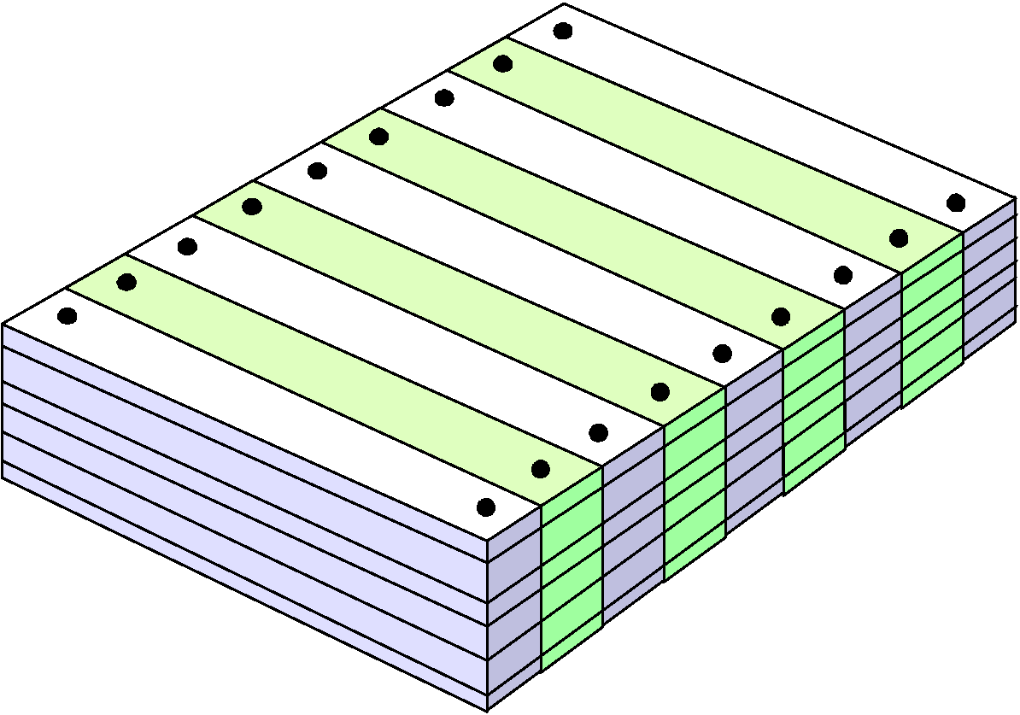
What Are These Changes?
changes in
business requirements
changes in
technical requirements
changes in
user requirements
other
documents
software models
Project
Plan
data
Test
code
These slides are designed to accompany Software Engineering: A Practitioner’s Approach, 8/e (McGraw-Hill 2014). Slides copyright 2014 by Roger Pressman.
3

Slide 4
The Software Configuration
programs
documents
The pieces
data
These slides are designed to accompany Software Engineering: A Practitioner’s Approach, 8/e (McGraw-Hill 2014). Slides copyright 2014 by Roger Pressman.
4

Slide 5
Baselines
The IEEE (IEEE Std. No. 610.12-1990) defines a baseline as:
A specification or product that has been formally reviewed and agreed upon, that thereafter serves as the basis for further development, and that can be changed only through formal change control procedures.
a baseline is a milestone in the development of software that is marked by the delivery of one or more software configuration items and the approval of these SCIs that is obtained through a formal technical review
These slides are designed to accompany Software Engineering: A Practitioner’s Approach, 8/e (McGraw-Hill 2014). Slides copyright 2014 by Roger Pressman.
5

Slide 6
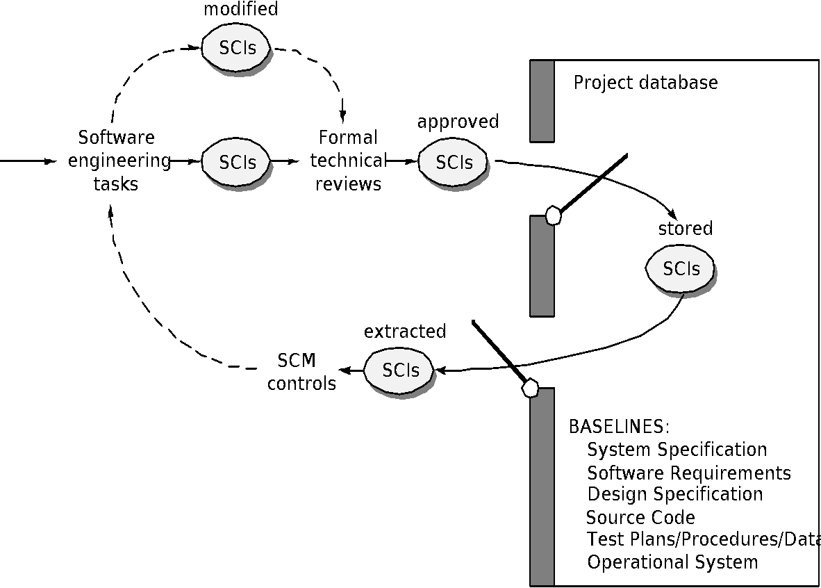
Baselines
These slides are designed to accompany Software Engineering: A Practitioner’s Approach, 8/e (McGraw-Hill 2014). Slides copyright 2014 by Roger Pressman.
6

Slide 7
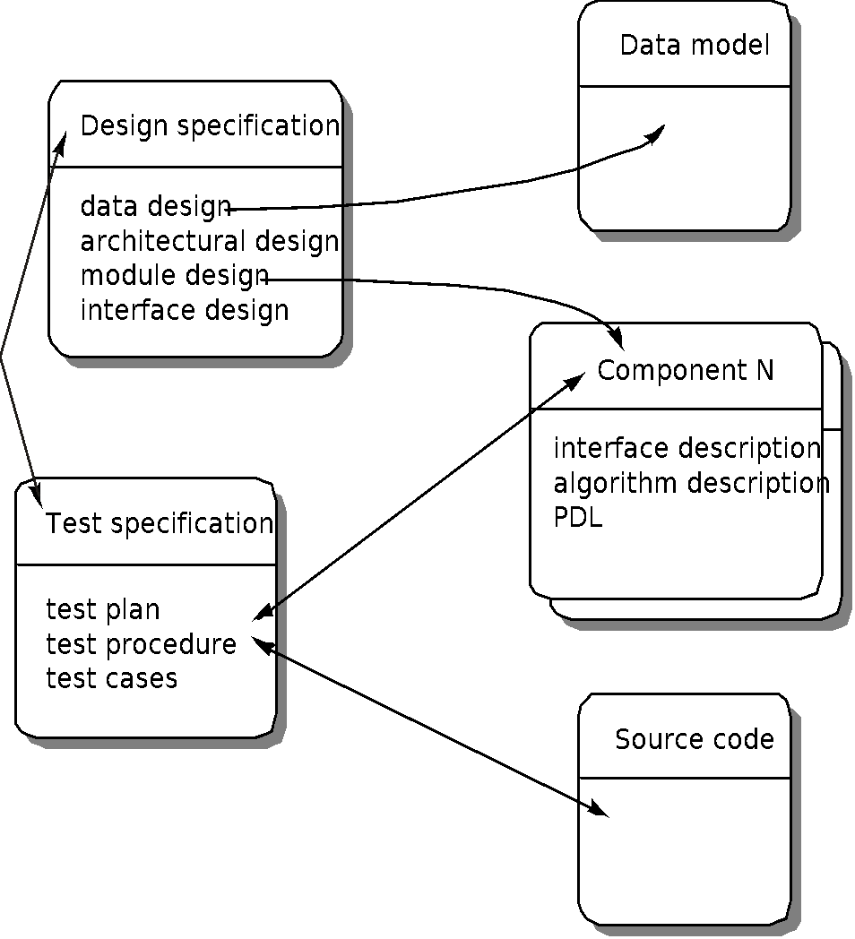
Software Configuration Objects
These slides are designed to accompany Software Engineering: A Practitioner’s Approach, 8/e (McGraw-Hill 2014). Slides copyright 2014 by Roger Pressman.
7

Slide 8
SCM Repository
The SCM repository is the set of mechanisms and data structures that allow a software team to manage change in an effective manner
The repository performs or precipitates the following functions [For89]:
Data integrity
Information sharing
Tool integration
Data integration
Methodology enforcement
Document standardization
These slides are designed to accompany Software Engineering: A Practitioner’s Approach, 8/e (McGraw-Hill 2014). Slides copyright 2014 by Roger Pressman.
8

Slide 9
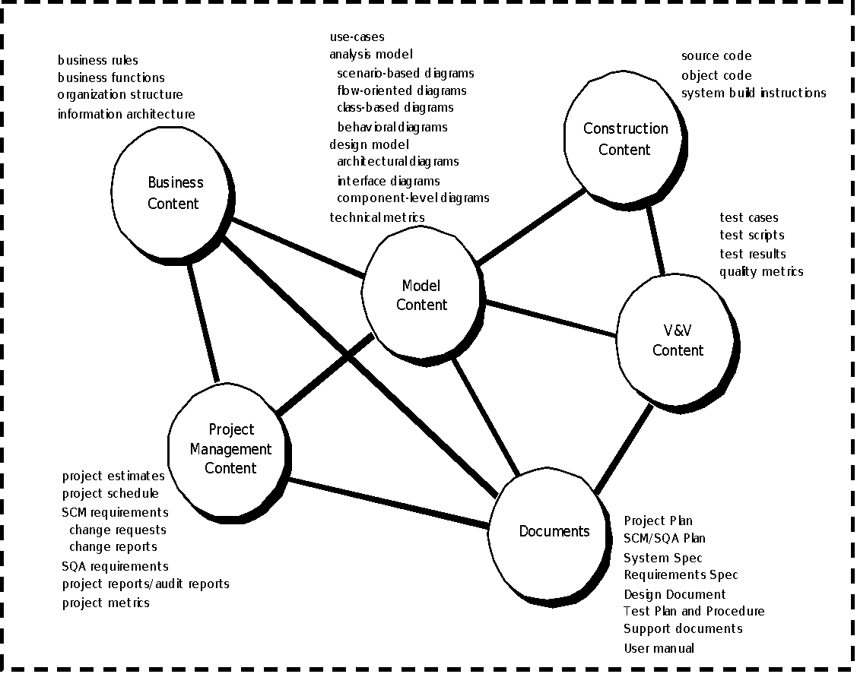
Repository Content
These slides are designed to accompany Software Engineering: A Practitioner’s Approach, 8/e (McGraw-Hill 2014). Slides copyright 2014 by Roger Pressman.
9

Slide 10
Repository Features
Versioning.
saves all of these versions to enable effective management of product releases and to permit developers to go back to previous versions
Dependency tracking and change management.
The repository manages a wide variety of relationships among the data elements stored in it.
Requirements tracing.
Provides the ability to track all the design and construction components and deliverables that result from a specific requirement specification
Configuration management.
Keeps track of a series of configurations representing specific project milestones or production releases. Version management provides the needed versions, and link management keeps track of interdependencies.
Audit trails.
establishes additional information about when, why, and by whom changes are made.
These slides are designed to accompany Software Engineering: A Practitioner’s Approach, 8/e (McGraw-Hill 2014). Slides copyright 2014 by Roger Pressman.
10

Slide 11
SCM Elements
Component elements—a set of tools coupled within a file management system (e.g., a database) that enables access to and management of each software configuration item.
Process elements—a collection of procedures and tasks that define an effective approach to change management (and related activities) for all constituencies involved in the management, engineering and use of computer software.
Construction elements—a set of tools that automate the construction of software by ensuring that the proper set of validated components (i.e., the correct version) have been assembled.
Human elements—to implement effective SCM, the software team uses a set of tools and process features (encompassing other CM elements)
These slides are designed to accompany Software Engineering: A Practitioner’s Approach, 8/e (McGraw-Hill 2014). Slides copyright 2014 by Roger Pressman.
11

Slide 12
The SCM Process
Addresses the following questions …
How does a software team identify the discrete elements of a software configuration?
How does an organization manage the many existing versions of a program (and its documentation) in a manner that will enable change to be accommodated efficiently?
How does an organization control changes before and after software is released to a customer?
Who has responsibility for approving and ranking changes?
How can we ensure that changes have been made properly?
What mechanism is used to appraise others of changes that are made?
These slides are designed to accompany Software Engineering: A Practitioner’s Approach, 8/e (McGraw-Hill 2014). Slides copyright 2014 by Roger Pressman.
12

Slide 13
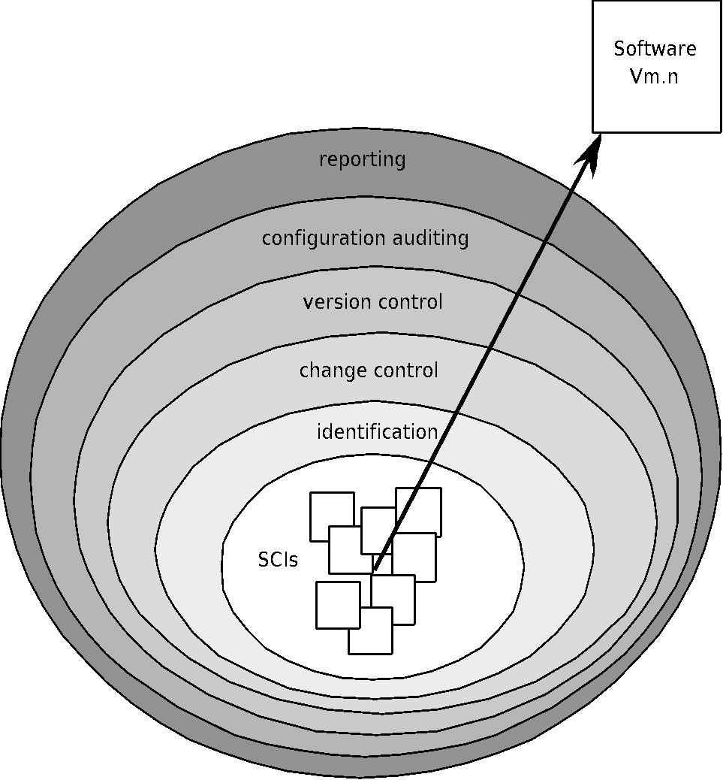
The SCM Process
These slides are designed to accompany Software Engineering: A Practitioner’s Approach, 8/e (McGraw-Hill 2014). Slides copyright 2014 by Roger Pressman.
13

Slide 14
Version Control
Version control combines procedures and tools to manage different versions of configuration objects that are created during the software process
A version control system implements or is directly integrated with four major capabilities:
a project database (repository) that stores all relevant configuration objects
a version management capability that stores all versions of a configuration object (or enables any version to be constructed using differences from past versions);
a make facility that enables the software engineer to collect all relevant configuration objects and construct a specific version of the software.
an issues tracking (also called bug tracking) capability that enables the team to record and track the status of all outstanding issues associated with each configuration object.
These slides are designed to accompany Software Engineering: A Practitioner’s Approach, 8/e (McGraw-Hill 2014). Slides copyright 2014 by Roger Pressman.
14

Slide 15
Change Control
STOP
These slides are designed to accompany Software Engineering: A Practitioner’s Approach, 8/e (McGraw-Hill 2014). Slides copyright 2014 by Roger Pressman.
15

Slide 16
Change Control Process—I
need for change is recognized
change request from user
developer evaluates
change report is generated
change control authority decides
request is queued for action
change request is denied
user is informed
change control process—II
These slides are designed to accompany Software Engineering: A Practitioner’s Approach, 8/e (McGraw-Hill 2014). Slides copyright 2014 by Roger Pressman.
16

Slide 17
Change Control Process-II
assign people to SCIs
check-out SCIs
make the change
review/audit the change
establish a “baseline” for testing
change control process—III
These slides are designed to accompany Software Engineering: A Practitioner’s Approach, 8/e (McGraw-Hill 2014). Slides copyright 2014 by Roger Pressman.
17

Slide 18
Change Control Process-III
perform SQA and testing activities
check-in the changed SCIs
promote SCI for inclusion in next release
rebuild appropriate version
review/audit the change
include all changes in release
These slides are designed to accompany Software Engineering: A Practitioner’s Approach, 8/e (McGraw-Hill 2014). Slides copyright 2014 by Roger Pressman.
18

Slide 19
Auditing
Change
Requests
SQA
Plan
SCIs
SCM Audit
These slides are designed to accompany Software Engineering: A Practitioner’s Approach, 8/e (McGraw-Hill 2014). Slides copyright 2014 by Roger Pressman.
19

Slide 20
Status Accounting
Change
Reports
Change
Requests
ECOs
SCIs
Status Accounting
Reporting
These slides are designed to accompany Software Engineering: A Practitioner’s Approach, 8/e (McGraw-Hill 2014). Slides copyright 2014 by Roger Pressman.
20

Slide 21
SCM for Web and Mobile Engineering-I
Content.
A typical Web or Mobile App contains a vast array of content—text, graphics, applets, scripts, audio/video files, forms, active page elements, tables, streaming data, and many others.
The challenge is to organize this sea of content into a rational set of configuration objects (Section 29.2.1) and then establish appropriate configuration control mechanisms for these objects.
People.
Because a significant percentage of Web and Mobile App development continues to be conducted in an ad hoc manner, any person involved in the App can (and often does) create content.
These slides are designed to accompany Software Engineering: A Practitioner’s Approach, 8/e (McGraw-Hill 2014). Slides copyright 2014 by Roger Pressman.
21

Slide 22
SCM for Web and Mobile Engineering-II
Scalability.
As size and complexity grow, small changes can have far-reaching and unintended affects that can be problematic. Therefore, the rigor of configuration control mechanisms should be directly proportional to application scale.
Politics.
Who ‘owns’ a App?
Who assumes responsibility for the accuracy of the information displayed by the App?
Who assures that quality control processes have been followed before information is published to the site?
Who is responsible for making changes?
Who assumes the cost of change?
These slides are designed to accompany Software Engineering: A Practitioner’s Approach, 8/e (McGraw-Hill 2014). Slides copyright 2014 by Roger Pressman.
22

Slide 23
Content Management-I
The collection subsystem encompasses all actions required to create and/or acquire content, and the technical functions that are necessary to
convert content into a form that can be represented by a mark-up language (e.g., HTML, XML)
organize content into packets that can be displayed effectively on the client-side.
The management subsystem implements a repository that encompasses the following elements:
Content database—the information structure that has been established to store all content objects
Database capabilities—functions that enable the CMS to search for specific content objects (or categories of objects), store and retrieve objects, and manage the file structure that has been established for the content
Configuration management functions—the functional elements and associated workflow that support content object identification, version control, change management, change auditing, and reporting.
These slides are designed to accompany Software Engineering: A Practitioner’s Approach, 8/e (McGraw-Hill 2014). Slides copyright 2014 by Roger Pressman.
23

Slide 24
Content Management-II
The publishing subsystem extracts from the repository, converts it to a form that is amenable to publication, and formats it so that it can be transmitted to client-side browsers. The publishing subsystem accomplishes these tasks using a series of templates.
Each template is a function that builds a publication using one of three different components [BOI02]:
Static elements—text, graphics, media, and scripts that require no further processing are transmitted directly to the client-side
Publication services—function calls to specific retrieval and formatting services that personalize content (using predefined rules), perform data conversion, and build appropriate navigation links.
External services—provide access to external corporate information infrastructure such as enterprise data or “back-room” applications.
These slides are designed to accompany Software Engineering: A Practitioner’s Approach, 8/e (McGraw-Hill 2014). Slides copyright 2014 by Roger Pressman.
24

Slide 25
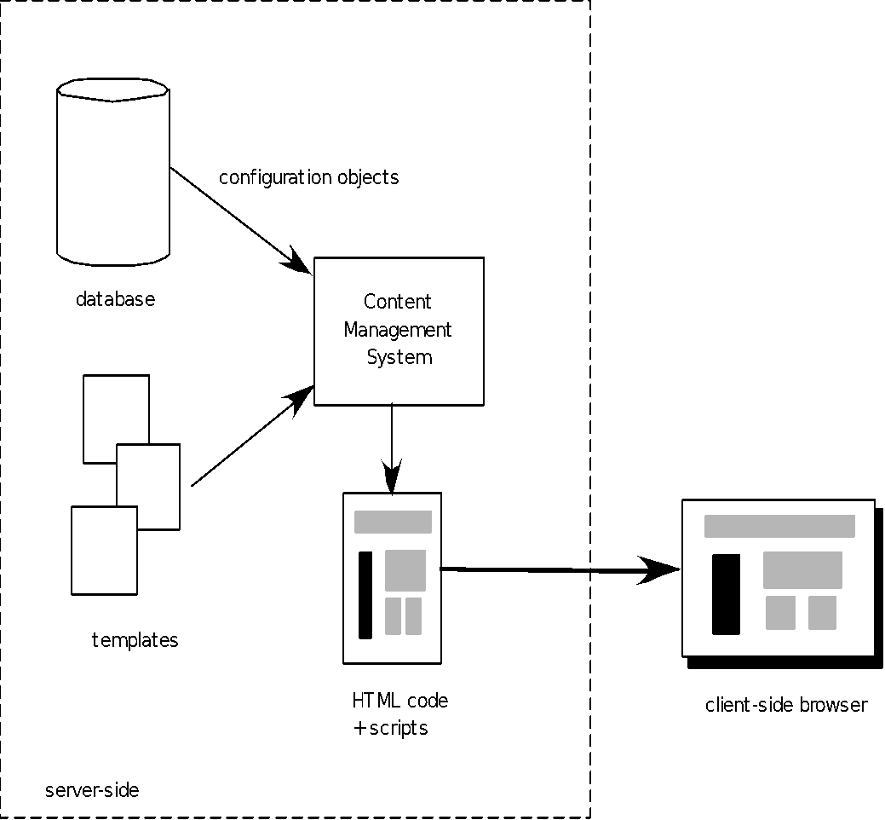
Content Management - III
These slides are designed to accompany Software Engineering: A Practitioner’s Approach, 8/e (McGraw-Hill 2014). Slides copyright 2014 by Roger Pressman.
25

Slide 26
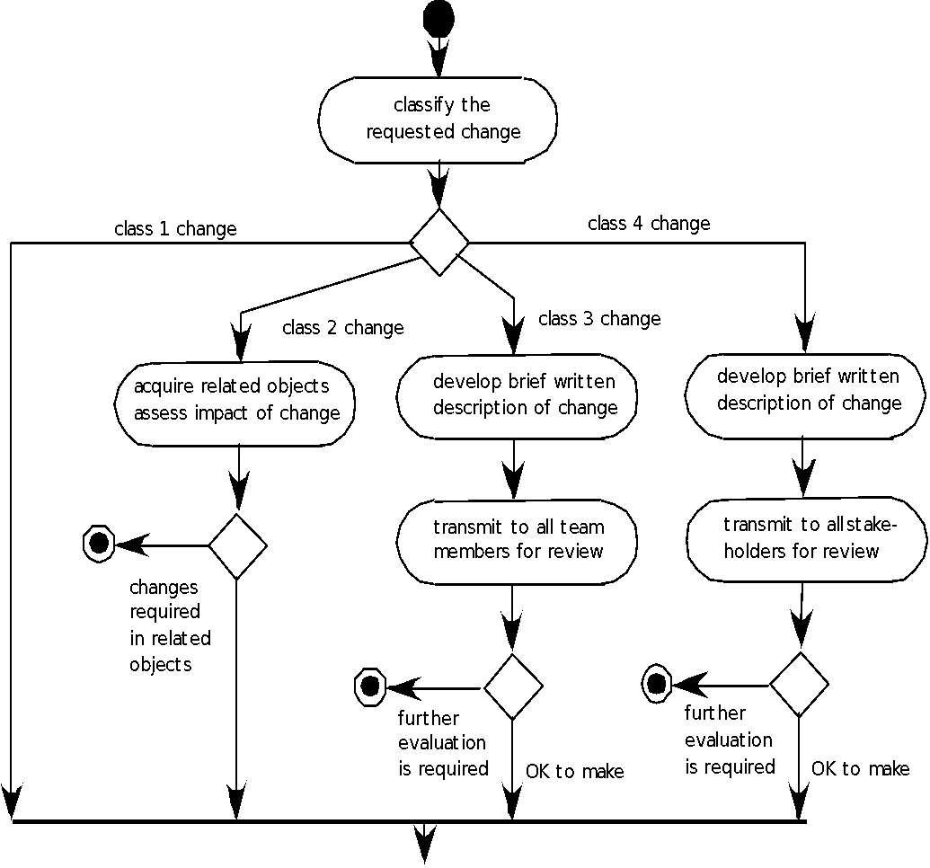
Change Management for Web and Mobile Apps-I
These slides are designed to accompany Software Engineering: A Practitioner’s Approach, 8/e (McGraw-Hill 2014). Slides copyright 2014 by Roger Pressman.
26

Slide 27
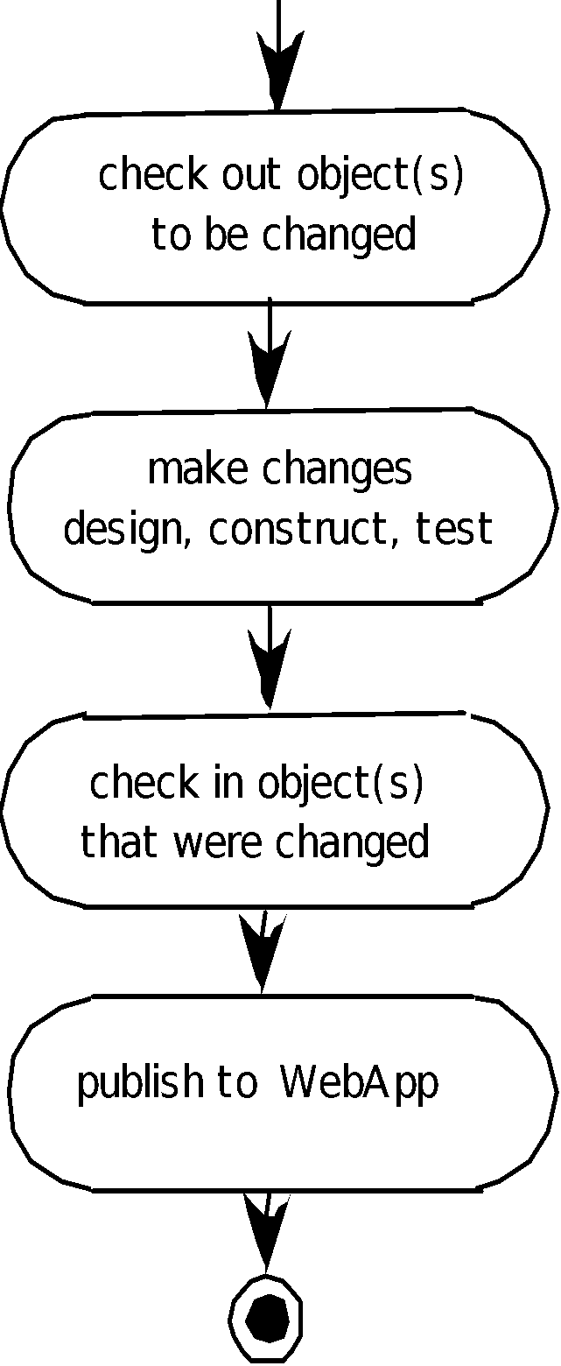
Change Management for Web and Mobile Apps-II
These slides are designed to accompany Software Engineering: A Practitioner’s Approach, 8/e (McGraw-Hill 2014). Slides copyright 2014 by Roger Pressman.
27

