Slide 1
Chapter 36
Maintenance and Reengineering
Slide Set to accompany Software Engineering: A Practitioner’s Approach, 8/e
by Roger S. Pressman and Bruce R. Maxim
Slides copyright © 1996, 2001, 2005, 2009, 2014 by Roger S. Pressman
For non-profit educational use only
May be reproduced ONLY for student use at the university level when used in conjunction with Software Engineering: A Practitioner's Approach, 8/e. Any other reproduction or use is prohibited without the express written permission of the author.
All copyright information MUST appear if these slides are posted on a website for student use.
These slides are designed to accompany Software Engineering: A Practitioner’s Approach, 8/e (McGraw-Hill 2014). Slides copyright 2014 by Roger Pressman.
‹#›
Notes:
‹#›

Slide 2
Software Maintenance
Software is released to end-users, and
within days, bug reports filter back to the software engineering organization.
within weeks, one class of users indicates that the software must be changed so that it can accommodate the special needs of their environment.
within months, another corporate group who wanted nothing to do with the software when it was released, now recognizes that it may provide them with unexpected benefit. They’ll need a few enhancements to make it work in their world.
All of this work is software maintenance
These slides are designed to accompany Software Engineering: A Practitioner’s Approach, 8/e (McGraw-Hill 2014). Slides copyright 2014 by Roger Pressman.
‹#›
Notes:
‹#›

Slide 3
Maintainable Software
Maintainable software exhibits effective modularity
It makes use of design patterns that allow ease of understanding.
It has been constructed using well-defined coding standards and conventions, leading to source code that is self-documenting and understandable.
It has undergone a variety of quality assurance techniques that have uncovered potential maintenance problems before the software is released.
It has been created by software engineers who recognize that they may not be around when changes must be made.
Therefore, the design and implementation of the software must “assist” the person who is making the change
These slides are designed to accompany Software Engineering: A Practitioner’s Approach, 8/e (McGraw-Hill 2014). Slides copyright 2014 by Roger Pressman.
‹#›
Notes:
‹#›

Slide 4
Software Supportability
“the capability of supporting a software system over its whole product life.
This implies satisfying any necessary needs or requirements, but also the provision of equipment, support infrastructure, additional software, facilities, manpower, or any other resource required to maintain the software operational and capable of satisfying its function.” [SSO08]
The software should contain facilities to assist support personnel when a defect is encountered in the operational environment (and make no mistake, defects will be encountered).
Support personnel should have access to a database that contains records of all defects that have already been encountered—their characteristics, cause, and cure.
These slides are designed to accompany Software Engineering: A Practitioner’s Approach, 8/e (McGraw-Hill 2014). Slides copyright 2014 by Roger Pressman.
‹#›
Notes:
‹#›

Slide 5
Reengineering
Business
processes
IT
systems
Software
applications
Reengineering
These slides are designed to accompany Software Engineering: A Practitioner’s Approach, 8/e (McGraw-Hill 2014). Slides copyright 2014 by Roger Pressman.
‹#›
Notes:
‹#›

Slide 6
Business Process Reengineering
Business definition. Business goals are identified within the context of four key drivers: cost reduction, time reduction, quality improvement, and personnel development and empowerment.
Process identification. Processes that are critical to achieving the goals defined in the business definition are identified.
Process evaluation. The existing process is thoroughly analyzed and measured.
Process specification and design. Based on information obtained during the first three BPR activities, use-cases are prepared for each process that is to be redesigned.
Prototyping. A redesigned business process must be prototyped before it is fully integrated into the business.
Refinement and instantiation. Based on feedback from the prototype, the business process is refined and then instantiated within a business system.
These slides are designed to accompany Software Engineering: A Practitioner’s Approach, 8/e (McGraw-Hill 2014). Slides copyright 2014 by Roger Pressman.
‹#›
Notes:
‹#›

Slide 7
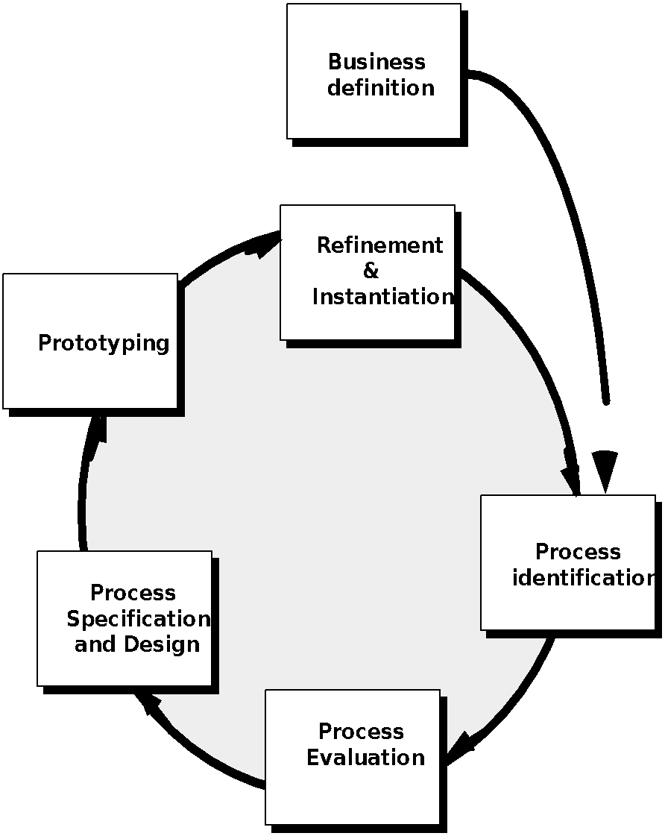
Business Process Reengineering
These slides are designed to accompany Software Engineering: A Practitioner’s Approach, 8/e (McGraw-Hill 2014). Slides copyright 2014 by Roger Pressman.
‹#›
Notes:
‹#›

Slide 8
BPR Principles
Organize around outcomes, not tasks.
Have those who use the output of the process perform the process.
Incorporate information processing work into the real work that produces the raw information.
Treat geographically dispersed resources as though they were centralized.
Link parallel activities instead of integrated their results. When different
Put the decision point where the work is performed, and build control into the process.
Capture data once, at its source.
These slides are designed to accompany Software Engineering: A Practitioner’s Approach, 8/e (McGraw-Hill 2014). Slides copyright 2014 by Roger Pressman.
‹#›
Notes:
‹#›

Slide 9
Software Reengineering
Forward
engineering
inventory
analysis
Data
restructuring
document
restructuring
code
restructuring
reverse
engineering
These slides are designed to accompany Software Engineering: A Practitioner’s Approach, 8/e (McGraw-Hill 2014). Slides copyright 2014 by Roger Pressman.
‹#›
Notes:
‹#›

Slide 10
Inventory Analysis
build a table that contains all applications
establish a list of criteria, e.g.,
name of the application
year it was originally created
number of substantive changes made to it
total effort applied to make these changes
date of last substantive change
effort applied to make the last change
system(s) in which it resides
applications to which it interfaces, ...
analyze and prioritize to select candidates for reengineering
These slides are designed to accompany Software Engineering: A Practitioner’s Approach, 8/e (McGraw-Hill 2014). Slides copyright 2014 by Roger Pressman.
‹#›
Notes:
‹#›

Slide 11
Document Restructuring
Weak documentation is the trademark of many legacy systems.
But what do we do about it? What are our options?
Options …
Creating documentation is far too time consuming. If the system works, we’ll live with what we have. In some cases, this is the correct approach.
Documentation must be updated, but we have limited resources. We’ll use a “document when touched” approach. It may not be necessary to fully redocument an application.
The system is business critical and must be fully redocumented. Even in this case, an intelligent approach is to pare documentation to an essential minimum.
These slides are designed to accompany Software Engineering: A Practitioner’s Approach, 8/e (McGraw-Hill 2014). Slides copyright 2014 by Roger Pressman.
‹#›
Notes:
‹#›

Slide 12
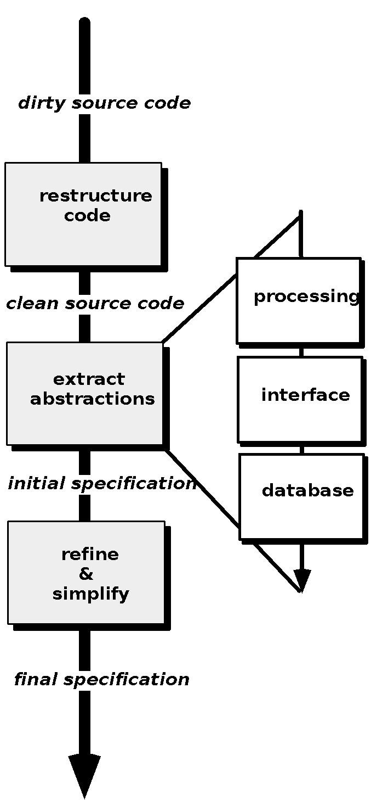
Reverse Engineering
These slides are designed to accompany Software Engineering: A Practitioner’s Approach, 8/e (McGraw-Hill 2014). Slides copyright 2014 by Roger Pressman.
‹#›
Notes:
‹#›

Slide 13
Code Restructuring
Source code is analyzed using a restructuring tool.
Poorly design code segments are redesigned
Violations of structured programming constructs are noted and code is then restructured (this can be done automatically)
The resultant restructured code is reviewed and tested to ensure that no anomalies have been introduced
Internal code documentation is updated.
These slides are designed to accompany Software Engineering: A Practitioner’s Approach, 8/e (McGraw-Hill 2014). Slides copyright 2014 by Roger Pressman.
‹#›
Notes:
‹#›

Slide 14
Data Restructuring
Unlike code restructuring, which occurs at a relatively low level of abstraction, data structuring is a full-scale reengineering activity
In most cases, data restructuring begins with a reverse engineering activity.
Current data architecture is dissected and necessary data models are defined (Chapter 9).
Data objects and attributes are identified, and existing data structures are reviewed for quality.
When data structure is weak (e.g., flat files are currently implemented, when a relational approach would greatly simplify processing), the data are reengineered.
Because data architecture has a strong influence on program architecture and the algorithms that populate it, changes to the data will invariably result in either architectural or code-level changes.
These slides are designed to accompany Software Engineering: A Practitioner’s Approach, 8/e (McGraw-Hill 2014). Slides copyright 2014 by Roger Pressman.
‹#›
Notes:
‹#›

Slide 15
Forward Engineering
1. The cost to maintain one line of source code may be 20 to 40 times the cost of initial development of that line.
2. Redesign of the software architecture (program and/or data structure), using modern design concepts, can greatly facilitate future maintenance.
3. Because a prototype of the software already exists, development productivity should be much higher than average.
4. The user now has experience with the software. Therefore, new requirements and the direction of change can be ascertained with greater ease.
5. CASE tools for reengineering will automate some parts of the job.
6. A complete software configuration (documents, programs and data) will exist upon completion of preventive maintenance.
These slides are designed to accompany Software Engineering: A Practitioner’s Approach, 8/e (McGraw-Hill 2014). Slides copyright 2014 by Roger Pressman.
‹#›
Notes:
‹#›

Slide 16
Economics of Reengineering-I
A cost/benefit analysis model for reengineering has been proposed by Sneed [Sne95]. Nine parameters are defined:
P₁ = current annual maintenance cost for an application.
P₂ = current annual operation cost for an application.
P₃ = current annual business value of an application.
P₄ = predicted annual maintenance cost after reengineering.
P₅ = predicted annual operations cost after reengineering.
P₆ = predicted annual business value after reengineering.
P₇ = estimated reengineering costs.
P₈ = estimated reengineering calendar time.
P₉ = reengineering risk factor (P₉ = 1.0 is nominal).
L = expected life of the system.
These slides are designed to accompany Software Engineering: A Practitioner’s Approach, 8/e (McGraw-Hill 2014). Slides copyright 2014 by Roger Pressman.
‹#›
Notes:
‹#›

Slide 17
Economics of Reengineering-II
The cost associated with continuing maintenance of a candidate application (i.e., reengineering is not performed) can be defined as
C_{maint} = [P₃ - (P₁ + P₂)] x L
The costs associated with reengineering are defined using the following relationship:
C_{reeng} = [P₆ - (P₄ + P₅) x (L - P₈) - (P₇ x P₉)] `
Using the costs presented in equations above, the overall benefit of reengineering can be computed as
cost benefit = C_{reeng} - C_{maint}
These slides are designed to accompany Software Engineering: A Practitioner’s Approach, 8/e (McGraw-Hill 2014). Slides copyright 2014 by Roger Pressman.
‹#›
Notes:
‹#›

