Slide 1
Chapter 38
Emerging Trends in Software Engineering
Slide Set to accompany Software Engineering: A Practitioner’s Approach, 8/e
by Roger S. Pressman and Bruce R. Maxim
Slides copyright © 1996, 2001, 2005, 2009, 2014 by Roger S. Pressman
For non-profit educational use only
May be reproduced ONLY for student use at the university level when used in conjunction with Software Engineering: A Practitioner's Approach, 8/e. Any other reproduction or use is prohibited without the express written permission of the author.
All copyright information MUST appear if these slides are posted on a website for student use.
These slides are designed to accompany Software Engineering: A Practitioner’s Approach, 8/e (McGraw-Hill 2014). Slides copyright 2014 by Roger Pressman.
‹#›

Slide 2
Trends
Challenges we face when trying to isolate meaningful technology trends:
What Factors Determine the Success of a Trend?
What Lifecycle Does a Trend Follow?
How Early Can a Successful Trend be Identified?
What Aspects of Evolution are Controllable?
Ray Kurzweil [Kur06] argues that technological evolution is similar to biological evolution, but occurs at a rate that is orders of magnitude faster.
Evolution (whether biological or technological) occurs as a result of positive feedback—“the more capable methods resulting from one stage of evolutionary progress are used to create the next stage.” [Kur06]
These slides are designed to accompany Software Engineering: A Practitioner’s Approach, 8/e (McGraw-Hill 2014). Slides copyright 2014 by Roger Pressman.
‹#›

Slide 3
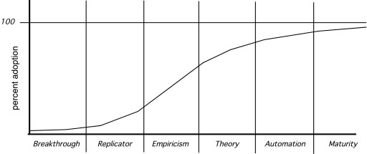
Technology Innovation Lifecycle
These slides are designed to accompany Software Engineering: A Practitioner’s Approach, 8/e (McGraw-Hill 2014). Slides copyright 2014 by Roger Pressman.
‹#›

Slide 4
Observing SE Trends
Barry Boehm [Boe08] suggests that “software engineers [will] face the often formidable challenges of dealing with rapid change, uncertainty and emergence, dependability, diversity, and interdependence, but they also have opportunities to make significant contributions that will make a difference for the better.”
But what of more modest, short-term innovations, tools, and methods?
These slides are designed to accompany Software Engineering: A Practitioner’s Approach, 8/e (McGraw-Hill 2014). Slides copyright 2014 by Roger Pressman.
‹#›

Slide 5
The Hype Cycle
technology trigger—a research breakthrough or launch of an innovative new product that leads to media coverage and public enthusiasm
peak of inflated expectations—over-enthusiasm and overly optimistic projections of impact based on limited, but well-publicized successes
disillusionment— overly optimistic projections of impact are not met and critics begin the drumbeat; the technology becomes unfashionable among the cognoscenti
slope of enlightenment—growing usage by a wide variety of companies leads to a better understanding of the technology’s true potential; off the shelf methods and tools emerge to support the technology
plateau of productivity—real world benefits are now obvious and usage penetrates a significant percentage of the potential market
Gartner Group [Gar08]
These slides are designed to accompany Software Engineering: A Practitioner’s Approach, 8/e (McGraw-Hill 2014). Slides copyright 2014 by Roger Pressman.
‹#›

Slide 6
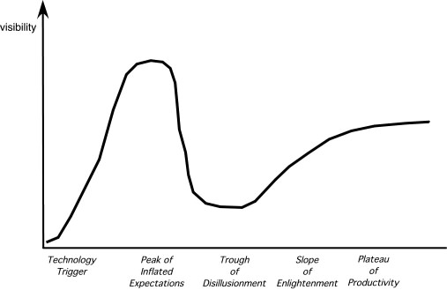
The Hype Cycle
These slides are designed to accompany Software Engineering: A Practitioner’s Approach, 8/e (McGraw-Hill 2014). Slides copyright 2014 by Roger Pressman.
‹#›

Slide 7
Soft Trends
Connectivity and collaboration (enabled by high bandwidth communication) has already led to a software teams that do not occupy the same physical space (telecommuting and part-time employment in a local context).
Globalization leads to a diverse workforce (in terms of language, culture, problem resolution, management philosophy, communication priorities, and person-to-person interaction).
An aging population implies that many experienced software engineers and managers will be leaving the field over the coming decade. The software engineering community must respond with viable mechanisms that capture the knowledge of these aging managers and technologists
Consumer spending in emerging economies will double to well over $12 trillion. [Pet06] There is little doubt that a non-trivial percentage of this spending will be applied to products and services that have a digital component—that are software-based or software-driven.
These slides are designed to accompany Software Engineering: A Practitioner’s Approach, 8/e (McGraw-Hill 2014). Slides copyright 2014 by Roger Pressman.
‹#›

Slide 8
Managing Complexity
In the relatively near future, systems requiring over 1 billion LOC will begin to emerge
Consider the interfaces for a billion LOC system
both to the outside world
to other interoperable systems
to the Internet (or its successor), and
to the millions of internal components that must all work together to make this computing monster operate successfully.
Is there a reliable way to ensure that all of these connections will allow information to flow properly?
Consider the project itself.
Consider the number of people (and their locations) who will be doing the work
Consider the engineering challenge.
Consider the challenge of quality assurance.
These slides are designed to accompany Software Engineering: A Practitioner’s Approach, 8/e (McGraw-Hill 2014). Slides copyright 2014 by Roger Pressman.
‹#›

Slide 9
Open-World Software
Concepts such as ambient intelligence, context-aware applications, and pervasive/ubiquitous computing—all focus on integrating software-based systems into an environment far broader than anything to date
“open-world software”—software that is designed to adapt to a continually changing environment ‘by self-organizing its structure and self-adapting its behavior.” [Bar06]
These slides are designed to accompany Software Engineering: A Practitioner’s Approach, 8/e (McGraw-Hill 2014). Slides copyright 2014 by Roger Pressman.
‹#›

Slide 10
Emergent Requirements
As systems become more complex, requirements will emerge as everyone involved in the engineering and construction of a complex system learns more about it, the environment in which it is to reside, and the users who will interact with it.
This reality implies a number of software engineering trends.
process models must be designed to embrace change and adopt the basic tenets of the agile philosophy (Chapter 5).
methods that yield engineering models (e.g., requirements and design models) must be used judiciously because those models will change repeatedly as more knowledge about the system is acquired
tools that support both process and methods must make adaptation and change easy.
These slides are designed to accompany Software Engineering: A Practitioner’s Approach, 8/e (McGraw-Hill 2014). Slides copyright 2014 by Roger Pressman.
‹#›

Slide 11
Software Building Blocks
the software engineering community attempts to capture past knowledge and reuse proven solutions, but a significant percentage of the software that is built today continues to be built “from scratch.”
Part of the reason for this is a continuing desire (by stakeholders and software engineering practitioners) for “unique solutions.”
“merchant software”—software building blocks designed specifically for a unique application domain (e.g., VoIP devices).
These slides are designed to accompany Software Engineering: A Practitioner’s Approach, 8/e (McGraw-Hill 2014). Slides copyright 2014 by Roger Pressman.
‹#›

Slide 12
Open Source
“Open source is a development method for software that harnesses the power of distributed peer review and transparency of process. The promise of open source is better quality, higher reliability, more flexibility, lower cost, and an end to predatory vendor lock-in.” [OSO08]
The term open source when applied to computer software, implies that software engineering work products (models, source code, test suites) are open to the public and can be reviewed and extended (with controls) by anyone with interest and permission.
These slides are designed to accompany Software Engineering: A Practitioner’s Approach, 8/e (McGraw-Hill 2014). Slides copyright 2014 by Roger Pressman.
‹#›

Slide 13
Process Trends
As SPI frameworks evolve, they will emphasize “strategies that focus on goal orientation and product innovation.” [Con02]
Because software engineers have a good sense of where the process is weak, process changes should generally be driven by their needs and should start form the bottom up.
Automated software process technology (SPT) will move away from global process management (broad-based support of the entire software process) to focus on those aspects of the software process that can best benefit from automation.
Greater emphasis will be placed on the return-on-investment of SPI activities.
As time passes, the software community may come to understand that expertise in sociology and anthropology may have as much of more to do with successful SPI as other, more technical disciplines.
New modes of learning may facilitate the transition to a more effective software process.
These slides are designed to accompany Software Engineering: A Practitioner’s Approach, 8/e (McGraw-Hill 2014). Slides copyright 2014 by Roger Pressman.
‹#›

Slide 14
The Grand Challenge
There is one trend that is undeniable—software-based systems will undoubtedly become bigger and more complex as time passes.
It is the engineering of these large, complex systems, regardless of delivery platform or application domain, the poses the “grand challenge” [Bro06] for software engineers.
Key approaches:
more effective distributed and collaborative software engineering philosophy
better requirements engineering approaches
a more robust approach to model-driven development, and
better software tools
These slides are designed to accompany Software Engineering: A Practitioner’s Approach, 8/e (McGraw-Hill 2014). Slides copyright 2014 by Roger Pressman.
‹#›

Slide 15
Collaborative Development
Today, software engineers collaborate across time zones and international boundaries, and every one of them must share information.
The challenge over the next decade is to develop methods and tools that facilitate that collaboration.
Critical success factors:
Shared goals
Shared culture
Shared process
Shared responsibility
These slides are designed to accompany Software Engineering: A Practitioner’s Approach, 8/e (McGraw-Hill 2014). Slides copyright 2014 by Roger Pressman.
‹#›

Slide 16
Requirements Engineering
To improve the manner in which requirements are defined, the software engineering community will likely implement three distinct sub-processes as RE is conducted [Gli07]:
improved knowledge acquisition and knowledge sharing that allows more complete understanding of application domain constraints and stakeholder needs
greater emphasis on iteration as requirements are defined
more effective communication and coordination tools that enable all stakeholders to collaborate effectively.
These slides are designed to accompany Software Engineering: A Practitioner’s Approach, 8/e (McGraw-Hill 2014). Slides copyright 2014 by Roger Pressman.
‹#›

Slide 17
Model-Driven Development
couples domain-specific modeling languages with transformation engines and generators in a way that facilitates the representation of abstraction at high levels and then transforms it into lower levels [Sch06]
Domain-specific modeling languages (DSMLs)
represent “application structure, behavior and requirements within particular application domains”
described with metamodels that “define the relationships among concepts in the domain and precisely specify the key semantics and constraints associated with these domain concepts.” [Sch06]
These slides are designed to accompany Software Engineering: A Practitioner’s Approach, 8/e (McGraw-Hill 2014). Slides copyright 2014 by Roger Pressman.
‹#›

Slide 18
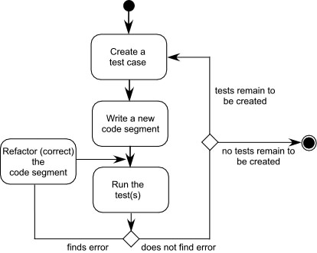
Test-Driven Development
In test-driven development (TDD), requirements for a software component serve as the basis for the creation of a series of test cases that exercise the interface and attempt to find errors in the data structures and functionality delivered by the component.
TDD is not really a new technology but rather a trend that emphasizes the design of test cases before the creation of source code.continue to emphasize the importance of software architecture
These slides are designed to accompany Software Engineering: A Practitioner’s Approach, 8/e (McGraw-Hill 2014). Slides copyright 2014 by Roger Pressman.
‹#›

Slide 19
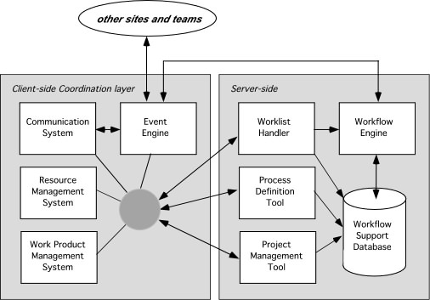
Tools Trends—SEE
These slides are designed to accompany Software Engineering: A Practitioner’s Approach, 8/e (McGraw-Hill 2014). Slides copyright 2014 by Roger Pressman.
‹#›

