Slide 1
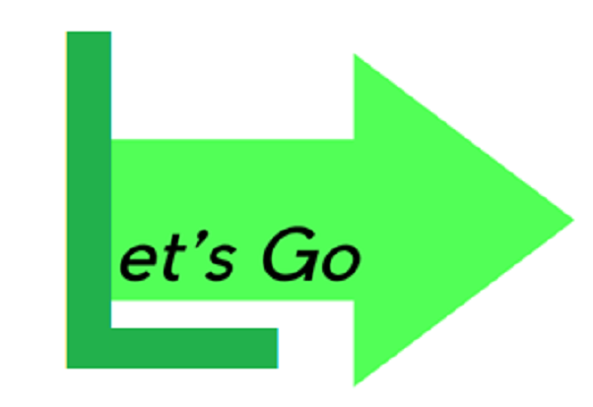
Lucas Dachman
Jasmine Rethmann
Nihar Nandan
Jonathan Taing
Ningtian Ruan

Slide 2
Vision Statement
Making it easier for CU students to find and participate in events on campus

Slide 3
Methodologies

Slide 4
Agile and Peer Code Review
Tried to work sequentially/iteratively, but would respond to a particular issue if it was a dependency
If issue was not a dependency or didn’t have high priority, would skip it and come back
Helped each other fix bugs

Slide 5
Tools

Slide 6
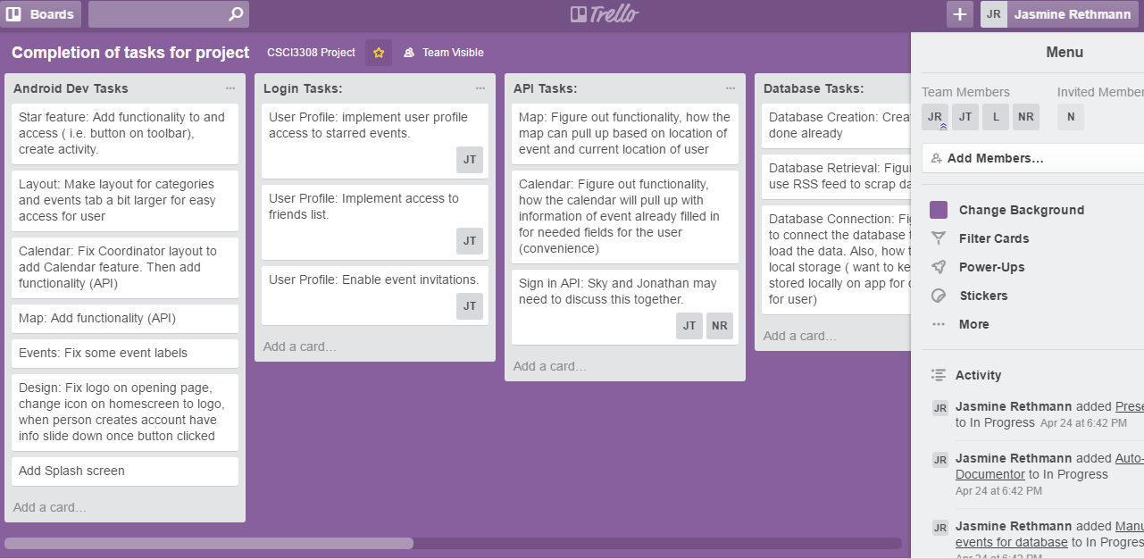

Project Tracker
Purpose:
Kept track of parts of the project that needed to be finished
3.5

Slide 7
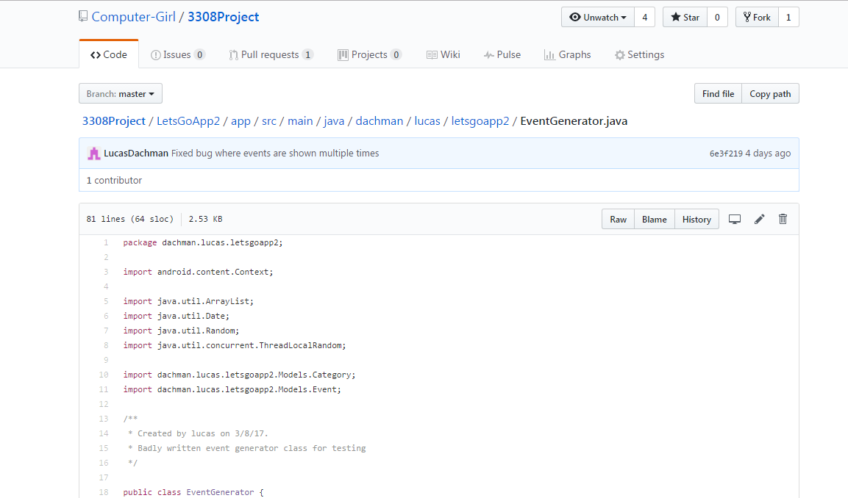

VCS Repository
Purpose:
Save project-related work for
group to easily access
4

Slide 8
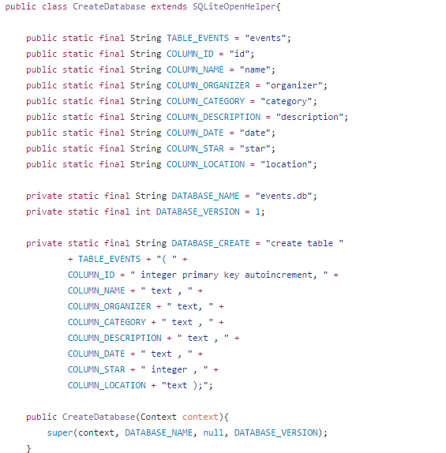

Database
Purpose:
To store information for events
4

Slide 9
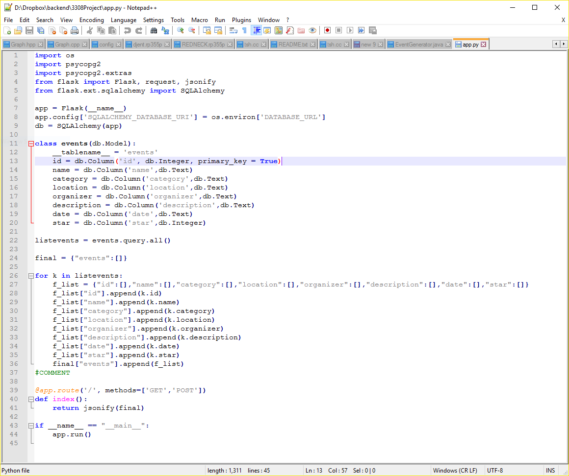


Online Framework
Purpose:
To store information for events
4

Slide 10
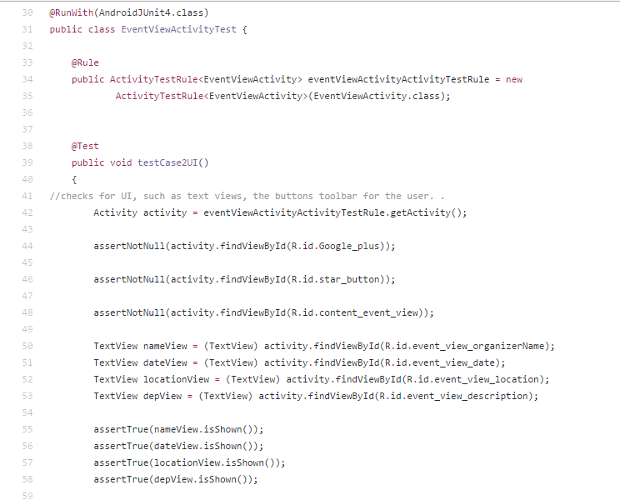


Testing
Purpose:
Used these frameworks to develop unit tests for the code
5

Slide 11
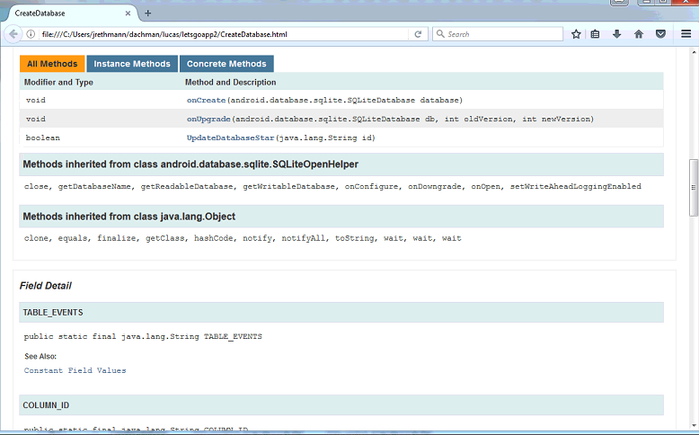

Auto-Documenter
Purpose: To gather all comments and summaries of code
4

Slide 12
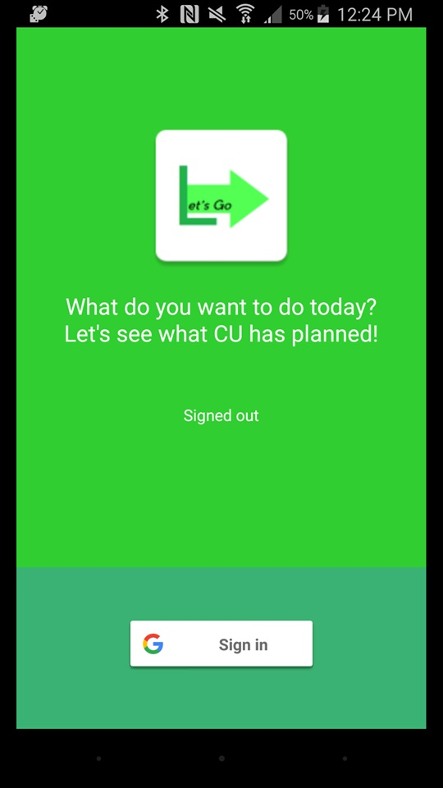

Deployment Environment
Purpose: To test and run the app
4

Slide 13
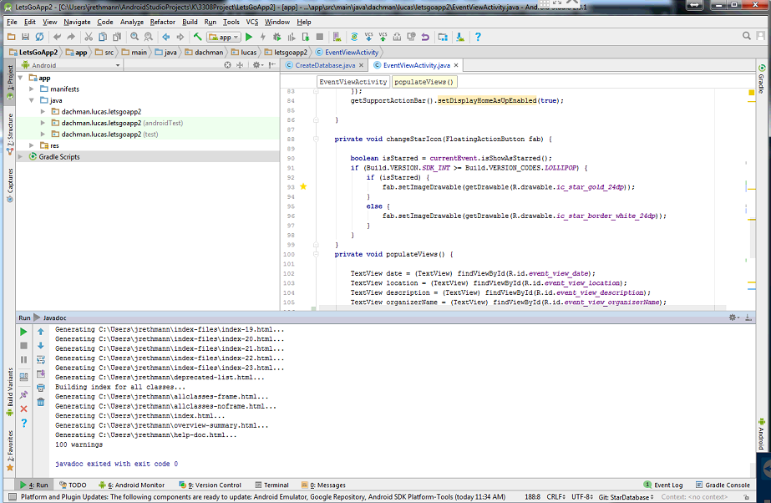

Framework
Purpose:
We used this to develop the code needed for the app
3

Slide 14
Challenges

Slide 15
Challenges
Friends feature
More complex to develop
Decided that it wasn’t needed for the purpose of the app
Off campus events
More concerned with on campus events
Didn’t deem it to be necessary for original purpose

Slide 16
Questions so far?

Slide 17
Demo

