Slide 1
COMPUTER NETWORKS
GROUP-11

Slide 2
Time Division Multiple Access
(TDMA)

Slide 3
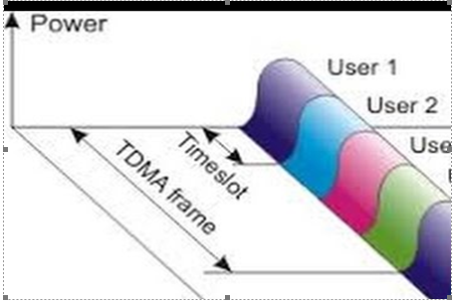

Slide 4
Issues taken care by MAC - Protocol
Synchronization
Throughput
Access Delay
Congestion Control
Energy Management

Slide 5
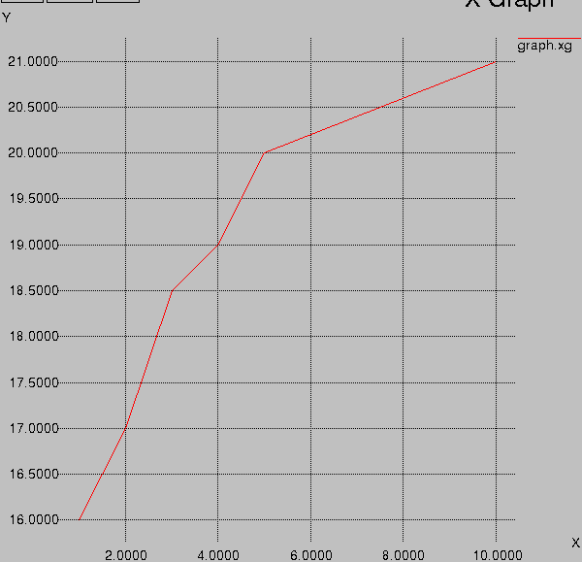
Throughput vs Slot Size

Slide 6
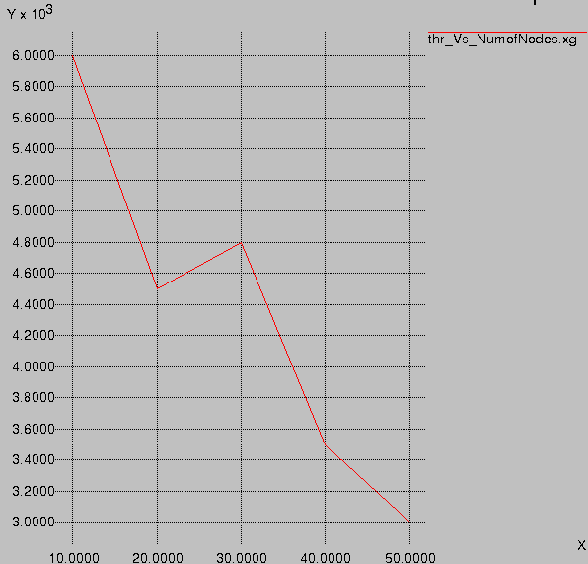
Throughput vs Number of nodes

Slide 7
ZONE ROUTING PROTOCOL
Zone routing (ZRP) consists of proactive and reactive. As Proactive uses the most of the bandwidth of the network which causes its wastage and Reactive routing causes lots of delays. So, here we introduce the zone routing protocol which has the most promising and the best characteristics of both proactive and reactive techniques and thus called Hybrid Proactive/Reactive routing protocol.

Slide 8
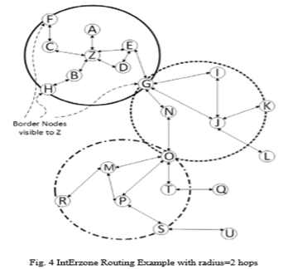
Interzone routing protocol
It works on the Reactive Routing Technique. IERP is a protocol which helps the node to find the route which is not yet discovered and thus not have any information in the Route table. It works along with another protocol known as Border Cast Resolution Protocol.

Slide 9
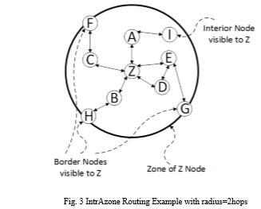
Intrazone routing protocol
It Works on the Proactive Routing Technique.
Its scope depends on the zone radius.

Slide 10
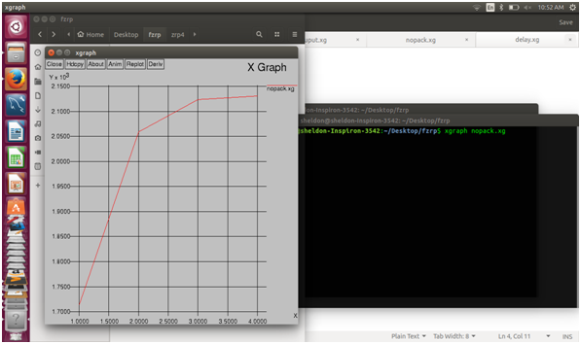
Graphical analysis :
Number of packets loss :

Slide 11
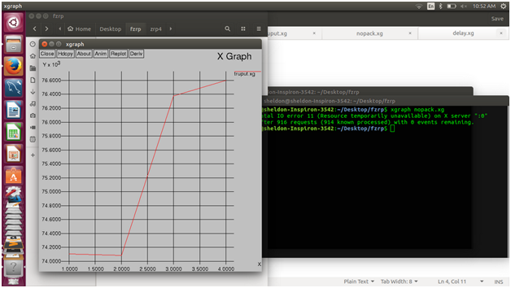
Graphical analysis :
Throughput :

Slide 12
GO BACK N
Stop and wait ARQ mechanism does not utilize the resources at their best. When the acknowledgement is received, the sender sits idle and does nothing. In Go-Back-N ARQ method, both sender and receiver maintain a window.

Slide 13
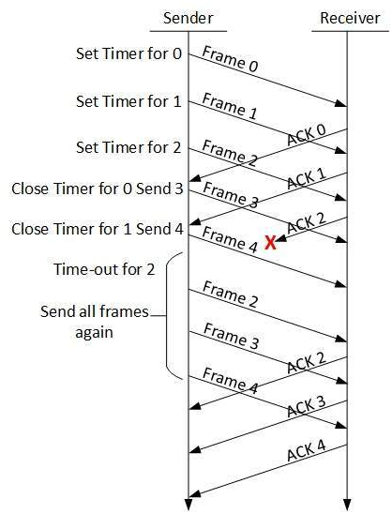

Slide 14
The sending-window size enables the sender to send multiple frames without receiving the acknowledgement of the previous ones. The receiving-window enables the receiver to receive multiple frames and acknowledge them. The receiver keeps track of incoming frame’s sequence number.
When the sender sends all the frames in window, it checks up to what sequence number it has received positive acknowledgement. If all frames are positively acknowledged, the sender sends next set of frames. If sender finds that it has received NACK or has not receive any ACK for a particular frame, it retransmits all the frames after which it does not receive any positive ACK.
WINDOW SIZE: -
->Sender Window Size: - (2^n)-1.
->Receiving Window Size: - 1.

Slide 15
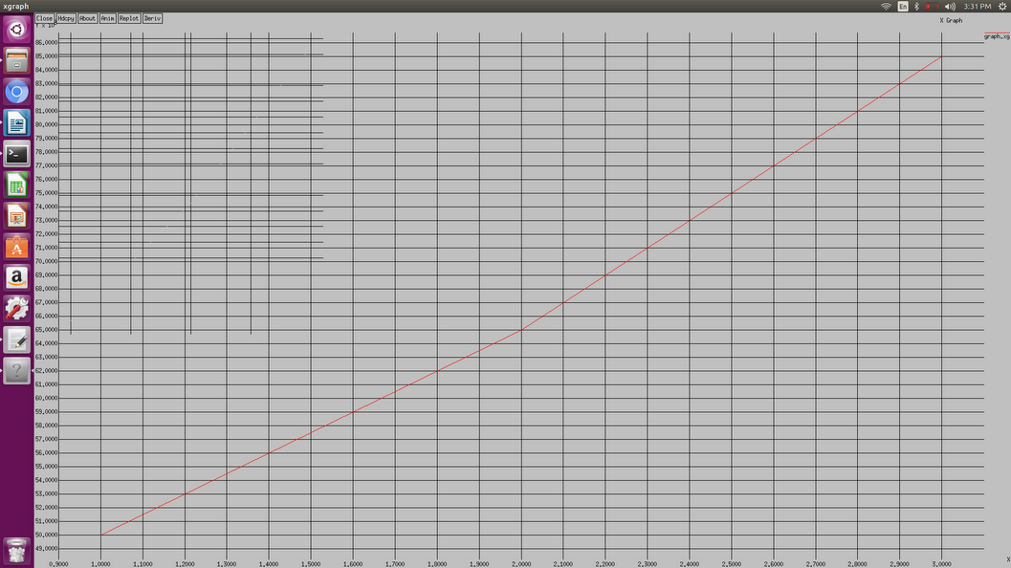

Slide 16
In the graph X-AXIS denotes the mbps in the drop tail section in the tcl file.
Y-AXIS denotes the throughput generated from awk file.

