Slide 1
Computer Programming for Lawyers
Rachel Orey
Fall 2024

Slide 2
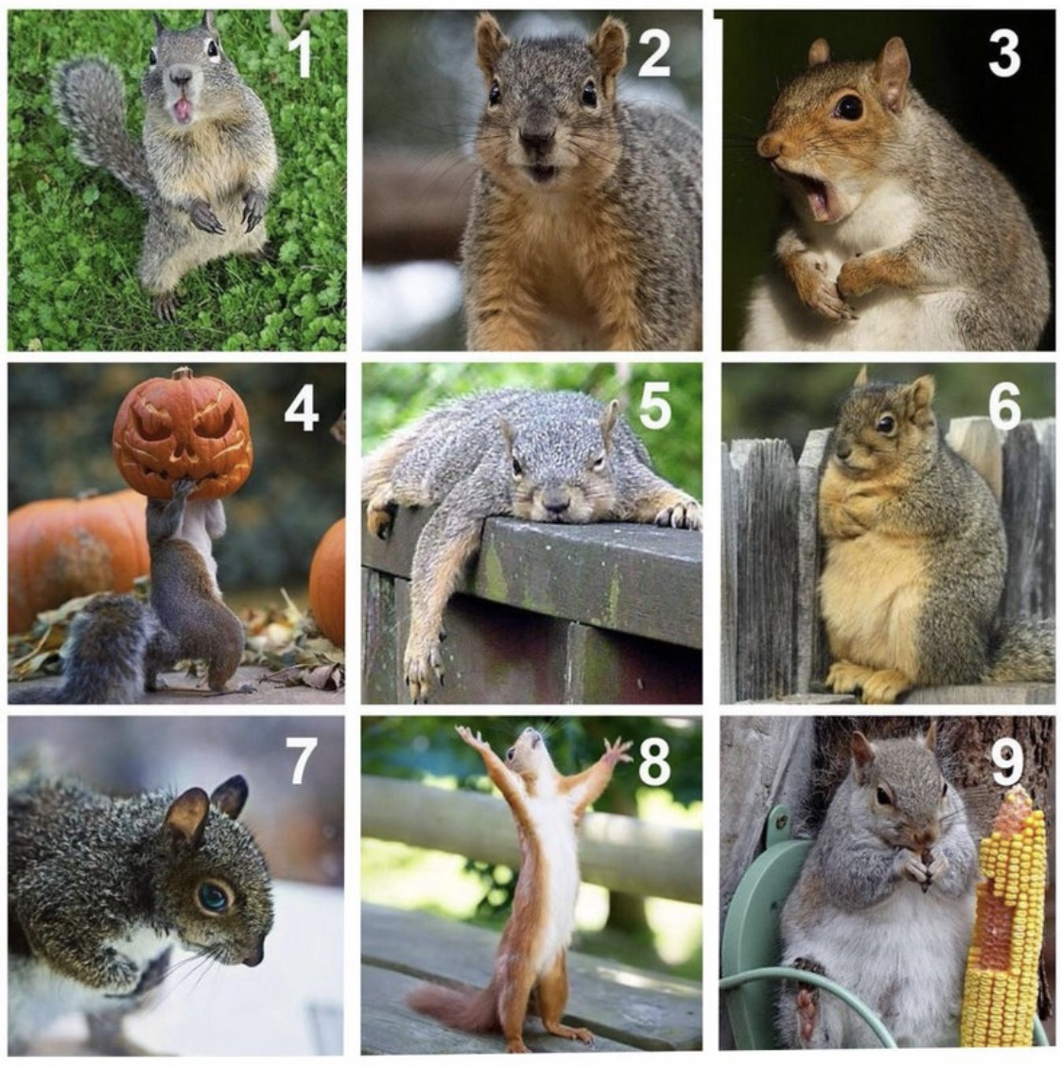

Slide 3
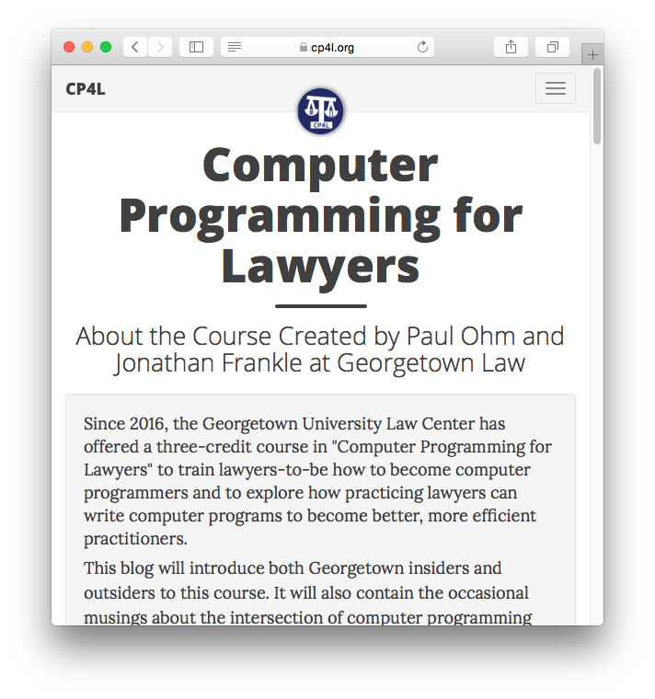
Notes:
Course has an associated blog about the philosophy of the course, which has been taught here since 2016. Encourage you to check it out but will also talk about it now.
This course is an argument in the form of a course. The argument is that basically every lawyer can be a better lawyer if they learn rudimentary programming skills. This semester, I think this argument is even more true with the advent of AI. Basic programming skills will actually take you way, way further than they did before AI. I'll talk more about that later.

Slide 4
Course philosophy
Lawyers process information, but use inefficient tools for the job.
Coding is an emerging legal skill, like writing and research
Automate the ‘Boring Stuff’
Work at Scale
Have Fun!
Notes:
So a little more on the philosophy here. A big part of being a lawyer is processing information. Lots of text: cases, statutes, contracts. But increasingly: accounting data, scientific data, government reports. But most lawyers don't have a very modern set of tools for the job. Knowing how to code is going to help you process more information faster and better. And it will make your life more enjoyable!
Essentially, we argue that programming is a legal skill just like legal writing and legal research. It's going to allow you to do three things:
Automate the boring stuff. There are so many tasks that are dull and laborious. Taking this class will allow you to see what parts of that can be automated, which will be more efficient, and also hopefully more accurate.
You can work at scale. Knowing how to program will allow you to scale up the amount of work you can accomplish.
Hopefully, you'll have fun! When I'm confronted with a boring task, thinking about how to program it completely transforms the task from something I'm dreading into an interesting puzzle. And then the task becomes far more enjoyable. If you like games or puzzles, I think you'll feel the same way. I hope you find the problem sets in this course a fun example of how enjoyable programming can be.
You're going to learn the core elements of the Python programming language.
You'll learn everything you need to be a proficient computer programmer.
We will mostly focus on the parts of Python that are common to every programming language, so you'll have an easy time learning new ones.
In short, the programming skill set we hope to teach will be transferrable. You're learning programming, not just learning Python.

Slide 5
Goals and side-effects
Make you more efficient in ordinary legal practice
Text manipulation, search, summary
Document manipulation (pdf, docx, xlsx)
File manipulation
Application Programming Interfaces (APIs)
Scraping
Knowing how to work with AI to do... anything?!
Notes:
After this course, you should be more efficient in a wide variety of legal tasks:
You should be able to mine large piles of text documents (like every Supreme Court opinion ever written) to extract information most relevant to you
Manipulating PDFs, Excel spreadsheets, and other kinds of documents programmatically.
Managing and processing files on your computer.
Accessing data from government agencies or start-up companies using APIs.
Using APIs to control online accounts (think Twitter bots)
Scraping useful content off of websites into data you can store and process.
Knowing how to work with AI to do... anything?!
We firmly believe that you can put programming to work in your day-to-day lawyering, and this course is our way of proving it.
www.cp4l.org/post/side-effect-benefits/

Slide 6
What this class is not
A law class.
A class on cybersecurity, the internet, or any other specific technology.
A math-heavy class.
This is a skills class, plain and simple.
Notes:
This is not a class on the law. Again, I am not a lawyer. Hopefully I can learn some law from you all!
First and foremost, this is a technical skills class that has law applications. In terms of core material, it's not very different from an accelerated CS 101 class or even an AP Computer Science course. We will bring in legal applications as often as possible but this isn't a class on technology law or policy.
This is not a class on cybersecurity, the Internet, or any other specific technology. This class is a great jumping off point for exploring those topics, and might make you more fluent on some of these--and I would love to talk about these topics with you outside of class--but we do not focus on them in this class, and this class is suitable for anyone regardless of what areas of law they want to pursue.
This is not a math-heavy class, which makes it distinctive from other CS classes. Our focus is on programming as a practical skill. Any math that comes up will be extremely rudimentary.
This is going to be a highly accelerated class. So you won't learn everything that you think might be part of a core CS class.

Slide 7
Beginners Only!
Ineligible if you have:
Taken a programming class in college or graduate school.
Mastered any programming language.
Must consult with instructors if you are unsure if you are eligible.
Notes:
If you have taken a programming class in college or if you have mastered a programming language on your own, you are not eligible for this course. A few of you have come to us because you weren't sure if your experience counted... you took a class a long time ago... thanks! If there's anyone else who is wondering about that, please come talk to me after the class!
There is usually a waiting list of people trying to get into this course, and we want to give as many spots as possible to novice programmers who have the most to gain.

Slide 8
Waitlisters
You must go to one lab on Wednesday to get off the list.
If you don’t submit PS1 and PS2 before add/drop deadline (XXX), you will be removed from the class.
No auditors.
Notes:
If you're on the waitlist, go to lab on Wednesday. If you don't go to a lab, you will not get admitted off the waitlist.
You have to submit the first two problem sets before the end of the add/drop period.
I don't allow any auditors.

Slide 9
Course Logistics

Slide 10
Warning: This class is an experiment.
Prior semesters:
1 hour of lecture each week delivered via async videos
Replit in place of GitHub Classroom
AI (LLMs) initially nonexistent, then forbidden, then slowly integrated
Readings on lecture topic AFTER lecture, not before
My first time!
Notes:
Thank Will Adler, Paul Ohm. Joshua Frankle
AI (LLMs) initially nonexistent, then forbidden, then slowly integrated.
In previous semesters, AI was not widely available. Nonexistent, basically. And then last semester was the first one since AI became widely available.
Raise your hand if you have tried using an AI chatbot like ChatGPT or Google Bard.
These chatbots are incredibly capable. You can ask them to write a program for you and it will do a passable job. Obviously, this creates a pedagogical problem. You won't learn how to code if you ask ChatGPT to do everything for you. So what we did in some semesters was forbid students from using AI.
But part of why we're adjusting this course is that I don't think that's a sustainable approach. I also don't think it's the best way to make sure you are capable programmers. So we are changing the policy. In the beginning of the course, you are allowed to use AI for very general questions. And then you will be required to work with AI to make programs that I am *not going to teach you how to write.* More on this later.
My first time! Let’s learn and grow together. Programming is all about problem solving, and I think that’s what I’m best at.
Note on difficulty: I'm warning you now. This class has historically been on the hard side for many students. But if this experiment works the way I hope it does, you will come out of this semester equipped to write a much broader set of programs than previous students were able.

Slide 11
Policy on use of AI
 | Problem sets 1–4 | Problem sets 5-8
Level of detail in instructions | High | Low
How you can use AI | Only to ask general questions. No copying and pasting to or from an AI. Using AI is not necessary for these problem sets. | You will be using AI to achieve high-level goals, using skills that you will not have been taught.
Prior knowledge required to be successful | Nothing! | A deep understanding of the concepts covered in problem sets 1–5
Notes:
Let's go back to talk about our policy on the use of AI. As I said before, last semester we forbade the use of AI entirely.
This semester we are being a bit looser in problem sets 1–5. The problem sets in the beginning will be very detailed, and will almost hold your hand as you complete them. You are allowed to use AI to ask it general questions, as if it was a teacher. Stuff like "I don't understand the differences between dictionaries and lists." and getting into a dialogue. You can also use our lab sessions and our Ed forum for that! And we encourage you to. But if you want an instant response, you are welcome to try using AI.
A caveat: AI often gets things wrong, and it gets things wrong in a confident fashion. That's not great. But most of the material covered here is fairly basic, so the AI should handle general questions well.
As I wrote in the syllabus, for PS1-4 you are not allowed to copy and paste, re-type, or paraphrase anything from the problem set. And similarly, you are not allowed to copy and paste or re-type code that it generates into the solution that you hand in. There are tells when a student does this, and we have ways of detecting it. Please don't do this.
And I should also add that it is not necessary at all to use AI to complete these problem sets.
For the last four problem sets:
I'm going to give you a complex task to complete, that I haven't taught you how to complete, and that might seem daunting. And you'll have to work with AI to accomplish the task. I'm going to ask you to do things that might seem unfair, I don't know! You might look at the assignment and say, I don't have any idea how to get started on that. I don't know how to scrape a website. And this will be exactly the point. People who program are constantly being asked to do things they have never done before. And they have to teach themselves. Until recently, programmers would mostly do this by Googling around. But now, programmers can use AI to get started on a program. You can use it to generate code. You can ask it to explain its own code. You can tell it that the code isn't working, and try to debug it together. It's a new kind of programming skill. I want you to leave this class with that skill.
We’ll also focus on HOW to use AI well in those four problem sets. Thinking through things like how to break down big problems into chunks that AI can help with.
For you to get good:
But in order for that to happen, you'll have to really have a deep understanding of the concepts covered in the first 4 problem sets. If you try to phone in *any one* of the next five problem sets, you *are* going to miss something fundamental. And then when we throw you into the deep end in the last two problem sets, you're going to struggle. You're going to ask ChatGPT to help you with a problem, it's going to be buggy, and you're not going to understand the code it gives you well enough to debug it and get it to work. So, please, really try to deeply understand what you're asked to do in the first five problem sets. It will pay off.

Slide 12
Course Structure
8 problem sets. You’ve already done one: PS1!
Next four: “core” Python.
Last three: co-programming with AI.

Slide 13
Weekly Schedule
Mon. | Tues. | Wed. | Thu. | Fri. | Sat. | Sun.
Lecture @ 5:45pm
Labs
Office hours (only optional thing)
New problem set posted
Work on problem set, complete reading for next lecture
Problem set due @ 8pm

Slide 14
Course Readings
Recommended, generally not required
Skim to get comfortable with ideas that will be presented during lecture
Lean on cheat sheets

Slide 15
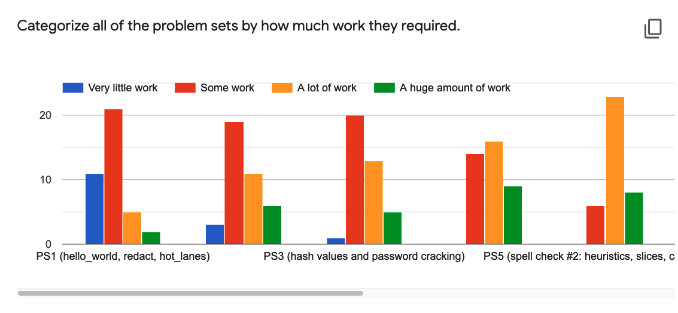
Notes:
Problem set 1: Was it hard? Was it enjoyable?
Honestly determine whether you are okay with problem sets getting substantially more difficult over the semester.
Every year, 5-10% of students in this class face fundamental difficulties trying to complete the problem sets. I wish I could identify the characteristics of those people.
It's not tied to prior experience, intelligence, logical thinking, or undergraduate major.
I know this because the people who have struggled are all very capable students in other ways, and they are all very different from one another.
One theory: it's about having the space in your life this semester that permits you to spend an unexpectedly large number of hours in some week on a disastrous problem set without it destroying you.
So if you have a job and very difficult classes and family obligations and you don't know how you'd find many additional hours in an unexpected week to write code, you might reconsider whether this class is for you. There might be one problem set that you find particularly hard for some reason. If you miss it or phone it in, you're going to have a hard time making up for it in the rest of the class, because it's going to be intense.

Slide 16
Why are problem sets difficult?
The coding-debugging cycle is very different from writing. It’s more like puzzle-solving.
You can’t predict which problem sets will be most challenging for you.
But we have an army of support!
TAs
Office Hours
Ed
Lab
Google/AI/Stack Overflow/Python docs
Notes:
Main thing is that coding is very different from writing. Programming goes like this: You want to do a thing! You write code to do a thing. It doesn't work. It has a bug. You have to debug it and figure out why. You spend 10 minutes (or several hours!) figuring out what you're doing wrong. You fix it! You move on. Overall, you spend almost all of your time fixing, and debugging. In this way, it's very different than writing. You have to like this kind of thing! But it's not for everyone. It might feel annoying, frustrating. But for me, for most coders, and for many students in this class, it's a fun and satisfying kind of puzzle solving, with real results.
2. You can't know which problem sets will be most difficult for you conceptually or when you will run into a really challenging bug. At least once this term, you'll spend a lot of hours working your way out of a nasty bug. This can't be avoided, but it places you in a long tradition following what millions of others have done to learn to be a programmer.
--
Google is your friend. And when you Google coding questions you will often end up on StackOverflow, a website where people can ask and answer questions about programming. And answers get voted up or down. Most questions you ask will be so general that they've been seen by thousands of other intro programming students so will often have tons of votes.
2. Pretty much every general question you might ask about has been answered on StackOverflow.
3. You are welcome to use Google, StackOverflow, ChatGPT for general questions.
4. You'll often end up at Python documentation, or want to look there. It's very precise. But it also might be overly concise. But might not be what you want because there might be jargon, and it won't hold your hand. But still useful.

Slide 17
Collaboration Policy
Unless told otherwise, you must work on your own for the problem sets. Except in lab, you may ask each other only general questions.
See syllabus for more.

Slide 18
Ed
Along with office hours, the best resource for getting help
Discouraged:
Emailed questions
Ed posts that say, “Why is this code not working?”

Slide 19
Laptop Policy
I encourage you not to have your laptop open while we’re coding together during lecture. But keep it handy for self-guided exercises.
No need to copy down all the code. It will be available at github.com/Computer-Programming-for-Lawyers/Fall-2024 (link is on syllabus)
But trust yourself if you think you need your laptop open.

Slide 20
Pass/fail
Your TAs will score each problem set as 0, 1, or 2.
But only I can officially grade you.
To pass, you must demonstrate:
effort on every problem set
progression toward a good working knowledge of Python
Do not obsess about your percentage.
No one has failed the class. But dozens of students have had to work very, very hard not to fail.

Slide 21
Programming Tools We’ll Use This Semester

Slide 22
Terms you’ll hear a lot
Tool | Purpose | Key Features
Git | Version control system | Tracks code changes Branching and merging Commit history
GitHub | Online Git repository hosting | Repository hosting Pull requests Issue tracking Code review
Notes:
Git is a version control system that helps you track changes in your code, manage different versions of your projects, and collaborate with others. It's a powerful tool for managing code development locally on your machine. GitHub, on the other hand, is an online platform that hosts Git repositories, making it easier to share your projects with others and collaborate remotely.
GitHub is the industry standard for version control and collaboration, and we're intentionally using it as the infrastructure for this course because learning to navigate and utilize GitHub is a valuable skill in itself.

Slide 23
Terms you’ll hear a lot
Tool | Purpose | Key Features
Git | Version control system | Tracks code changes Branching and merging Commit history
GitHub | Online Git repository hosting | Repository hosting Pull requests Issue tracking Code review
Notes:
For the purposes of this course, you don't really need to worry too much about the difference between Git and GitHub. We'll be using GitHub to manage and submit your assignments, so you can focus on the essential tasks without getting bogged down by the nuances of local Git usage. So let’s do away with that row for now.

Slide 24
Terms you’ll hear a lot
Tool | Purpose | Key Features
GitHub | Online Git repository hosting | Repository hosting Pull requests Issue tracking Code review

Slide 25
Terms you’ll hear a lot
Tool | Purpose | Key Features
GitHub | Online Git repository hosting | Repository hosting Pull requests Issue tracking Code review
GitHub Classroom | Education-focused GitHub extension | Assignment distribution Automatic repository creation Integrated feedback
GitHub Codespaces | Cloud-based development environments | Pre-configured w customization options Auto-save for 30 days Accessible from anywhere
Notes:
GitHub Classroom:
GitHub Classroom is an extension of GitHub tailored specifically for educational purposes. We'll be using GitHub Classroom to manage and submit all your assignments. You can find a link to each problem set on the syllabus. If you click into future problem sets right now, they’ll be empty. We’ll populate them just after each lecture.
GitHub Codespaces:
GitHub Codespaces provides cloud-based development environments that are pre-configured with all the tools you need for coding. This means you can start coding right away without worrying about setting up your development environment on your local machine. This is far from the only way to code. But it integrates easily with GitHub and has a lower barrier-to-entry than many alternatives.

Slide 26
Terms you’ll hear a lot
Tool | Purpose | Key Features
Python | General-purpose programming language | Simple syntax Extensive libraries Cross-platform compatibility
Jupyter | Interactive coding environment | Code and Markdown cells Inline visualizations Support multiple languages, incl Python

Slide 27
Hidden: Remainder of Class
Live GitHub tour
Codespaces
Kernels
Save/submit issues in GitHub classroom
Note that initial assignments we have auto commit/push configured
Commit issues from Ed
How to use during lecture and lab
AT THIS POINT, HAVE EVERYONE TEST IT OUT
Python expressions and types, variables, booleans

