Slide 1
Intro to Functions
Computer Programming for Lawyers, Fall 2024
OCTOBER 7, 2024

Slide 2



Recap: Conditionals and For Loops
IF STATEMENTS
WHILE LOOPS
FOR LOOPS
Conditional statements that execute a block of code if a specified condition is true.
Loops that repeatedly execute a block of code as long as a specified condition is true.
Loops that execute a block of code a specific number of times, often used to iterate over a collection.

Slide 3
A function is a reusable block of code that performs a specific task.

Slide 4
Motivating Functions
CODE REUSE
Functions allow developers to write code once and reuse it multiple times, saving time and effort.
EASE OF MODIFICATION
When a function is used throughout the code, modifying it in one place updates the behavior everywhere it is used.
DEBUGGING
Isolating functionality in a function makes it easier to identify and fix issues, as the code is more modular and easier to reason about.
MODULARITY
Functions help break down a larger problem into smaller, more manageable pieces, which can be solved independently and then combined to solve the original problem.
ABSTRACTION
Functions add new "commands" to the Python language, enabling you to tackle increasingly complex problems.
ENCAPSULATION
Functions provide a contract that, when given properly-formed input, will produce the correct output, without the need to understand the underlying implementation details.

Slide 5
Function Structure
INPUTS (PARAMETERS)
OUTPUTS (RETURN VALUES)
CALLING A FUNCTION
Functions can take in one or more inputs, called parameters, to use in their operations.
Functions can return a value after processing the inputs, called the return value.
To use a function, you 'call' it and pass in any required parameters.

Slide 6
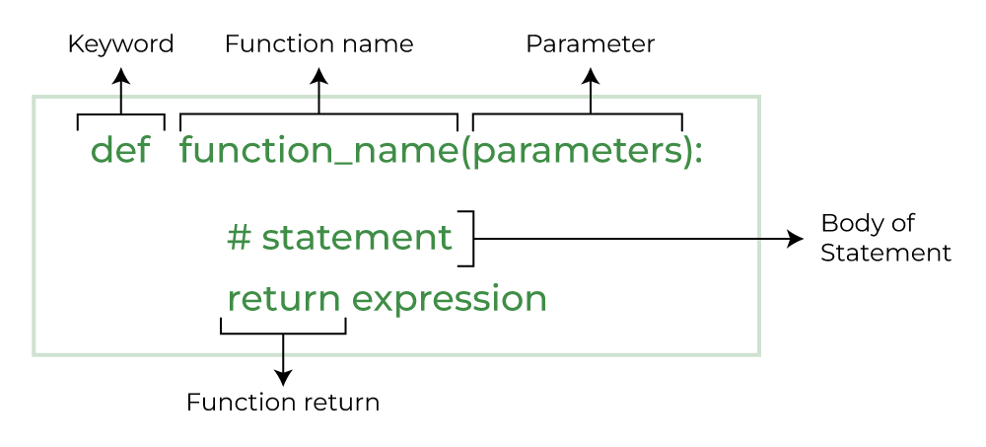
Image source: Python Functions, GeeksforGeeks

Slide 8
Modules and Imports

Slide 9
A module is a collection of related functions or definitions you can use in your Python programs.
Other terms you might hear: Libraries or Packages — for our purposes, these terms are interchangeable.

Slide 10


STUDENT FILE ONE
import cpl_hash
MODULE
STUDENT FILE TWO
cpl_hash
import cpl_hash
STUDENT FILE THREE
import cpl_hash

Slide 11
Difference between .py and .ipynb files for Modules
FILE EXTENSION
PURPOSE
EXECUTION
MODULES
Python files end in .py while Jupyter Notebooks end in .ipynb
.py files are Python script files, while .ipynb files are Jupyter Notebook files that can contain both code and text.
.py files are executed directly from the command line, while .ipynb files are run within a Jupyter Notebook environment.
.py files can be imported as modules in other Python scripts, while .ipynb files can be used to import and run reproducible modules.

