Slide 1

LOW-LIGHT IMAGERY
Dual Illumination Estimation
for
Robust Exposure Correction
Team – RC Squad

Slide 2
Objectives:
We first perform dual illumination estimation to obtain the forward and reverse illuminations, from which we recover the intermediate under- and over-exposure corrected images.
The two intermediate exposure correction images together with the input image are fused into the desired image that seamlessly blends the best exposed parts in each of the three images

Slide 3
Method Overview -
We are going to implement this paper by dividing the whole process into 4 parts:
Correcting the under-exposed input image using forward illumination method.
Correcting the over-exposed input image using reverse illumination method.
Fusing these 2 intermediate correct exposure image(mentioned above) with the input image to extract the best exposed parts.
Combining these best exposed parts to get final well-exposed output image.

Slide 4

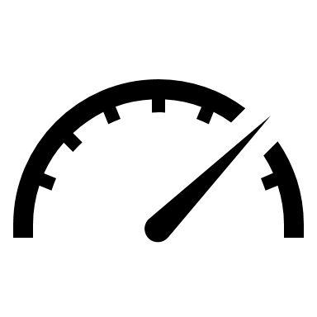
Timeline -
Mid Evaluation -
Forward Illumination method
Reverse Illumination method

Slide 5
THANK YOU

