Slide 1

COMPUTER VISION PROJECT
“LOW-LIGHT IMAGERY”
Abhishek Sharma
Rishabh malik
Piyush Atri
Devansh Dobriyal
(RC-SQUAD)

Slide 2
PAPER IMPLEMENTATION
“Dual Illumination Estimation
for
Robust Exposure Correction”
By - Qing Zhang, Yongwei Nie, and Wei-Shi Zheng

Slide 3
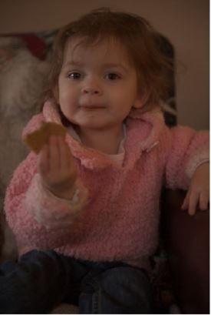
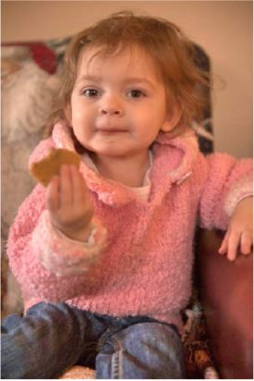
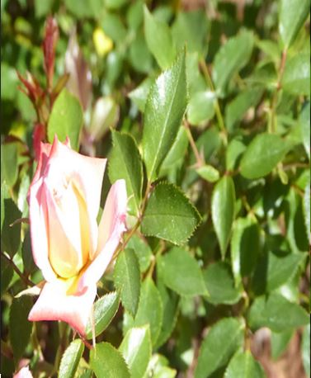
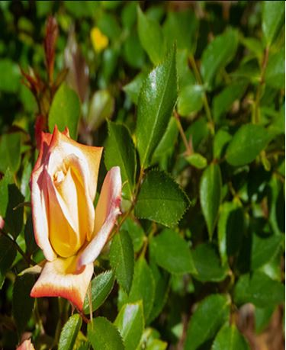
OBJECTIVE
To make an automatic exposure correction method.
Fixes both under-exposed and over-exposed images.

Slide 4
METHOD OVERVIEW
We are going to implement this paper by dividing the whole process into 4 parts:
Correcting the under-exposed input image using forward illumination method.
Correcting the over-exposed input image using reverse illumination method.
Fusing these 2 intermediate correct exposure image(mentioned above) with the input image to extract the best exposed parts.
Combining these best exposed parts to get final well-exposed output image.

Slide 5
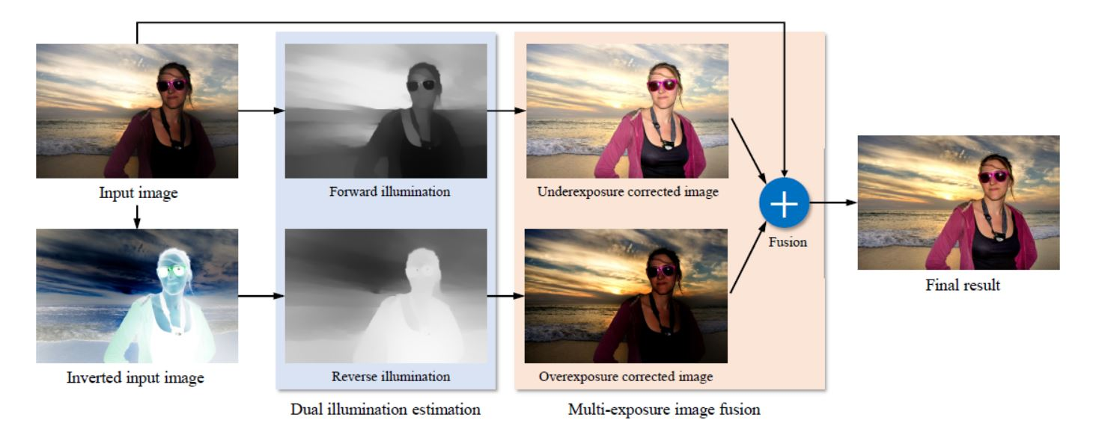
METHOD OVERVIEW

Slide 6
FORWARD ILLUMINATION METHOD
Fundamental of this method is based on the same assumption as used in Retinex-based image enhancement approach
Assumption:
Image I (normalized to [0,1]) can be characterized as a pixel-wise product of the desired enhanced image I’ and a single-channel illumination map L:
I = I’ x L -> Eq1
Where x denotes pixel-wise multiplication.
So we can extract the best exposed parts of the under-exposed image using Retinex-based image enhancement model.

Slide 7
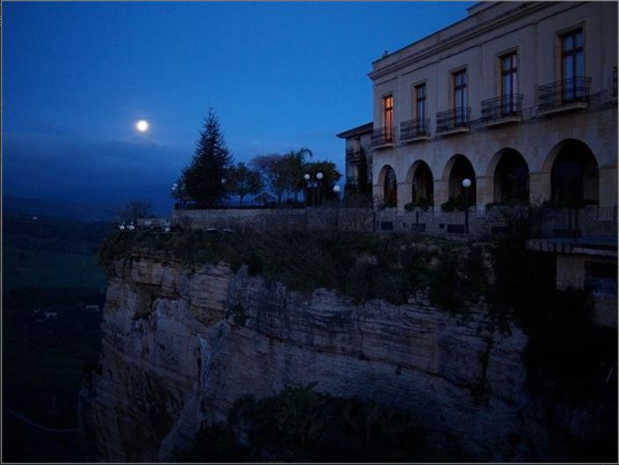
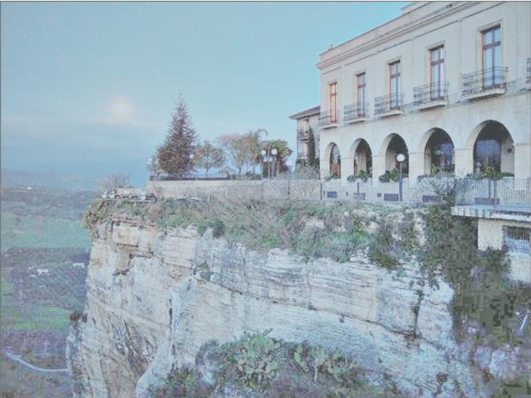
FORWARD ILLUMINATION METHOD
RESULTS

Slide 8

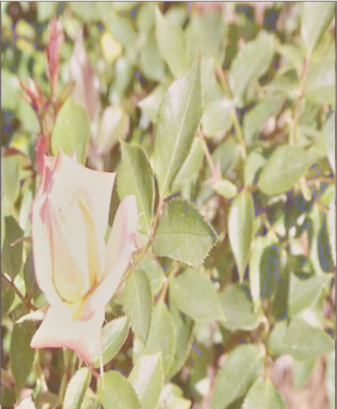
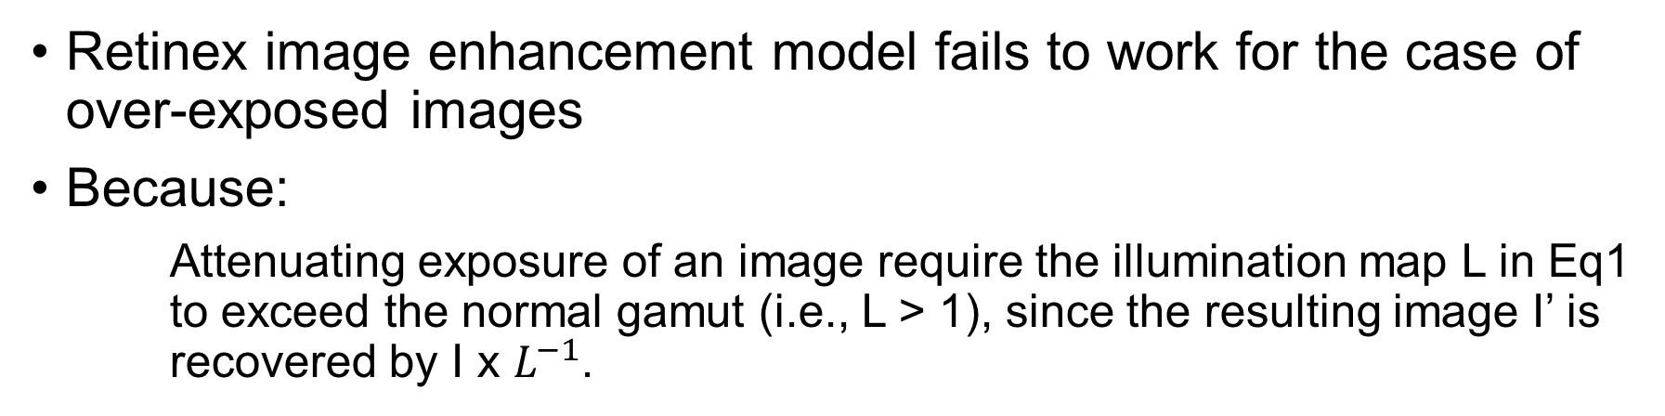
reverse ILLUMINATION METHOD
Retinex image enhancement model fails to work for the case of over-exposed images
Because:
Attenuating exposure of an image require the illumination map L in Eq1 to exceed the normal gamut (i.e., L > 1), since the resulting image I’ is recovered by I x $L^{−1}$.

Slide 9
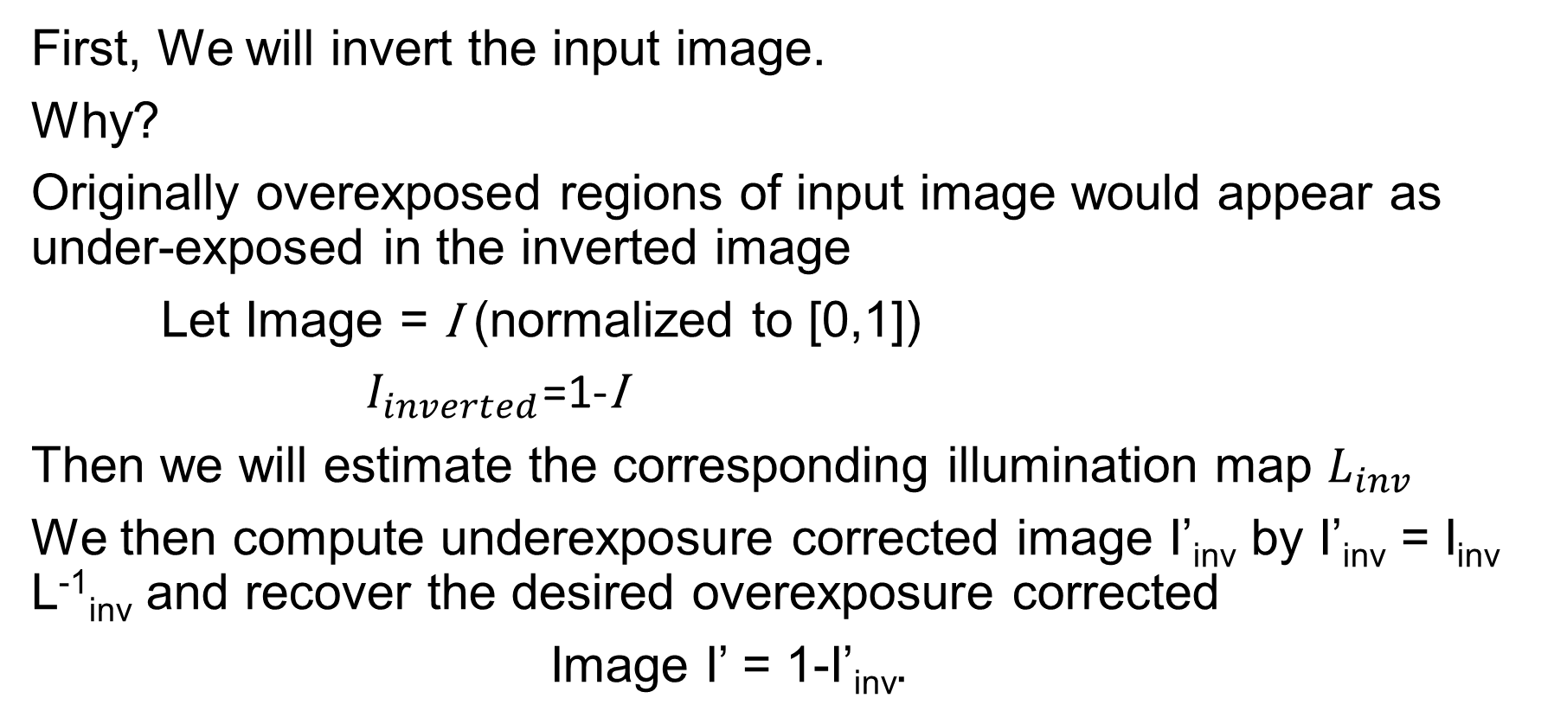
Approach for over exposed images
First, We will invert the input image.
Why?
Originally overexposed regions of input image would appear as under-exposed in the inverted image
Let Image = I (normalized to [0,1])
$I_{inverted}$=1-I
Then we will estimate the corresponding illumination map $L_{inv}$
We then compute underexposure corrected image I’_{inv} by I’_{inv} = I_{inv} L⁻¹_{inv} and recover the desired overexposure corrected
Image I’ = 1-I’_{inv}.

Slide 10
FUSION METHOD
INPUT IMAGE
Extract the best exposed parts
Well-Exposed output image
UNDER-EXPOSURE CORRECTED IMAGE
OVER-EXPOSURE CORRECTED IMAGE

Slide 11
DEADLINES
Mid-Evaluation
Forward Illumination method
Reverse Illumination method
Final-Evaluation
Fusion of the 3 images
Any additional development if time permits

Slide 12
THANK YOU

