Slide 1
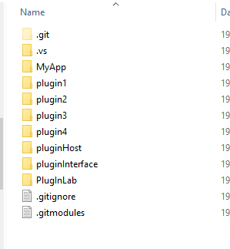
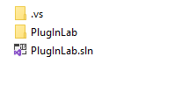

Slide 2
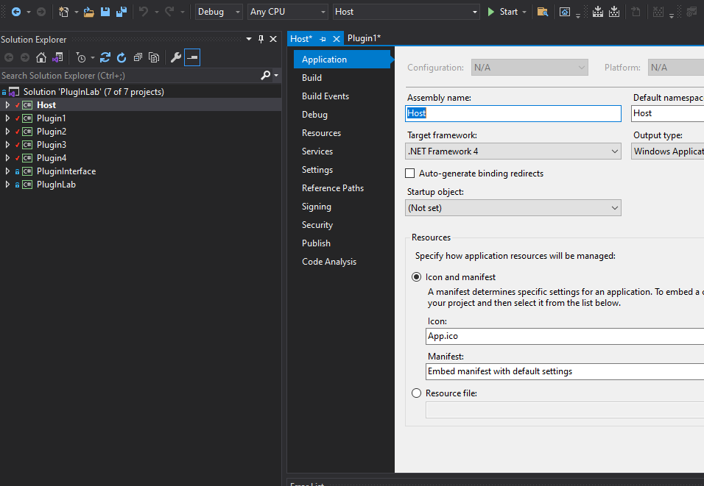
2
3
1

Slide 3
Host
Host
Debug
Executable file

Slide 4
Plugin Interface
MyApplication
Plugin
1
Host
Plugins
Plugin
4

Slide 5
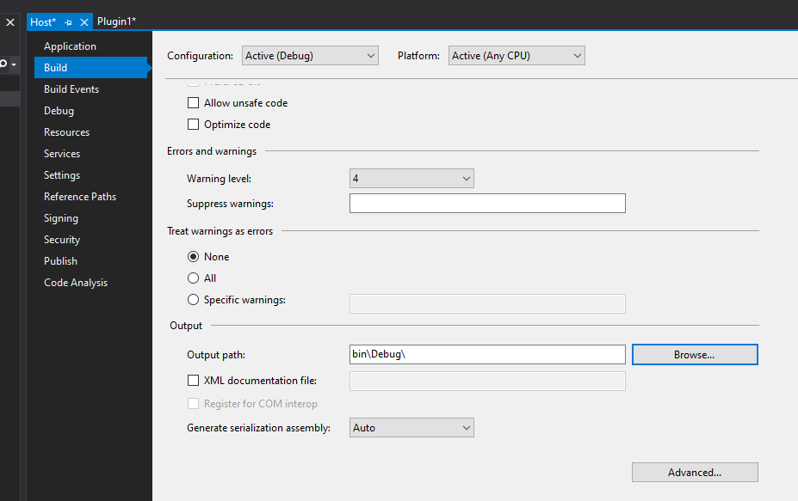
1
2

Slide 6
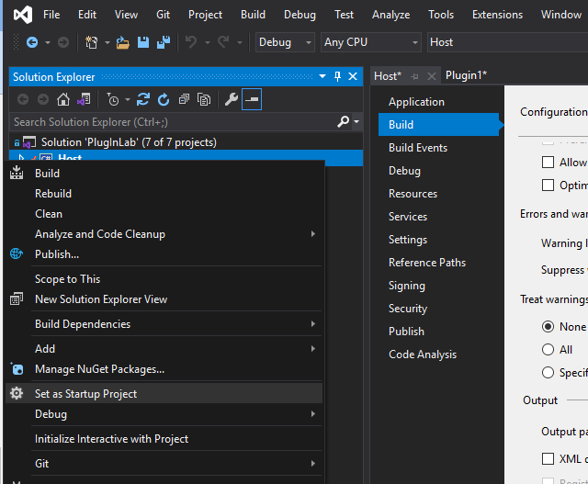
1
2

