Slide 1
Digital Image Processing
Bob Schriver

Slide 2
What is an Image?
Discrete (i.e. Digital)
Matrix
Continuous (i.e. Analog)
2D Function
First task: Analog to Digital
Notes:
In both of these cases, the value of a function at a point is the “intensity” of an image, or in the case of a greyscale image, its brightness
Talk about a gradient image as a function

Slide 3
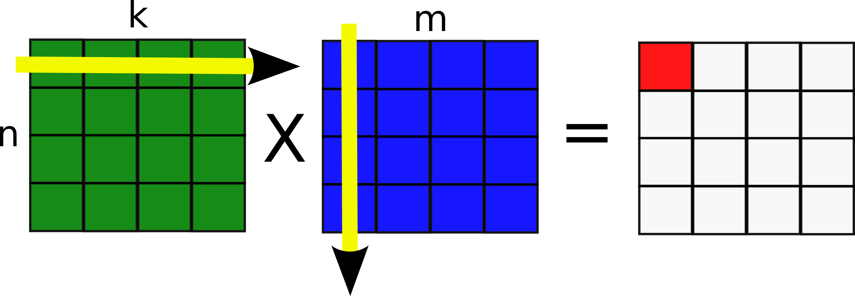
Matrices
What are they?
Vector of Vectors (2D array in a programing sense)
Vectors
1D array of numbers

Slide 4
Function Demo
g = [1:.1:16]' * [1:.1:16];
imshow(uint8(g))

Slide 5
Sampling & Quantization
Sampling
Convert a continuous function to discrete values
Number of pixels
Quantization
Convert continuous intensity values to discrete grey levels
Bit-depth of an image

Slide 6
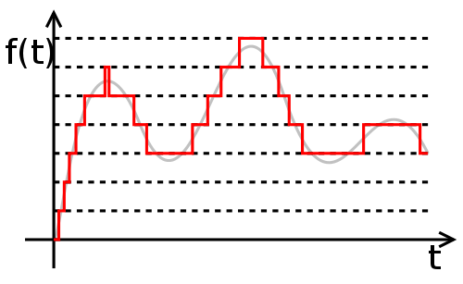
How do we quantize?
We can imagine a simple quantization function as the round function
A better quantizer would be a step function, corresponding to the desired number of grey levels
Notes:
Quantization occurs in the digital domain, going from a continuous analog function to ones and zeros (secretly its more complicated)

Slide 7
Quantization Demo
im = imread('lena.tif');
imshow(im)
quant_round = im2double(im);
quant_round = round(quant_round);
imshow(quant_round)
q_step = im;
q_step(q_step > (3/4) * 255 & q_step < (4/4) * 255) = (7/8) * 255;
q_step(q_step > (2/4) * 255 & q_step < (3/4) * 255) = (5/8) * 255;
q_step(q_step > (1/4) * 255 & q_step < (2/4) * 255) = (3/8) * 255;
q_step(q_step > (0/4) * 255 & q_step < (1/4) * 255) = (1/8) * 255;
imshow(q_step)
Notes:
Rounding Quantizer, four level quantizer

Slide 8
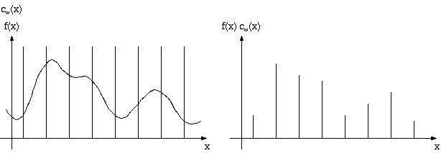
How do we sample?
Dirac delta function
Impulse of value 1 at the origin
Now we take a lot of these at periodic intervals and…

Slide 9
Nyquist-Shannon Sampling Theorem
How much should we sample?
The Nyquist-Shannon Sampling Theorem has the answer!
Sample at twice the highest frequency
What happens if we don’t sample enough?
Notes:
We want to sample often enough such that we can reconstruct the original signal.

Slide 10
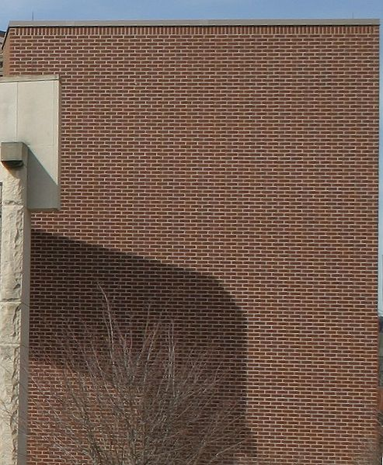
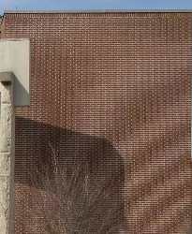
Aliasing
Notes:
If we don’t sample enough, we get aliasing in the reconstructed image. This is because we could not accurately represent high frequency components of an image
How do we find the frequency of an image?

Slide 11
Fourier Transform
Converts a signal from spatial to frequency domain
What does frequency mean in an image?
Fourier has to be cooler than that though, right?
Hell yeah!
Makes shit easy
Notes:
We can imagine the frequency of an image to be the spatial distance of edges. Close edges will have a high corresponding frequency, thus we must sample more
Transferring an image to the frequency domain turns convolution into multiplication! So simple

Slide 12
Fourier Demo
square = zeros(256 , 256);
square(116:1:140 , 92:1:164) = 1;
square_fft = fft2(square , 256 , 256);
square_fft = fftshift(square_fft);
imshow(log(abs(square_fft)) , [-1 5])

Slide 13
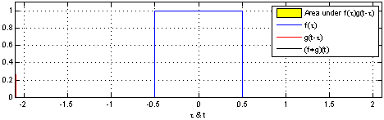
Convolution
What is it?
Overlapping area as we shift function
How is it useful?
Used in the discrete domain for image filters
Notes:
Shift using the Dirac Delta function
Convolution is the result of shifting and multiplying one function on another

Slide 14
Convolution Demo
f = rand(1 , 16)
filt = (1/3) * [1 1 1]
conv(f , filt , ‘same’)
im = double(imread('lena.tif'));
filter = (1/9) * [1 1 1; 1 1 1; 1 1 1];
im_avg = conv2(im , filter);
imshow(uint8(im_avg))
Figure
imshow(uint8(im))

Slide 15
Noise Reduction
Averaging Filter
Blurs noise into image
Gaussian Filter
Median Filter
Removes outliers
Performs poorly with high frequency edges
Notes:
Gaussian performs poorly with salt and pepper noise
Median performs poorly with Gaussian noise

Slide 16
Noise Reduction Demo
im_noisy = imnoise(im , 'salt & pepper' , 0.1);
imshow(im_noisy);
gaussian_filter = fspecial('gaussian');
gaussian_denoise = imfilter(im_noisy , gaussian_filter);
imshow(gaussian_denoise);
median_denoise = medfilt2(im_noisy);
imshow(median_denoise);

Slide 17

Edge Detection
Derivatives
Have a high response near large changes in value
Derivative Filter
Only one dimension at a time
Notes:
Large changes of value in an image means edges
Modified Sobel operator, vertical and horizontal

Slide 18
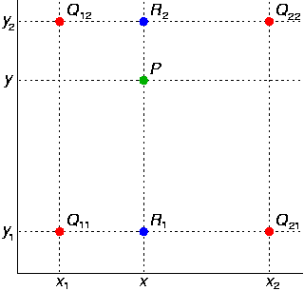
Interpolation
Guessing unknown values
Used in image upscaling, demosaicing and more
Nearest Neighbor
Bilinear

Slide 19
Histogram
What does a histogram tell us?
Number of gray levels in an image
Number of pixels at each grey level
Why do we care
Probability that a random pixel will be a certain value
Notes:
Once we normalize (ie divide by number of pixels in image), the histogram becomes the probability density function of the image

Slide 20
Thresholding
How do we turn a greyscale image into a binary image?
Similar to quantization
Mean Thresholding
Median Thresholding
Otsu’s Method
Minimizes inner class variance
Maximizes between class variance
Notes:
Problems with Mean and Median: Pixels that were very similar in the original image ie around the mean, are now very different
Otsu’s method thresholds between two classes

Slide 21
Thresholding Demo
im = imread('lena.tif');
thresh_im = im;
threshold = mean2(im)
threshold = median(im(:))
threshold = 255 * graythresh(im)
thresh_im(im < threshold) = 0;
thresh_im(im >= threshold) = 255;
imshow(thresh_im);

Slide 22
Compression
Reduce data needed to give good representation of image
Throw away data
Encode data in fewer bits
‘Default’ image value
Notes:
Default image value means we want as much as the image as possible to be one value – we can the just send the size of the image and assume any unknown value is default

Slide 23
Compression - Coding
One to one transformation
How does this compress?
Represent most frequent data in smaller number
Huffman coding
Run Length encoding
Notes:
Huffman coding represents the data in such a way that it is ‘instantly decodable’ ie we can look at it in a stream and know the symbol immediately
Run length encoding stores a value and the number of times that value appears in a sequence – good for text. BMP uses this

Slide 24
Compression - JPEG
LAB Color Space
Luminance and Chrominance Channels
Luminance contains spatial info
Chrominance contains color info
Color info can be resized or remove
Notes:
Approximates Human Vision – Distance between colors correspond to human visual perception

Slide 25
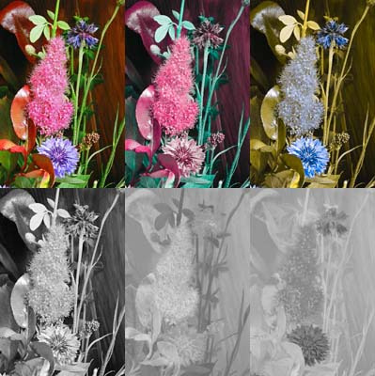
Compression - JPEG

Slide 26
Compression - JPEG
Discrete Cosine Transform
Like Fourier, but better
Able to control compression quality
Quantization factor
Notes:
We can imagine the Fourier Transform as a function representation of an image, with the functions being sinusoids and the coefficients being the Fourier Transform values

Slide 27
Compression – Tying it all together
First, covert to LAB space
Downsample Chrominance 2x
Perform the DCT on 8x8 block in Luminance Channel
Quantize to desired coefficient level
Encode the blocks and store
Encode using Entropy Coding
15-20 times compression with little artifacting
Notes:
Entropy coding is a combination of Run Length coding and Huffman coding that composes a square matrix as a vector that zig-zags through the square

