Slide 1
Flash & ActionScript
Syntax is similar to JavaScript
But dumber with some nuances.
Declaring with a type
  var num:int;
  public function whoop(n:int):void { }

Slide 2
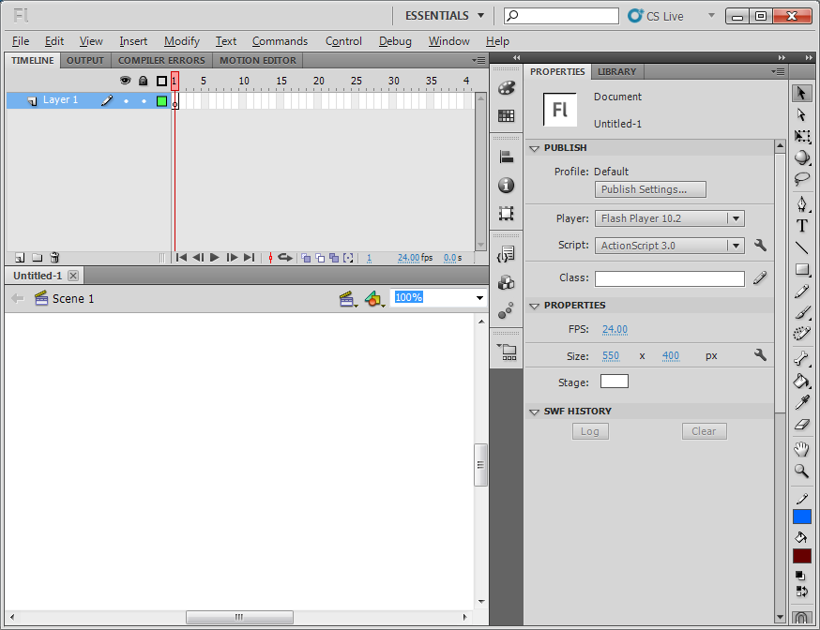

Slide 3
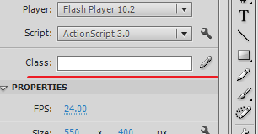
Document Class
Flash's “main”
Type “Document.as” (or whatever you want) into the class field, and hit that pencil thing.
There's a dialog box warning that the class doesn't exist. It will create one for you.
Flash somehow doesn't have a file tree for your project, or at least one I can find. Fuck it, use explorer (or your OS's equivalent)

Slide 4
Packages
Similar to a namespace
If you don't use one, all of your code should be thrown into the same folder as your flash file
If you do use one, all classes should be prefaced with the package name (src.MyClass.as)

Slide 5
Event Driven!
Actionscript games are event driven
You're going to be setting up event listeners and firing events off.
addEventListner(Event, function);

Slide 6
Update Loop
public function update(e:Event):void {
  //STUFF
}
Add an event listener to the Document class constructor that will call update
addEventListener(Event.ENTER_FRAME, update);

Slide 7
Making objects
One of two ways:
1. Draw something, convert to symbol
2. Create new symbol
Use Movieclip
Give it an instance name in the properties bar

Slide 8
Animation
Animation is achieved using “keyframes”
A blank keyframe will make a new blank frame
A new keyframe will copy the current frame
A regular frame will extend the current frame
Use labels to name animations, access them from code
You can add script to the current frame (not usually an awesome idea) but works for small stuff

Slide 9
Keyboard Input
It's dumb
Download COM from me
There are some imports to do

Slide 10
HitTestObj
Use for collisions
Actually really easy

