Slide 1
XNA
Proprietary Microsoft framework
C#

Slide 2
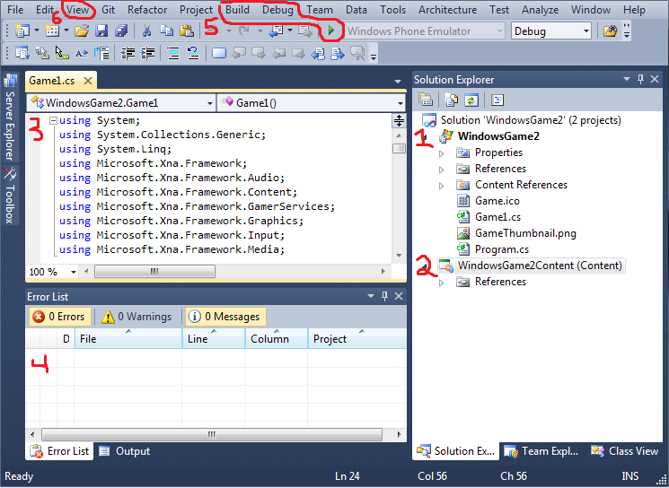
Interface

Slide 3
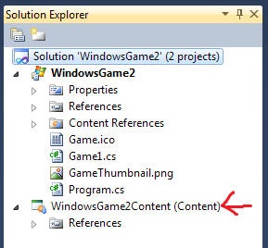
Adding Content

Slide 4
Game1.cs
Shit's already been written for you!
Initialize()
LoadContent()
UnloadContent()
Update()
Draw()

Slide 5
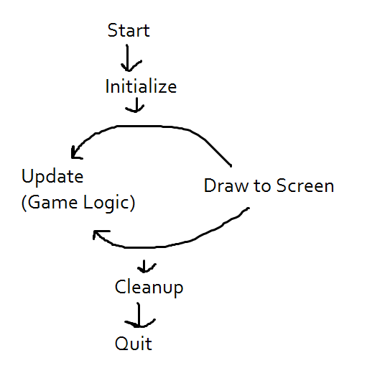
The Game Loop

Slide 6
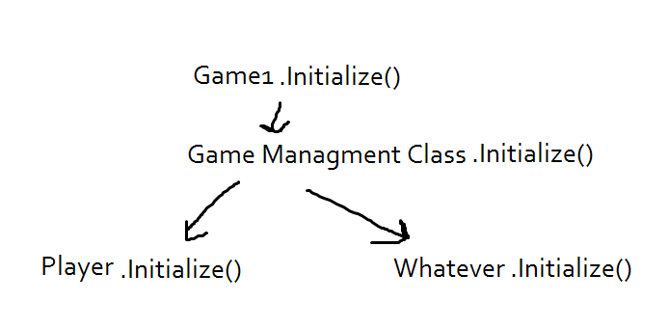
Initialize
Initialize graphics device, set up resolution
GraphicsDeviceManager
Init() of all your game elements

Slide 7
LoadContent
XNA uses Texture2D to store picture files
ContentManager class allows you to load Texture2Ds from the ContentProj
Content.Load<Texture2D>(“mydumbfile”);
(Type goes inside angle brackets)

Slide 8
Rectangle
Draw method requires either a rectangle or vector2
Rectangle rect = new Rectanlge(x,y,w,h);
Use it to keep track of object positions, or collision boundaries

Slide 9
Update
Runs every frame, put game logic in here.
HINT: Have some kind of game management class with it's own update method, which in turn updates all of your game objects.
Get player input, do something with it.

Slide 10
Input
KeyboardState, MouseState, GamepadState
Keyboard.GetState(), etc..
MyMouse = Mouse.GetState();
Keys is an enum that contains all keys
if(myKeyboard.IsKeyDown(Keys.Right))
{ myRect.x += 5; }

Slide 11
Input Tip
KeyBoardState only keeps track of whether or not a key is down. So what if you want to know if a key has JUST been pressed? (IE: Player jumps when you press Space Bar)
Have a keyState var and oldKeyState. At the end of the Update loop, set oldKeyState to the current keyState.
During update, if current keyState button is pressed, and oldKeyState is released, then the condition is met

Slide 12
Draw -SpriteBatch
SpriteBatch handles all rendering. One has already been Initialized in Game1.cs
spriteBatch.Begin();
//DRAW STUFF HERE
spriteBatch.End();

Slide 13
Draw
SpriteBatch.Draw() has a fuck ton of overloads
Here's an easy one:
Draw(Texture2D, Rectangle, Color)
Color is an enum. Just do Color.White for now
(you can instantiate a new Color(r,g,b,a)
Other overloads include scaling, rotation, and source/destination rects

Slide 14
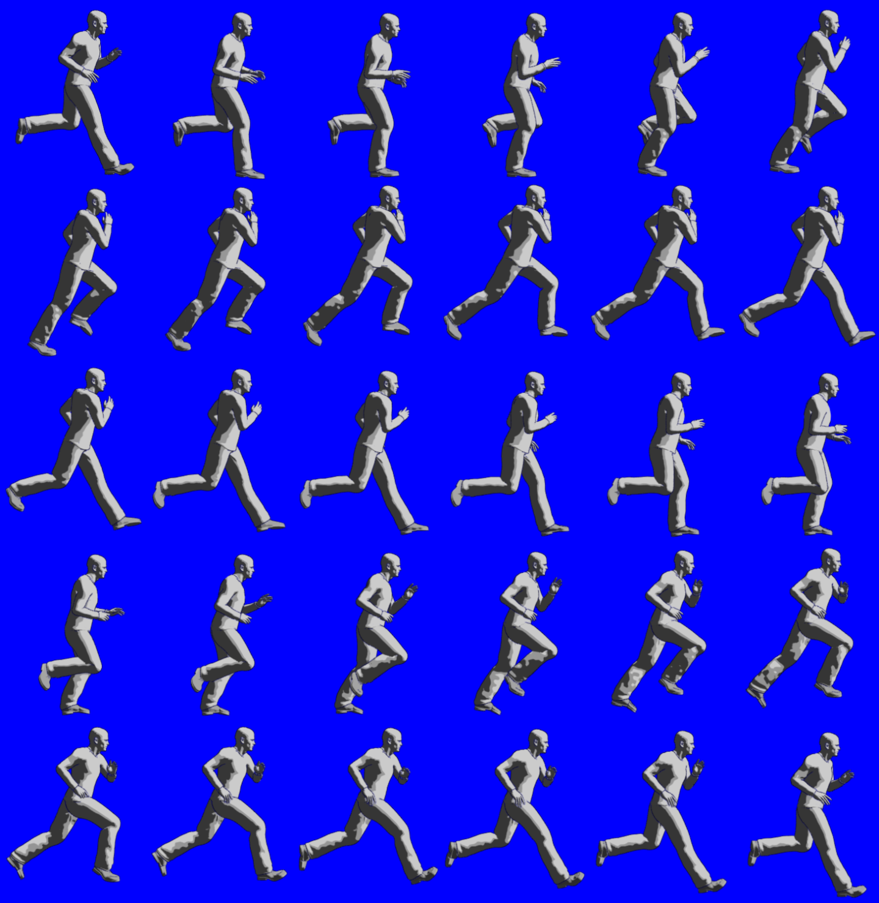
SpriteSheets

Slide 15
SpriteSheets
Destination Rect determines
where the obj will be drawn
on screen
Source Rect determines
what portion of the source image will be drawn
Animation can be achieved by drawing different portions of the source image in rapid succession.

Slide 16
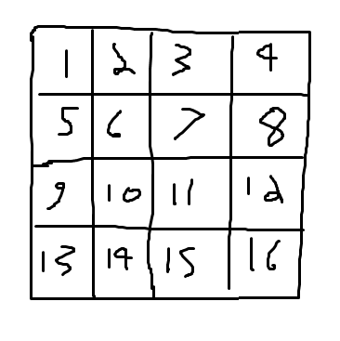
Rows = 4;
Cols = 4;
Lets say you want to draw
frame 6.
Int w = texture.Width / rows
Int h = texture.Height / cols
Int x = (currentFrame % rows) * width;
Int y = (currentFrame % cols) * height;
Rectangle source = new Rectangle(x,y,w,h);

Slide 17
Sound
Usually the last thing anyone gets to
Load a SoundEffect or a Song through the ContentManager class.
Use mySound.Play() or MediaPlayer.Play(song)
It's just that easy!

Slide 18
Collision Detection
There are a number of ways to do collision detection, but bounding boxes is the easiest.
myStupidRectangle.Instersects(fucktangle)

