Slide 1
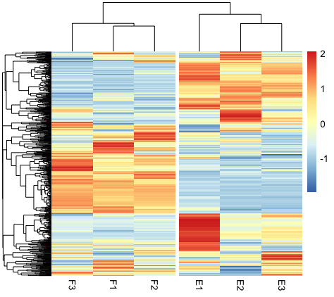
Introduction to Gene Expression
Part I

Slide 2
Introduction
Course Objective
Give biologist the basic understanding of RNA sequencing
Give biologist the basic ability to analyze the RNA sequencing data (Focused on model organism mice)
Identification of the differentially expressed genes
Future directions for usage of RNAseq data analysis

Slide 3
Introduction
This course is …
Formal introduction to RNA sequencing analysis
This course is not …
Not a advance coding course
Not for downstream applications of RNA sequencing

Slide 4
What you do need to success ?
Basic R, microsoft excel usage
Basic understating of central dogma in Biology
Practice, Practice, Practice
What you don’t need to succeed?
Deep coding knowledge
Deep R usage
Deep understanding of sequencing methods

Slide 5
Gene Expression
Wednesday
Central dogma and sequencing
Downloading RAW FASTA file from GEO
Downloading reference transcriptome from GENECODE
R basics (installation of DESeq2, pheatmap etc)
Thursday
Importing the count files in R
Finding DEGs
Finding gene of interest
Data visualization
Gene Ontology

Slide 6
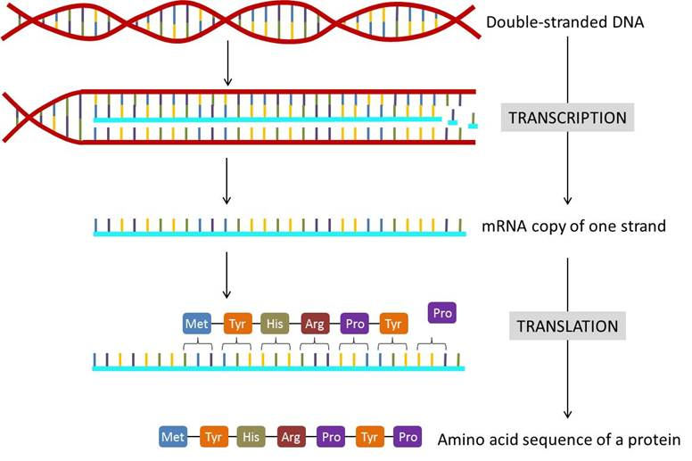
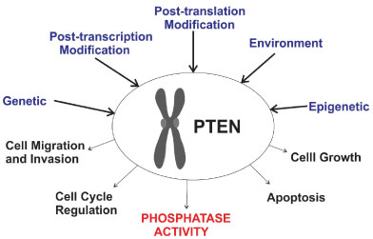
Central dogma
Gene expression
https://rwu.pressbooks.pub/bio103/chapter/the-central-dogma-genes-to-traits/
Silva KSF (2019) Genetic Counseling, Polymorphisms and Breast Cancer. J Fam Med Dis Prev 5:098. doi.org/10.23937/2469-5793/1510098

Slide 7
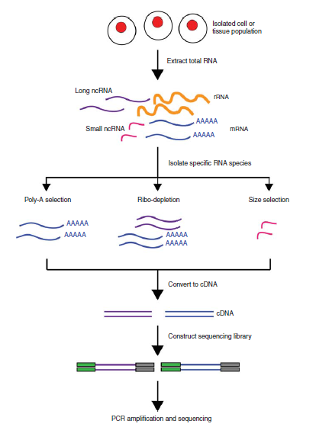
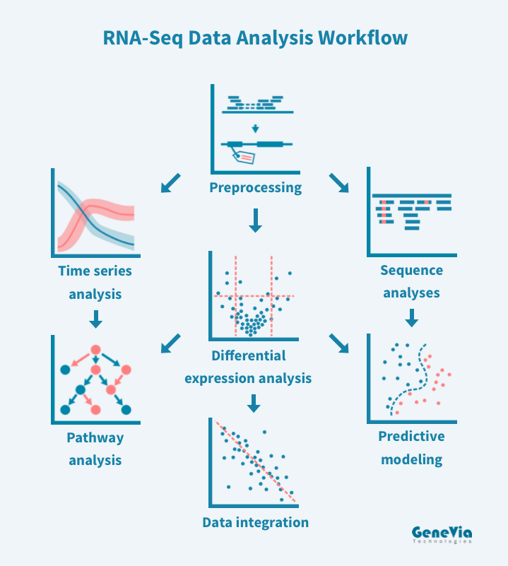
Overview of sequencing
Analysis
https://geneviatechnologies.com/bioinformatics-analyses/rna-seq-data-analysis/
https://www.rna-seqblog.com/introduction-to-rna-sequencing-and-analysis/

Slide 8
Data processing pipeline
Genome: GRCm38 from genecode
Annotation: Ensembl
RNA-Seq
Illumina TruSeq
50bp SE reads
Reference Transcriptome indexing
Alignment with Reference Transcript
Quality assessment
FastQC(just for information)
DEG testing
DESeq2 in R
Quality Trimming
Trim Galore
Cutadapt (just for Information)
Gene ontology
Metascape in browser

Slide 9
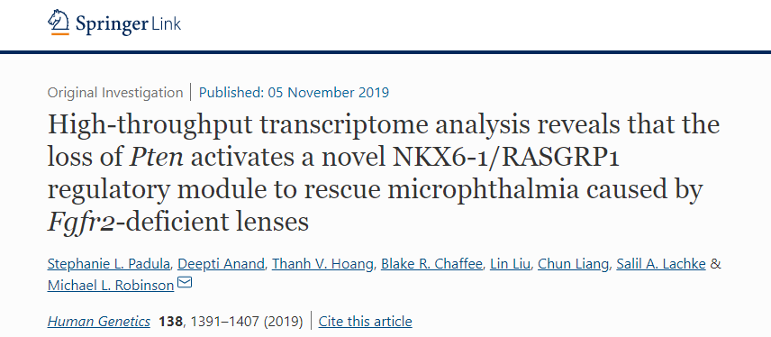
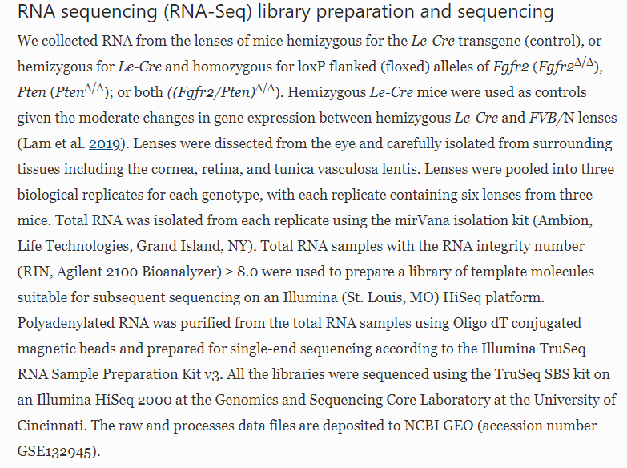
Finding the data of our interest...

Slide 10
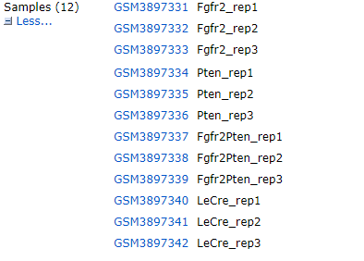
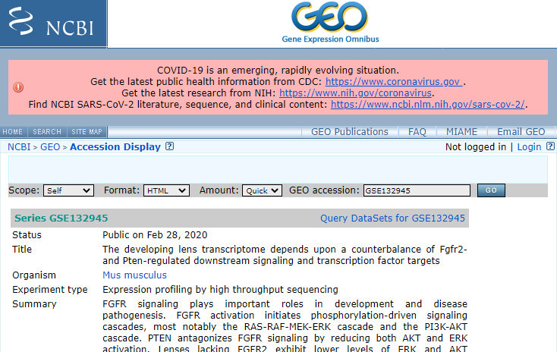
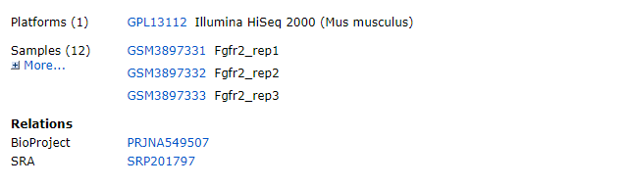
How to access the data?
https://www.ncbi.nlm.nih.gov/geo/query/acc.cgi?acc=GSE132945

Slide 11
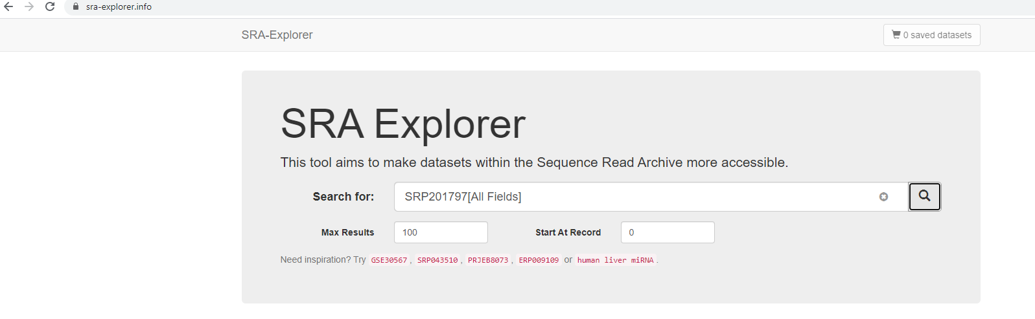
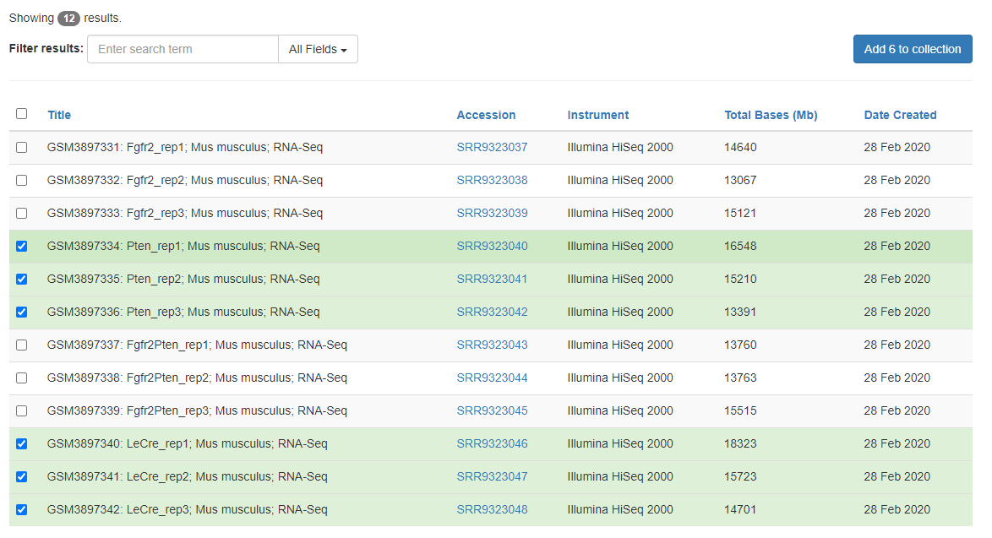
Downloading Raw FASTA/FASTq file

Slide 12
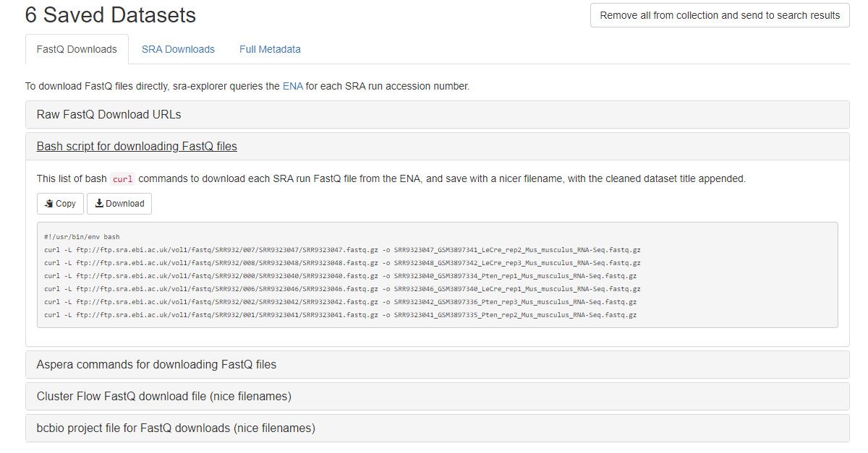

Slide 13
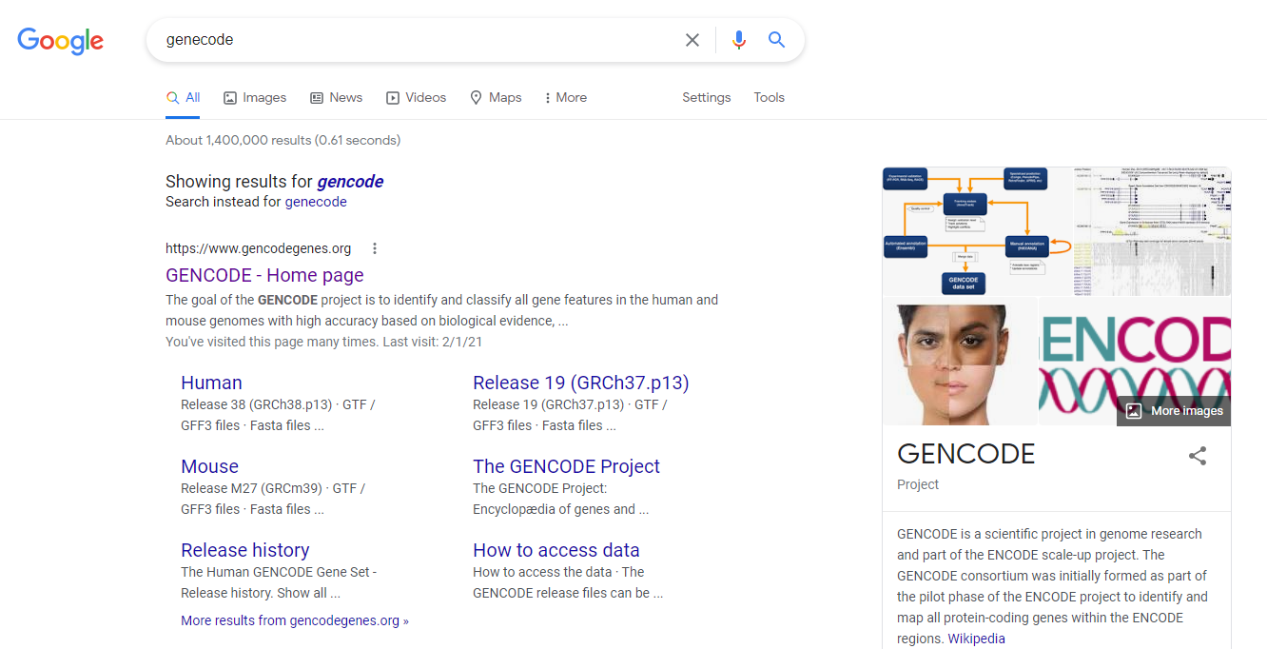
Finding reference genome/transcriptome?

Slide 14
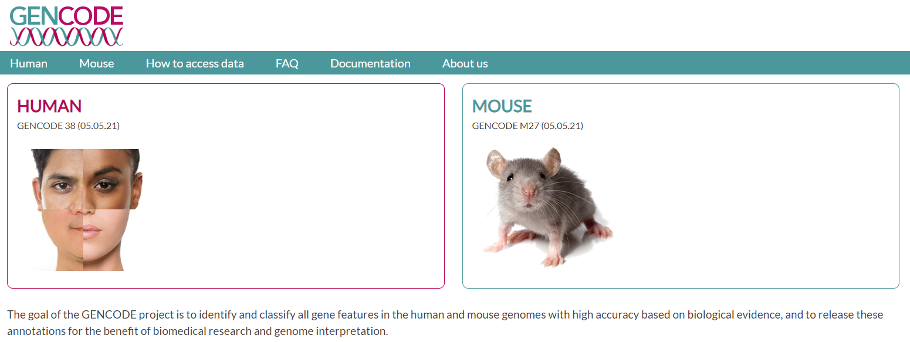
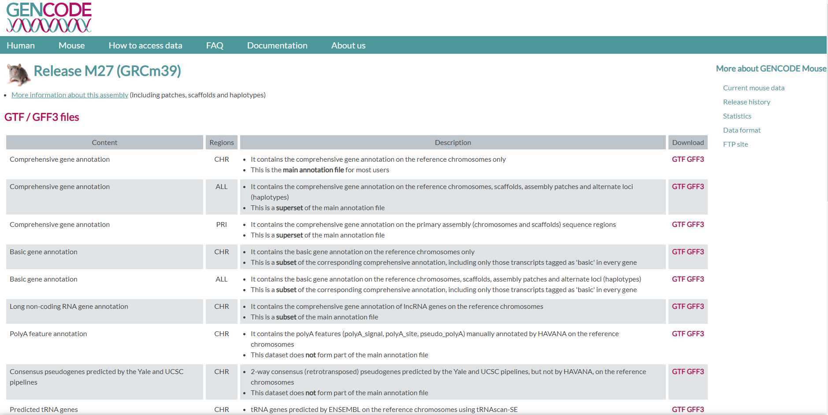
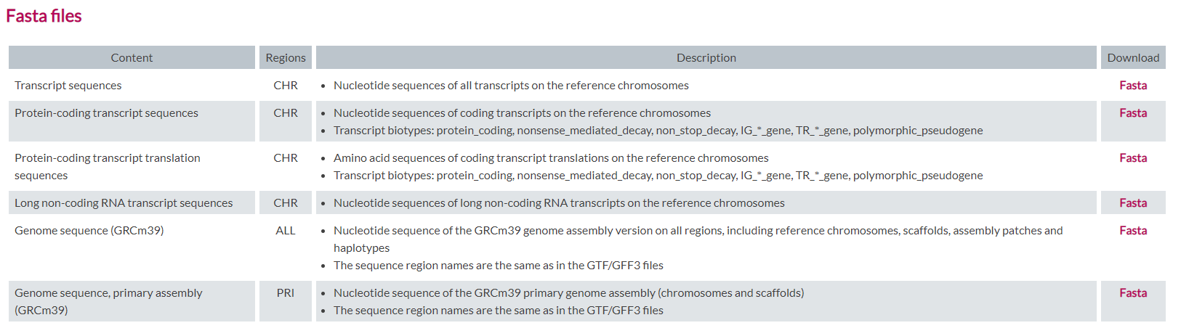
conda install -c anaconda wget

Slide 15
R packages needed
Tximport = Exporting the GFF file for processing by kallisto
GenomicFeatures = Basic package needed for lot of genomic analysis
AnnotationDbi = Basic package for all annotation packages
DESeq2 = DEG processing package
pheatmap = For making heatmaps

Slide 16
Tximport
if (!requireNamespace("BiocManager", quietly = TRUE))
install.packages("BiocManager")
BiocManager::install("tximport")
https://bioconductor.org/packages/release/bioc/html/tximport.html

Slide 17
GenomicFeatures
if (!requireNamespace("BiocManager", quietly = TRUE))
install.packages("BiocManager")
BiocManager::install("GenomicFeatures")
https://bioconductor.org/packages/release/bioc/html/GenomicFeatures.html

Slide 18
AnnotationDbi
if (!requireNamespace("BiocManager", quietly = TRUE))
install.packages("BiocManager")
BiocManager::install("AnnotationDbi")
https://bioconductor.org/packages/release/bioc/html/AnnotationDbi.html

Slide 19
DESEq2
pheatmap
if (!requireNamespace("BiocManager", quietly = TRUE))
install.packages("BiocManager")
BiocManager::install("DESeq2")
https://bioconductor.org/packages/release/bioc/html/DESeq2.html
install.packages("pheatmap")

Slide 20
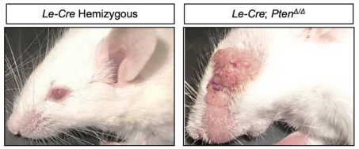
Understanding data..
What is the role of PTEN in lens development?
Knock Out PTEN in mice
Observe the phenotype
Find the Differentially Expressed Genes (DEGs)
Predict the cell signaling pathway leading to this effect
Verify using wet lab analysis
PTEN present
PTEN deletion
DEGs when compared Le-Cre vs PTEN KO

Slide 21

Bonus
If you want to perform the RNA sequencing analysis on your own
I have provided step by step method for analysis ...
https://businesstech.co.za/news/business/104803/end-of-year-bonuses-may-bring-out-the-worst-in-people/

Slide 22
Anaconda install
Operating system: Windows 8 or newer, 64-bit macOS 10.13+, or Linux, including Ubuntu, RedHat, CentOS 6+, and others
Minimum 5 GB disk space to download and install.
For Windows
https://docs.anaconda.com/anaconda/install/windows/
For macOS
https://docs.anaconda.com/anaconda/install/mac-os/
For Linux
https://docs.anaconda.com/anaconda/install/linux/
Anaconda
Distribution of the Python and R programming languages for scientific computing (data science, machine learning applications, large-scale data processing, predictive analytics, etc.),
To simplify package management and deployment
Runs in terminal /Command prompt

Slide 23
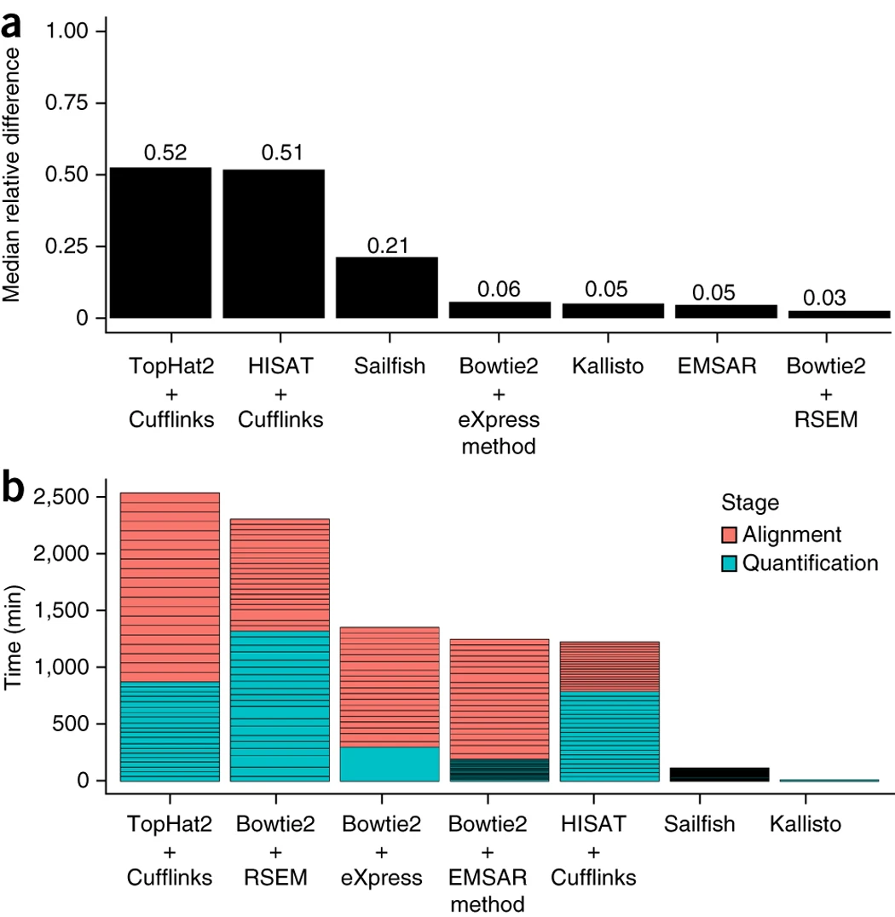
Kallisto
https://pachterlab.github.io/kallisto/
“RNA-seq quantification program that is two orders of magnitude faster than previous approaches and achieves similar accuracy. Kallisto pseudoaligns reads to a reference, producing a list of transcripts that are compatible with each read while avoiding alignment of individual bases. We use kallisto to analyze 30 million unaligned paired-end RNA-seq reads in <10 min on a standard laptop computer. This removes a major computational bottleneck in RNA-seq analysis.”
Nicolas L Bray, Harold Pimentel, Páll Melsted and Lior Pachter, Near-optimal probabilistic RNA-seq quantification, Nature Biotechnology 34, 525–527 (2016), doi:10.1038/nbt.3519

Slide 24
Creating your environment for RNA seq
Kallisto installation
Checking all the packages and version installed
FASTqc installation
Exit environment
Step 4:
conda install -c biobuilds kallisto
Enter Y
Step 1:
Open Terminal / Command Prompt
Conda create --name RNA_seq
Step 2:
For windows : activate RNA_seq
For LINUX, macOS: source activate RNA_seq
Step 5:
conda list
Step 3:
conda install -c bioconda fastqc
Enter Y
Windows: deactivate
macOS,LINUX : source deactivate

Slide 25

Quality control ….
Things needed
Le-cre control mice raw file (3)
Pten KO raw file (3)
Mouse reference transcriptome
Comprehensive gene annotation file(GTF)
Make a folder in Desktop named PTEN_KO_DEG_Analysis
Save all the files in this folder
Open terminal
For windows : activate RNA_seq
For LINUX, macOS: source activate RNA_seq
cd Desktop/PTEN_KO_DEG_Analysis
Quality of raw reads using FASTqc
https://www.dreamstime.com/stock-illustration-quality-control-cartoon-inspector-checks-along-production-line-image91164438
Usage: fastqc file 1 file 2 file 3
Example: fastqc LeCre_rep1_Mus_musculus_RNA-Seq.fastq.gz

Slide 26
Indexing the reference transcriptome
Kallisto indexing of mouse transcriptome
Builds a kallisto index
Usage: kallisto index [arguments] FASTA-files
Required argument:
-i, --index=STRING Filename for the kallisto index to be constructed
kallisto index -i Mouse_transcriptome /home/Desktop/Pten/Mouse_transcript.fa.gz

Slide 27
Aligning the reads of our interest with reference transcriptome
Open terminal
Step 1: For windows : activate RNA_seq
For LINUX, macOS: source activate RNA_seq
Step 2: cd Desktop/PTEN_KO_DEG_Analysis
mkdir Kallisto_out
Step 3: ls
Check for the presence of all of the needed files
Le-cre control mice raw file (3)
Pten KO raw file (3)
Mouse reference transcriptome
Comprehensive gene annotation file(GTF)
Step 4: kallisto quant -i index -o output --single -l 100 -s 2 file1.fastq.gz
Example: kallisto quant -i ~/Desktop/PTEN_KO_DEG_Analysis/Mouse_transcriptome -o ~/Desktop/PTEN_KO_DEG_Analysis/Kallisto_out/L1 --single -l 100 -s 2 ~/Desktop/PTEN_KO_DEG_Analysi/L1.fq.gz

Slide 28

Making things easy
Second command will only run if the first ends with non zero
kallisto quant -i ~/Desktop/PTEN_KO_DEG_Analysis/Mouse_transcriptome -o ~/Desktop/PTEN_KO_DEG_Analysis/Kallisto_out/L1 --single -l 100 -s 2 ~/Desktop/PTEN_KO_DEG_Analysi/L1.fq.gz &&
kallisto quant -i ~/Desktop/PTEN_KO_DEG_Analysis/Mouse_transcriptome -o ~/Desktop/PTEN_KO_DEG_Analysis/Kallisto_out/L2 --single -l 100 -s 2 ~/Desktop/PTEN_KO_DEG_Analysi/L2.fq.gz
In the same way you can add all the remaining five sequence file
Output
abundances.h5 is a HDF5 binary file containing run info, abundance estimates, bootstrap estimates, and transcript length information length.
abundances.tsv is a plaintext file of the abundance estimates. It does not contains bootstrap estimates. The first line contains a header for each column, including estimated counts, TPM, effective length.
run_info.json is a json file containing information about the run
https://techcrunch.com/2016/04/21/the-automation-revolution-and-the-rise-of-the-creative-economy/

