Slide 1
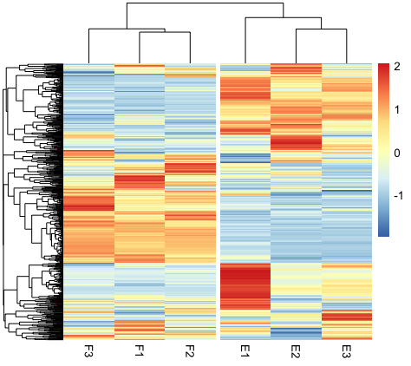
Introduction to Gene Expression
Part II

Slide 2
R programming
Data processing pipeline
Genome: GRCm38 from genecode
Annotation: Ensembl
RNA-Seq
Illumina TruSeq
50bp SE reads
Reference Transcriptome indexing
Alignment with Reference Transcript
Quality assessment
FastQC(just for information)
DEG testing
DESeq2 in R
Quality Trimming
Trim Galore
Cutadapt (just for Information)
Gene ontology
Metascape in browser

Slide 3
R studio
In Desktop make a folder PTEN_KO_DEG_Analysis
Make new folder named R_analysis
Step 1: Copy only the .tsv file for all six reads inside the folder
Step 2: Setting working directory
setwd(“~Desktop/PTEN_KO_DEG_Analysis/R_analysis”)
Step 3:Loading the following packages in R
library(tximport) #exporting the GFF file
library(GenomicFeatures) # basic package needed for lot of genomic analysis
library(AnnotationDbi) # basic package for all annotation packages
library(DESeq2) #DEG processing package
library(pheatmap) #making heatmap

Slide 4
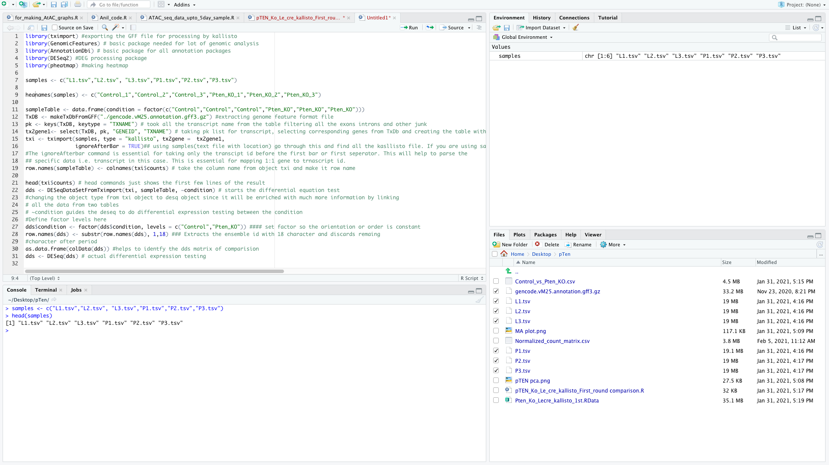
Preparing the data files for DEGs testing
Compiling data from all the 6 reads in one variable
samples <- c("L1.tsv","L2.tsv", "L3.tsv","P1.tsv","P2.tsv","P3.tsv")

Slide 5
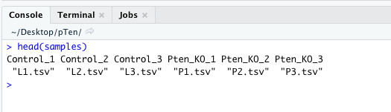
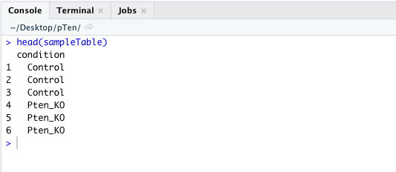
Preparing the data files for DEGs testing
2.Matching the data file with the sample name
names(samples) <- c("Control_1","Control_2","Control_3","Pten_KO_1","Pten_KO_2","Pten_KO_3")
Making dataframe defining the factor level
sampleTable <- data.frame(condition = factor(c("Control","Control","Control","Pten_KO","Pten_KO","Pten_KO")))

Slide 6
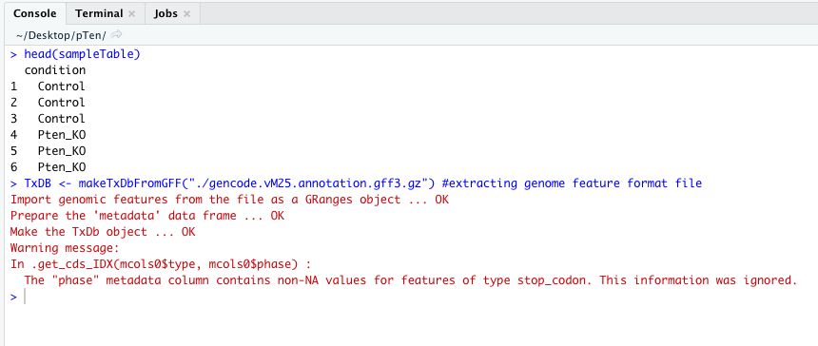
Preparing the data files for DEGs testing
4.Extracting genomic feature format file and making TxDB object
TxDB <- makeTxDbFromGFF("./gencode.vM25.annotation.gff3.gz")

Slide 7
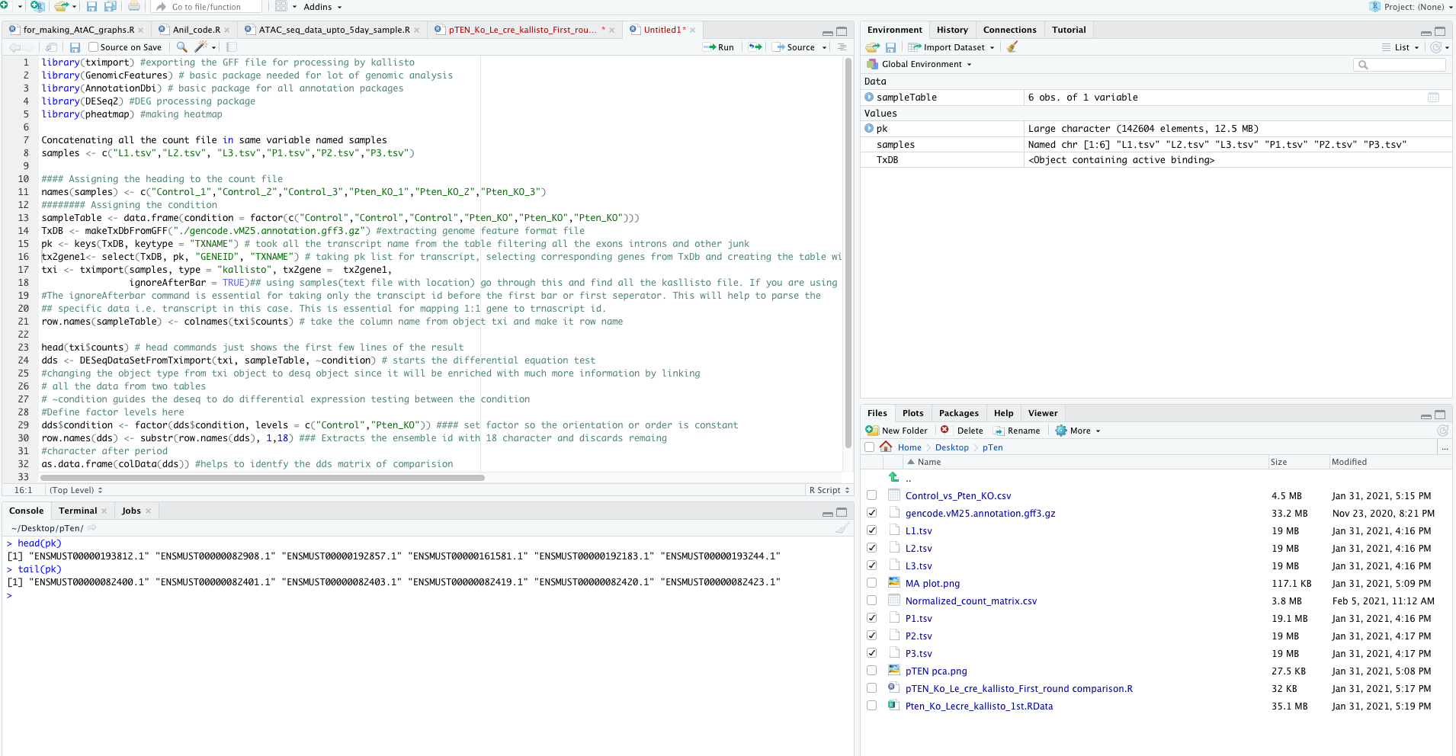
Preparing the data files for DEGs testing
5. Took all the transcript name from the table filtering all the exons introns and other junk
pk <- keys(TxDB, keytype = "TXNAME")

Slide 8
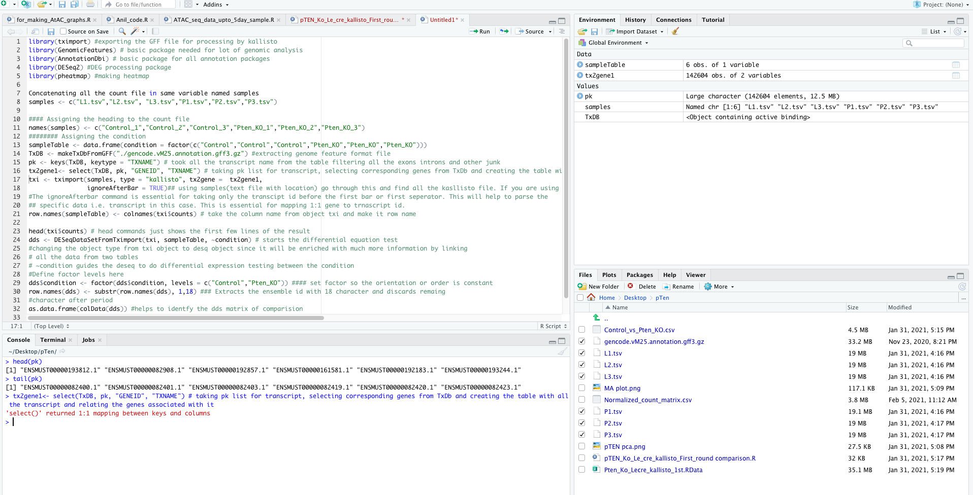
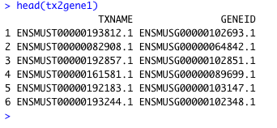
Preparing the data files for DEGs testing
6. Taking pk list for transcript, selecting corresponding genes from TxDb and creating the table with all the transcript and relating the genes associated with it
tx2gene1<- select(TxDB, pk, "GENEID", "TXNAME")

Slide 9
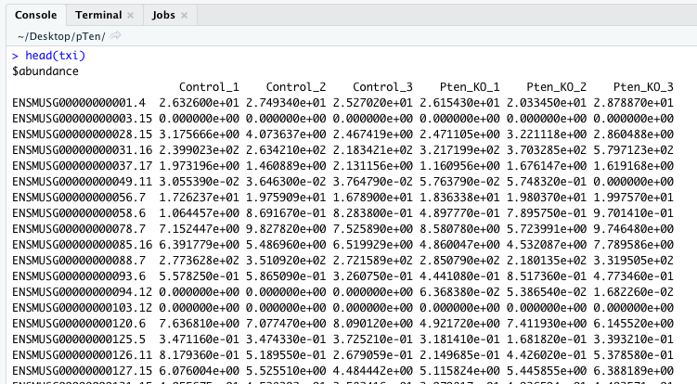
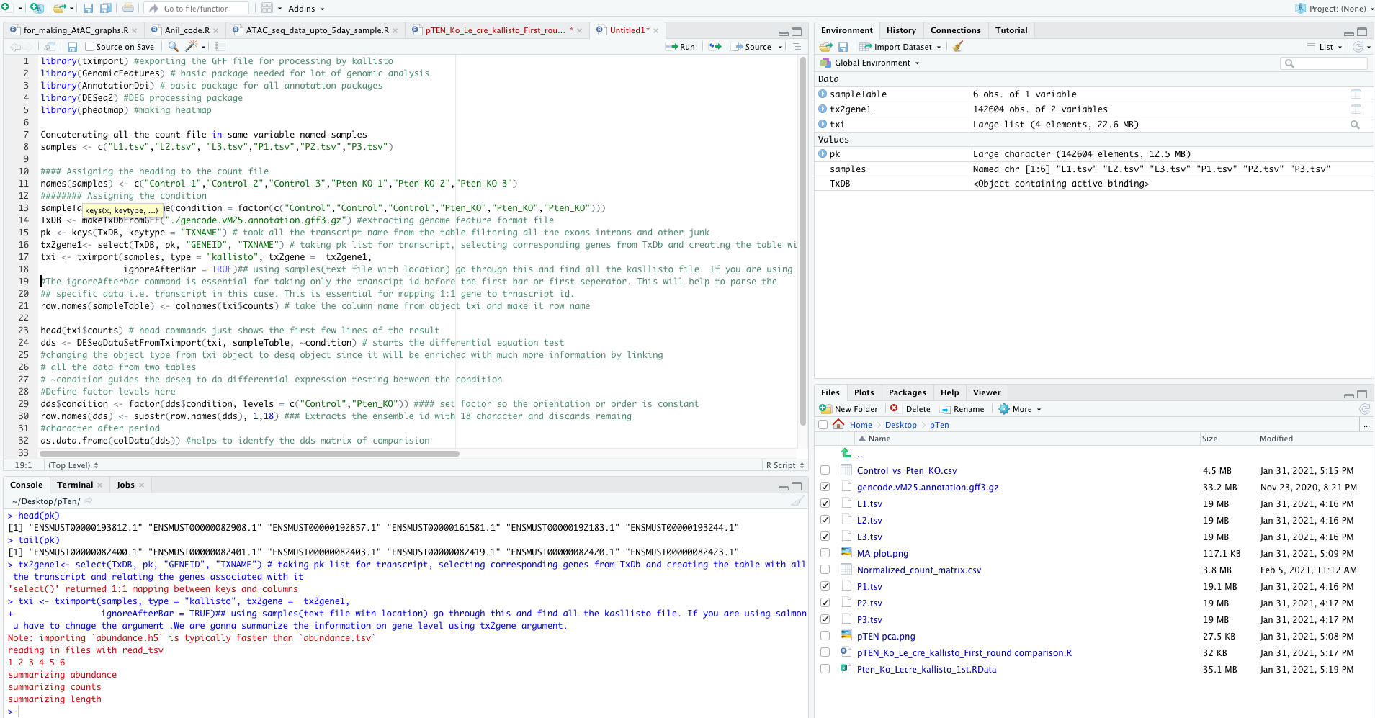
7. Using samples to summarize the information on gene level using tx2gene argument.
#The ignoreAfterbar command is essential for taking only the transcript id before the first bar or first separator.
txi <- tximport(samples, type = "kallisto", tx2gene = tx2gene1,
ignoreAfterBar = TRUE)

Slide 10
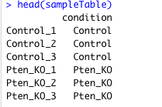
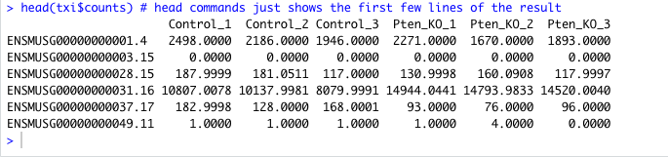
Preparing the data files for DEGs testing
8. Take the column name from object txi and make it row name
row.names(sampleTable) <- colnames(txi$counts)
9. head commands just shows the first few lines of the result
head(txi$counts)

Slide 11
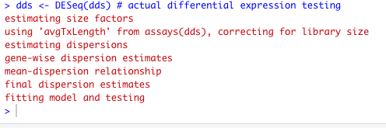
10. Starts the differential equation test
dds <- DESeqDataSetFromTximport(txi, sampleTable, ~condition)
#changing the object type from txi object to desq object since it will be enriched with much more information by linking
# all the data from two tables # ~condition guides the deseq to do differential expression testing between the condition

Slide 12

Continue...
11. Define factor levels here
dds$condition <- factor(dds$condition, levels = c("Control","Pten_KO"))
#### set factor so the orientation or order is constant
12.Extracts the ensemble id with 18 character and discards remaining
row.names(dds) <- substr(row.names(dds), 1,18)
13. Helps to identify the dds matrix of comparison
as.data.frame(colData(dds))
14. Actual differential expression testing
dds <- DESeq(dds)
https://slideplayer.com/slide/7869541/
ENSMUSG00000016918.15
ENSMUSG00000016918

Slide 13
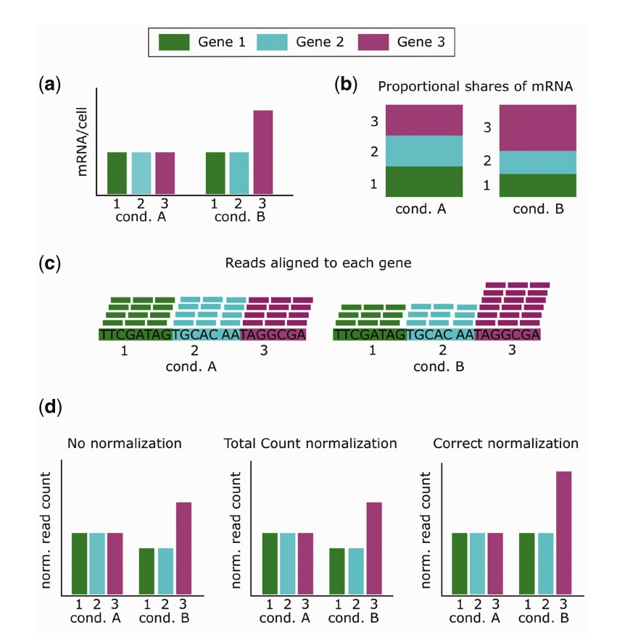
Normalization of the data
Normalization : Process of creating a set schema
Why?
To store non-redundant and consistent data.
Reduce redundancy and inconsistency
Normalization in RNA-seq
Needed to account for factors that affect the number of reads mapped to a gene, like length , GC-content and sequencing depth.
Length and GC-content are within-sample effects, meaning that they affect the comparison of read counts between different genes in a sample.
Sequencing depth, on the other hand, is a between-sample effect that alters the comparison of read counts between the same gene in different samples
Evans et al, Brief Bioinform. 2018 Sep; 19(5): 776–792.
Published online 2017 Feb 27. doi: 10.1093/bib/bbx008

Slide 14
How do we perform the normalization?
Use DESEq2 for the normalization process.
Norm_counts <- counts(dds,normalized=T)
Norm_counts<-cbind(Norm_counts,new_1) #merges the columns
write.csv(Norm_counts,file="Normalized_count_matrix.csv")
Your first normalized count matrix

Slide 15
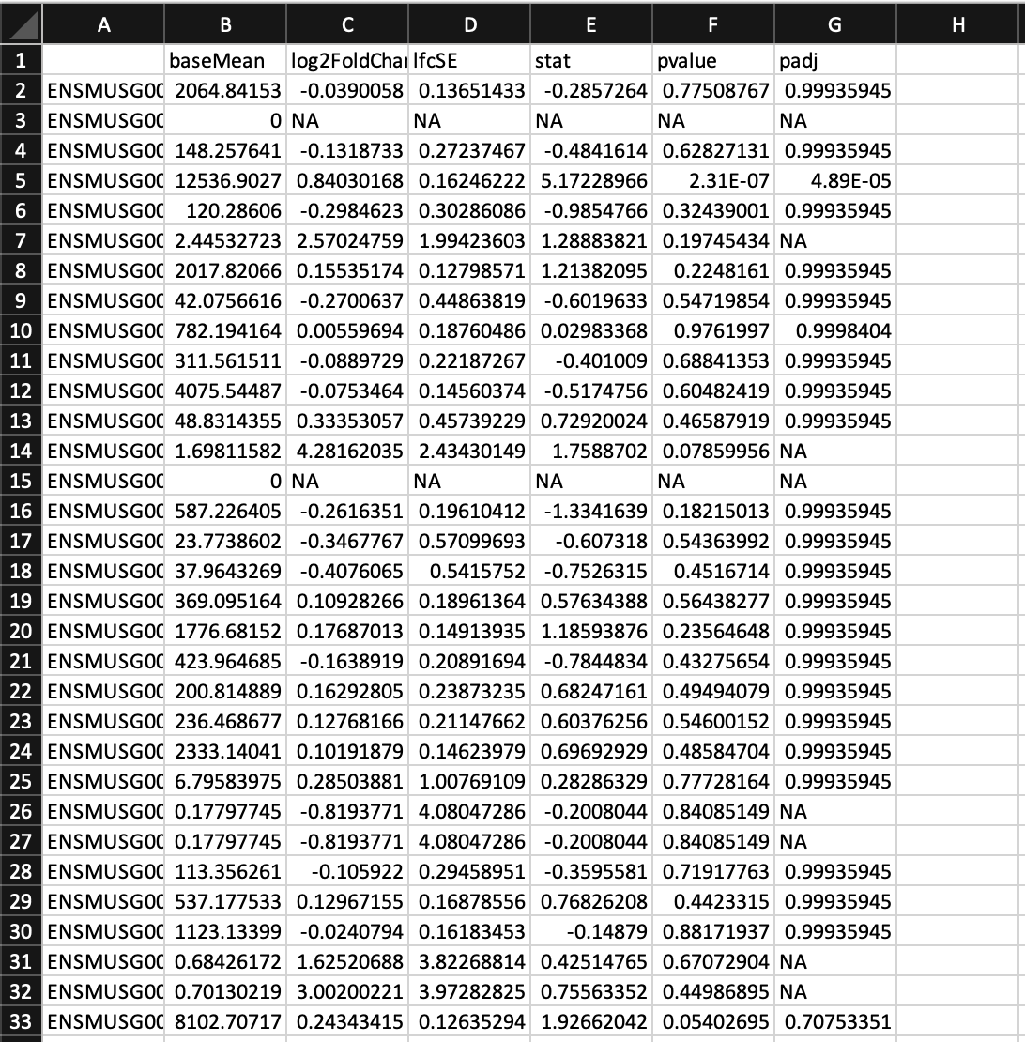
Getting Final DEG list
DEGtesting1<- results(dds,name="condition_Control_vs_Pten_KO" )
DEGtesting1<-results(dds, contrast = c("condition","Pten_KO","Control"))
write.csv(DEGtesting1, file="./Control_vs_Pten_KO.csv")

Slide 16
Visualization of the data
counttable<-counts(dds,normalized=TRUE)
y<-counttable[c("ENSMUSG00000022723","ENSMUSG00000025952", "ENSMUSG00000066975", "ENSMUSG00000019866", "ENSMUSG00000029343", "ENSMUSG00000042240", "ENSMUSG00000000724", "ENSMUSG00000033501","ENSMUSG00000029352"),]
pheatmap(y,cluster_cols = FALSE,scale = "row",
cutree_rows = 2, cutree_cols = 2,
main = "Crystalline genes", gaps_col = c(3,6,9,12))
Is the ensembl ID much informative at all ?

Slide 17
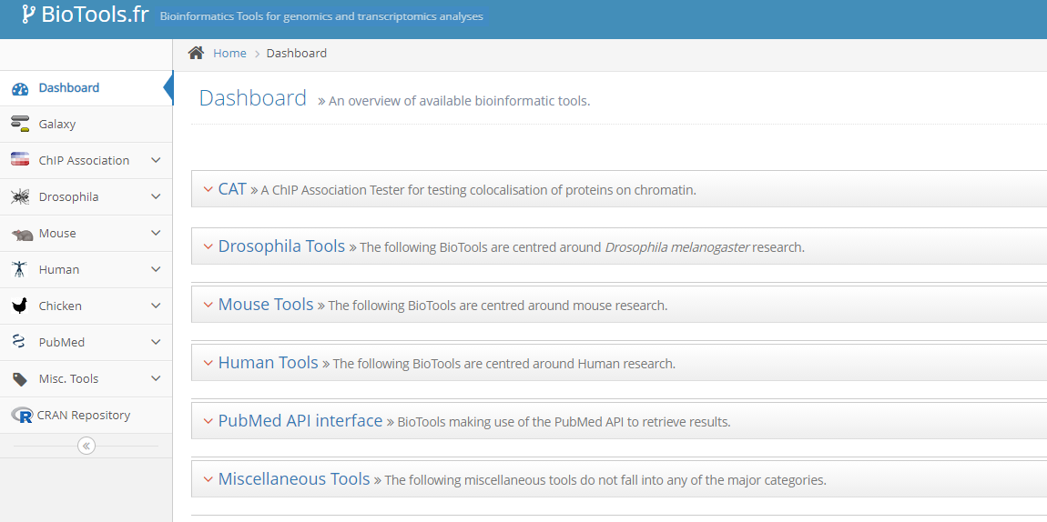
Finding gene names of the associated ensembl ID

Slide 18
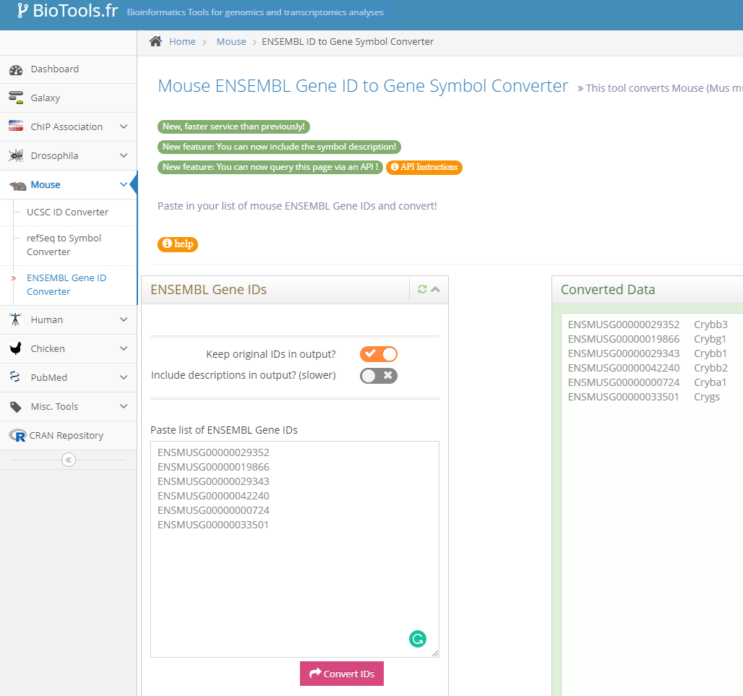
Usage
Step 1: Open file named
Control_vs_Pten_KO.csv
Step 2: Select the column with ensembl ID
Step 3: Copy it
Step 4: Paste it in the biotools window
Step 5: Hit Convert ID
Step 6: Select all (Ctrl+a or Cmd +a)
Step 7: Copy it
Step 8: Paste the output in new excel sheet

Slide 19
Using data for visualization
Replace all the ensemble ID with gene ID
Arrange the data in descending order for Log2fold change column
Keep a filter at padjust value with <0.05 (genes considered significant only when p <0.05)
Keep a filter in Log2fold change with >0.5 (genes considered significant only when Log2fold > 0.05)
What is the total number of significant DEG in the dataset?
What is the total number of significant upregulated genes in the dataset?
Note : Log2Foldchange in positive for upregulation
What is the total number of downregulated genes in the dataset?

Slide 20
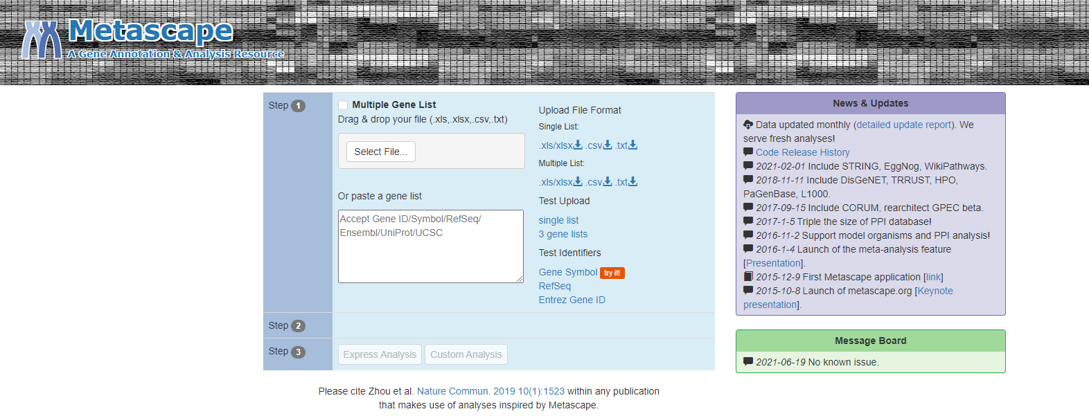
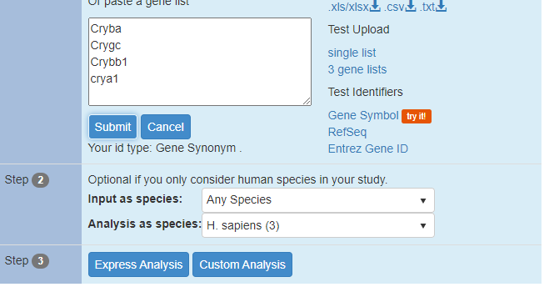
What information can we get from the DEG?
Lets select top 200 DEGs.
Find what is the general pattern of gene expression?
Paste the gene name in the box
Click submit
Select Mus musculus
In both option
Click Express Analysis
https://metascape.org/gp/index.html#/main/step1

Slide 21
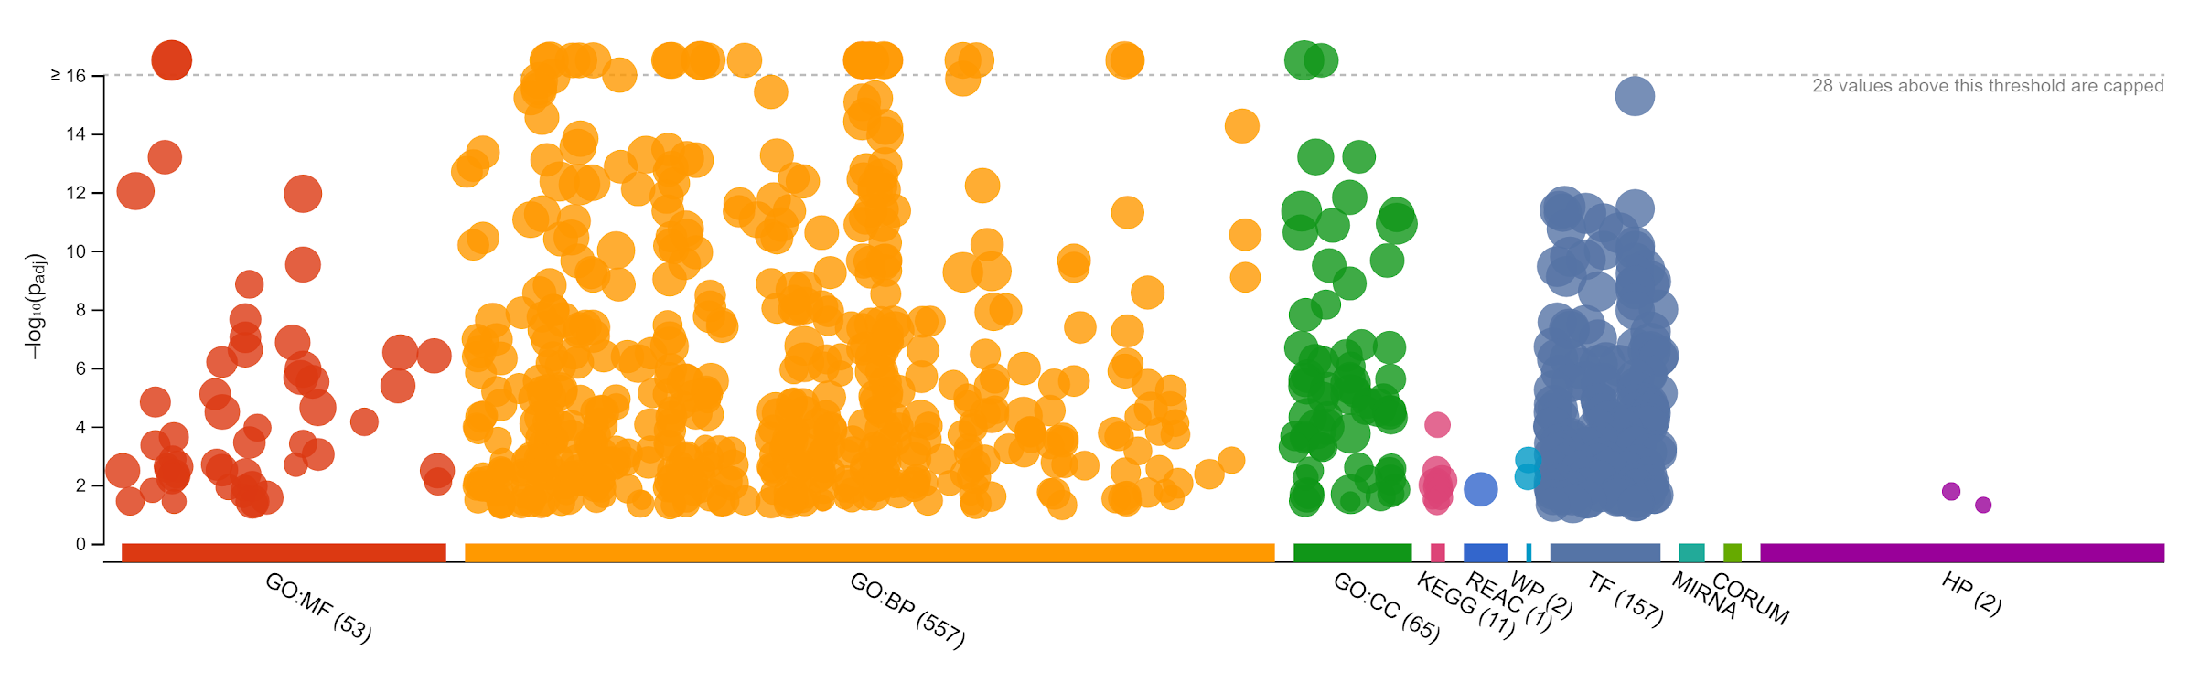
What are you able to see ?
What are some of the common pathways that are altered ?
What do you think PTEN is regulating ?
How would you show your prediction is true?

