Slide 1



Rmarkdown and
R integration with python
Computer Science in Modern Biology Workshop
Instructor:
Luis Miguel Montilla
TA:
Alfredo Ascanio

Slide 2

What?
Mr. Mark Down?
Reproducible documents

Slide 3
“R Markdown is a file format for making dynamic documents with R. An R Markdown document is written in markdown (an easy-to-write plain text format) and contains chunks of embedded R code...”
https://rmarkdown.rstudio.com/articles_intro.html
Notes:
Lightweight
Can be edited in any text editor in any OS

Slide 4

Why?
More coding?

Slide 5
If done properly:
Better documented code
Can be run by colleagues/public
Notes:
We’re choosing the word better, as the documentation can be subjective (there are guidelines and proposal of standards though)

Slide 6
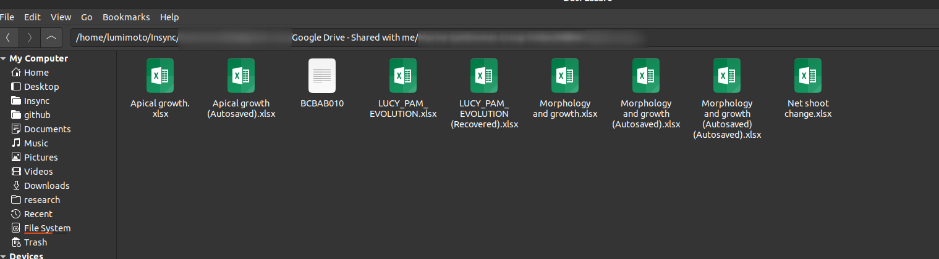
Notes:
Individual binary files tendo be to be terribly organized

Slide 7
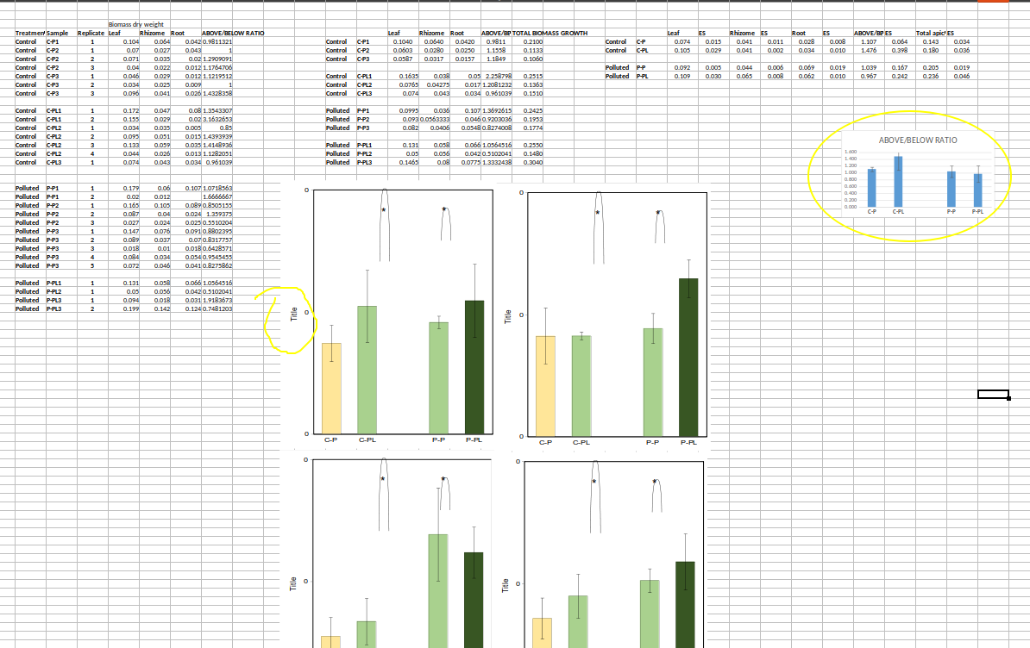
Notes:
Spreadsheets can be fine to start collecting the data (debatable) but they are far from ideal when we talk about collaboration

Slide 8

How?

Slide 9
