Slide 1
Submariner Photography
Team “Sub-Optical”
Lance Millholland, Erick Bodett, Jeffrey Daniels,
Kevin Fedde, Shawn McCrimmon, Fatemah Almahana,
Bobby Graese

Slide 2
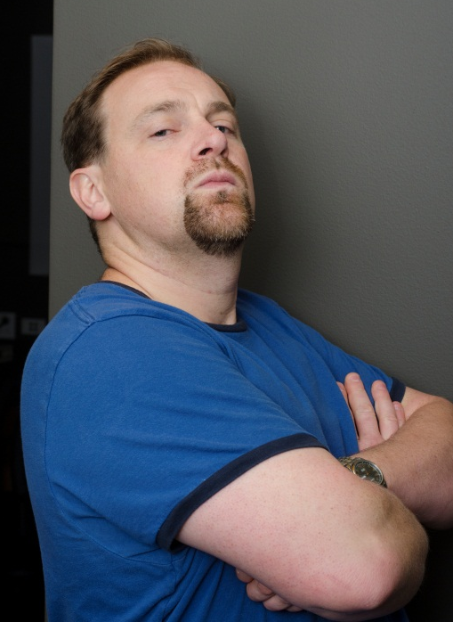
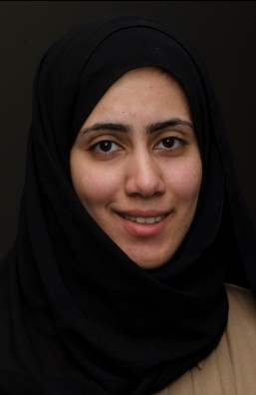
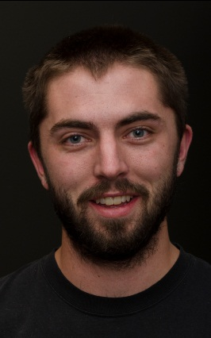
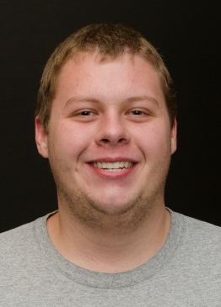
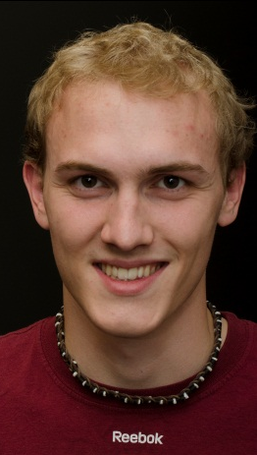
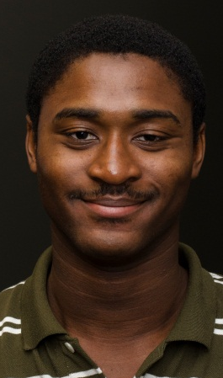
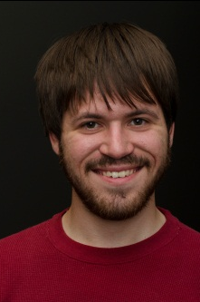
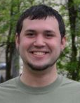
The Team
Lance Millholland
Electrical Engineer
Fatemah Almahana Computer Engineer
Erick Bodett
Mechanical Engineer
Prof. Jeff Will
Advisor
Bobby Graese Computer Engineer
Kevin Fedde
Mechanical Engineer
Shawn McCrimmon Computer Engineer
Jeffrey Daniels
Mechanical Engineer

Slide 3
Requirements
Underwater vehicle
Remotely controlled
Camera on-board to take pictures
Dive to “superhuman” depths
Maneuverable with minimal training
Provide a live video feed to operator
Operator can control camera shutter

