Slide 1
Opening up the Blackbox: Explaining AI decision-making through object recognition
Jiro Mizuno

Slide 2
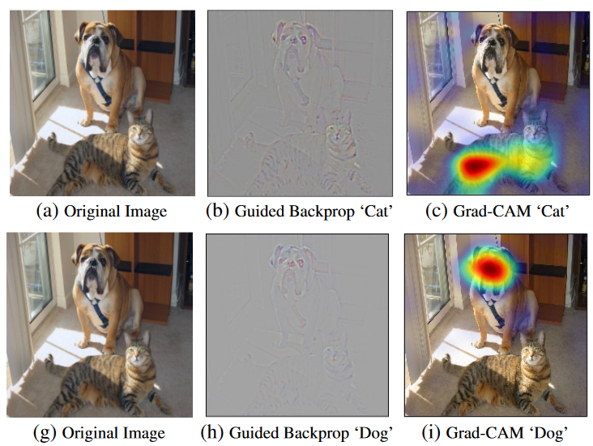
What is AI Explainability?
Artificial Intelligence tends to unintelligible to most users and even engineers
Mathematical explanations can be too complex
Can you trust the AI’s answer? Why?
Must be a way to demonstrate how an AI made it’s final decision.
Example from GRAD-CAM
R. R. Selvaraju, M. Cogswell, A. Das, R. Vedantam, D. Parikh and D. Batra, "Grad-CAM: Visual Explanations from Deep Networks via Gradient-Based Localization," 2017 IEEE International Conference on Computer Vision (ICCV), Venice, Italy, 2017, pp. 618-626, doi: 10.1109/ICCV.2017.74.

Slide 3
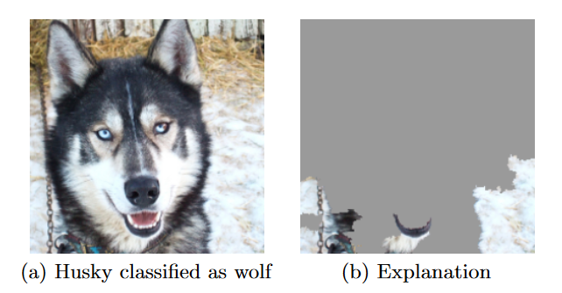
Why object recognition?
Viewing an image is straightforward.
Many students are visual learners and will benefit from a less text-based explanation
Raiyn, Jamal. (2016). The Role of Visual Learning in Improving Students’ High-Order Thinking Skills. Journal of Education and Practice. 7. 115-121.
Understanding abstractly vs seeing the results
Teaching students to not trust AI so singlehandedly
From LIME (local interpretable model-agnostic explanation)
Ribeiro, M. T., Singh, S., & Guestrin, C. (2016, August). " Why should i trust you?" Explaining the predictions of any classifier. In Proceedings of the 22nd ACM SIGKDD international conference on knowledge discovery and data mining (pp. 1135-1144).

Slide 4
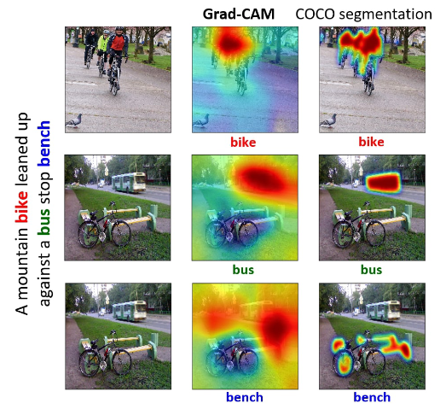
Used Resources:
GRAD-CAM used as it is one of the earliest examples of explainable AI
LIME will also used to contrast and compare different explainability technologies
Kaggle’s “Cat and Dog” dataset containing 12,500 images of each (we only used 1,500) will be used
Pyqt6 was used for GUI.

Slide 5
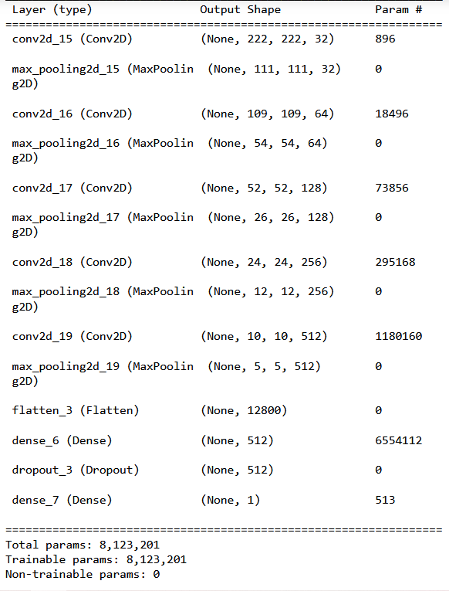
CNN model used
- used Tensorflow’s KERAS
- utilized a 5 layer fully convolutional network
- each layer:
- a 2d convolutional network
- a ReLU activation layer
- 2x2 max pooling
- increased from 32 -> 64 -> 128 -> 256 -> 512
- finished off with a dropout rate of 20% and sigmoid predictor
- 75 epochs

Slide 6
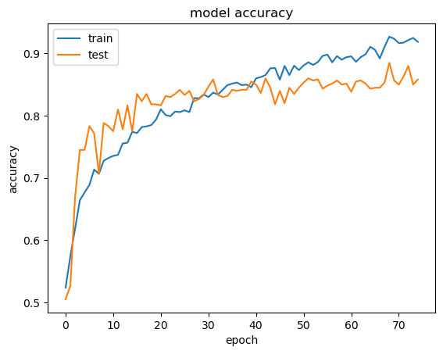
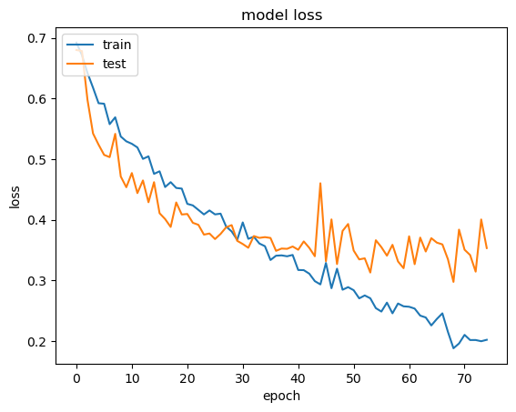
Model Results
Training Accuracy: 0.919
Testing Accuracy: 0.8583
Training Loss: 0.2018
Testing Loss: 0.3532

Slide 7
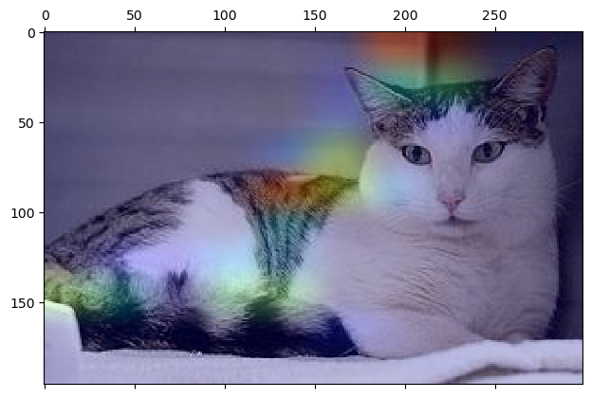
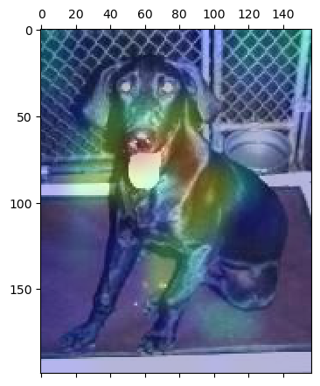
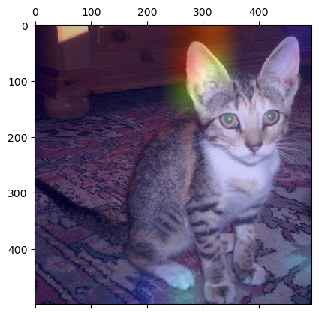
GRAD-CAM Results:

Slide 8
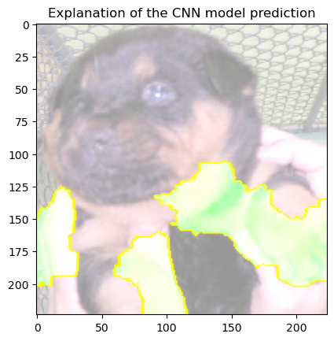
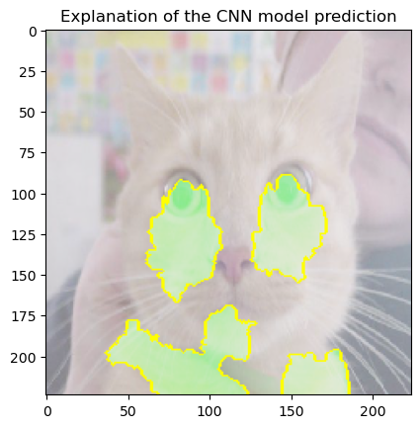
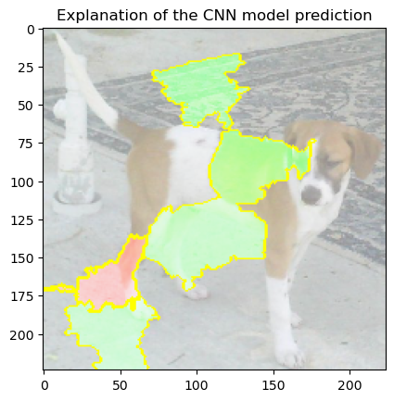
LIME results:

Slide 9
GUI Demo

Slide 10
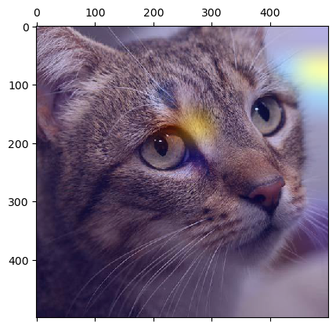
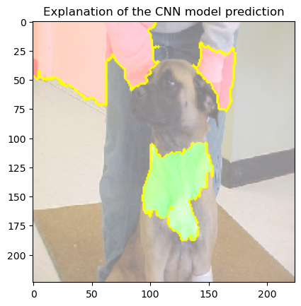
General impressions:
- More often than not, the environment was much more focused on by the model
- Although accuracy is high and losses are low, the model actually makes me quite nervous
- That realization is helpful to improve results and also encourage caution

Slide 11
Further plans?
- Try out different explainability technologies
- Improve my own model to reach >95% validation accuracy

Slide 12
Questions?

