Slide 1
Rhino Hunting – Illegal Possession Investigation
Traffic Log Analysis: HTTP
Notes:
https://www.youtube.com/watch?v=6G3qm60dfA8&ab_channel=PrashantThombre

Slide 2


What is HTTP?
HTTP stands for hypertext transfer protocol and is used to transfer data across the Web
Request
Response

Slide 3
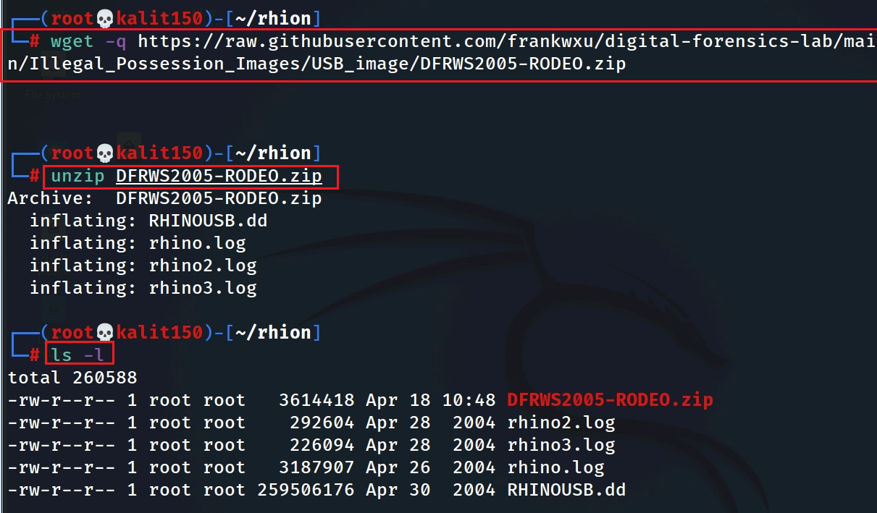
Prepare lab files
Notes:
wget -q https://raw.githubusercontent.com/frankwxu/digital-forensics-lab/main/Illegal_Possession_Images/USB_image/DFRWS2005-RODEO.zip
unuzp DFRWS2005-RODEO.zip

Slide 4
Plan of Investigation
rhino2.log
  Investigating http traffics contain .jpg
  Investigating http traffics contain .gif
  Investigating email traffics
rhino3.log
  Investigating http traffics contain .exe

Slide 5
Investigate rhino2.log
HTTP traffic forensics

Slide 6
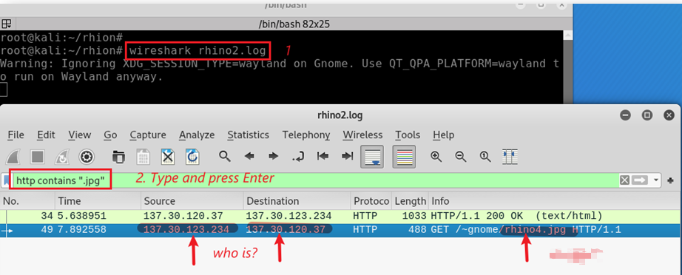
Any activities of uploading or downloading images (.jpg) using HTTP?
Search suspect’s http requests to download .jpg
GET is used to request data from a specified resource.

Slide 7
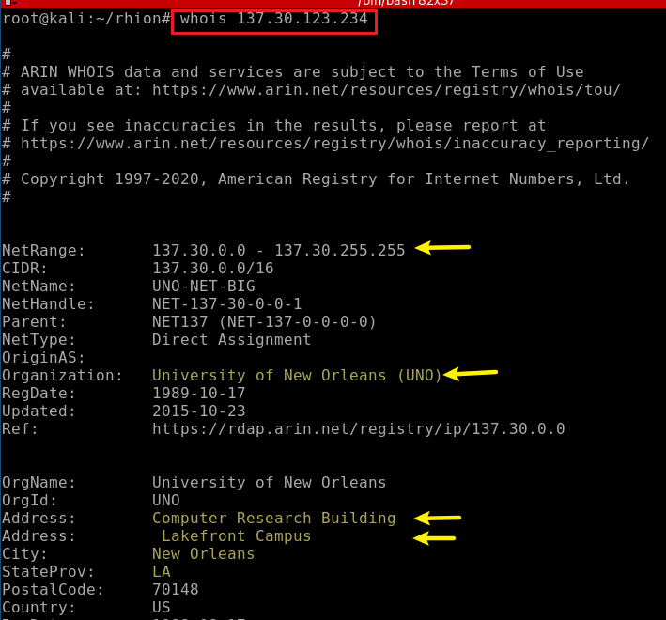
Find who owns the IP

Slide 8
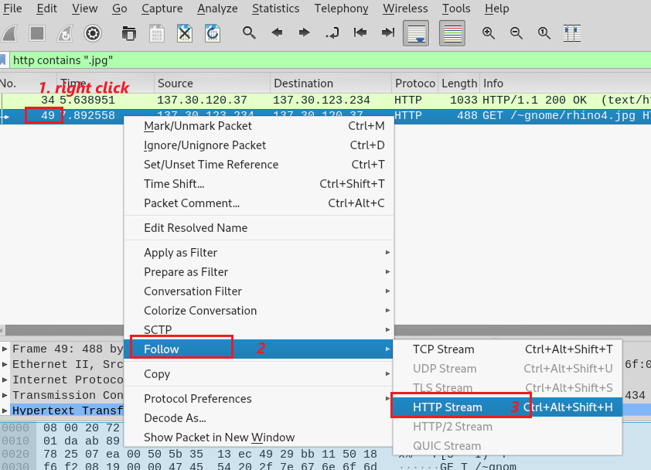
Follow rhino4.jpg HTTP traffic
Notes:
49 2004-04-28 21:08:38.073111 137.30.123.234 137.30.120.37 HTTP 488 GET /~gnome/rhino4.jpg HTTP/1.1

Slide 9
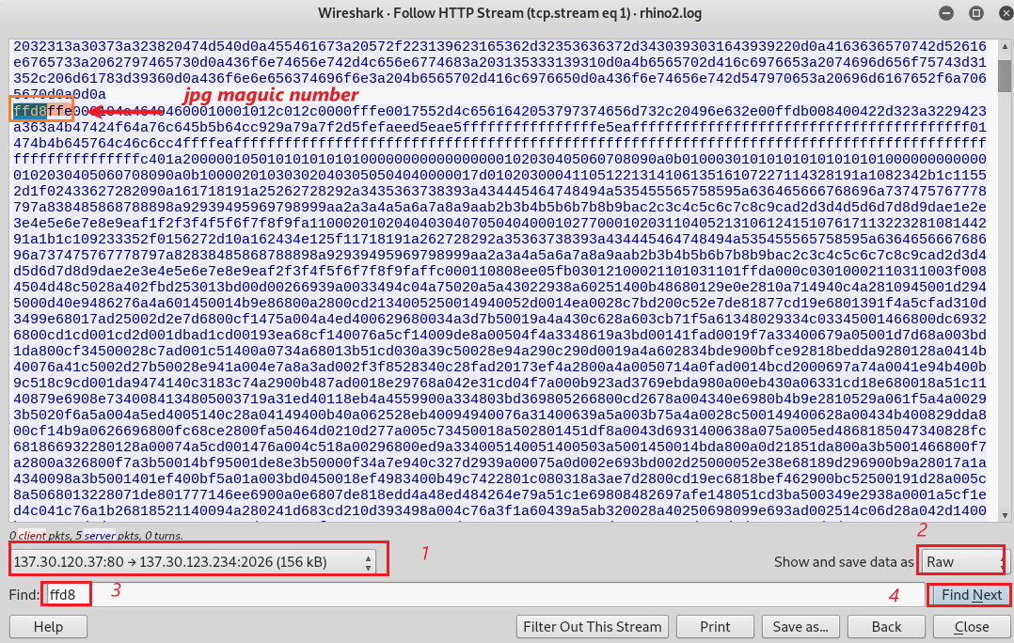
Find the rhino4.jpg magic number
Only care the packets from the server to the suspect’s machine

Slide 10
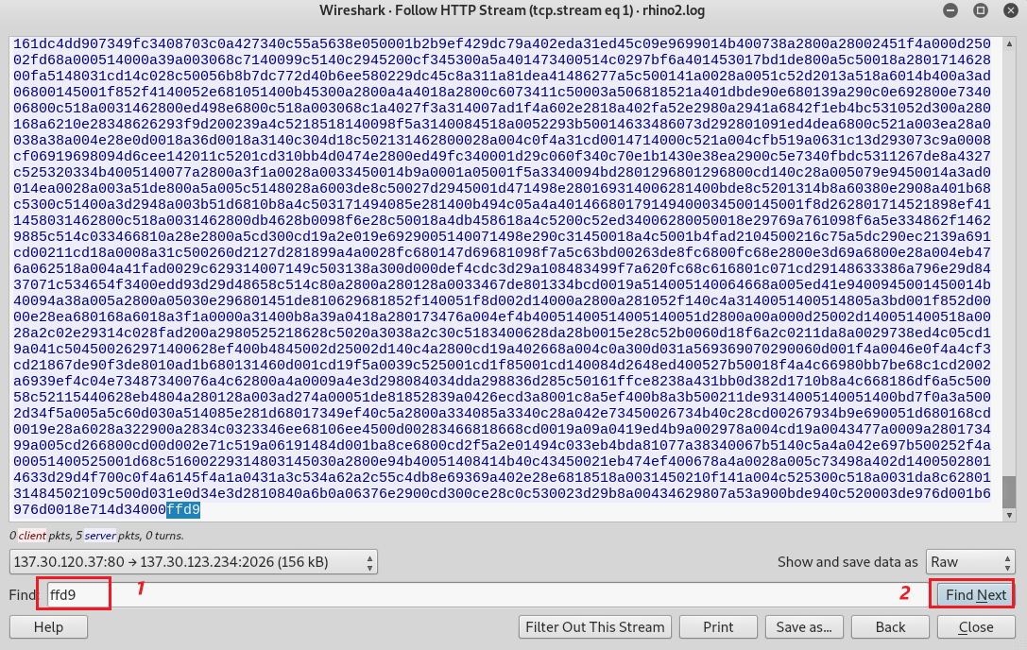
Find the end of the rhino4.jpg
End of the image

Slide 11
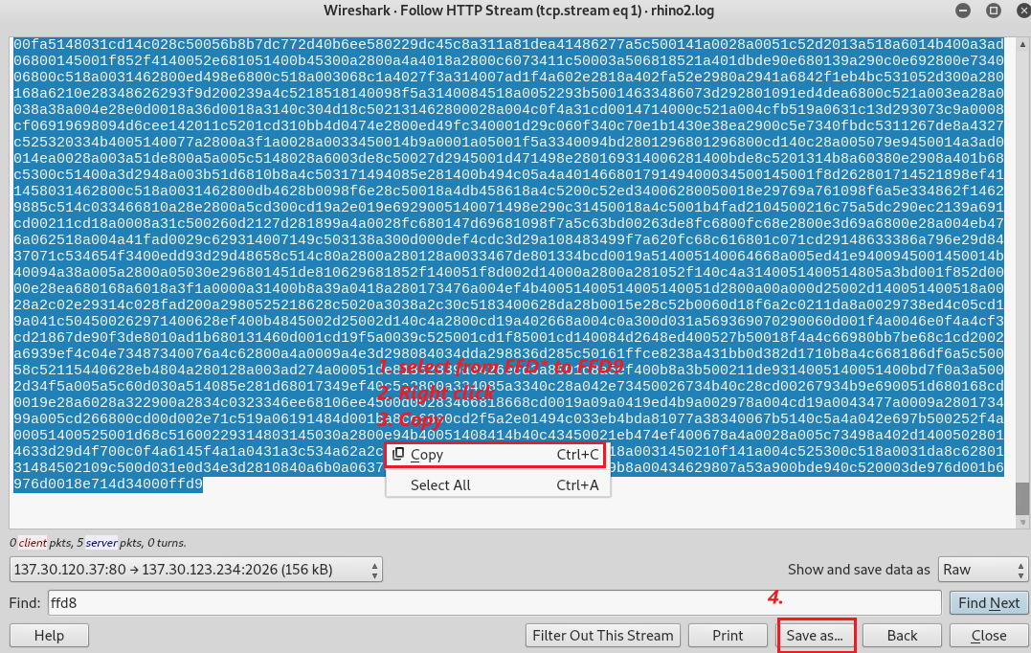
Copy the raw data of rhino4.jpg
How to select: (1) shift + click the beginning of ffd8 (2) shift + click the end of ffd9

Slide 12
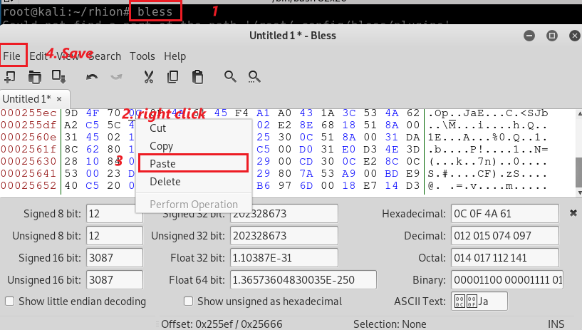
Paste to a Hex Editor

Slide 13
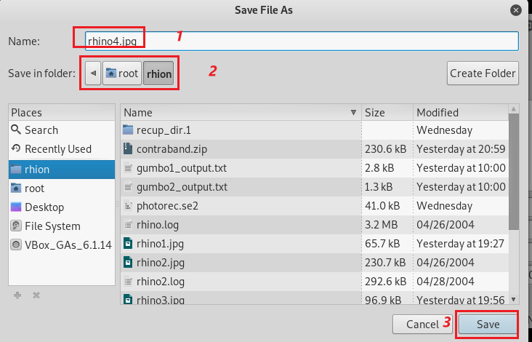
Save it as rhino4.jpg

Slide 14

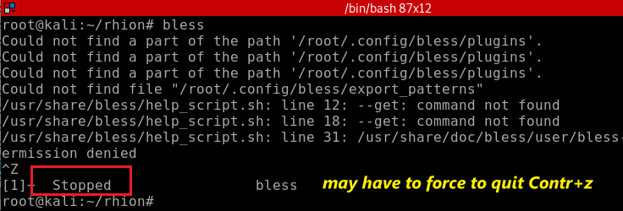
You may have to stop the Hex Editor

Slide 15
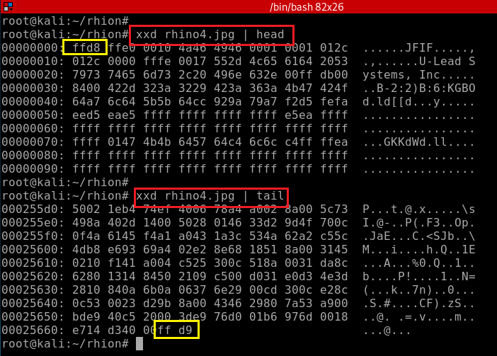
Verify rhino4.jpg magic number
Verify rhino4.jpg trailor

Slide 16
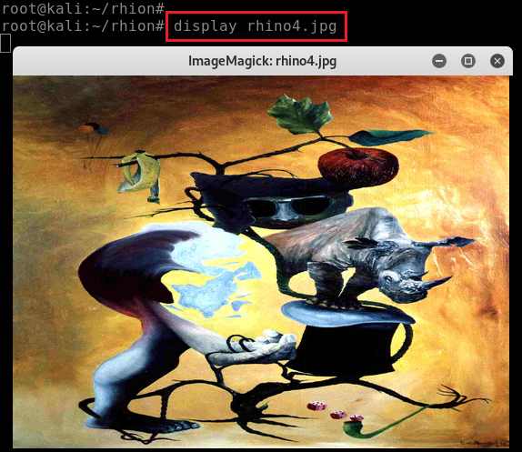

Display rhino4.jpg
7
aa64102afff71b93ed61fb100af8d52a

Slide 17
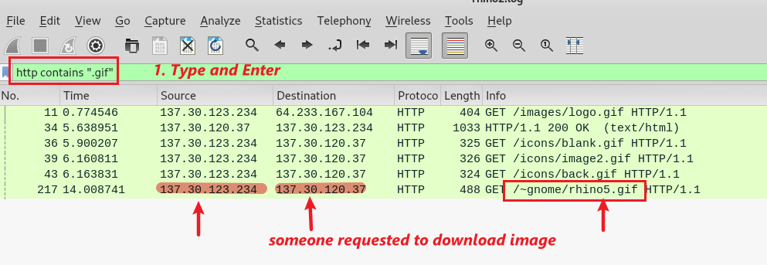
Any activities of uploading or downloading images (.gif) using HTTP?
Search .gif HTTP traffic
Note we have 5 .gif. Let’s double click rhino5.gif
Notes:
217 2004-04-28 21:08:44.189294 137.30.123.234 137.30.120.37 HTTP 488 GET /~gnome/rhino5.gif HTTP/1.1

Slide 18
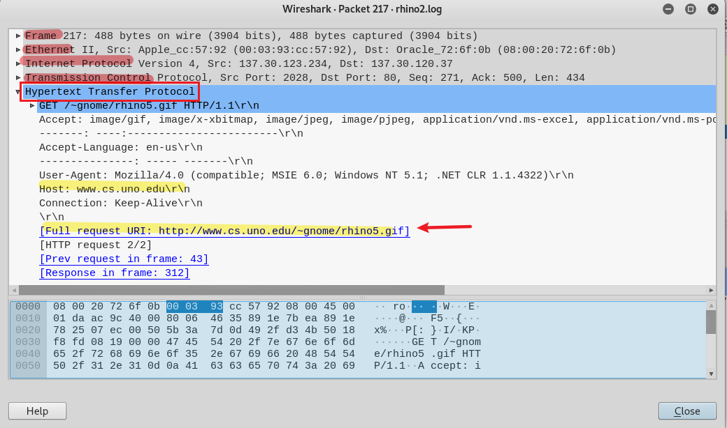
Rhino5.gif is hoted by cs.uno.edu

Slide 19
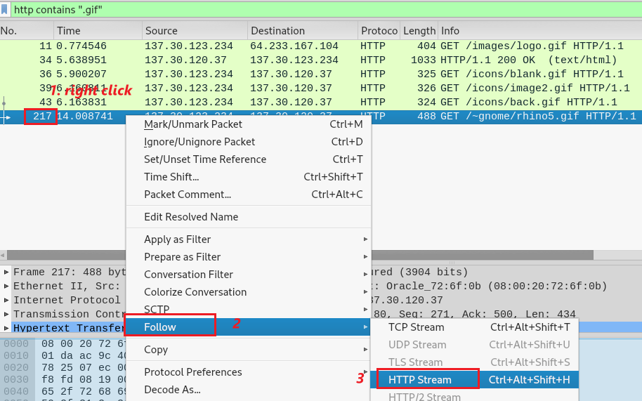
Follow HTTP traffic of rhino5.gif

Slide 20
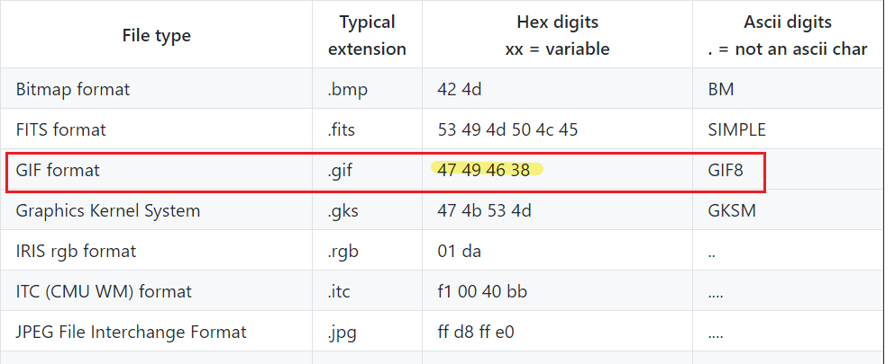
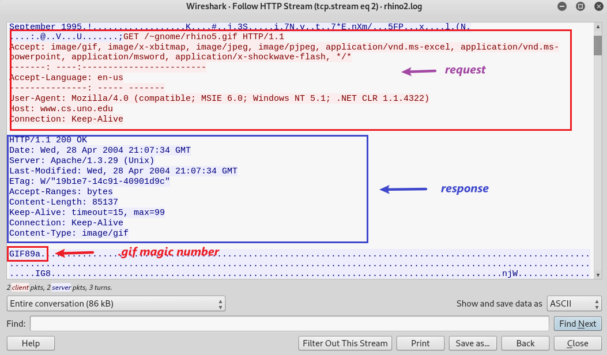
Find the packet contains rhino5.gif
You can click the magic number, which leads you to the packet. You can exit now

Slide 21
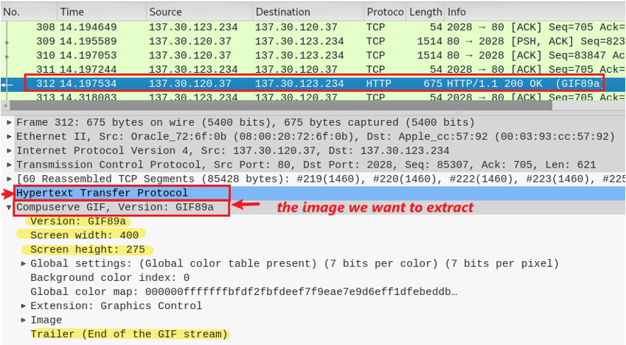
312 is the packet contains rhino5.gif
Click to show how HTTP transfers images
GIF property

Slide 22
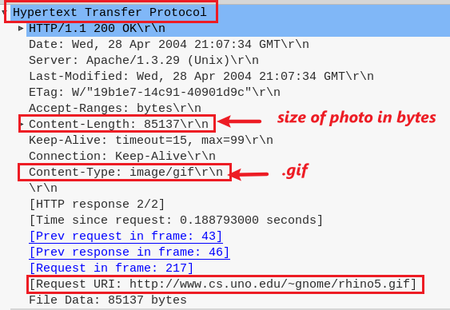
Details of how HTTP transfers images

Slide 23
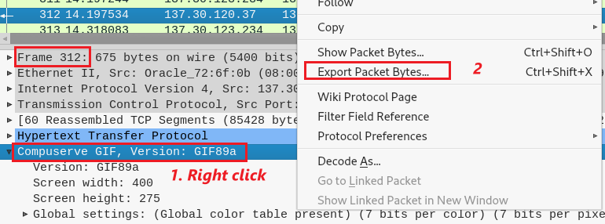
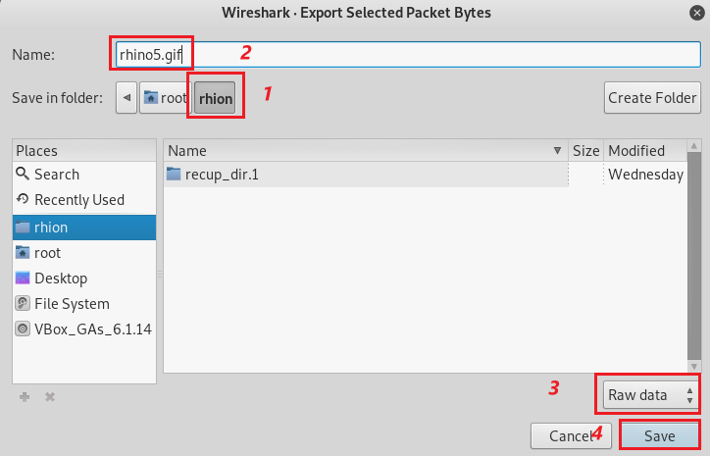
Export traffic packet to a file
Save the file as rhino5.gif

Slide 24
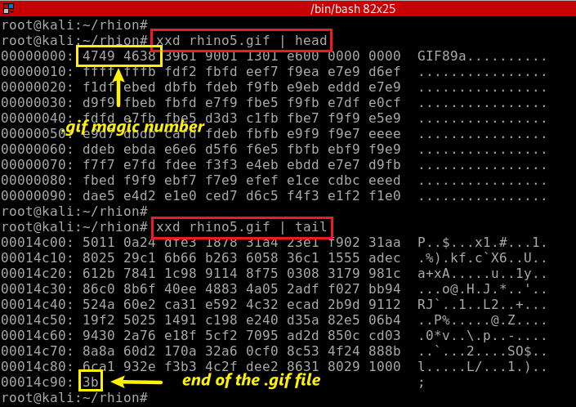
Verify the magic number of rhino5.gif
Verify the trailer of rhino5.gif

Slide 25
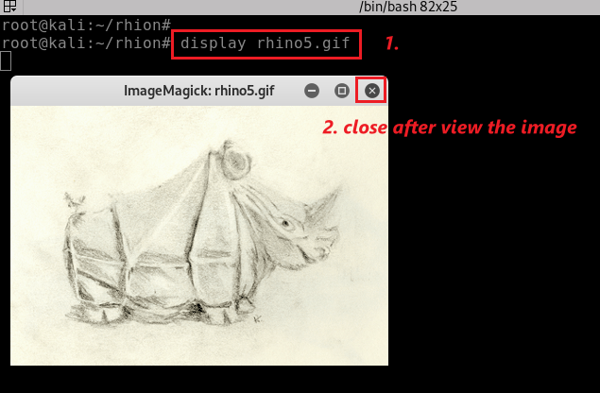
Display rhino5.gif
8
md5: 1e90b7f70b2ecb605898524a88269029

Slide 26
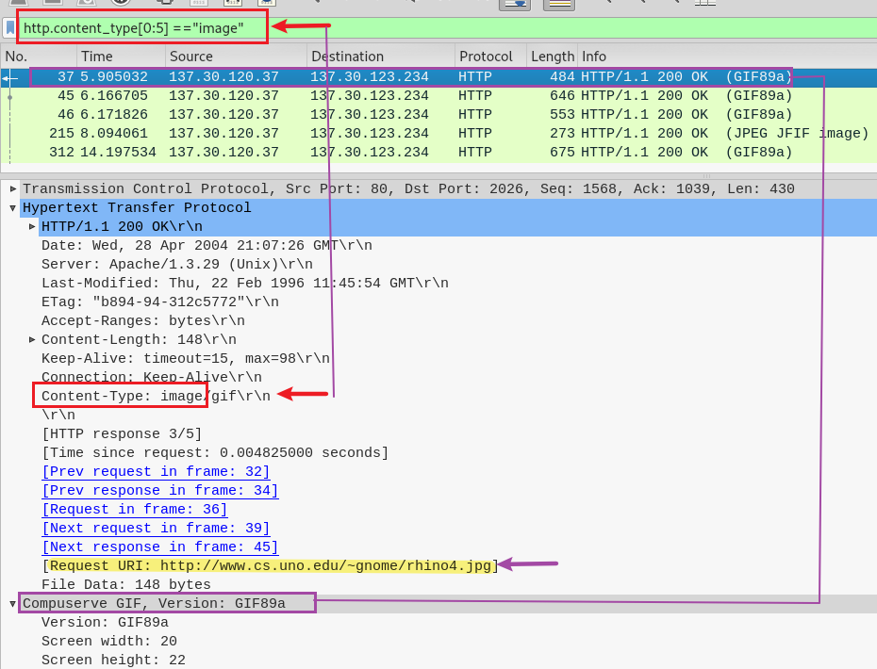
Any photos in http?
Show all http with content-type="image/(gif|jpeg|png|etc)"
5 http packets. Are there 5 photos?

Slide 27
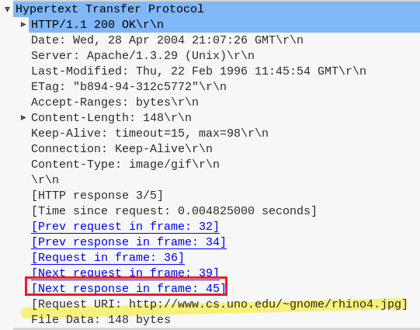
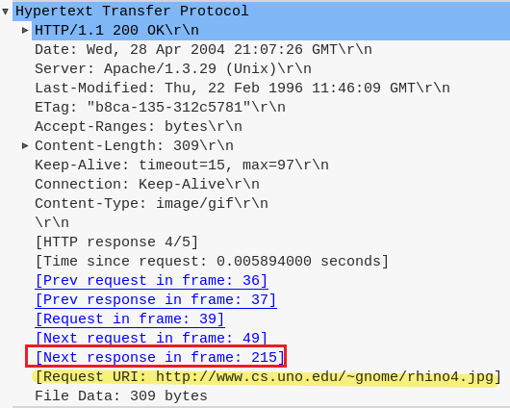
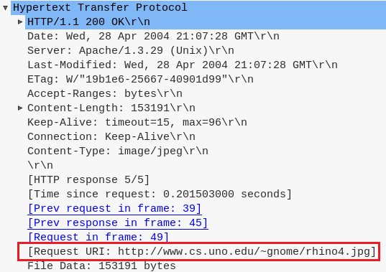

Slide 28







Investigate Email traffics (optional)
Email protocol is a standard method for exchanging information between
  email clients like Thunderbird, Apple Mail, or Mailbird and
  email provider’s servers like Gmail, Outlook, Yahoo, and vice versa.
SMTP
SMTP
IMAP
SMTP (Simple Mail Transfer Protocol): sending emails
IMAP (Internet Access Message Protocol): download emails

Slide 29
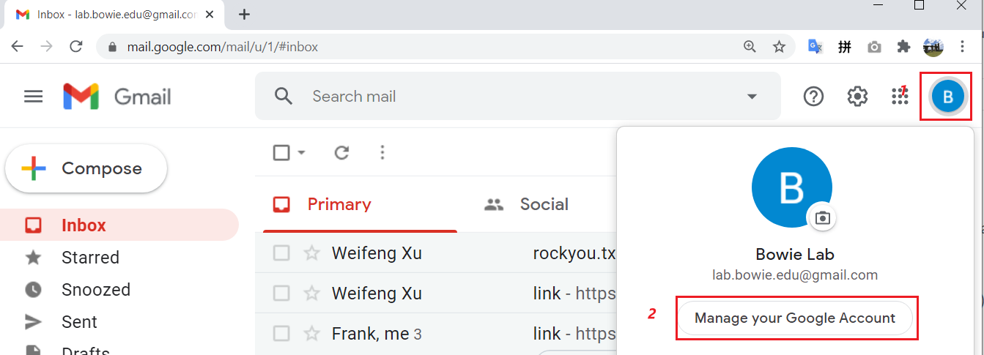

Slide 30
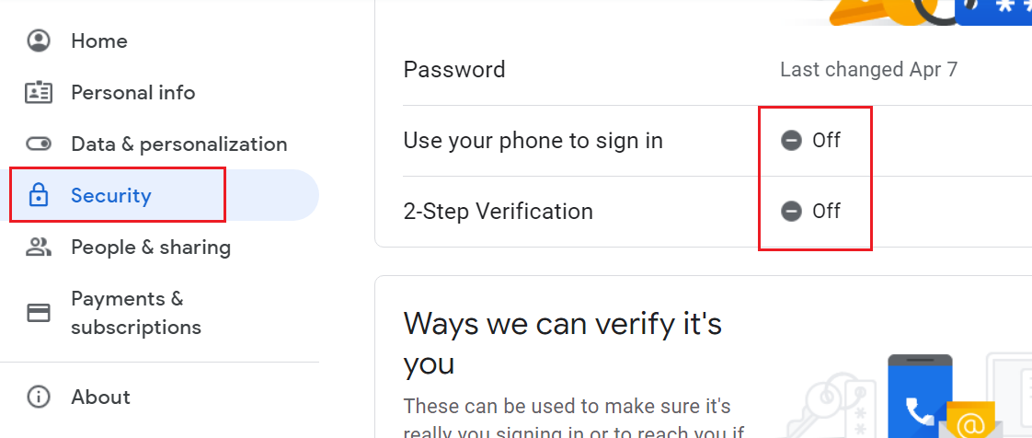

Slide 31
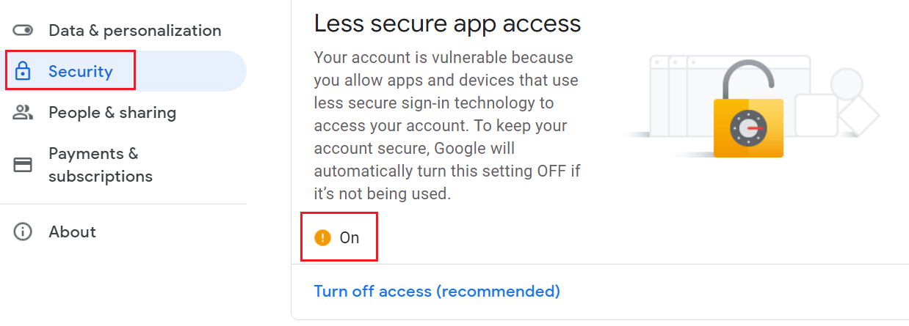

Slide 32
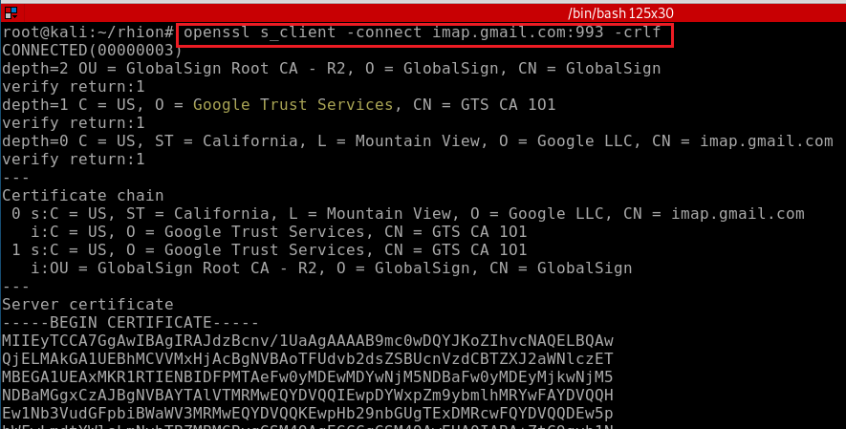

Slide 33
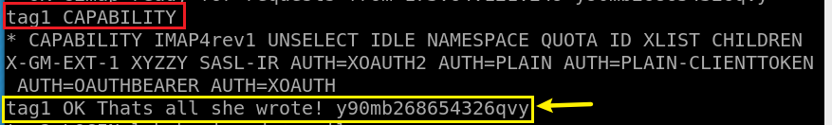
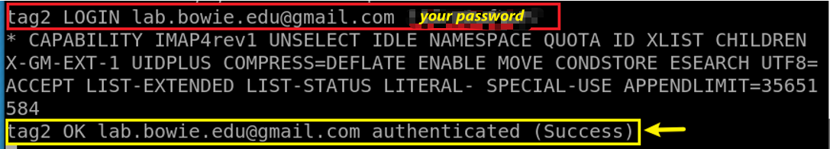
<tag> <command> [<arg1><arg2>…]

Slide 34
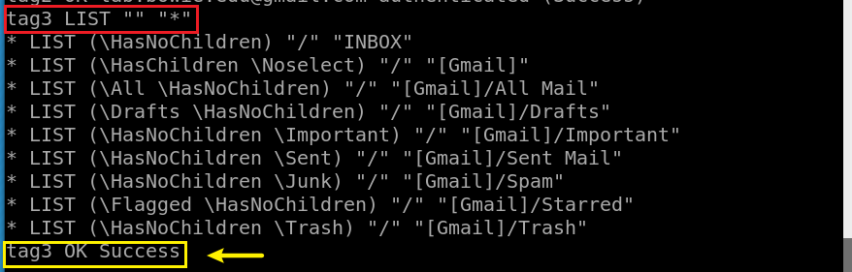

Slide 35
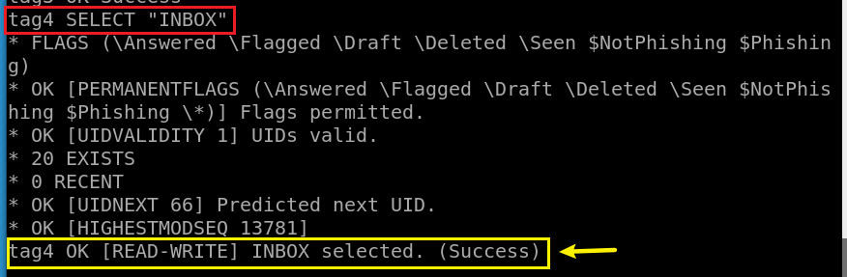

Slide 36
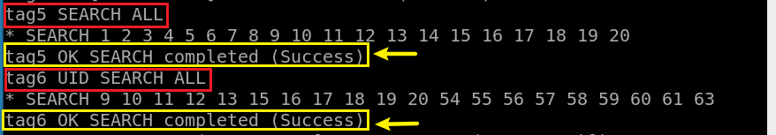
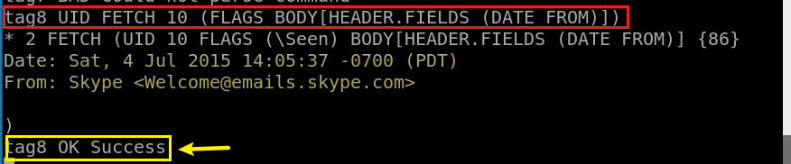

Slide 37
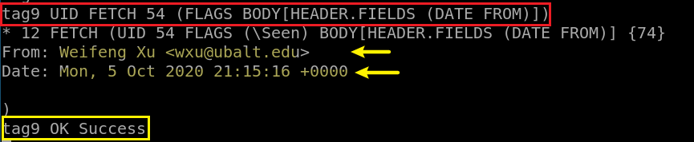
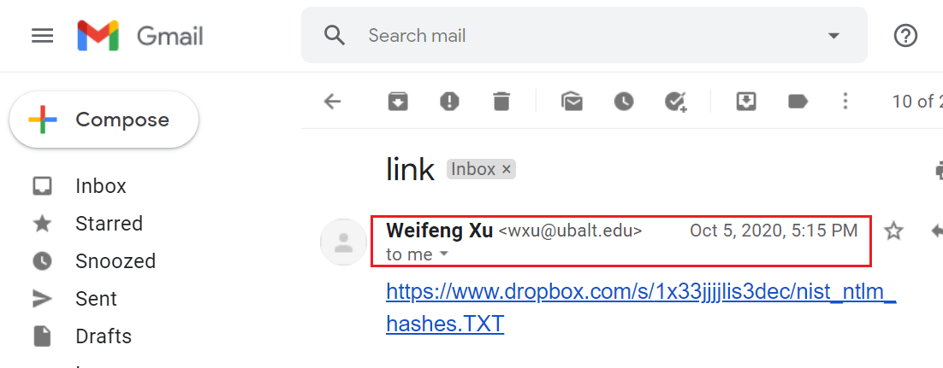
Notes:
https://www.atmail.com/blog/imap-commands/

Slide 38
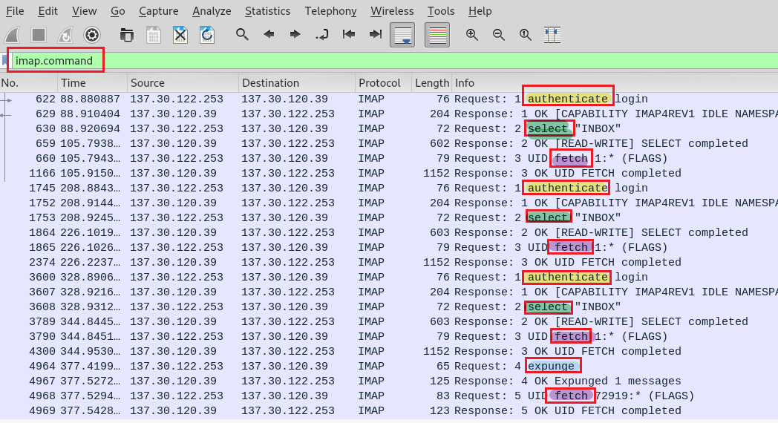
Notes:
https://www.nylas.com/blog/nylas-imap-therefore-i-am/

Slide 39
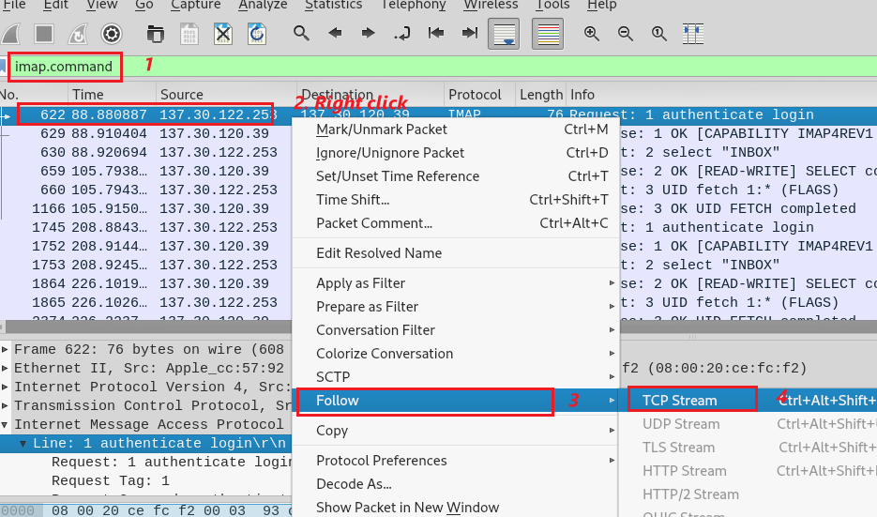

Slide 40
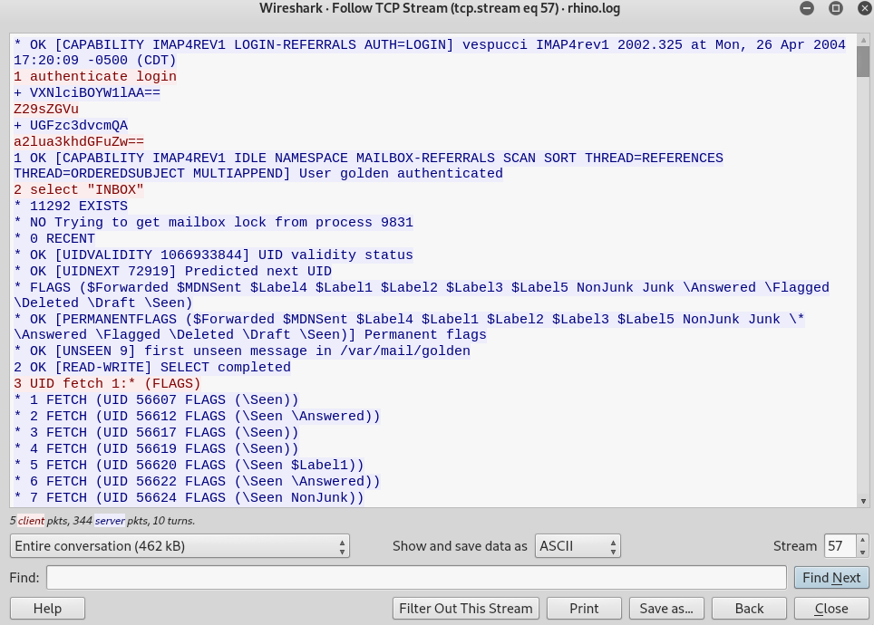
User name
golden (base 64 => ASCII)
Password
kinky!tang (base 64 => ASCII)
Nothing found!

Slide 41
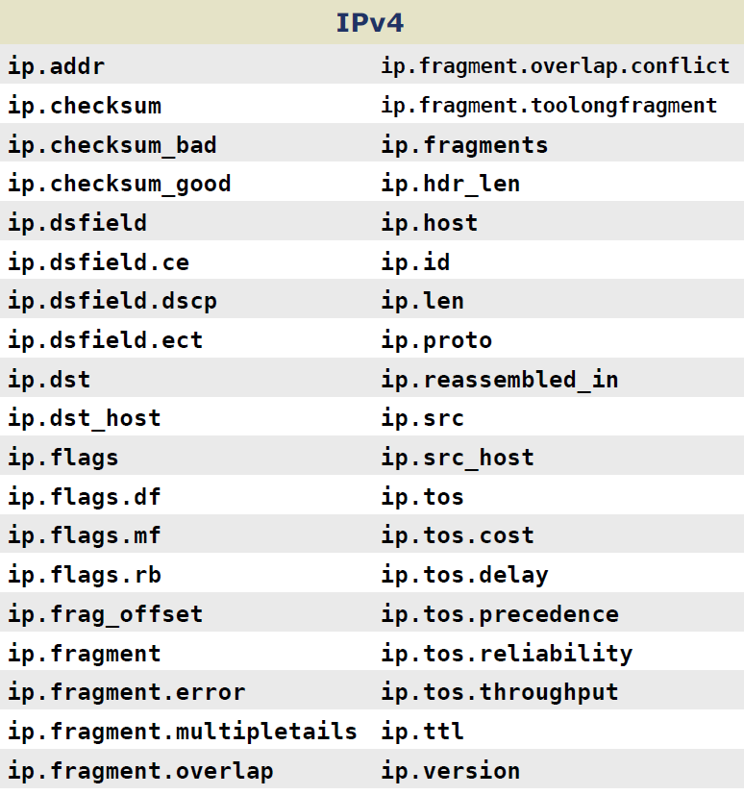
Notes:
https://packetlife.net/media/library/13/Wireshark_Display_Filters.pdf

Slide 42
Investigate rhino3.log
Investigating http traffics contain .exe

Slide 43
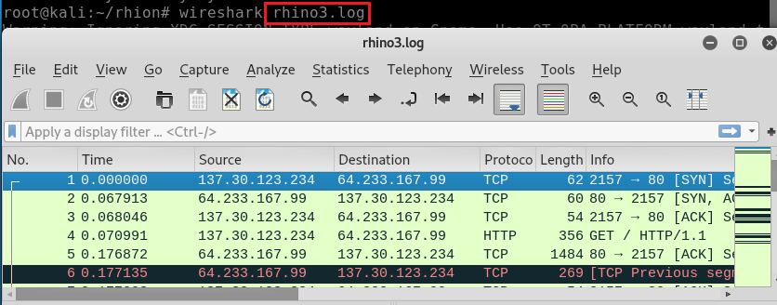
Open rhino3.log

Slide 44
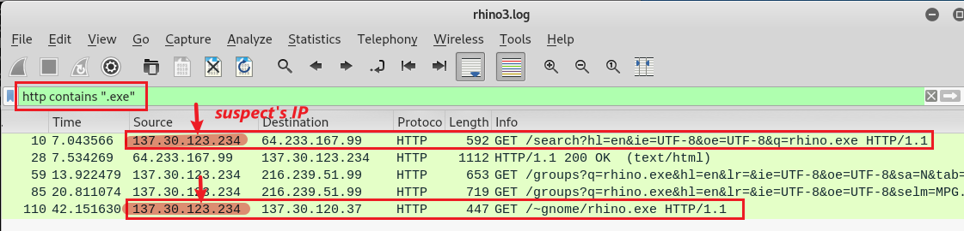
Search for http traffic with .exe

Slide 45
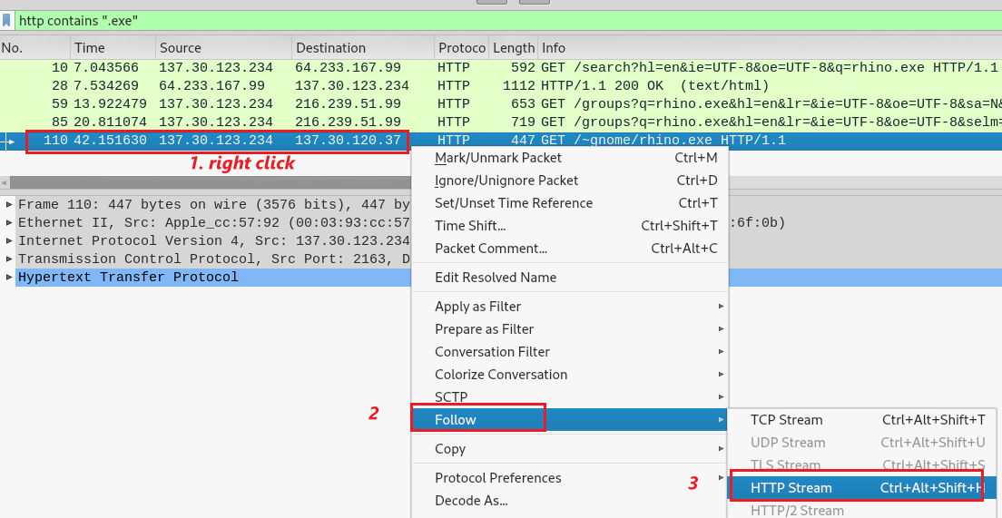
Follow HTTP stream of .exe

Slide 46
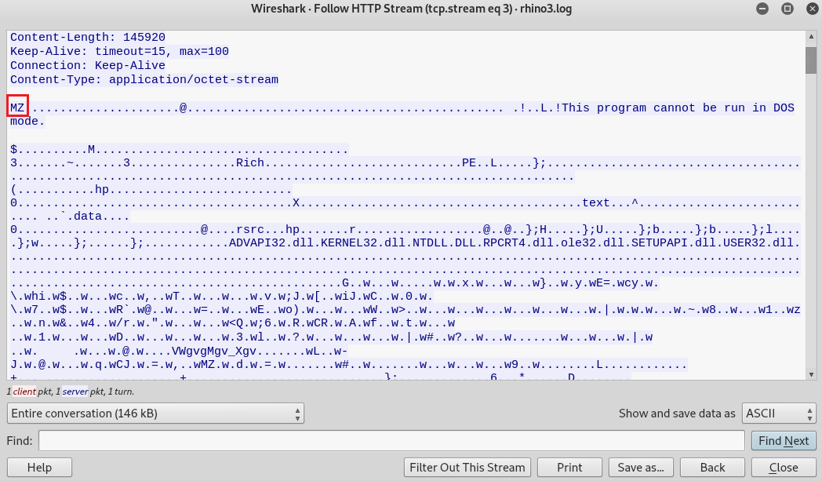
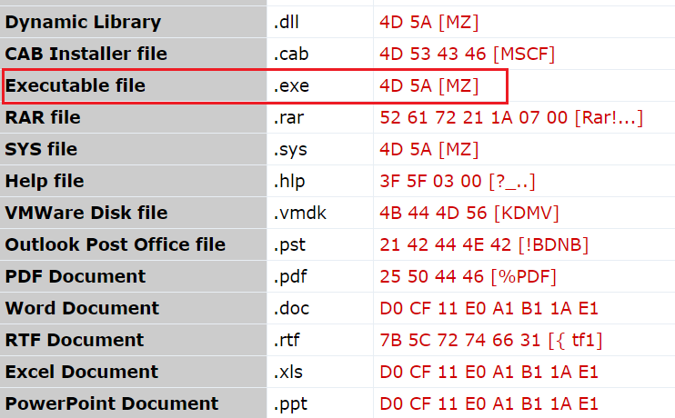
What are we looking for? Click magic number to the .exe packets

Slide 47
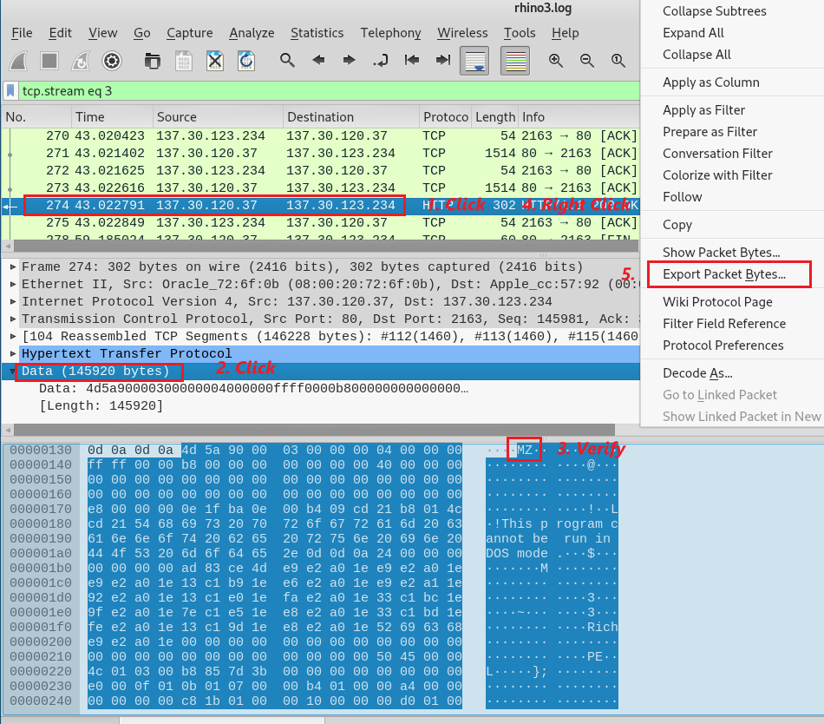
Find packets contain .exe
Verify the magic number
Export packet byte

Slide 48
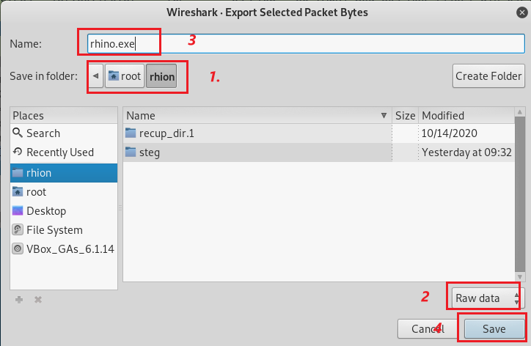
Save these traffic packets contains .exe to rhino.exe

Slide 49

Find rhino.exe information
Execute rhino.exe

Slide 50


Calculate rhino.exe md5 hash
Search the md5 hash online
Notes:
d62d9989535c4c8db14e50b58c9f25a0

Slide 52



