Slide 1
Investigate Data Leakage Case
Keywords: Windows Security Event Logs, XML, Python
Notes:
http://xmlstar.sourceforge.net/doc/UG/

Slide 2
Topics
Introduction to Python for Digital Forensics
Introduction to XML
Retrieve information from bookstore.xml file
Investigate Windows Security Event Logs
  binary logs are converted to a .xml file

Slide 3
Introduction to Python for Digital Forensics

Slide 4
What is Python?
Python is a versatile, high-level programming language.
  Known for its simplicity, readability, and extensive ecosystem.
Key Features:
  Readability: Clear, easily understood syntax.
  Interpreted: No compilation required; code runs directly.
  Cross-Platform: Works on Windows, macOS, Linux, and more.
  Comprehensive Library: Rich standard library for various tasks.
  Open Source: Freely available with an active community.

Slide 5
Use Cases
Web Development
Data Science
Scientific Computing
Automation
Artificial Intelligence
Digital Forensics

Slide 6
Learning Python for digital forensics
Scripting for specific forensic tasks
  parse log files, analyze registry entries, or extract metadata
Automation: automate repetitive tasks
Forensic Tool Development
  perform custom analysis and investigations.
Data Manipulation
Data Visualization
Community and Resources
  many Python libraries for digital forensics
Notes:
Automation: Python allows you to automate repetitive tasks and processes involved in digital forensics investigations. This can save time and reduce the risk of errors when analyzing large volumes of data.
Scripting: Python is an excellent scripting language that can be used to write custom scripts for specific forensic tasks. Whether you need to parse log files, analyze registry entries, or extract metadata from files, Python provides the flexibility to create specialized tools.
Forensic Tool Development: Python allows you to develop your own forensic tools and utilities tailored to your specific needs. You can create tools for data extraction, timeline analysis, artifact examination, and more.
Data Manipulation: Python has powerful libraries for data manipulation and analysis, such as Pandas and NumPy. These libraries are invaluable for organizing and processing large datasets commonly encountered in digital forensics.
Integration: Python can be used to integrate various forensic tools and workflows. You can build scripts that interact with popular forensic tools and APIs, enabling seamless data transfer and analysis.
Cross-Platform: Python is cross-platform, meaning your scripts and tools can run on different operating systems commonly encountered in digital forensics, such as Windows, Linux, and macOS.
Community and Resources: Python has a large and active community of developers and forensic professionals. This means there is a wealth of resources, libraries, and open-source tools available to support your work.
Forensic Libraries: There are Python libraries specifically designed for digital forensics, such as dfVFS (Digital Forensics Virtual File System) and pytsk, which provide access to file system structures and artifacts.
Custom Analysis: Python allows you to perform custom analysis and investigations. You can create scripts to search for specific patterns, identify anomalies, and extract relevant information from digital evidence.
Flexibility: Python's versatility makes it suitable for a wide range of forensic tasks, including disk and memory forensics, network forensics, mobile device forensics, and more.
Data Visualization: Python offers various libraries for data visualization, such as Matplotlib and Seaborn. You can create charts, graphs, and visual representations of forensic data, making it easier to communicate findings.
Career Advancement: Proficiency in Python is a valuable skill that can enhance your career prospects in digital forensics. Many employers seek professionals who can script and automate tasks to improve efficiency and effectiveness.

Slide 7
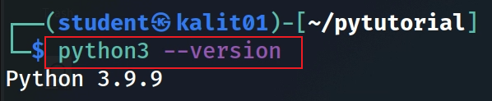
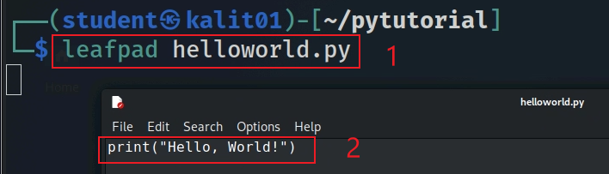
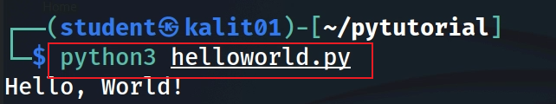
Python helloworld.py
Check Python version
helloworld.py
Run python file
Notes:
https://www.guru99.com/python-tutorials.html

Slide 8
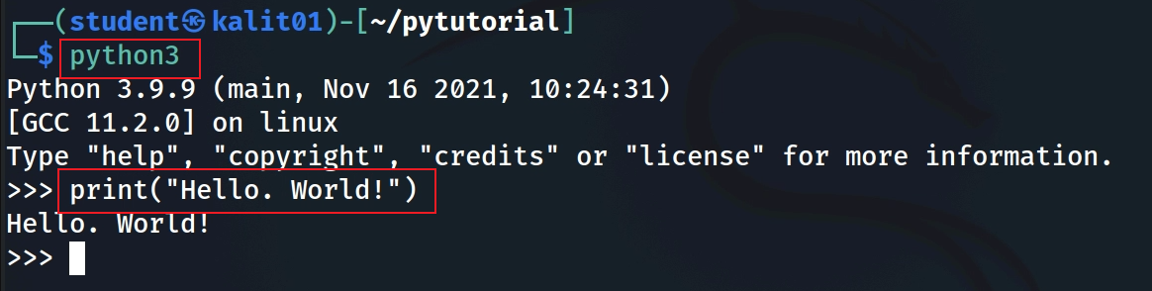
Python interactive model
Notes:
print("Hello, World!")

Slide 9

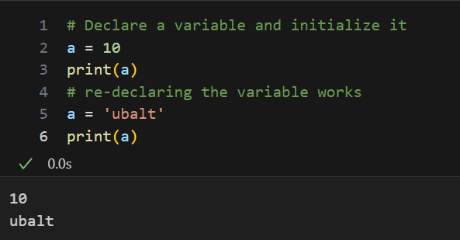
Python Variables
https://raw.githubusercontent.com/frankwxu/digital-forensics-lab/main/NIST_Data_Leakage_Case/py_version/pycode/security_evt_xml/py_tutorial.ipynb
Open ipynb using https://colab.research.google.com/

Slide 10
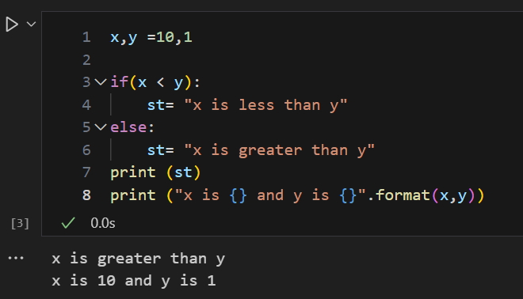
Python Conditional Statements

Slide 11
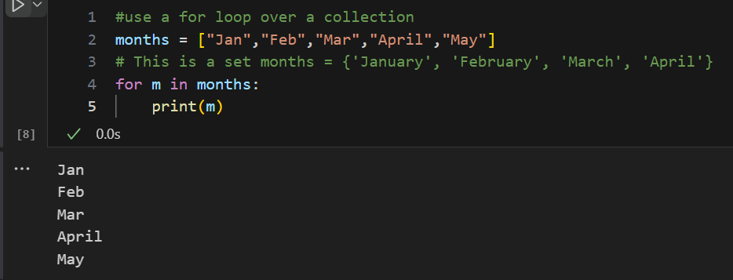
For loop over a list

Slide 12
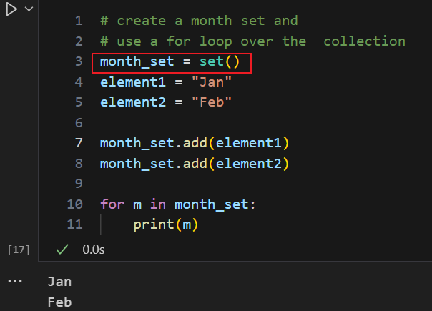
Add months to a set
Lists are ordered collections of items, while sets are unordered and have no duplicated items
Notes:
myset = {"apple", "banana", "cherry"}

Slide 13
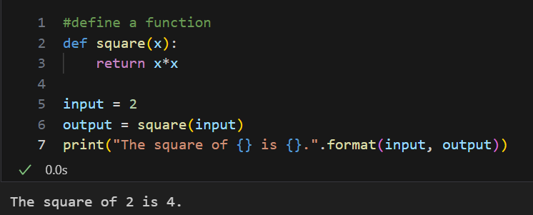
Function

Slide 14
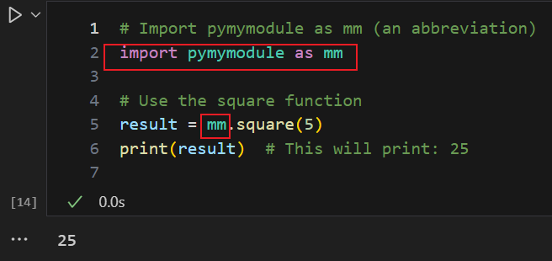
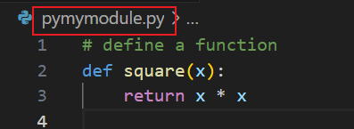
Reuse functions defined in a module
Define a module pymymodule.py contains functions, e.g., square()
reusing the function by importing the module

Slide 15
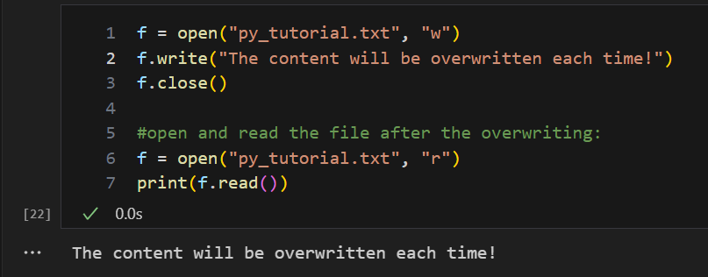

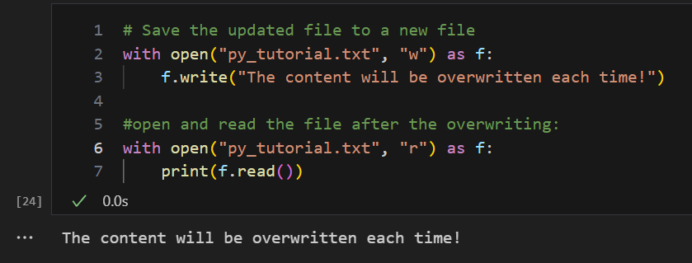
Save and read file

Slide 16
Introduction to XML

Slide 17
What is XML
An XML file is an eXtensible Markup Language file that structures data for storage and transport.
XML files can be used for various purposes
  Data transfer: XML files can store and retrieve data for different applications.
  Formatting documents: XML files can define how web pages or other documents are displayed.
  Web searching: XML files can help search engines index and rank web pages
  Creating layouts: XML files can design the user interface of mobile applications.
  Storing configuration data: XML files can store the settings and preferences of an application.

Slide 18
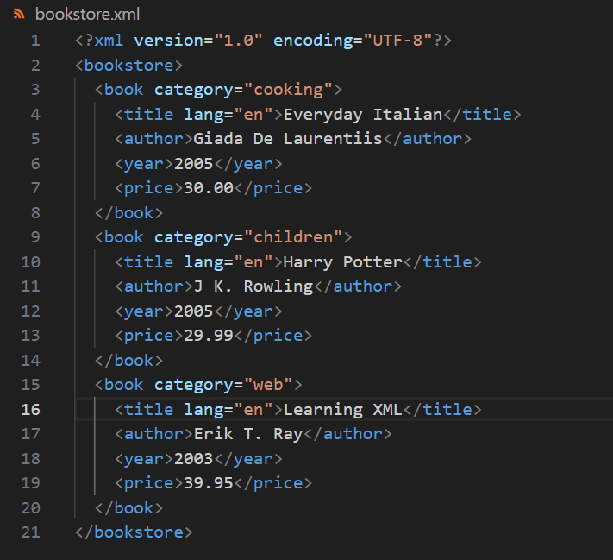
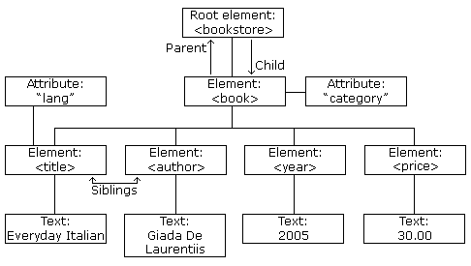
UTF-8 is capable of encoding all 1,112,064 characters using one to four one-byte (8-bit) code units.
https://www.w3schools.com/xml/xml_tree.asp
Notes:
<?xml version="1.0" encoding="UTF-8"?>
<bookstore>
<book category="cooking">
<title lang="en">Everyday Italian</title>
<author>Giada De Laurentiis</author>
<year>2005</year>
<price>30.00</price>
</book>
<book category="children">
<title lang="en">Harry Potter</title>
<author>J K. Rowling</author>
<year>2005</year>
<price>29.99</price>
</book>
<book category="web">
<title lang="en">Learning XML</title>
<author>Erik T. Ray</author>
<year>2003</year>
<price>39.95</price>
</book>
</bookstore>

Slide 19
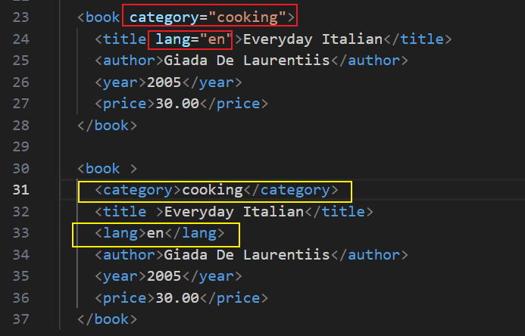


XML Elements vs. Attributes
Both examples provide the same information about the language of the title.
Avoid attributes, use elements instead

Slide 20
Retrieve information from bookstore.xml

Slide 21
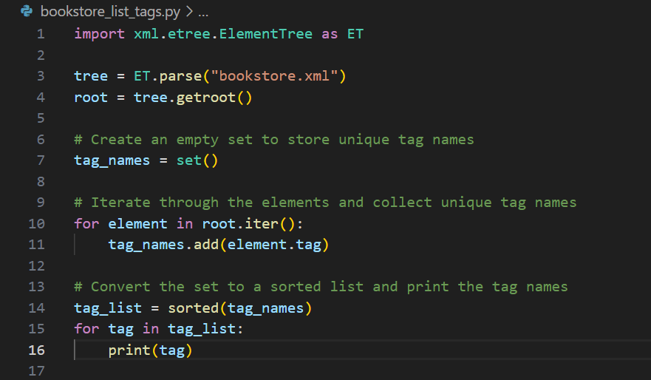
List all tags of bookstore.xml

Slide 22
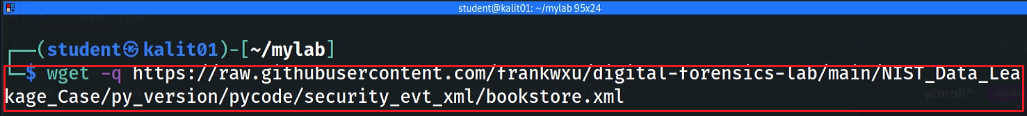
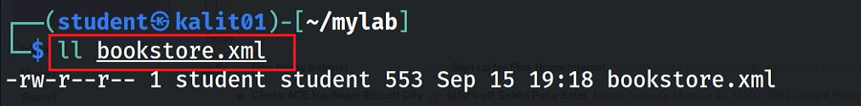
Download lab xml file bookstore.xml
Notes:
wget https://raw.githubusercontent.com/frankwxu/digital-forensics-lab/main/NIST_Data_Leakage_Case/py_version/pycode/security_evt_xml/bookstore.xml

Slide 23
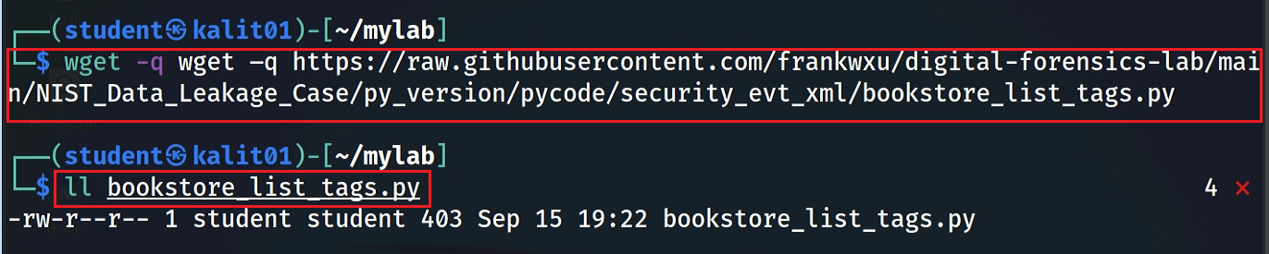
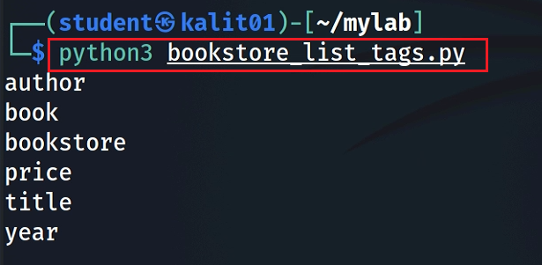
Download python code
Execution results: list all tags
Notes:
wget –q https://raw.githubusercontent.com/frankwxu/digital-forensics-lab/main/NIST_Data_Leakage_Case/py_version/pycode/security_evt_xml/bookstore_list_tags.py

Slide 24
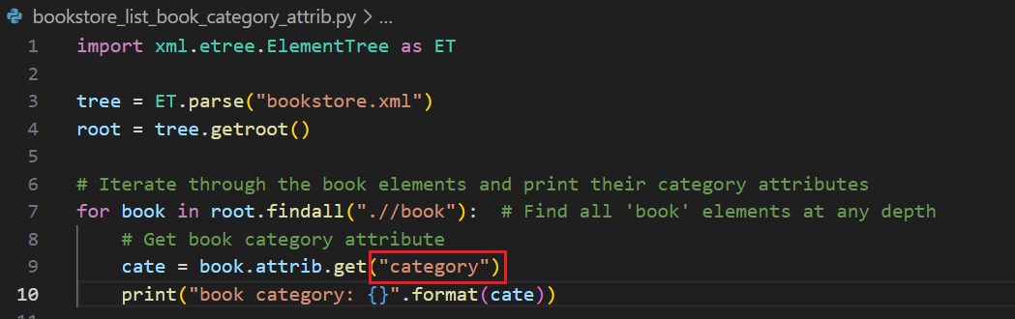
List a book attribute: category

Slide 25

https://raw.githubusercontent.com/frankwxu/digital-forensics-lab/main/NIST_Data_Leakage_Case/py_version/pycode/security_evt_xml/bookstore_list_book_category_attrib.py
Execution command
$ python3 bookstore_list_book_category_attrib.py
Execution results

Slide 26
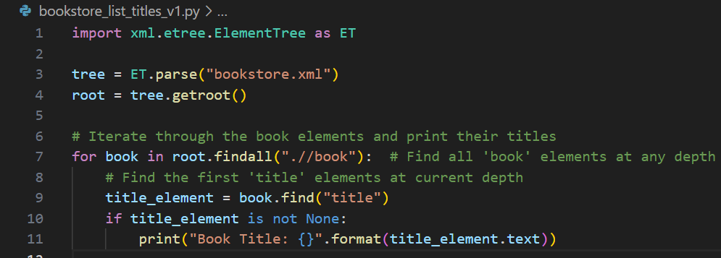
List a book tag: title and its text

Slide 27

https://raw.githubusercontent.com/frankwxu/digital-forensics-lab/main/NIST_Data_Leakage_Case/py_version/pycode/security_evt_xml/bookstore_list_book_titles_v1.py
Execution command
$ python3 bookstore_list_titles_v1.py
Execution results

Slide 28
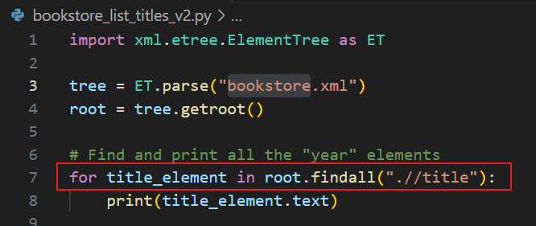
https://raw.githubusercontent.com/frankwxu/digital-forensics-lab/main/NIST_Data_Leakage_Case/py_version/pycode/security_evt_xml/bookstore_list_book_titles_v2.py
List a book tag: category and its text (alternative)

Slide 29
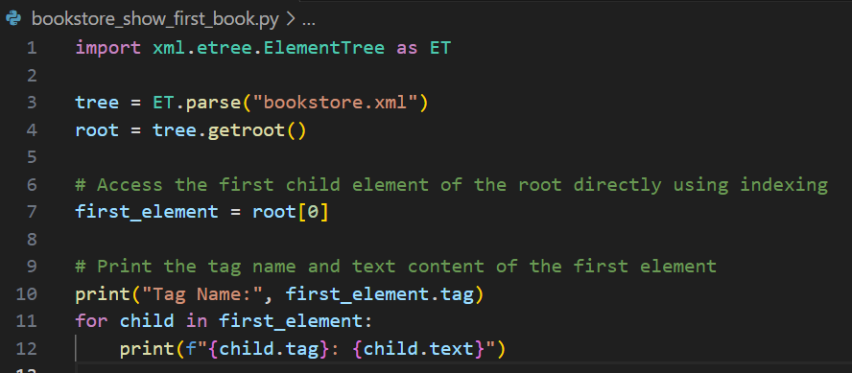
Show the first book details

Slide 30
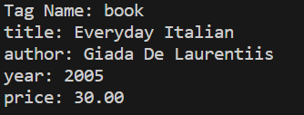
https://raw.githubusercontent.com/frankwxu/digital-forensics-lab/main/NIST_Data_Leakage_Case/py_version/pycode/security_evt_xml/bookstore_show_first_book.py
Execution command
$ python3 bookstore_show_first_book.py
Execution results

Slide 31
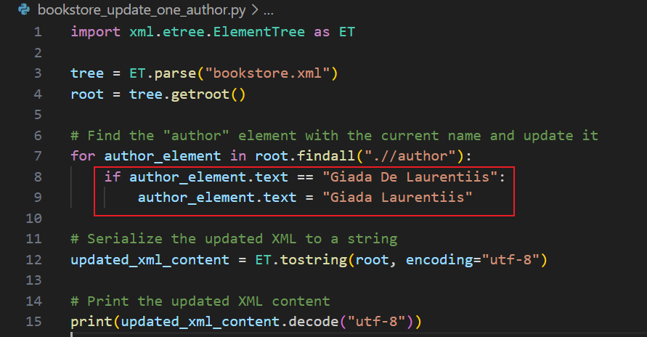
Update one author
"Giada Laurentiis"

Slide 32
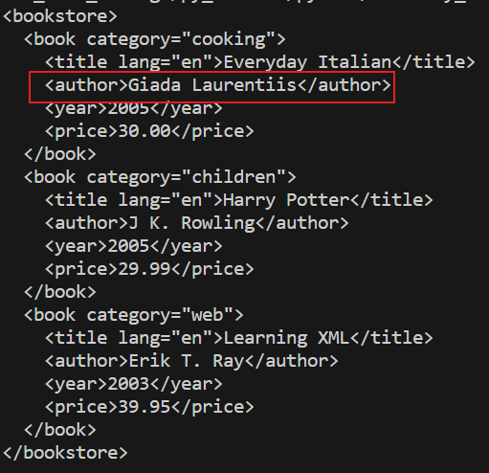
https://raw.githubusercontent.com/frankwxu/digital-forensics-lab/main/NIST_Data_Leakage_Case/py_version/pycode/security_evt_xml/bookstore_update_one_author.py
Execution command
$ python3 bookstore_update_one_author.py
Execution results

Slide 33
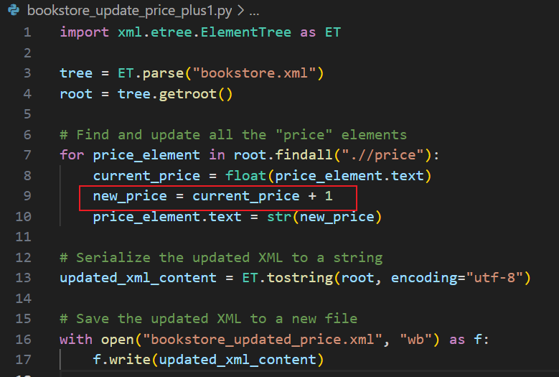
Update price with price +1

Slide 34
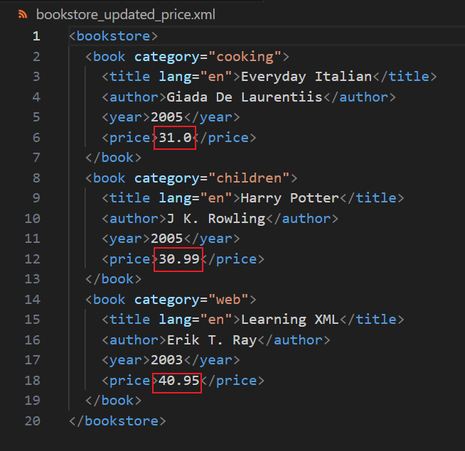
https://raw.githubusercontent.com/frankwxu/digital-forensics-lab/main/NIST_Data_Leakage_Case/py_version/pycode/security_evt_xml/bookstore_update_price_plus1.py
Execution command
$ python3 bookstore_update_price_plus1.py
Execution results

Slide 35
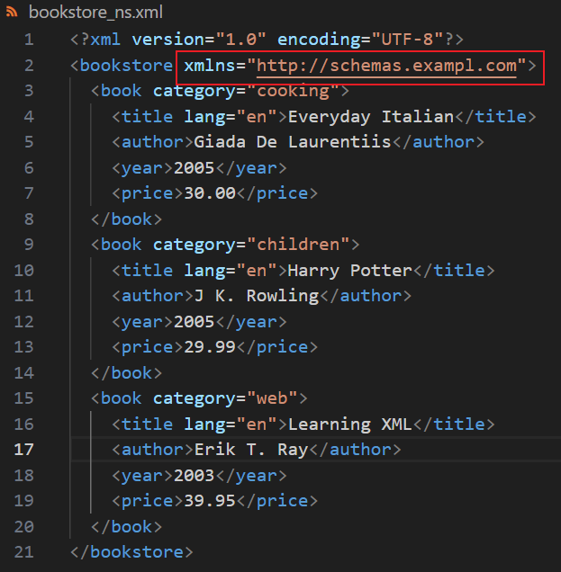
Remove namespace in XML
A namespace is a mechanism that allows you to uniquely identify elements and attributes within an XML document.
  It's used to avoid naming conflicts when different XML vocabularies or documents are combined or used together.
Namespaces are particularly useful when
  you have XML documents that contain elements and attributes with the same names, but they are intended to represent different things.
XML Namespaces provide a method to avoid element name conflicts.
  defined by an xmlns attribute in the start tag of an element.
  xmlns:prefix="URI".

Slide 36
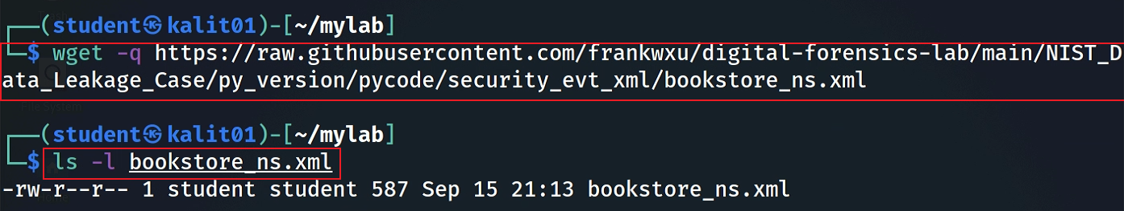
Download bookstore with the namespace
Notes:
wget -q https://raw.githubusercontent.com/frankwxu/digital-forensics-lab/main/NIST_Data_Leakage_Case/py_version/pycode/security_evt_xml/bookstore_ns.xml

Slide 37
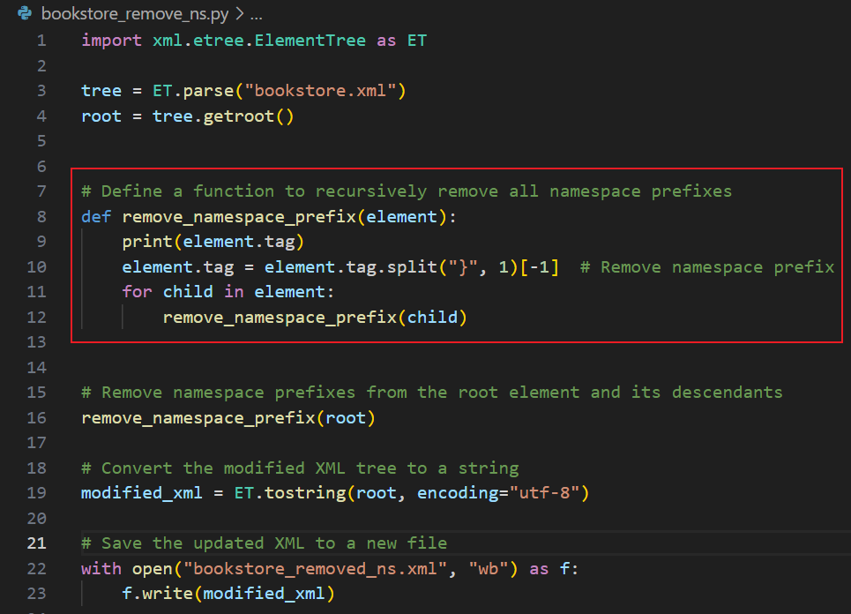

Slide 38
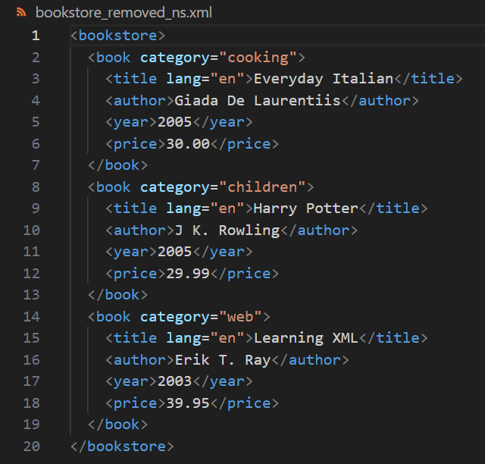
https://raw.githubusercontent.com/frankwxu/digital-forensics-lab/main/NIST_Data_Leakage_Case/py_version/pycode/security_evt_xml/bookstore_remove_ns.py
Execution command
$ python3 bookstore_remove_ns.py
Execution results

Slide 39
Investigate Windows Security Event Logs

Slide 40
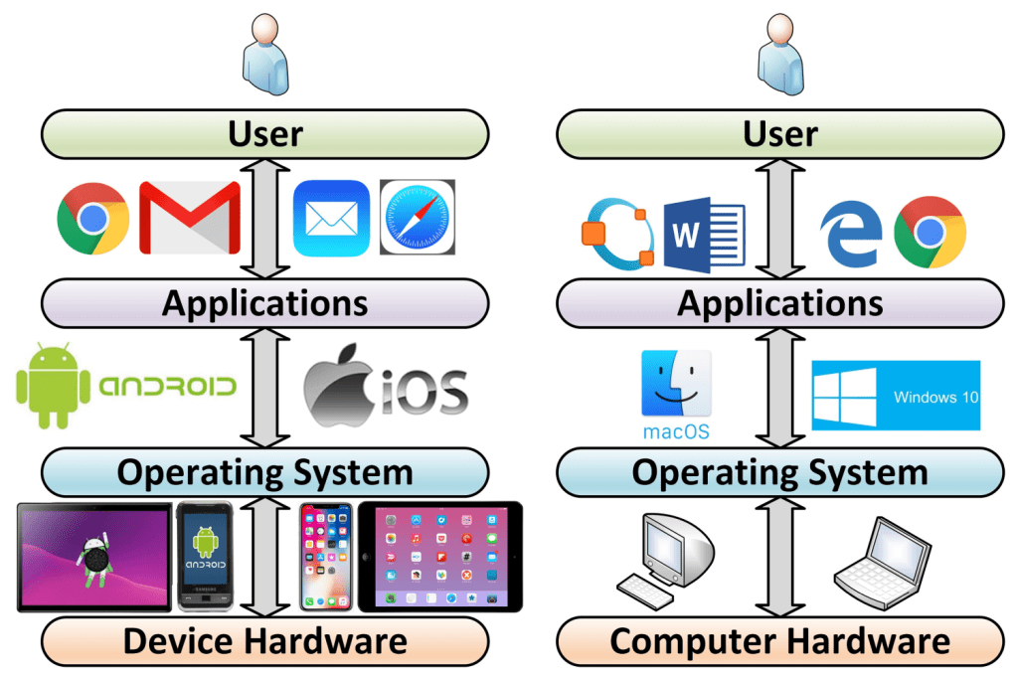
Layers of a computer system and evidence generation
Evidence is generated from each layer
User activities= Applications+ OS+ Disk/Memory
https://windsongtraining.ca/the-technology-layer-cake-users-apps-os-and-hardware/

Slide 41
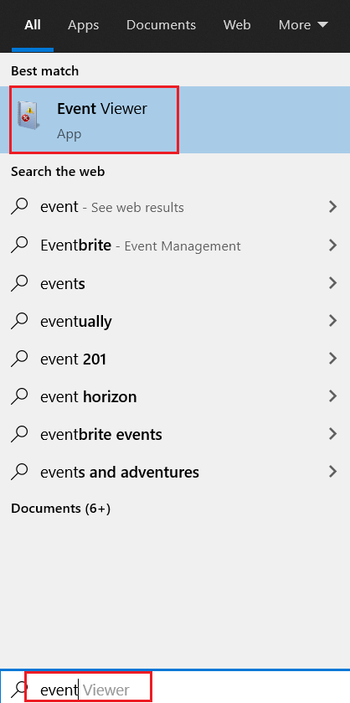
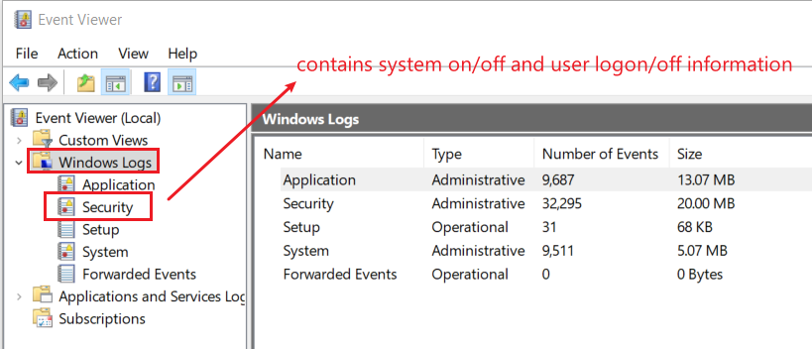
12. List all traces about the system on/off and the user logon/logoff (It should be considered only during a time range between 09:00 and 18:00 in the timezone (Eastern Time) from Question 4.
The Windows event log is a detailed record of system, security and application notifications stored by the Windows
It’s a useful tool for
  troubleshooting all kinds of different Windows problems
  forensics analysis
Notes:
evtx_dump.py Security.evtx > SecurityEvt.xml

Slide 42
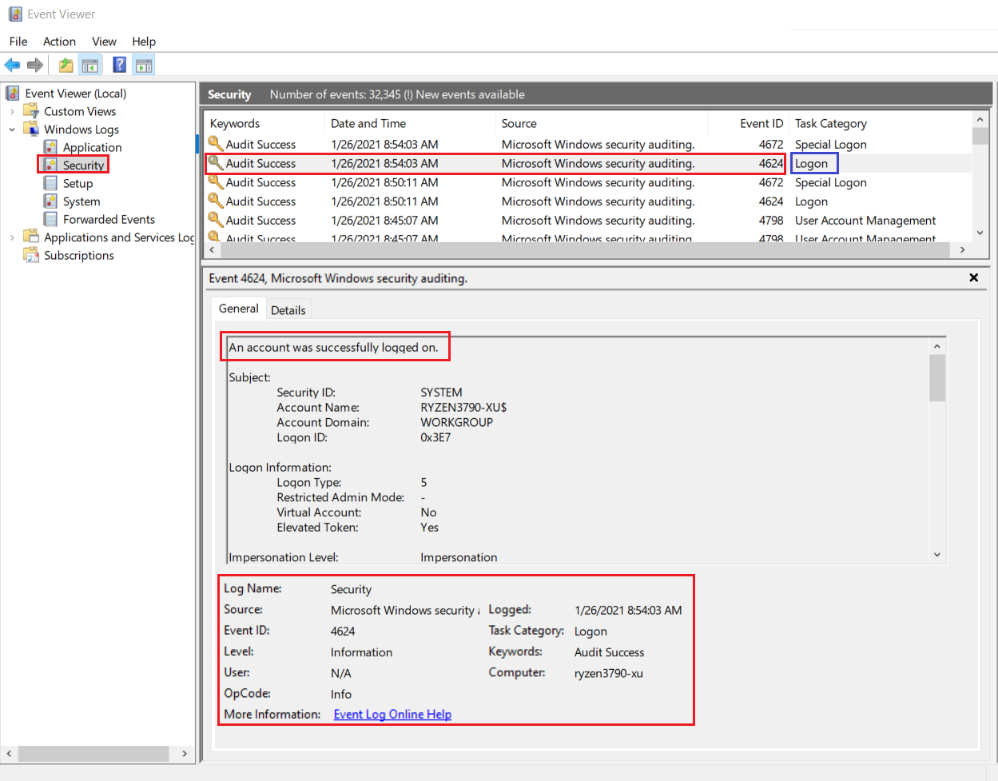
Logon event 4624

Slide 43
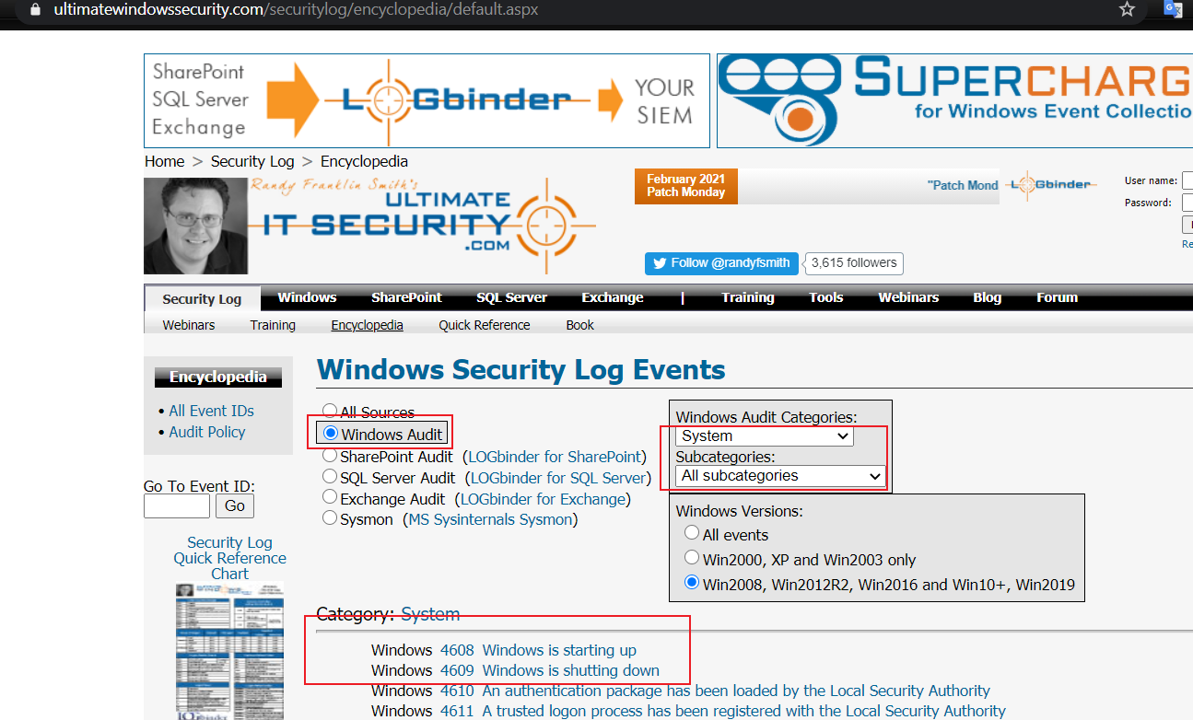
How to search events?
https://www.ultimatewindowssecurity.com/securitylog/encyclopedia/default.aspx

Slide 44
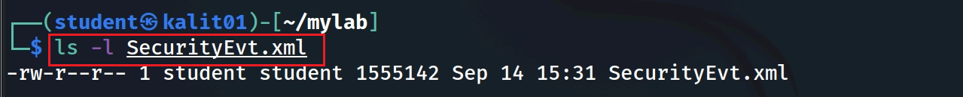
Get a copy of security event log
Please follow Environment Setup Lab and copy Security.evtx to the current folder
Verify the current folder contains Security.evtx
Convert Security.evtx to xml format
Verify .xml file
Notes:
evtx_dump.py Security.evtx > SecurityEvt.xml

Slide 45
Download the cleaned security event log
We cleaned the SecurityEvt.xml
  removed all namespaces as the attributes and tags as there are no name conflicts
  reformatted in a pretty format (indented)
The cleaned log file is secuirtyEvt_formatted.xml
  Two Python codes for removing namespace and reformatting can be found in the repository
  securityevt_ns_remove.py and securityevt_format.py
You can directory download the cleaned security log
wget –q https://raw.githubusercontent.com/frankwxu/digital-forensics-lab/main/NIST_Data_Leakage_Case/py_version/pycode/security_evt_xml/securityEvt_formatted.xml
Notes:
wget –q https://raw.githubusercontent.com/frankwxu/digital-forensics-lab/main/NIST_Data_Leakage_Case/py_version/pycode/security_evt_xml/securityEvt_formatted.xml

Slide 46
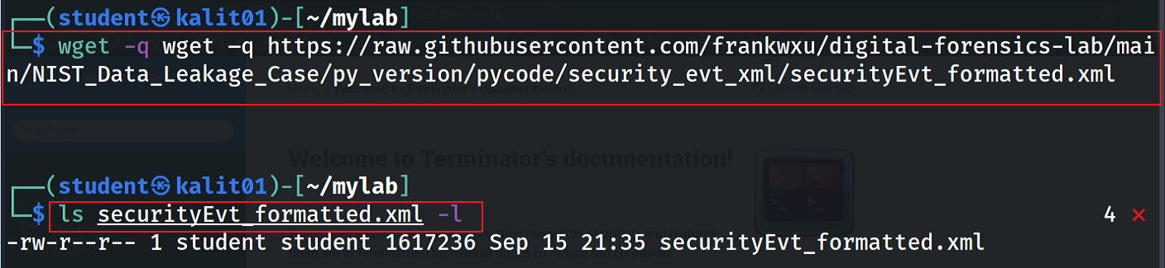
Download cleaned security event log
Notes:
wget –q https://raw.githubusercontent.com/frankwxu/digital-forensics-lab/main/NIST_Data_Leakage_Case/py_version/pycode/security_evt_xml/securityEvt_formatted.xml

Slide 47
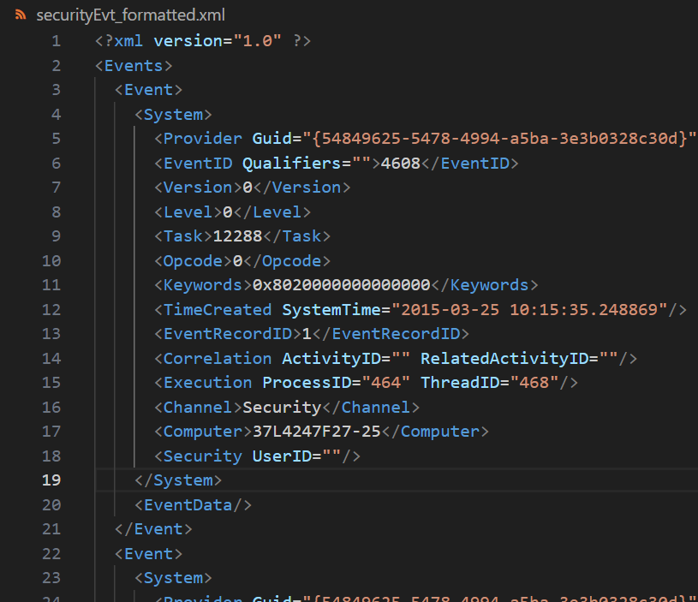
View the cleaned security event log

Slide 48
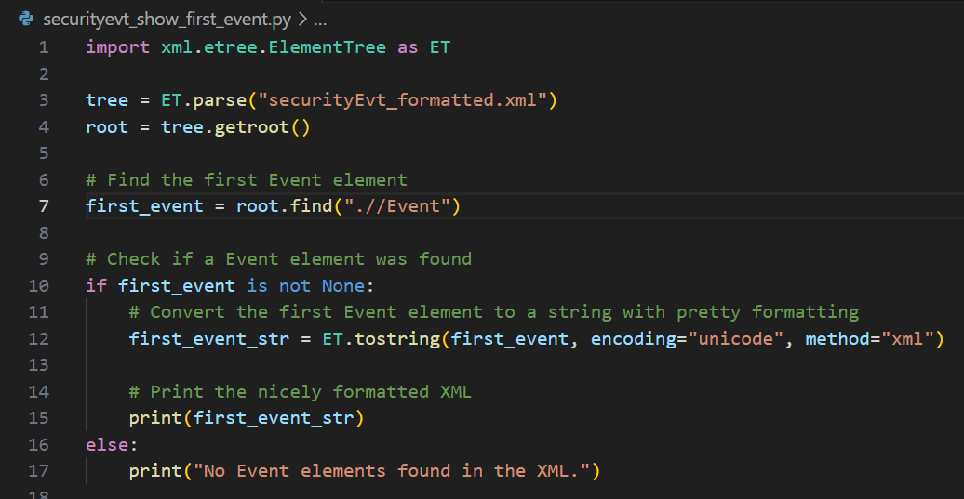
Show the first event

Slide 49
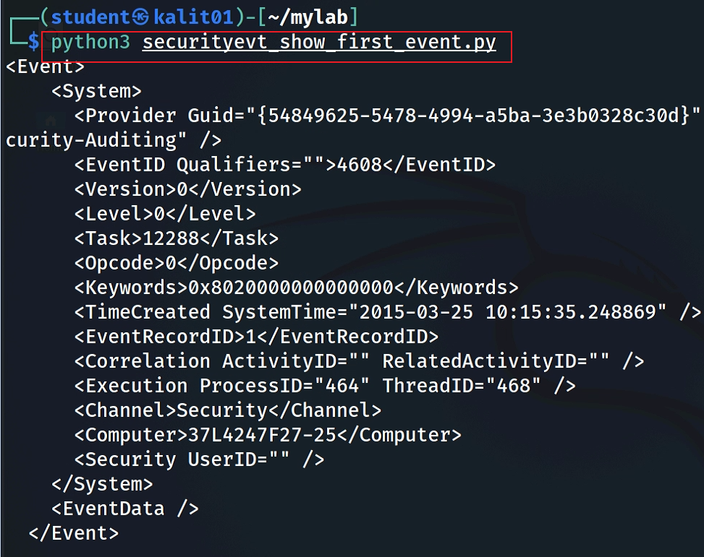
Download Python code
Execution command
Notes:
wget -q https://raw.githubusercontent.com/frankwxu/digital-forensics-lab/main/NIST_Data_Leakage_Case/py_version/pycode/security_evt_xml/securityevt_show_first_event.py

Slide 50
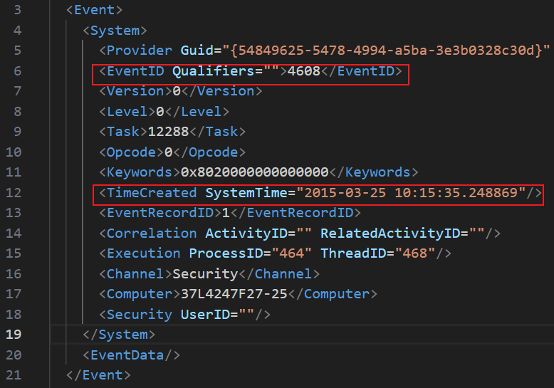
Find when Windows started
4608 (Windows is starting up)
1100 (service shutdown)
4624 (successful logon)
4634 (logoff)
4625 (logon failure)
4647 (a user initiated the logoff process)...
In digital forensics, determining when Windows started (boot time) can be crucial
  Timeline Analysis
  Incident Reconstruction
  Malware Analysis
  Unauthorized Access
  System Stability and Integrity
  Alibis and Altered System Times
  Correlation with Other Artifacts
Notes:
Timeline Analysis: Establishing an accurate timeline of events is a fundamental aspect of digital forensics. Knowing when a system was last booted can help forensic analysts understand the sequence of activities on the system. It allows them to correlate events, track user actions, and identify any suspicious or unauthorized activities.
Incident Reconstruction: When investigating security incidents or cybercrimes, forensic analysts need to reconstruct the sequence of events leading up to and following the incident. Boot time is a critical reference point for understanding the context and identifying potential indicators of compromise (IOCs).
Malware Analysis: Malware often attempts to hide its presence and activities on a compromised system. Examining the system's boot time can reveal if malware initiated during startup, helping analysts identify the persistence mechanisms used by the malware and any changes made to the system.
Unauthorized Access: In cases of unauthorized access or insider threats, knowing the boot time can help determine whether someone gained access to a system during a specific time window. This information can be used to establish user account activity patterns and assess potential insider involvement.
System Stability and Integrity: Analyzing boot times can provide insights into the stability and integrity of the system. Frequent or unexpected reboots may indicate hardware or software issues, and this information can be valuable in diagnosing problems.
Alibis and Altered System Times: In legal cases, verifying the boot time can be critical for establishing alibis or disproving false claims. It helps establish when a suspect was or was not using a specific computer system.
Correlation with Other Artifacts: The boot time can be correlated with other digital artifacts, such as log files, user account activity, and file timestamps. This correlation can help build a comprehensive picture of system usage and user actions.

Slide 51
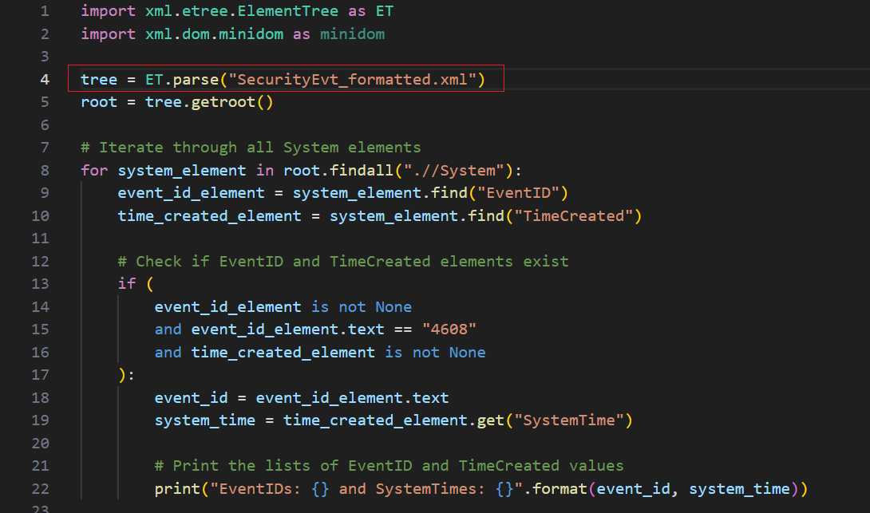
Find all Event ID 4608 (Windows is starting up) and its timestamps

Slide 52
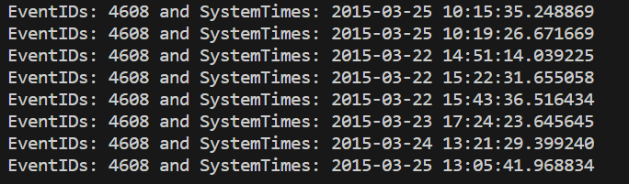
https://raw.githubusercontent.com/frankwxu/digital-forensics-lab/main/NIST_Data_Leakage_Case/py_version/pycode/security_evt_xml/securityevt_findall_eventid_time.py
Execution command
$ python3 securityevt_findall_eventid_time.py
Execution results

Slide 53
Assignments

Slide 54
Assignments
Practice the lab by following PPTs
Find the EventId “4634” (logoff) and its timestamp using Python
Substitute the EventId “4634” with the string “logoff”
Find the string “logoff” with timestamps

