Slide 1

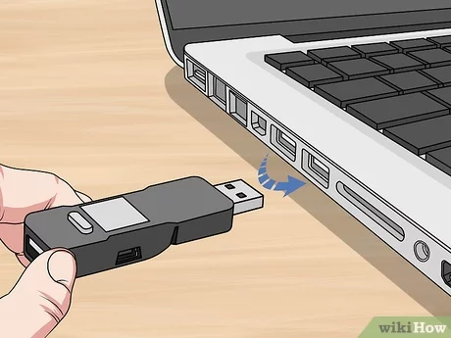
Investigate Data Leakage Case
Keywords: emails, USB,
Notes:
http://xmlstar.sourceforge.net/doc/UG/

Slide 2
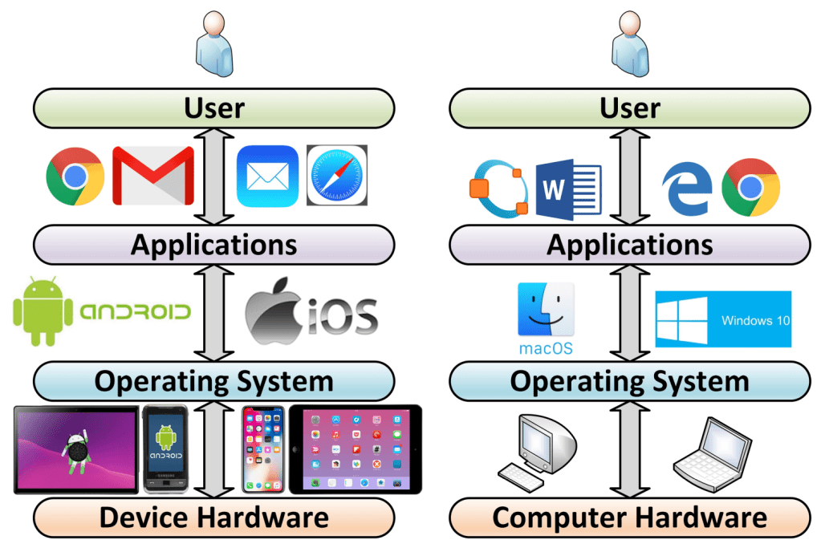
Evidence is generated from each layer
User activities= Applications+ OS+ Disk/Memory
Email
USB
Device driver
https://windsongtraining.ca/the-technology-layer-cake-users-apps-os-and-hardware/

Slide 3
Objectives
Email forensics (Application Layer)
Device forensics (Device driver Layer)

Slide 4
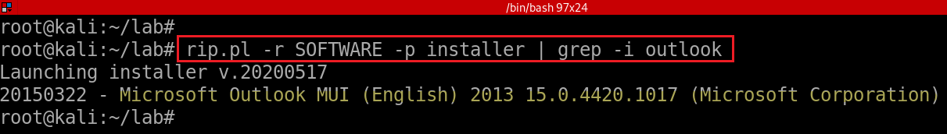
18. What application was used for e-mail communication?
rip.pl installer plugin; grep for Outlook
List of email clients
https://en.wikipedia.org/wiki/Comparison_of_email_clients
Notes:
rip.pl -r SOFTWARE -p installer | grep -i outlook

Slide 5
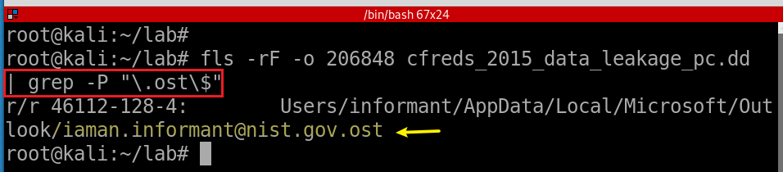
19. Where is the e-mail file located?
20. What was the e-mail account used by the suspect?
  OST (Offline Storage Table)
-r: Recursive on directory entries
-F: Display only files
$ End of string, or end of line in multi-line pattern
https://staff.washington.edu/weller/grep.html
Notes:
fls -rF -o 206848 cfreds_2015_data_leakage_pc.dd | grep -P "\.ost\$“
fls -rF -o 206848 cfreds_2015_data_leakage_pc.dd | grep -E "\.ost$"

Slide 6
21. List all e-mails of the suspect. If possible, identify deleted e-mails.
Install email extracting tool: libpff
Copy .ost file from a DD image
Extract email via libpff

Slide 7


libpff
libpff is a library to access the Personal Folder File (PFF) and the Offline Folder File (OFF) format.
  These format are used by Microsoft Outlook to store email, contacts and other data.
Support file types
  PAB (Personal Address Book)
  PST (Personal Storage Table)
  OST (Offline Storage Table)
https://github.com/libyal/libpff
Notes:
https://github.com/libyal/libpff

Slide 8
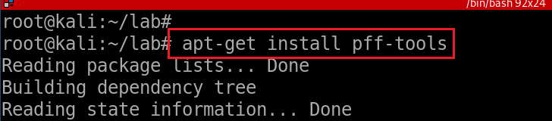
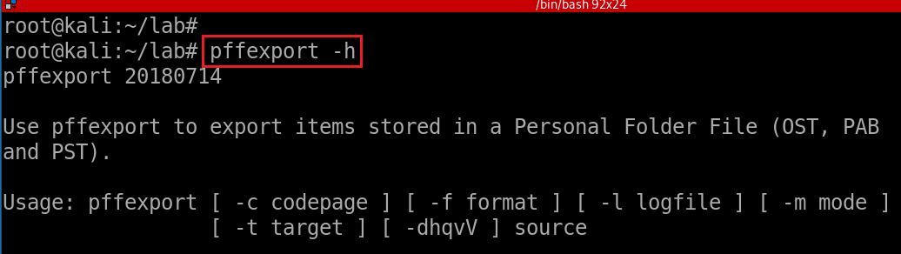
Install pffexport tool
Verify installation
Notes:
apt-get install pff-tools

Slide 9
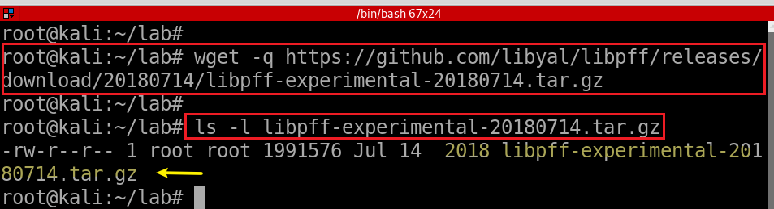
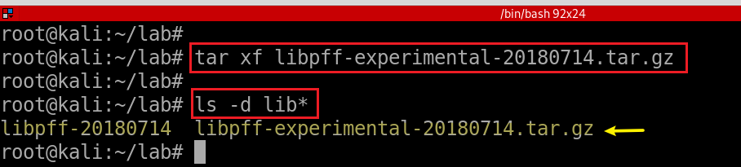
(Optional) Alternative Installation from source code
Download libpff via wget
Extract contents of tar.gz
Notes:
https://github.com/libyal/libpff/wiki/Building
wget -q https://github.com/libyal/libpff/releases/download/20180714/libpff-experimental-20180714.tar.gz
tar -xf libpff-experimental-20180714.tar.gz

Slide 10
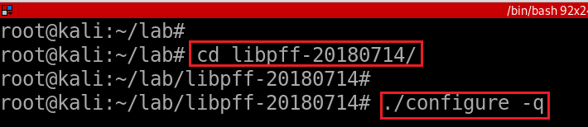


(Optional) Alternative Installation from source code

Slide 11
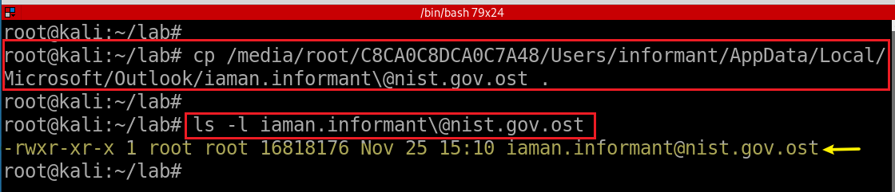
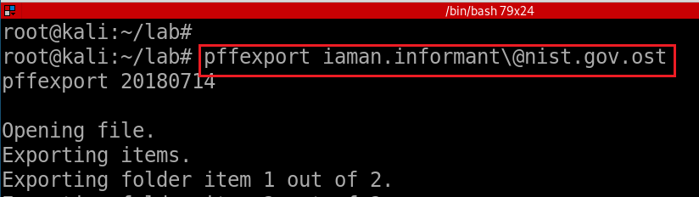
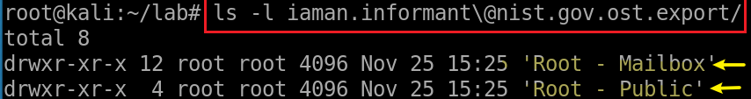
Copy email to current directory
-t: specify the basename of the target directory to export to
Extract emails via pffexport
Verify the default output directory
Notes:
losetup --partscan --find --show --read-only
cp /media/root/C8CA0C8DCA0C7A48/Users/informant/AppData/Local/Microsoft/Outlook/iaman.informant\@nist.gov.ost .
ls -l iaman.informant\@nist.gov.ost

Slide 12
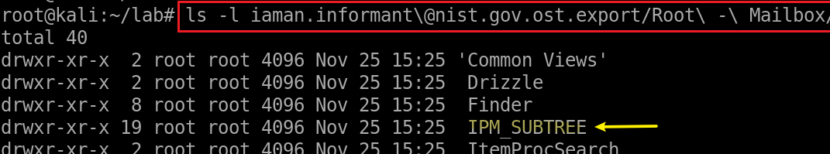
Access a message in suspect’s Mailbox
IPM_SUBTREE
Inbox
Outbox
Sent Items
Deleted Items
interpersonal message, or IPM, subtree. Created by MAPI
Messaging Application Programming Interface (MAPI) creates a tree of folders beneath the root folder of a message store for all clients that send messages to and receive messages from human, rather than computer, recipients.
Notes:
ls -l iaman.informant\@nist.gov.ost.export/Root\ -\ Mailbox/

Slide 13
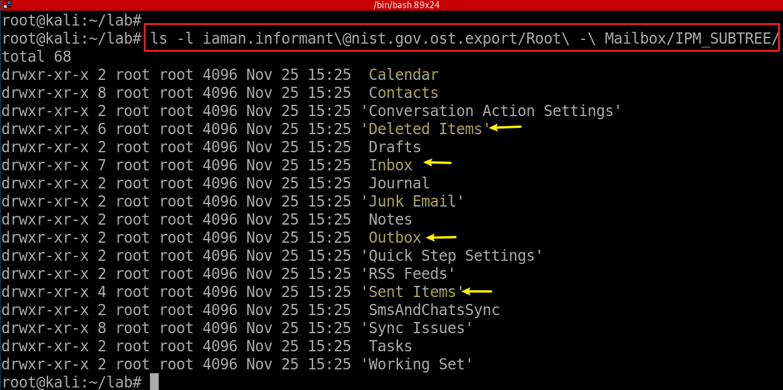
Access a message in suspect’s IPM_SUBTREE

Slide 14
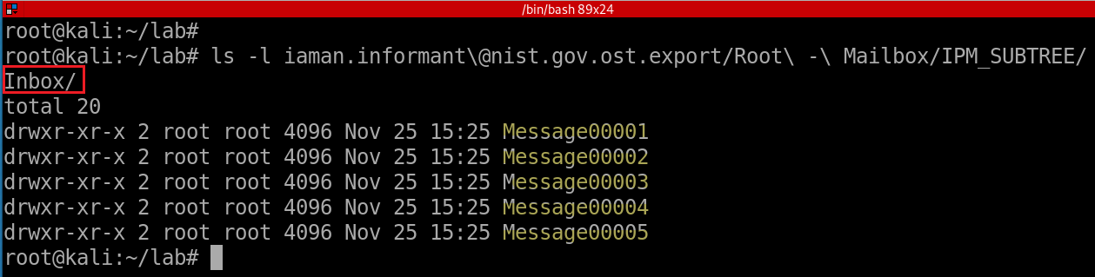
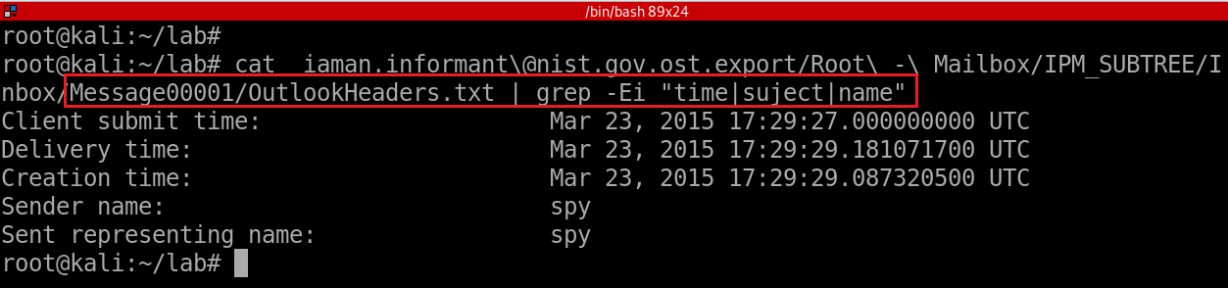
Notes:
ls -l iaman.informant\@nist.gov.ost.export/Root\ -\ Mailbox/IPM_SUBTREE/Inbox/
cat iaman.informant\@nist.gov.ost.export/Root\ -\ Mailbox/IPM_SUBTREE/Inbox/Message00001/OutlookHeaders.txt | grep -Ei "time|suject|name“
grep -E ‘strings’ Message*

Slide 15
Device driver forensics

Slide 16



Device drivers
A device driver is a software program
  that allows an operating system to communicate with and control a specific hardware device, such as a printer, scanner, or graphics card.
  acts as an interface between the hardware and the operating system, providing a standard way for software programs to access and use the device's functions.
Two types of device drivers
  bundled with the operating system
  provided by the device manufacturer and installed as part of the operating system's setup process.
device drivers are essential for the proper functioning of hardware devices
  without them, the operating system would not be able to use those devices.
Application
OS
Device Drivers
Hardware

Slide 17
22. List external storage devices attached to PC.
What are we looking for?
Possible Answer | Device Name | Volume Name | Serial No. | First Connected Time | Connected Time After Reboot
 | SanDisk Cruzer Fit USB Device |  | 4C530012450531101593 | 2015-03-23 14:31:10 Mon | 2015-03-24 09:38:00 Tue
 | SanDisk Cruzer Fit USB Device | IAMAN $_@ | 4C530012550531106501 | 2015-03-24 09:58:32 Tue | 2015-03-24 09:58:33 Tue
First Connect Time: The first time a USB is attached to a PC
USB Attached time after reboot: When a PC is rebooted, the time that the PC finds the USB
The last connected time: When a registry value is re-written

Slide 18




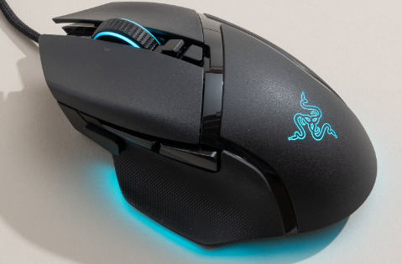

How does PC recognize a device?
A driver, or device driver, is a set of files that tells a piece of hardware how to function by communicating with a computer's operating system.
Manufactory mails with contains
Copy from to
Execute
Restart
Now PC recognizes

Slide 19
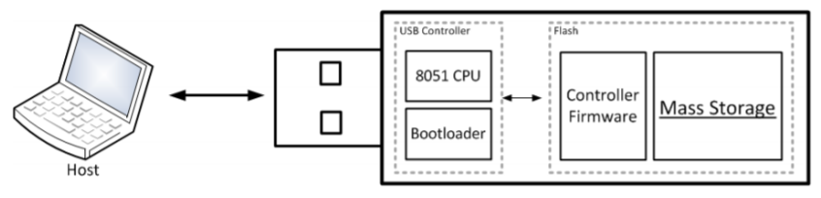


22.0 Understand Plug and Play (PnP) Manager
When a USB is plugged in, the PnP Manager finds device ID (Hardware ID or Compatible ID)
  PnP receives the event => enumerates devices from firmware (of a device) => device ID
PnP locates the appropriate driver for the device
  Queries the device descriptor (.inf) uses device IDs
PnP loads that driver use .inf
Once the device has been identified
  Multiple registry keys will be generated
USB Mass Storage device Class (MSC) communication protocols

Slide 20
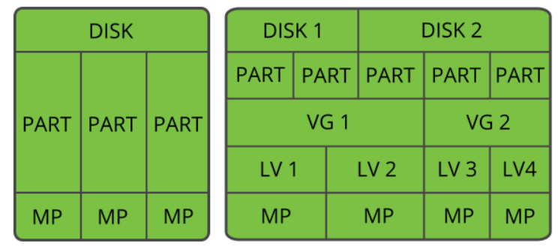
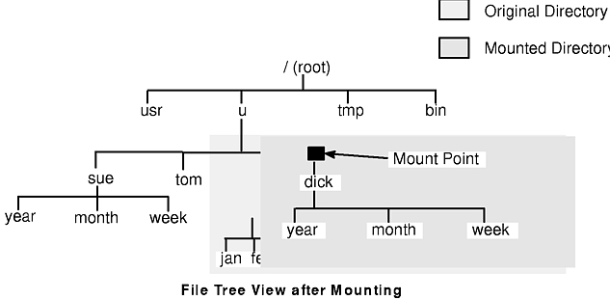
Disk, Partition, Volume, Mountpoint
partition start/end section
Vendor, Product, Serial #
Disk/drive signature (assigned by Win OS)
physical layer
Logical layer
Logical volume: Volume name, Drive letter, Volume serial number XXXX-XXXX (generated when format a volume)
MountPoints: GUID of path or Volume
MountedDevices map to MP GUID: \??\Volume\GUID
Notes:
https://documentation.suse.com/it-it/sles/12-SP3/html/SLES-all/cha-lvm.html

Slide 21
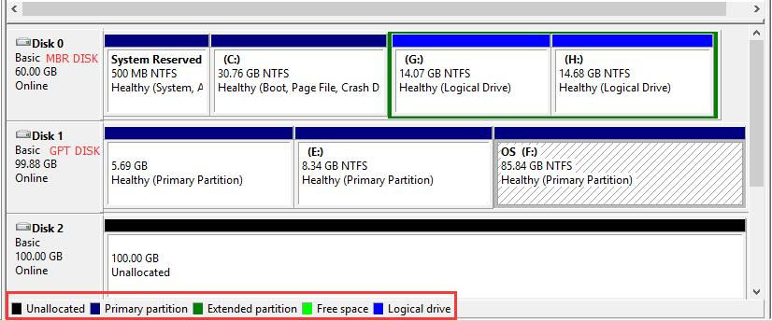
What information want to exam?
Time
  First Connected Time (driver installed)
  Time USB Last Attached
  Time USB Last Attached after reboot
Vendor/ Product ID/ Serial #
User Account
Volume
  Mounted Volume GUID
  Assigned Volume Drive Letter
Volume
Unallocated Space
physical space on a hard drive that doesn't belong to a partition.
no programs can write to the space.
the space doesn't exist to the operating system.
need to either create a new partition using the space or expand an existing partition.
Notes:
https://www.forensicfocus.com/forums/general/usbstor-registry-entries-windows-7/

Slide 22
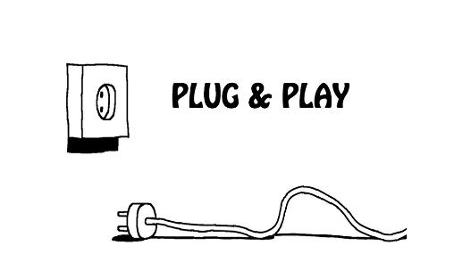


Evidence Source Types
PnP Logs
Windows Registry
System Events

Slide 23
Locations to exam
The last time a USB device was connected to a system can be determined by examining the last write time on the key of the device serial number in the SYSTEM hive
Locations | Time/Volume Serial # assigned by Windows | Vendor ID | Product ID | Product Serial #
SetupAPI Log | First installed/Connected Time | √ | √ | √
HKLM\SYSTEM\ControlSet###\Enum\USBSTOR\ HKLM\SYSTEM\CurrentControlSet\Enum\USB | First Connected Time Time Last Attached and connected time after reboot | √ | √ | √
HKU\informant\SOFTWARE\Microsoft\WindowsNT\CurrentVersion\EMDMgmt |  |  |  | √
HKU\informant\Software\Microsoft\Windows\CurrentVersion\Explorer\MountPoints2\ | User Account that mounted volume, Time USB Last Attached, Volume GUID
HKLM\SYSTEM\MountedDevices\ | Volume GUID and Assigned Volume
Notes:
https://www.forensicfocus.com/forums/general/usbstor-registry-entries-windows-7/
The last time a USB device was connected to a system can be determined by examining the last write time on the key of the device serial number in the SYSTEM hive

Slide 24
Locations to exam
Device (setup) Classes
  HKLM\SYSTEM\ControlSet###\Control\DeviceClasses\{a5dcbf10-6530-11d2-901f-00c04fb951ed}\
  HKLM\SYSTEM\ControlSet###\Control\DeviceClasses\{53f56307-b6bf-11d0-94f2-00a0c91efb8b}\
Volume Info Cache
  HKLM\SOFTWARE\Microsoft\Windows Search\VolumeInfoCache
System Events
  \Windows\System32\winevt\Logs\System.evtx

Slide 25
22.1 SetupAPI
The Plug and Play (PnP) manager logs information about device installation in a plain-text log file to
  Verify the installation of a device
  Troubleshoot device installation problems.
    "device did not install"
    "wrong driver installed"
    "Exit status: FAILURE".
Implemented in Windows Vista and later versions of Windows,
  Device installation: setupapi.dev.log
  Application installation: setupapi.app.log
  Default location %SystemRoot%\inf

Slide 26
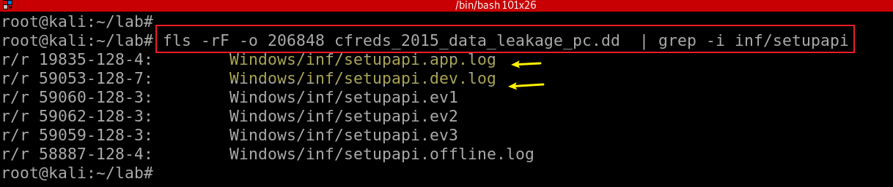
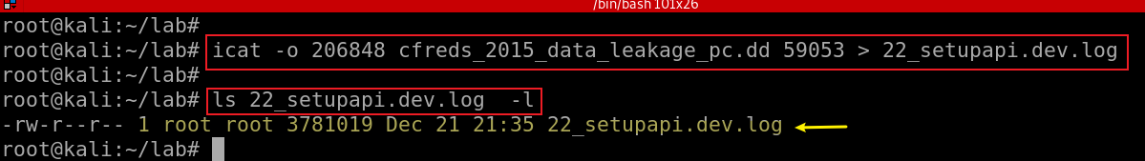
22.1 SetupAPI Log
Find the log file “setupspi.dev.log” by default
Extract setupspi.dev.log
Notes:
fls -rF -o 206848 cfreds_2015_data_leakage_pc.dd | grep -i inf/setupapi
icat -o 206848 cfreds_2015_data_leakage_pc.dd 59053 > 22_setupapi.dev.log
ls -l 22_setupapi.dev.log

Slide 27
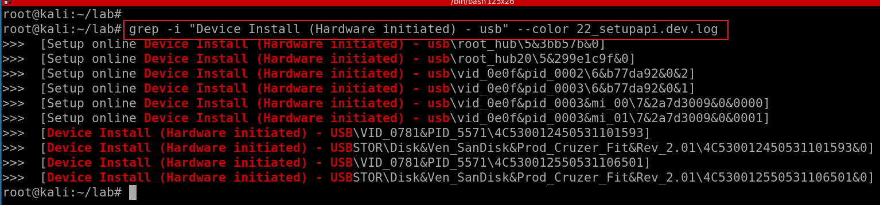
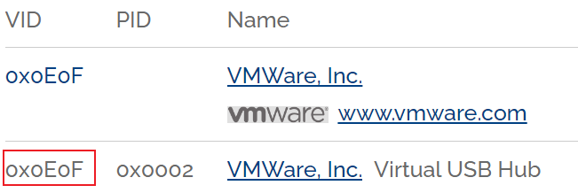
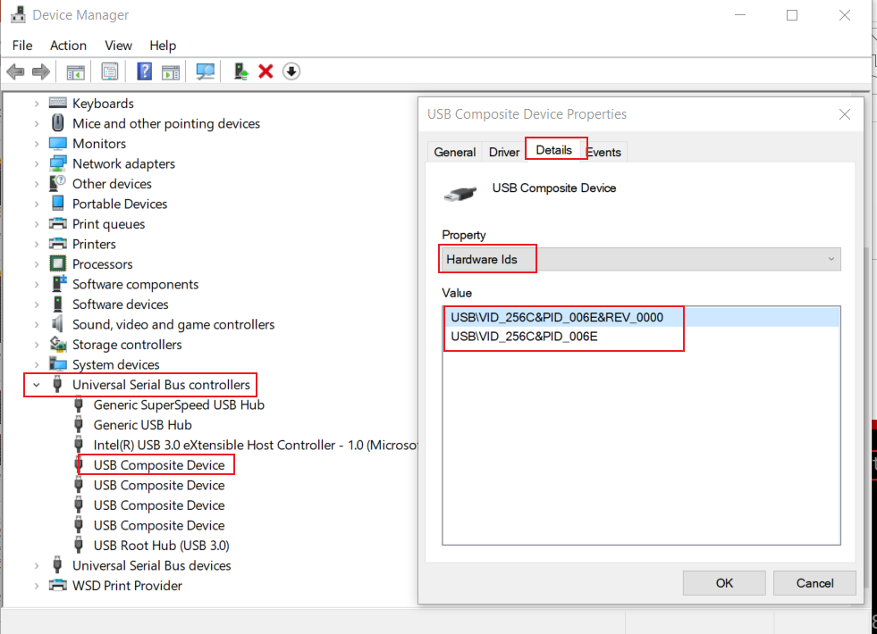
Search for usb installation evets
Two USB devices are discovered
VID/PID/Serial No:
Vendor IDentification: 0781
Product Identification: 5571
Serial No 1: 4C530012450531101593
Serial No 2: 4C530012550531106501
Can be used to restrict what USB devices can be utilized within an environment.
Notes:
grep -i "Device Install (Hardware initiated) - usb" --color 22_setupapi.dev.log

Slide 28
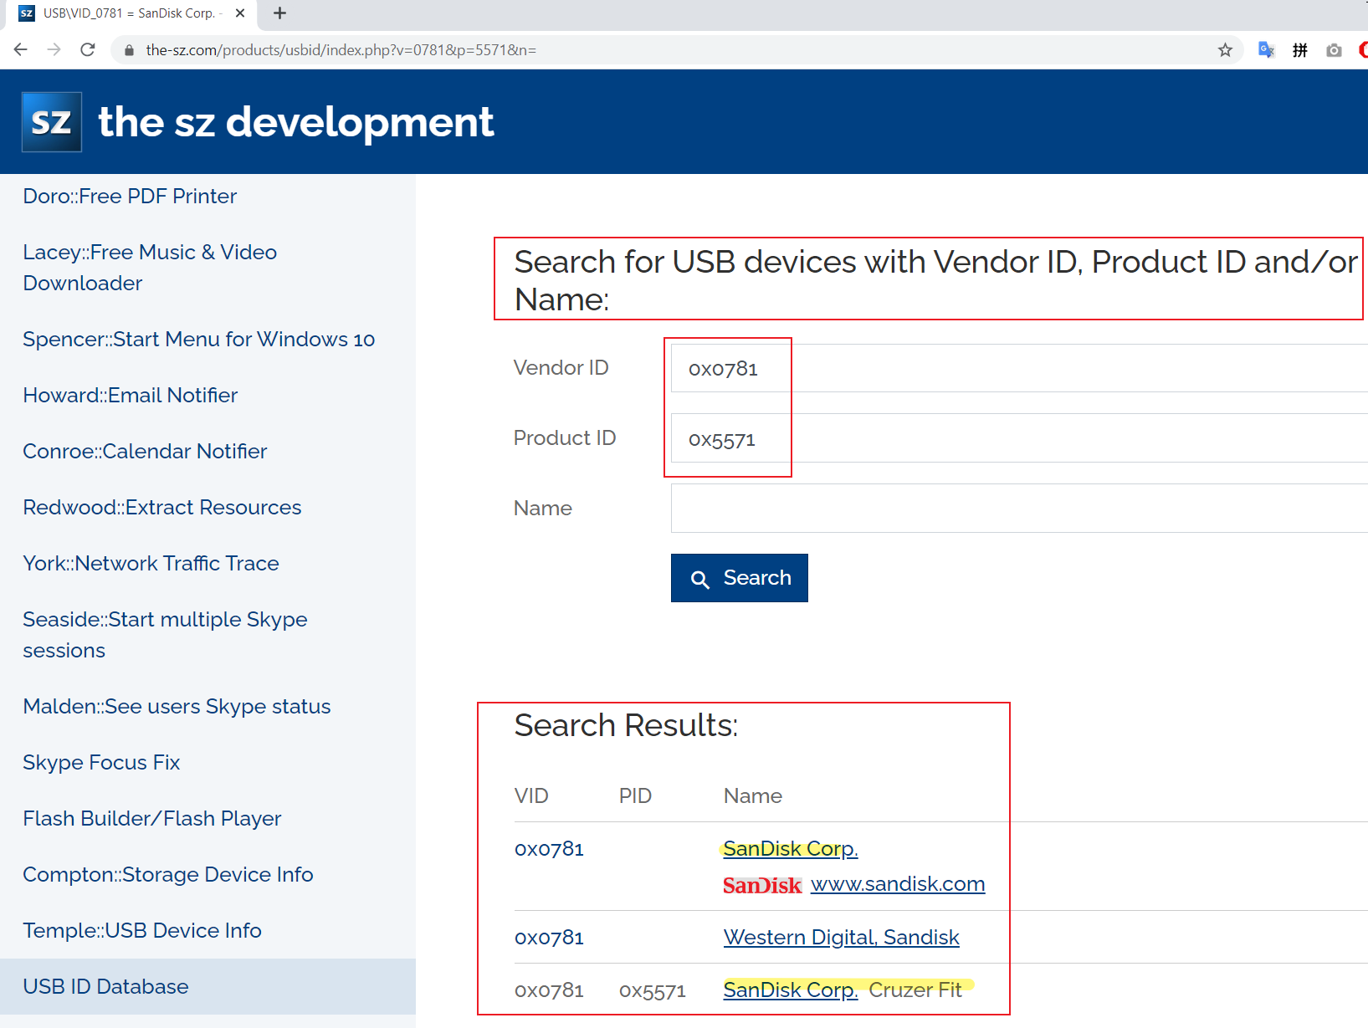
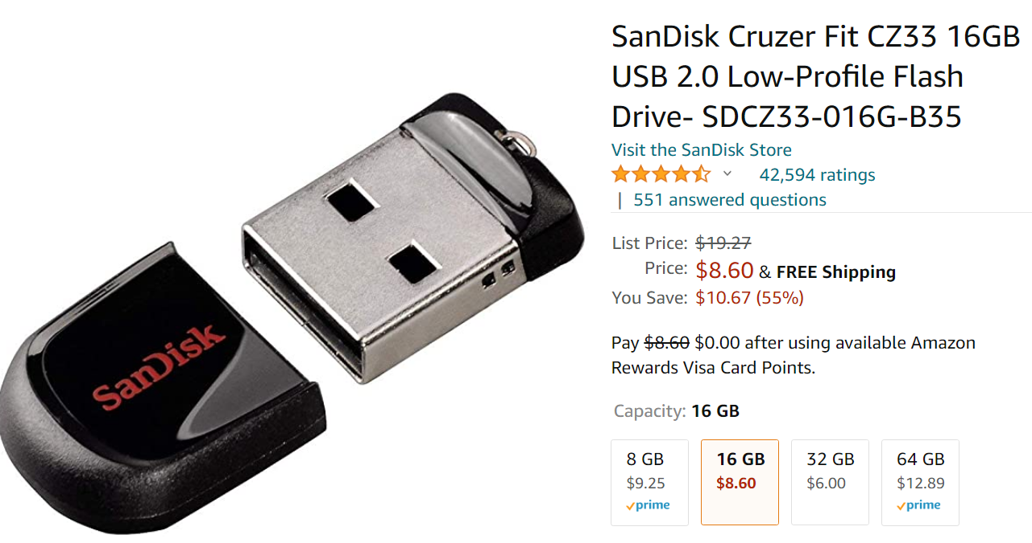
Notes:
https://www.the-sz.com/products/usbid/index.php?v=0781&p=5571&n=

Slide 29
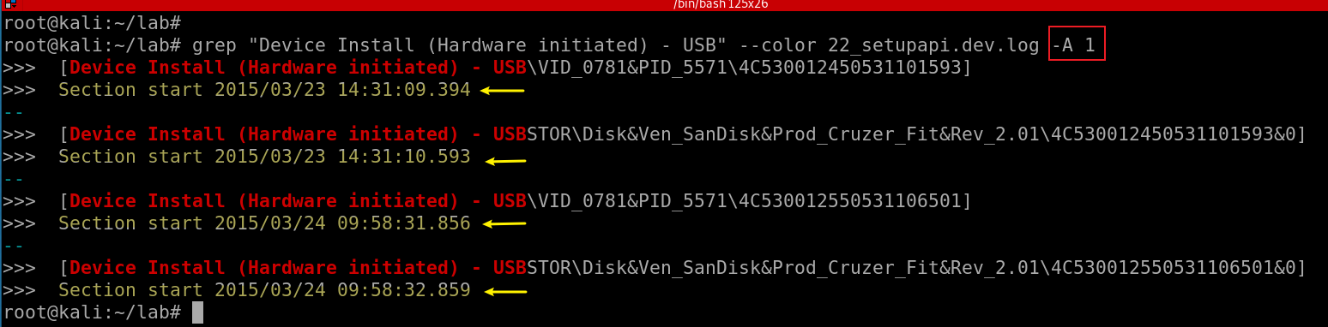
Exam the timestamps of driver installation
serial #
Conclusion:
Two USBs have been attached to the PC
OS recognized USBs right after USBs were attached to the PC
Notes:
grep "Device Install (Hardware initiated) - USB" --color 22_setupapi.dev.log -A 1

Slide 30
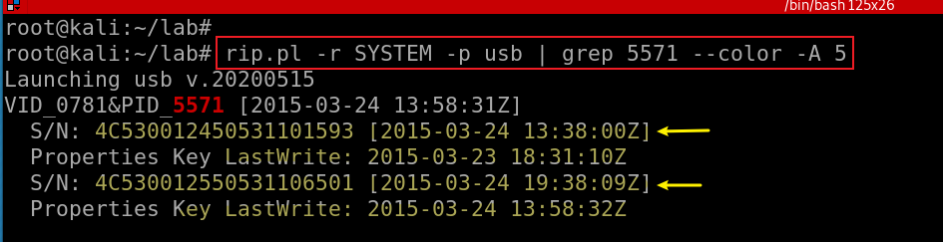
22.2 Exam SanDisk Cruzer Fit USB registry
Search for SanDisk Cruzer Fit USB via product ID
Connected Time After Reboot
Lastwrite Time/Last connect
'Z' stands for Zulu time, which is also GMT and UTC
UTC-> EST convert: - 5 hours
Note: the timestamps are incorrect (one hour off -6 hours)
Notes:
rip.pl -r SYSTEM -p usb | grep 5571 --color -A 5

Slide 31
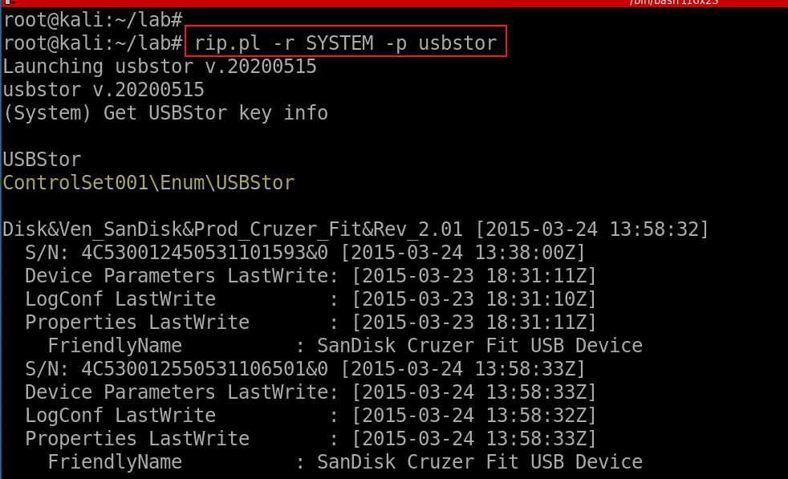
22.3 Exam USBStor registry
What is that?
Notes:
rip.pl -r SYSTEM -p usbstor

Slide 32
22.4 External Memory Device Management
When you insert a flash device like a USB key into a system
  EMDMgmt (i.e., a part of ReadyBoost) service looks at the device to determine its performance characteristics
    e.g., it's capabilities and see if it's suitable for use
  Stores the results of its test in HKLM\SOFTWARE\Microsoft\Windows NT\CurrentVersion\Emdmgmt.
    Contains Volume serial number
ReadyBoost consists of a service implemented in
  %SystemRoot%\System32\Emdmgmt.dll
    that runs in a Service Host process, and
  %SystemRoot%\System32\Drivers\Ecache.sys
    a volume filter driver,

Slide 33
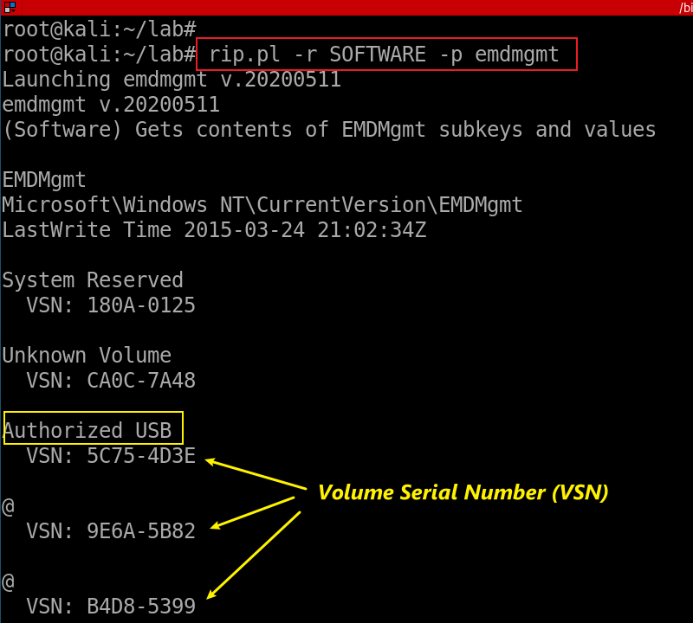
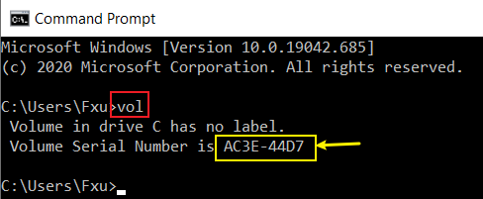
Volume serial number
The volume serial number is written to the volume by Windows each time it is formatted.
This value is calculated using the current date and time, and can be easily viewed by opening a command prompt to the volume (i.e., C:\, D:\, etc.) and typing the vol command.
Notes:
http://windowsir.blogspot.com/2009/05/definitions.html

Slide 34
22.5 MountPoints2
A volume mount point is a drive or volume in Windows that is mounted to a folder that uses the NTFS file system.
  A mounted drive is assigned a drive path instead of a drive letter.
  Volume mount points enable you to exceed the 26-drive-letter limitation.
  By using volume mount points, you can graft, or mount, a target partition onto a folder on another physical disk.
MountPoints2 is a registry entry that stores data to USB devices/ removable hard drives
  USB keys (removable device seen so far)
  autorun actions for various devices.
Contain GUID of a mount point
  May need to correlate the Volume entries to those found in the MountedDevices entries that begin with "\??\Volume{GUID}"
Notes:
rip.pl -r NTUSER_informant.DAT -p mp2

Slide 35
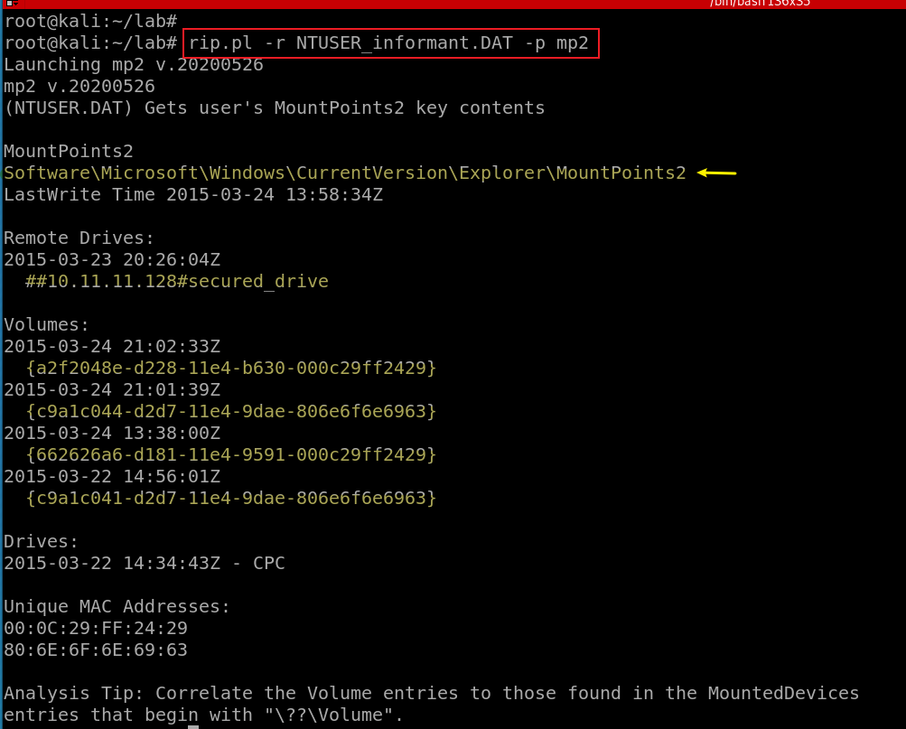
four mountpoint GUID
Notes:
rip.pl -r NTUSER_informant.DAT -p mp2

Slide 36

22.6 Mounted Devices
Devices attached to computer
  Persistent volume name
  Drive letter
  GUID (unique internal identifier of a mount point)
  Disk/Drive Signature
Device types include
  USB storage devices
  DVD/CDROM
root
folder1
file1
file2
folder2
mounting point
GUID
don’t have to have a drive letter
GUID
Vol 1
Vol 2
Disk Signature
GUID/C:

Slide 37
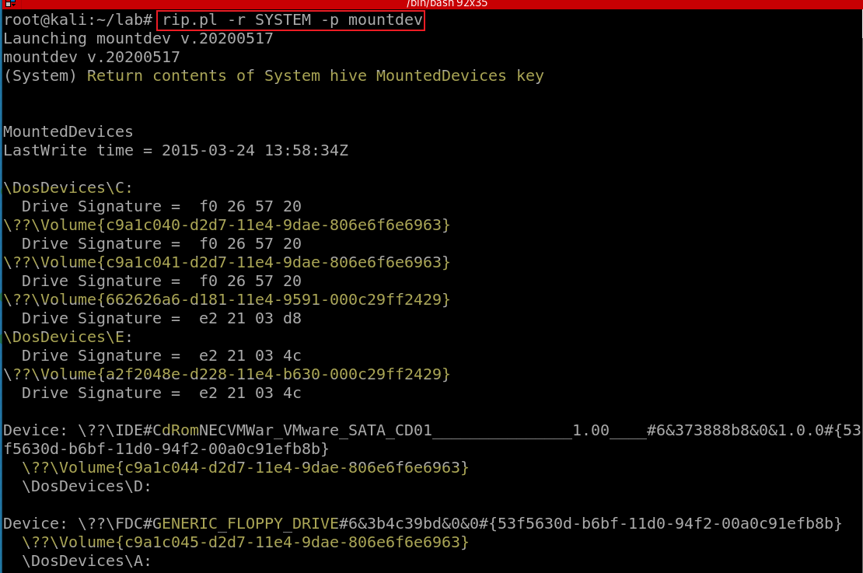

Show MountedDevices use plugin
The Drive/Disk Signature is a unique ID number that Windows writes to a specific location inside the Master Boot Record (MBR) on the first sector of every hard drive that it sees
We can use Drive signature to group disk and volumes
One disk-> multiple volumes
C: or \??\volume{xxxx-x-x-x-x-6963} is the main partition. The disk has three partitions
“boot" volume
GUID of a mount point
Notes:
rip.pl –r SYSTEM –p mountdev

Slide 38
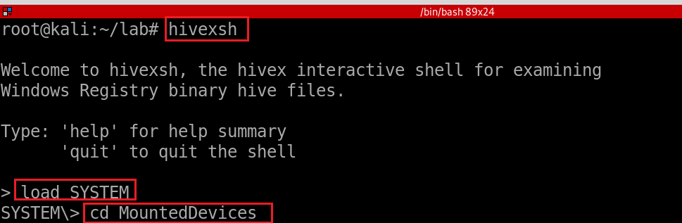
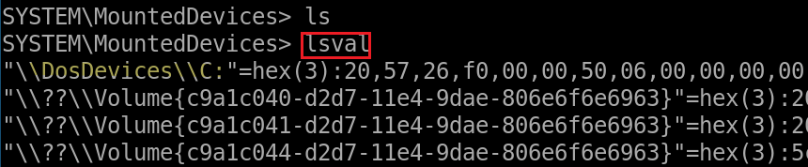
Show MountedDevices using hivexsh

Slide 39
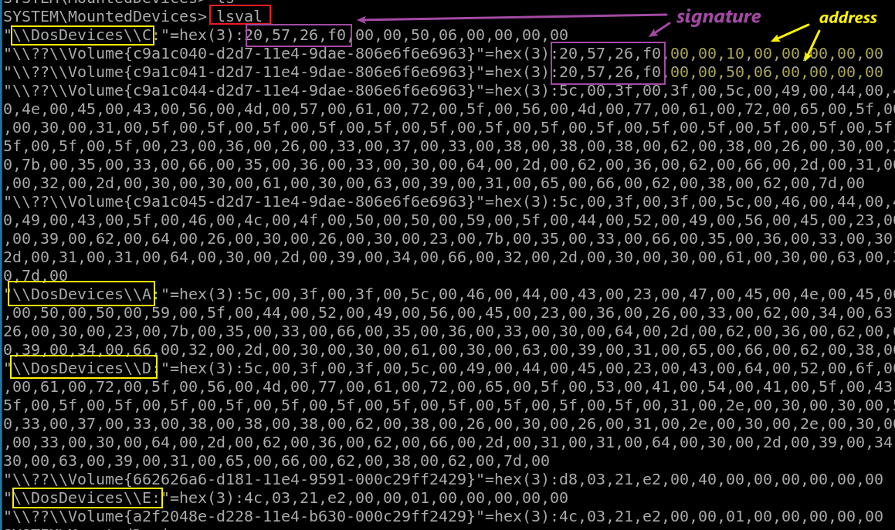
View more details of mounted devices via hivexsh
little-endian: sectors in bytes, Hex
System Partition 1: 0x 10,00,00
boot Partition 2: 0x 06,50,00,00
in sectors, Decimal
Partition 1: 2048
Partition 2: 206848

Slide 40
22.7 Device (setup) classes
Devices are grouped into a device setup class
  If devices have similar manner of set up and configuration
  SCSI media changer devices are grouped into the MediumChanger device setup class.
Microsoft defines setup classes for most devices.
  OEMs can define new device setup classes, but only if none of the existing classes apply.
  For example, a camera vendor does not have to define a new setup class because cameras fall under the Image setup class.
The device setup class GUID defines the ..\CurrentControlSet\Control\DeviceClass\{ClassGuid} registry key
Notes:
rip.pl -r SYSTEM -p devclass

Slide 41
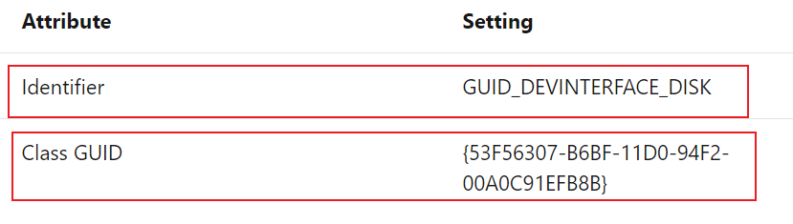
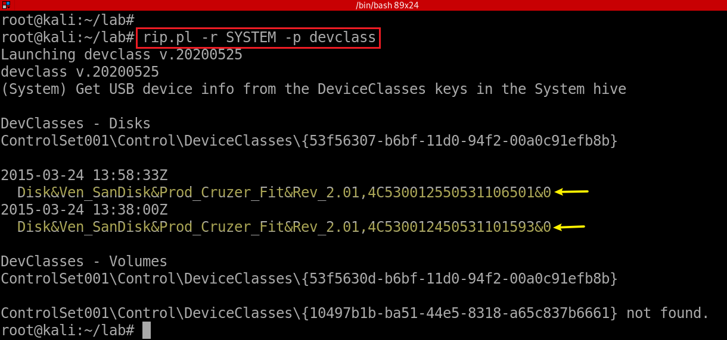
Show device setup classes and particular devices under the classes
Connected Time After Reboot
Notes:
rip.pl -r SYSTEM -p devclass

Slide 42
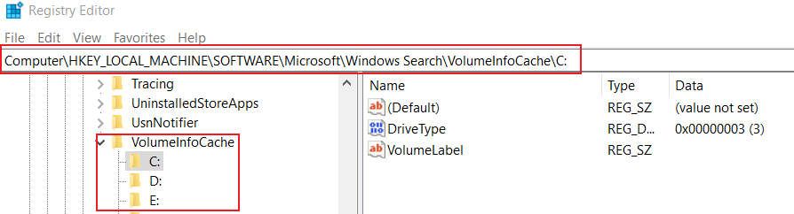
22.8 Volume information Cache
Windows Search registry is to help search function
VolumeInfoCache is a sub-key of Windows Search

Slide 43
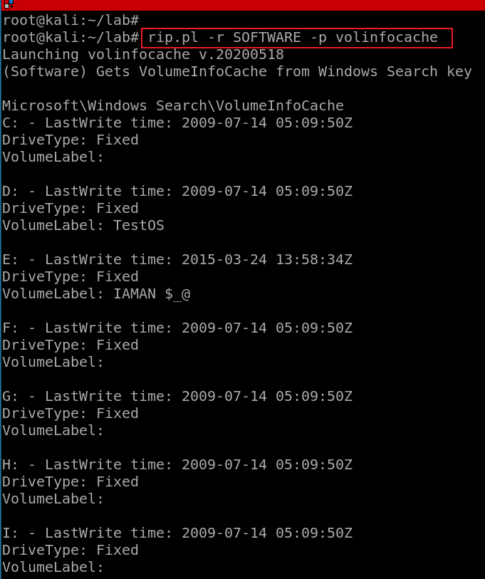
Exam Volume Infor Cache from Windows Search
time to write to the registry/last connected
Which USB?
check timestamp

Slide 44
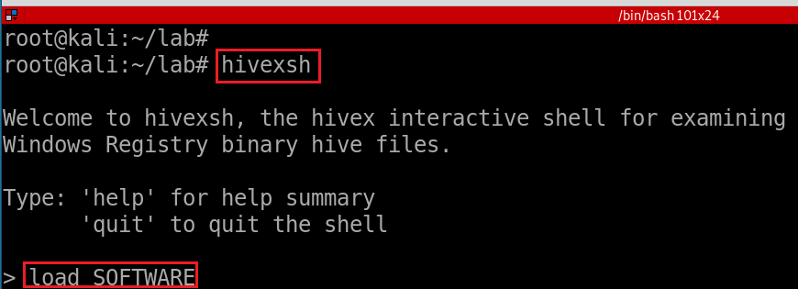
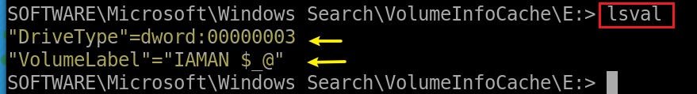
Show Volume information Cache using hivexsh
Notes:
load SOFTWARE
cd Microsoft\Windows Search\VolumeInfoCache\E:

Slide 45






Possible Answer | Device Name | Volume Name | Serial No. | First Connected Time (Local time) | Connected Time After Reboot
 | SanDisk Cruzer Fit USB Device |  | 4C530012450531101593 | 2015-03-23 14:31:10 Mon | 2015-03-24 09:38:00 Tue
 | SanDisk Cruzer Fit USB Device | IAMAN $_@ | 4C530012550531106501 | 2015-03-24 09:58:32 Tue | 2015-03-24 09:58:33 Tue
Considerations | - ‘First Connected Time’ can be identified from SetupAPI Log. (→ C:\Windows\inf\setupapi.dev.log) HKLM\SYSTEM\MountedDevices\ HKLM\SYSTEM\ControlSet###\Enum\USBSTOR\ HKLM\SYSTEM\ControlSet###\Control\DeviceClasses\{a5dcbf10-6530-11d2-901f-00c04fb951ed}\ HKLM\SYSTEM\ControlSet###\Control\DeviceClasses\{53f56307-b6bf-11d0-94f2-00a0c91efb8b}\ …… HKU\informant\Software\Microsoft\Windows\CurrentVersion\Explorer\MountPoints2\ HKLM\SOFTWARE\Microsoft\Windows Search\VolumeInfoCache\E: > timestamp: 2015-03-24 09:58:34 Tue > value: VolumeLabel > data: ‘IAMAN $_@’ \Windows\System32\winevt\Logs\System.evtx (Event ID: 20001, 20003…) ……

Slide 46
Assignment
Follow PPTs
Print sent email messages

